Slide 1

Angular 8
Sustainable architecture

Slide 2
Agenda
Intro about Angular
CLI and NPM NG
TypeScript
ES6 Classes
Arrow functions (Fat arrows)
Components
Templates
Directives
Pipes
Services
Modules
Injectors
Inheritance & Interfaces
Router
Shared modules
Feature modules
Guards

Slide 3
About Angular
Angular JS
• Javascript Framework for creating web and mobile single page applications
• Angular 2+
• Easier to learn than Angular 1.x
• Fewer concepts
• Supports multiple languages (ES5, ES6, TypeScript and DART)
• Modular (everything is a Component)
• Performant (5X faster than version 1)

Slide 4
CLI and NPM NG
Angular comes with its own CLI which adds the NG executable to the OS to make it available run following command: npm install -g @angular/cli
Executing the npm install command will add the NG support on a global level of your OS and will be available on every folder level through the command line
Your new project is created very easily by executing: ng new PROJECT_NAME
New things that are making development more configurable are: package.json & npm dependencies + build scripts and environments

Slide 5
Typescript
Angular 2+ is built in TypeScript
Official collaboration between Microsoft and Google
JavaScript-like language
Superset of EcmaScript6
Improvements over ES6
Types
Classes
Annotations
Imports
Language Utilities (e.g. destructuring)

Slide 6
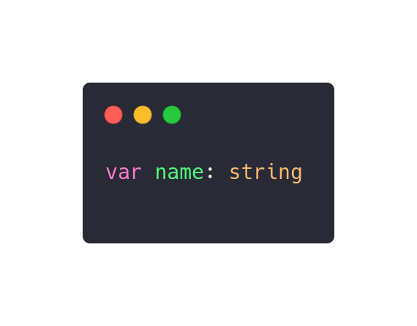
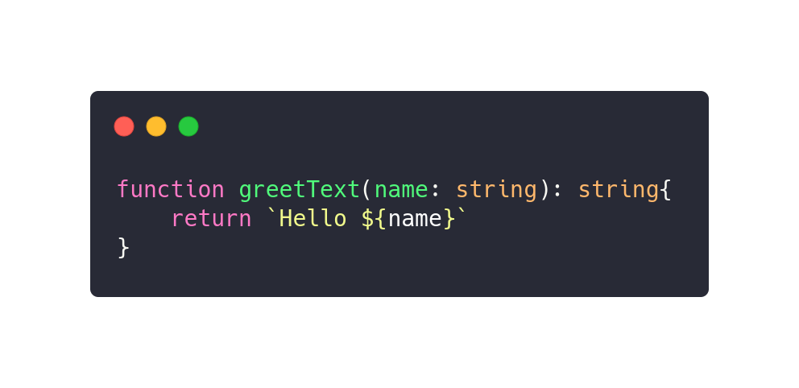
Major improvement over ES6: type checking
Helps when writing code because it prevents bugs at compile time
Helps when reading code because it clarifies your intentions
Types are optional
Same types as in ES: string, number, boolean,...
Types can also be used in function declarations:

Slide 7
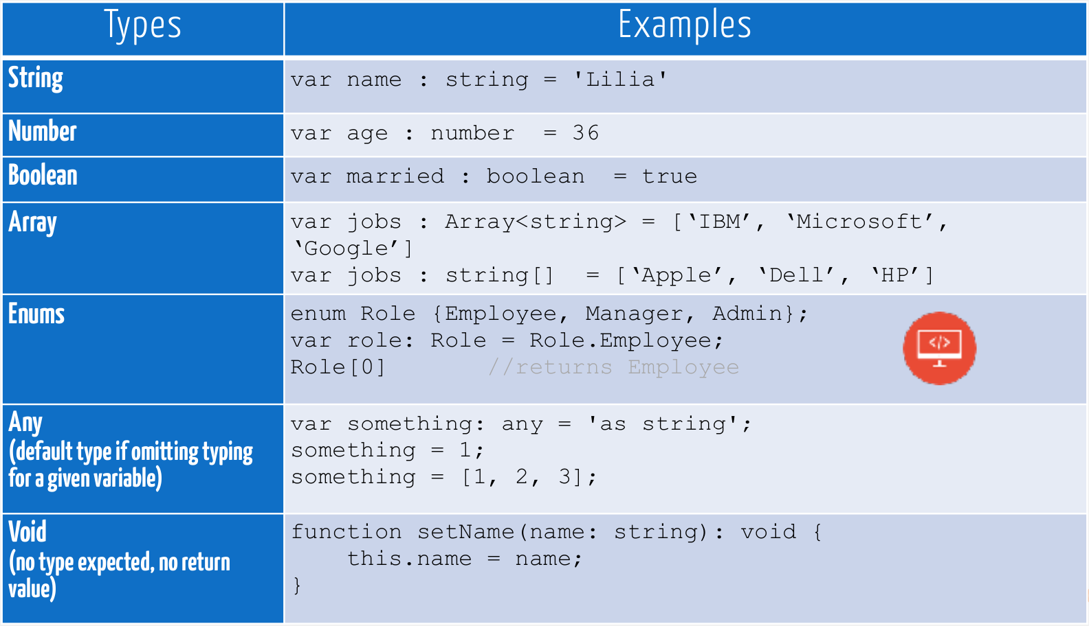

Slide 8
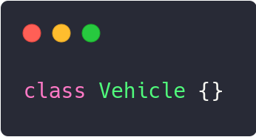
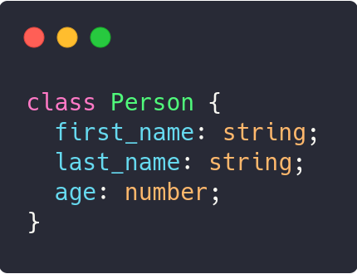
Classes
• In ES5, OO programming was accomplished by using prototype-based
objects
• In ES6, built-in classes were defined
• Classes may have properties, methods and constructors
• Each property can optionally have a type and privacy

Slide 9
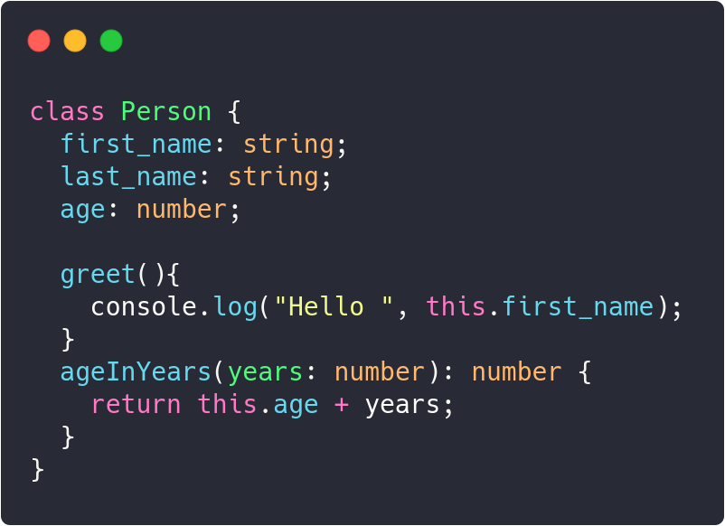
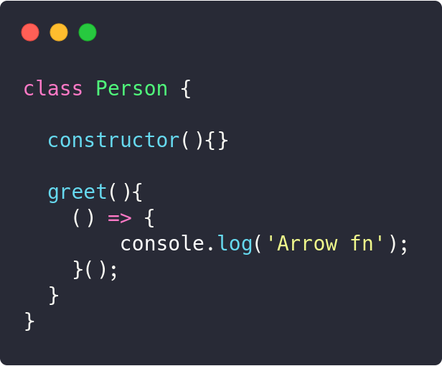
Methods and Arrow functions
To call a method of a class, we have to create an instance of this class, with the
new keyword
If the methods don’t declare an explicit return type and return a value, it’s assumed to be any

Slide 10
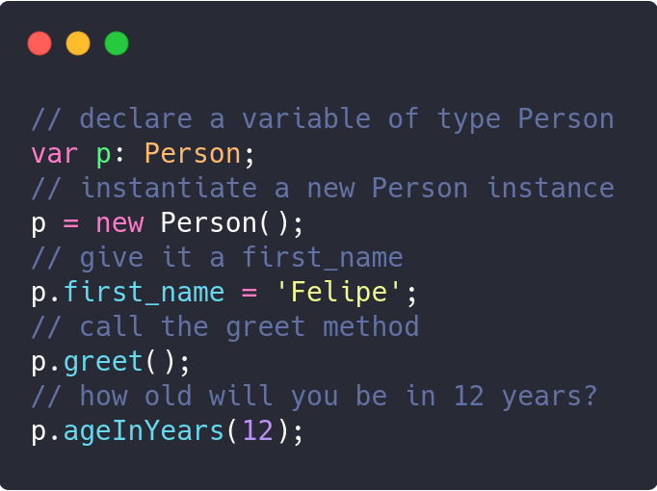
Invoke methods

Slide 11
Components
An angular application is a tree of Components
The top level component is the application itself, which is rendered by the browser when bootstrapping the application.
Components are:
Composable
Reusable
Hierarchical
Let's take as an example an profile dashboard application

Slide 12
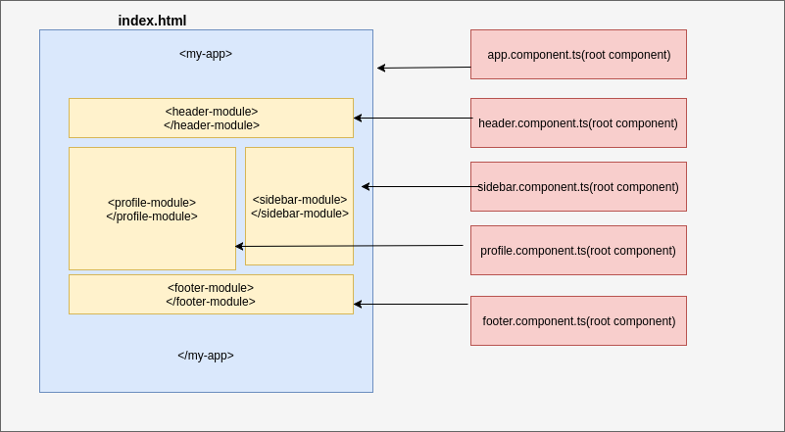

Slide 13
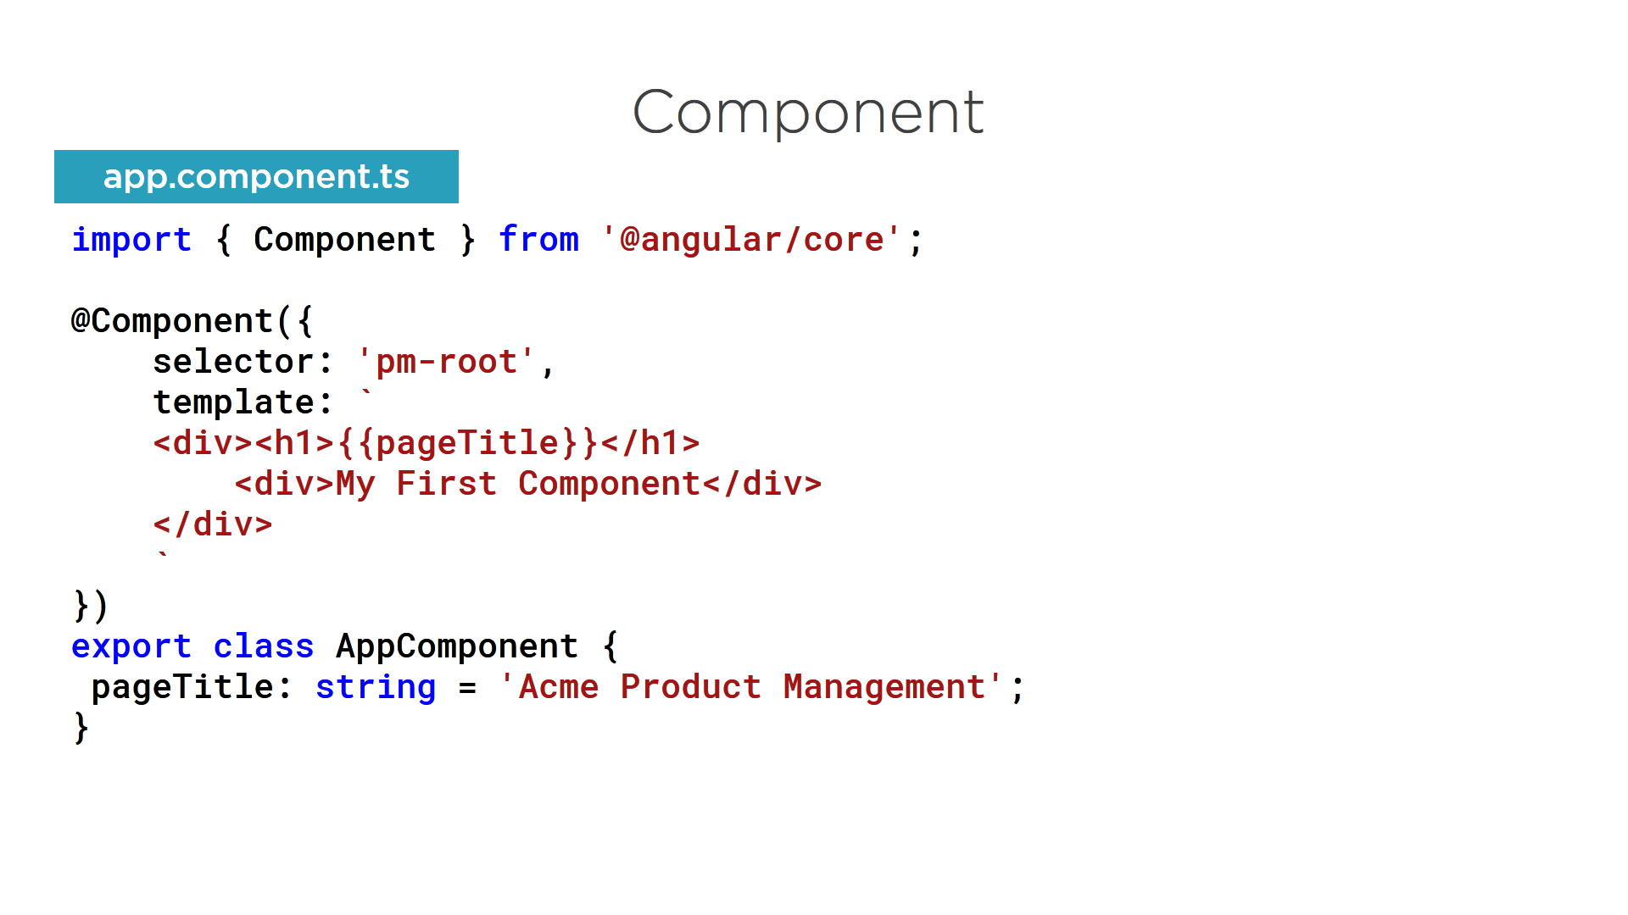
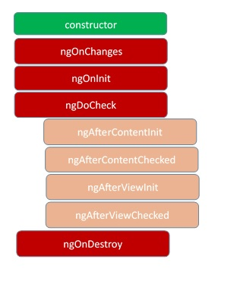
Component lifecycle

Slide 14
Metadata
Metadata tells the Angular how to process a class
@Component: identifies the class below it as a component class, with options:
selector: CSS selector for the template code
templateURL: address of the component's HTML template
providers: array of dependency injection providers for services that the component requires
Other metadata decorators:
@Injectable, @Input, @Output, @NgModule ...

Slide 15
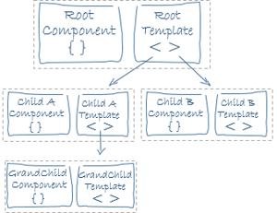
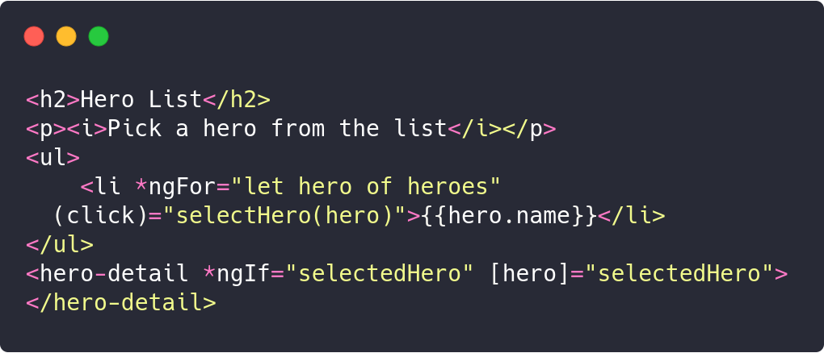
Templates
A snippet of the HTML code of a component
A component's view is defined with its template
Uses Angular's template syntax, with custom elements

Slide 16
Data Binding
Data Binding is mechanism for coordinating parts of a template with parts of a component
Four main forms:
{{hero.main}}: interpolation
[hero]: property binding
(click): event binding
[(ngModel)]: Two-way data binding - combines property and event binding, with ngModel

Slide 17
Directives
Angular templates are dynamic
When Angular renders them, it transforms the DOM according to instructions given by directives
A directive is a class with the @Directive decorator
A component is a directive-with-a-template
A @Component decorator is actually a @Directive extended with template-oriented features
Appear within an element tag as attributes do
Two types of directives
Structural directives (+ Attribute directives)
Custom directives

Slide 18
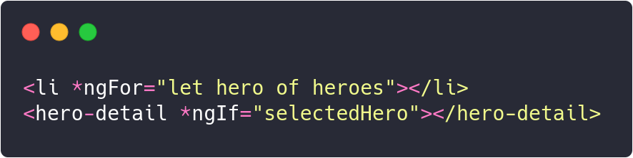
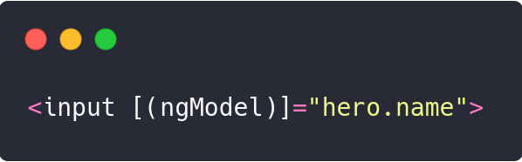
Structural directives
Alter the layout by adding, removing and replacing elements in the DOM
Attribute directives
Alter the appearance or behaviour of an existant element
Look like regular HTML attributes
Custom directives

Slide 19
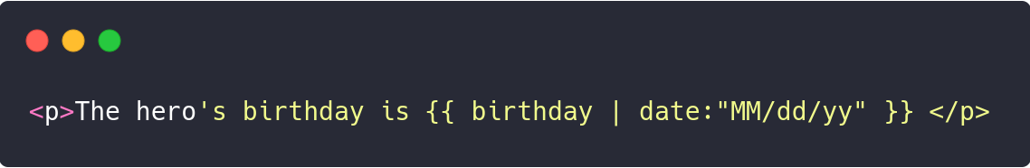
Pipes
Pipes are providing a way to write display-value transformations that you can declare in your HTML
When Angular renders the data, pipes are transfoming them in a desired format.
A pipe is a class with the @Pipe decorator
Two types of pipes
Built-in pipes
Custom pipes

Slide 20
Services
Almost anything can be a service
A class with a narrow, well-defined purpose
Ex: logging servie, data service, tax calculator, application configuration,...
There is no specific definition of a class in Angular, but classes are fundamental to any Angular application
Component classes should be lean
They shouldn't fetch data from the server, validate user input or log directly to the console
They just deal with user experience, mediate between the view and the logic
Everything non trivial should be delegated to services
A service is associated to a component using dependency injection

