Slide 1
Session 4

Slide 2
Agenda
Session 4
Homework discussion
Built-In functions
Workshop
Scalar functions
Workshop
Knowledge check (Quiz, Discussion, Homework)

Slide 3
Homework discussion

Slide 4
Built-In functions

Slide 5
Built-In functions
Built-In functions are used in SQL SELECT expressions to calculate values and manipulate data. These functions can be used anywhere expressions are allowed.
In SQL a built-in function is a piece for programming that takes zero or more inputs and returns a value.
There are several things to note regarding functions:
The inputs to a function are called parameters. Not all function has parameters, and some functions have more than one.
Parameters are enclosed in parenthesis.
We use functions in the SELECT clause as well as the WHERE filter condition. A function can be used anywhere in a SELECT statement that you can use an expression.
In SQL server the built-in functions return one value. These are called scalar functions and are used wherever expressions are allowed.

Slide 6
Built-In functions - Categories
Conversion functions – support data type casting and converting
Math functions – perform calculations based on input values provided as parameters to the functions and return numeric values
String functions – perform operations on a string input value
Date and Time data types and functions – perform operations on a date and time input values, and return string, numeric, or date and time values
More about functions https://docs.microsoft.com/en-us/sql/t-sql/functions/functions?redirectedfrom=MSDN&view=sql-server-ver15

Slide 7
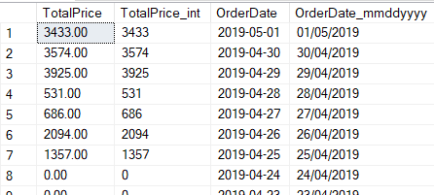
Built-In functions – Conversion functions
CAST, CONVERT - These functions convert an expression of one data type to another.
CAST Syntax: CAST ( expression AS data_type [ ( length ) ] )
CONVERT Syntax: CONVERT ( data_type [ ( length ) ] , expression [ , style ] )
Example:
select CAST(TotalPrice as int) as total_price_int
, CONVERT(NVARCHAR(10), OrderDate, 103) as converted_date_mmddyyyy
from [Order]

Slide 8

Built-In functions – Math functions
ABS() – returns the absolute value of specified numeric expression
CEILING() – returns the smallest integer greater than, or equal to, the specified numeric expression
FLOOR() – returns the largest integer less than or equal to the specified numeric expression
ROUND() – returns a numeric value, rounded to the specified length or precision
Example:
select ABS(-124) as absolute_value
, ROUND(1234.56, 1) as rounded_value
, CEILING(123.4) as ceiling_value
, FLOOR(125.6) as floor_value

Slide 9
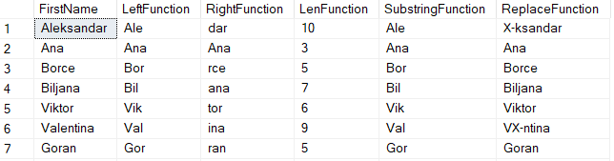
Built-In functions – String functions
LEFT(), RIGHT(), LEN()
SUBSTRING
SUBSTRING ( expression ,start , length )
REPLACE
REPLACE ( string_expression , string_pattern , string_replacement )
Example:
select FirstName,
LEFT(FirstName,3) as LeftFunction,
RIGHT(FirstName,3) as RightFunction,
LEN(FirstName) as LenFunction,
SUBSTRING(FirstName,1,3) as SubstringFunction,
REPLACE(FirstName,'Ale','X-') as ReplaceFunction
from dbo.Employee

Slide 10
Built-In functions – Date and time functions
GETDATE() – returns current date and time
DATEADD (datepart , number , date ) - adds a specified number value (as a signed integer) to a specified datepart of an input date value, and then returns that modified value.
DATEDIFF (datepart , startdate , enddate ) - returns the count (as a signed integer value) of the specified datepart boundaries crossed between the specified startdate and enddate.
DAY ( date ) - returns an integer that represents the day (day of the month) of the specified date
MONTH (date) – returns an integer that represents the month of the specified date
YEAR (date) – returns an integer that represents the year of the specified date
ISDATE(expression) – returns 1 if the expression is a valid date, otherwise 0

Slide 11
Built-In functions – Date and time functions (2)
Example:
select GETDATE() as current_datetime
, DATEADD(dd, 1, GETDATE()) as date_add_oneday
, DATEDIFF(mm, '2021-04-06', '2021-06-17') as date_diff_onemonth
, DAY('2021-06-17') as day_date
, MONTH('2021-06-17') as month_date
, YEAR('2021-06-17') as year_date
, ISDATE('angela') as is_date
, ISDATE('2021-06-17') as is_date

Slide 12
Built-In functions - Declarations
Scalar variable – used to store data during the batch execution period. They can be created for different data types, and can also have assigned values
Table variable – type of variable which is used to store data temporarily.
DECLARE @EmployeeId INT
SET @EmployeeId = 1
DECLARE @EmployeeList TABLE
(EmployeeId int, FirstName NVARCHAR(100), LastName NVARCHAR(100));
INSERT INTO @EmployeeList
SELECT Id, FirstName, LastName from dbo.Employee

Slide 13
Built-In functions – Declarations (2)
Temp table - is a database table that exists temporarily on the database server. A temporary table stores a subset of data from a normal table for a certain period of time.
To remove the table:
, or just close the session (by clicking on x)
CREATE TABLE #EmployeeList
(EmployeeId int, FirstName NVARCHAR(100), LastName NVARCHAR(100));
INSERT INTO #EmployeeList
SELECT Id, FirstName, LastName from dbo.Employee
DROP TABLE #EmployeeList

Slide 14
Built-In functions – Declarations (3)
Differences between temp table and table variable
Temporary table # | Table variable @
Used when working with large set of data | Used when working with small amount of data
Can be used by multiple users | Can be used by the current user only
Can do all the DLL operations | Can’t do DDL operations
Allowed to create indexes | Aren’t allowed to create indexes, they can have index by using Primary key or Unique constraint
Cannot be passed as a parameter to functions and stored procedures | Can be passed as a parameter to functions and stored procedures

Slide 15
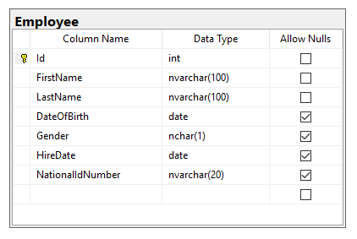
Built-in functions - Workshop
Declare scalar variable for storing FirstName values
Assign value ‘Aleksandar’ to the FirstName variable
Find all Employees having FirstName same as the variable
Declare table variable that will contain EmployeeId and DateOfBirth
Fill the table variable with all Female employees
Declare temp table that will contain LastName and HireDate columns
Fill the temp table with all Male employees having First Name starting with ‘A’
Retrieve the employees from the table which last name is with 7 characters

Slide 16
Scalar functions

Slide 17
Scalar functions
User-defined functions are routines that accept parameters, perform an action, such as a complex calculation, and return the result of that action as a value.
Scalar functions allow modular programming
Scalar functions return a single data value of the type defined in the RETURNS clause
How to create:
CREATE FUNCTION FunctionName (@ParaleterList [datatype])
RETURNS [datatype]
AS
BEGIN
DECLARE @OutputVariable [datatype]
SELECT @OutputVariable = ...
RETURN @OutputVariable
END
Notes:
https://docs.microsoft.com/en-us/sql/relational-databases/user-defined-functions/user-defined-functions?view=sql-server-2017

Slide 18
Scalar functions - example
Session 4 – 01 Scalar function.sql
Example for scalar function:
CREATE FUNCTION dbo.fn_EmployeeFullName (@EmployeeID int)
RETURNS NVARCHAR(500)
AS
BEGIN
DECLARE @Result NVARCHAR(500)
SELECT @Result = e.FirstName + N' ' + e.LastName
FROM dbo.Employee e
WHERE Id = @EmployeeID
RETURN @Result
END
How to call:
select dbo.fn_EmployeeFullName(1)
Notes:
https://docs.microsoft.com/en-us/sql/relational-databases/user-defined-functions/user-defined-functions?view=sql-server-2017

Slide 19
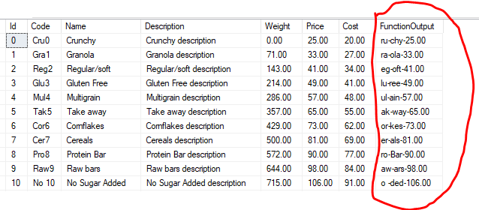
Scalar functions - Workshop
Declare scalar function (fn_FormatProductName) for retrieving the Product description for specific ProductId in the following format:
Second and Third character from the Code
-
Last three characters from the Name
-
Product Price

Slide 20
Knowledge check
Quiz, Discussion, Homework

Slide 21
Quiz
Can we assign multiple values to scalar variable?
a. Yes
b. No
Which SQL function is used to determine number of characters in the string?
a. LEFT
b. STRING
c. STRING_SIZE
d. LEN
Can we return two records in scalar function?
a. Yes
b. No
Can we insert data in some table by using scalar function?
a. Yes
b. No

Slide 22
Quiz
What is the main difference between temp table and table variable?

Slide 23
Homework 4

Slide 24
Homework requirement 1/2
Declare scalar variable for storing FirstName values
Assign value ‘Antonio’ to the FirstName variable
Find all Students having FirstName same as the variable
Declare table variable that will contain StudentId, StudentName and DateOfBirth
Fill the table variable with all Female students
Declare temp table that will contain LastName and EnrolledDate columns
Fill the temp table with all Male students having First Name starting with ‘A’
Retrieve the students from the table which last name is with 7 characters
Find all teachers whose FirstName length is less than 5 and
the first 3 characters of their FirstName and LastName are the same

Slide 25
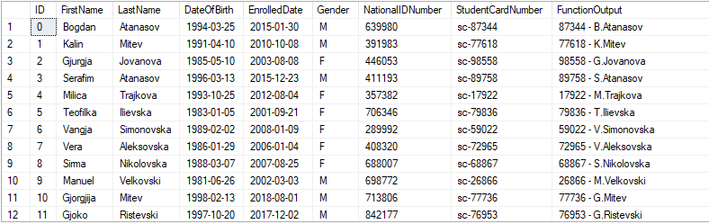
Homework requirement 2/2
Declare scalar function (fn_FormatStudentName) for retrieving the Student description for specific StudentId in the following format:
StudentCardNumber without “sc-”
“ – “
First character of student FirstName
“.”
Student LastName

