Slide 1
Session 5

Slide 2
Agenda
Session 5
Homework discussion
Table valued functions
Inline table-valued function
Multi-statement table-valued functions
Workshop

Slide 3
Table-valued functions
Inline, Multi-statement

Slide 4
Table-valued functions
User-defined function that returns a table
Table-valued function can be invoked in the same way as we query a table.
TVFs can be used after the FROM clause in the SELECT statements, so we can use them like a table in the queries.
The difference between Views and Table-valued functions is that Views do not allow parametrized usage, while TVF can use parameters.
Types of Table-valued functions:
Inline Table-value function
Multi-statement Table-valued function
Notes:
https://docs.microsoft.com/en-us/sql/relational-databases/user-defined-functions/user-defined-functions?view=sql-server-2017

Slide 5
Table-valued functions - Inline
Has similar concept to a VIEW in a sense that it’s based on a single query, only unlike a VIEW, it supports input parameters
The function body has only a single SELECT statement
There is no return variable
We specify TABLE as the return type instead of any scalar data type
The function body is not closed between BEGIN and END block
The structure of the table that gets returned is determined by the SELECT statement within the function
Syntax:
CREATE FUNCTION FunctionName (@ParaleterList [datatype])
RETURNS TABLE
AS
RETURN
SELECT ColumnList
FROM Table
Notes:
https://docs.microsoft.com/en-us/sql/relational-databases/user-defined-functions/user-defined-functions?view=sql-server-2017

Slide 6
Table-valued functions – Inline (2)
How to invoke the function:
Example:
SELECT *
FROM FunctionName(@Parameter)
CREATE FUNCTION dbo.fn_EmployeeDetails_Inline(@EmployeeID int)
RETURNS TABLE
AS
RETURN
SELECT Id, FirstName, LastName, DateOfBirth
FROM dbo.Employee e
WHERE Id = @EmployeeID
GO
SELECT *
FROM dbo.fn_EmployeeDetails_Inline(1)
Notes:
https://docs.microsoft.com/en-us/sql/relational-databases/user-defined-functions/user-defined-functions?view=sql-server-2017

Slide 7
Table-valued functions – Multi-statement
We use a variable of type TABLE, and we explicitly specify the structure of the return table
The query results are stored in the TABLE variable, which is returned when the function is invoked.
Allows multiple SQL Statements in the function body, and the output of those statements can be added to the return variable.
Syntax:
CREATE FUNCTION FunctionName (@ParaleterList [datatype])
RETURNS @TableVariable table (Column1, Column2,...)
AS
BEGIN
INSERT INTO @TableVariable
SELECT Column1,Column2,...
FROM TABLE1
RETURN
END
Notes:
https://docs.microsoft.com/en-us/sql/relational-databases/user-defined-functions/user-defined-functions?view=sql-server-2017

Slide 8
Table-valued functions – Multi-statement (2)
How to invoke it:
Example:
SELECT *
FROM FunctionName(@Parameter)
CREATE FUNCTION dbo.fn_EmployeeDetails_MultiStatement (@EmployeeID int)
RETURNS @output TABLE (Id int, FirstName NVARCHAR(100), LastName NVARCHAR(100), DateOfBirth date)
AS
BEGIN
INSERT INTO @output
SELECT Id,FirstName,LastName,DateOfBirth
FROM dbo.Employee e
WHERE Id = @EmployeeID
RETURN
END
GO
SELECT *
FROM dbo.fn_EmployeeDetails_MultiStatement(1)
Notes:
https://docs.microsoft.com/en-us/sql/relational-databases/user-defined-functions/user-defined-functions?view=sql-server-2017

Slide 9
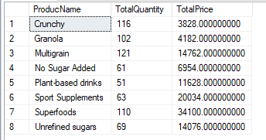
Functions - Workshop
Create multi-statement table value function that for specific BusinessEntity and Customer will return list of products sold, together with the total quantity sold and total price per product
Example resultset:

Slide 10
Homework 5

Slide 11
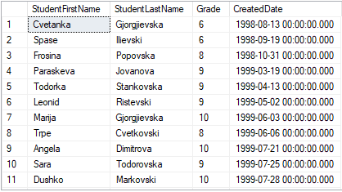
Homework requirement
Create multi-statement table value function that for specific Teacher and Course will return list of students (FirstName, LastName) who passed the exam, together with Grade and CreatedDate
Example resultset:

