Slide 1
Basic administration

Slide 2
Database backups
Database backup is the process of backing up the operational state, architecture and stored data of database software.
It enables the creation of a duplicate instance or copy of a database in case the primary database crashes, is corrupted or is lost.
Database backup is a way to protect and restore a database. It is performed through database replication and can be done for a database or a database server. Typically, database backup is performed by the RDBMS or similar database management software. Database administrators can use the database backup copy to restore the database to its operational state along with its data and logs. The database backup can be stored locally or on a backup server.
Database backup is also created/performed to ensure a company’s compliance with business and government regulations and to maintain and ensure access to critical/essential business data in case of a disaster or technical outage.
https://docs.microsoft.com/en-us/sql/relational-databases/backup-restore/create-a-full-database-backup-sql-server
Try to backup SEDC database on your PC
Notes:
https://docs.microsoft.com/en-us/sql/relational-databases/user-defined-functions/user-defined-functions?view=sql-server-2017

Slide 3
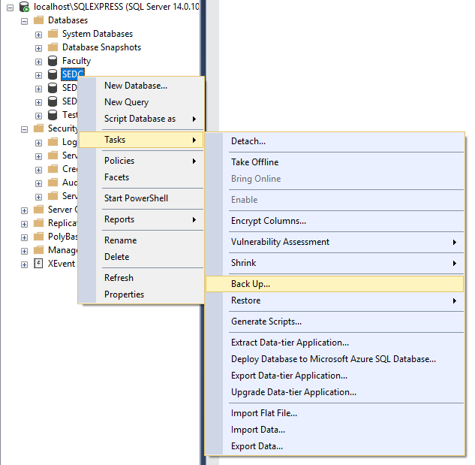
Database backups (2)
Notes:
https://docs.microsoft.com/en-us/sql/relational-databases/user-defined-functions/user-defined-functions?view=sql-server-2017

Slide 4
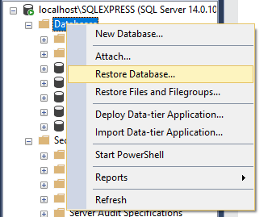
Database Restore
Restoring is the process of copying data from a backup and applying logged transactions to the data. Restore is what you do with backups. Take the backup file and turn it back into a database.
Try to restore database on your SQL server

Slide 5
Permissions
Permissions are the types of access granted to specific securables. At the server level, permissions are assigned to SQL Server logins and server roles. At the database level, they are assigned to database users and database roles
Server logins
Create new login
https://docs.microsoft.com/en-us/sql/t-sql/statements/create-login-transact-sql?view=sql-server-ver15
Map the login to specific roles
https://docs.microsoft.com/en-us/sql/relational-databases/security/authentication-access/server-level-roles?view=sql-server-ver15
Map the login to specific databases
https://docs.microsoft.com/en-us/sql/relational-databases/security/authentication-access/database-level-roles?view=sql-server-ver15
Test the new login
Notes:
https://docs.microsoft.com/en-us/sql/relational-databases/user-defined-functions/user-defined-functions?view=sql-server-2017

Slide 6
Knowledge check
Quiz, Discussion, Homework

Slide 7
Quiz
Can we use select statements inside error handling blocks?
a. Yes
b. No
Explain the main purpose of database backups
Explain the main purpose of users and logins

Slide 8
Homework 7

Slide 9
Homework requirement 1/1
Add error handling on CreateGradeDetail procedure
Test the error handling by inserting not-existing values for AchievementTypeID

Slide 10
Thank you

