Slide 1

CSS GRID
Gjorge Dimitrov
Trainer
Olga Penovska
Assistant

Slide 2

01
GRID
The CSS Grid Layout Module offers a grid-based layout system, with rows and columns, making it easier to design web pages without having to use floats and positioning.

Slide 3
CSS Grid
CSS Grid Layout is the most powerful layout system available in CSS. It is a 2-dimensional system, meaning it can handle both columns and rows, unlike flexbox which is largely a 1-dimensional system. You work with Grid Layout by applying CSS rules both to a parent element (which becomes the Grid Container) and to that element’s children (which become Grid Items).

Slide 4
02
Properties for Parent
Container

Slide 5
Display
Defines the element as a grid container and establishes a new grid formatting context for its contents.
Values:
grid – generates a block-level grid
inline-grid – generates an inline-level grid

Slide 6
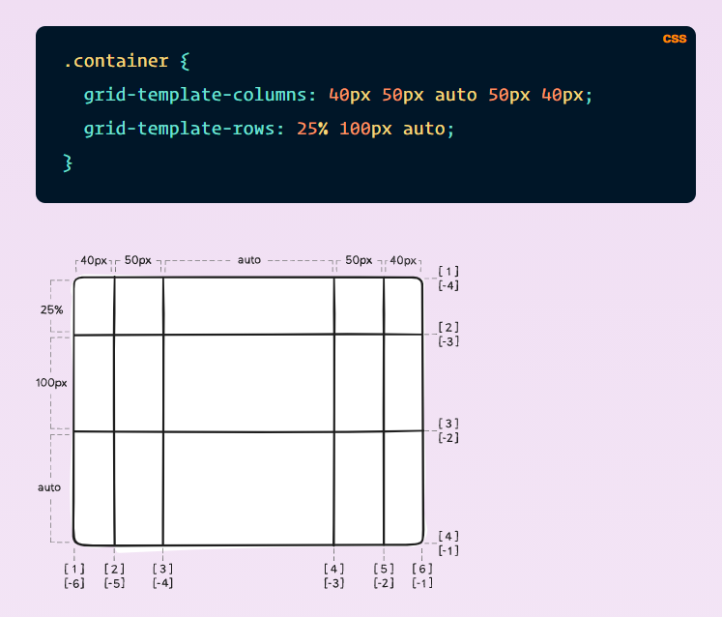
grid-template-columns | grid-template-rows
Defines the columns and rows of the grid with a space-separated list of values. The values represent the track size, and the space between them represents the grid line.
Values:
<track-size> – can be a length, a percentage, or a fraction of the free space in the grid (using the fr unit)
<line-name> – an arbitrary name of your choosing

Slide 7
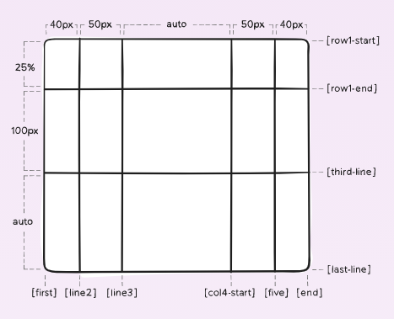
grid-template-columns | grid-template-rows

Slide 8
grid-template-areas
Defines a grid template by referencing the names of the grid areas which are specified with the grid-area property. Repeating the name of a grid area causes the content to span those cells. A period signifies an empty cell. The syntax itself provides a visualization of the structure of the grid.
Values:
<grid-area-name> – the name of a grid area specified with grid-area
. – a period signifies an empty grid cell
none – no grid areas are defined

Slide 9
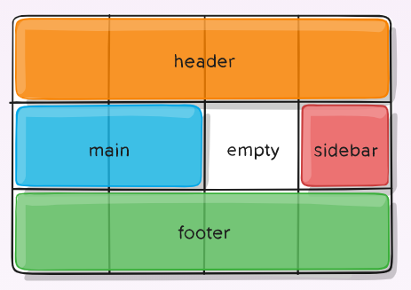
grid-template-areas

Slide 10
grid-template
A shorthand for setting grid-template-rows, grid-template-columns, and grid-template-areas in a single declaration.
Values:
none – sets all three properties to their initial values
<grid-template-rows> / <grid-template-columns> – sets grid-template-columns and grid-template-rows to the specified values, respectively, and sets grid-template-areas to none

Slide 11
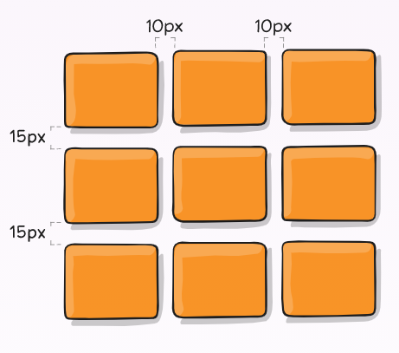
column-gap, row-gap, grid-column-gap, grid-row-gap

Slide 12
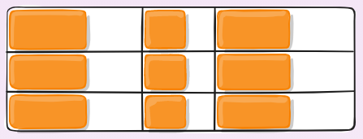
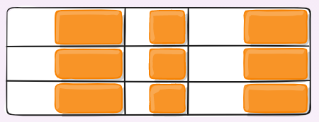
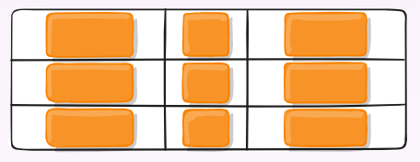
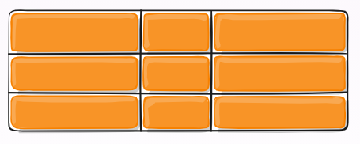
justify-items
Aligns grid items along the inline (row) axis (as opposed to align-items which aligns along the block (column) axis). This value applies to all grid items inside the container.
Values:
start – aligns items to be flush with the start edge of their cell
end – aligns items to be flush with the end edge of their cell
center – aligns items in the center of their cell
stretch – fills the whole width of the cell (this is the default)

Slide 13
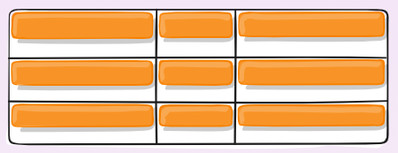
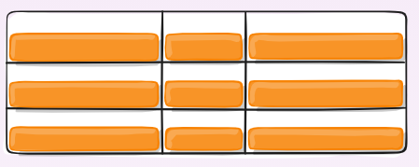
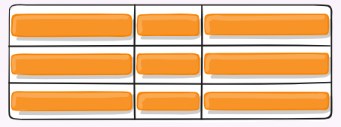
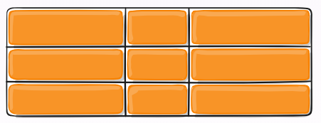
align-items
Aligns grid items along the block (column) axis (as opposed to justify-items which aligns along the inline (row) axis). This value applies to all grid items inside the container.
Values:
start – aligns items to be flush with the start edge of their cell
end – aligns items to be flush with the end edge of their cell
center – aligns items in the center of their cell
stretch – fills the whole height of the cell (this is the default)

Slide 14
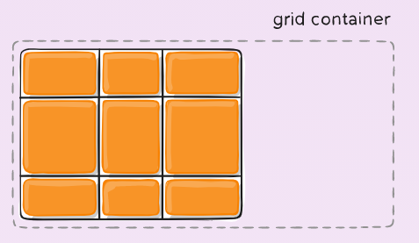
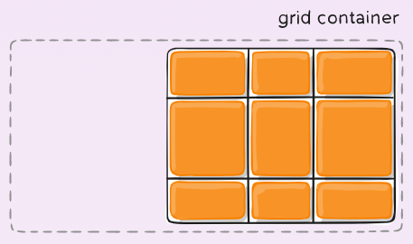
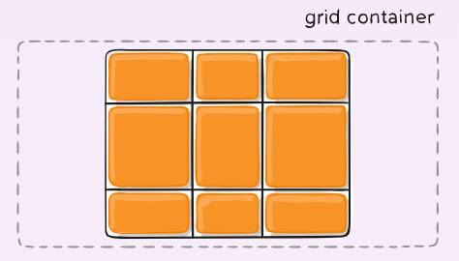
justify-content
Sometimes the total size of your grid might be less than the size of its grid container. This could happen if all of your grid items are sized with non-flexible units like px. In this case you can set the alignment of the grid within the grid container. This property aligns the grid along the inline (row) axis (as opposed to align-content which aligns the grid along the block (column) axis).
Values:
start – aligns the grid to be flush with the start edge of the grid container
end – aligns the grid to be flush with the end edge of the grid container
center – aligns the grid in the center of the grid container

Slide 15
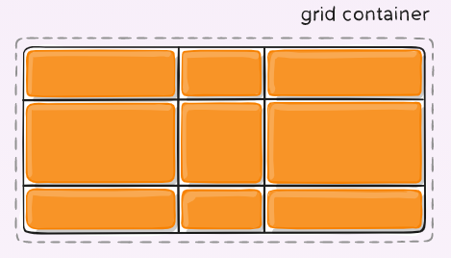
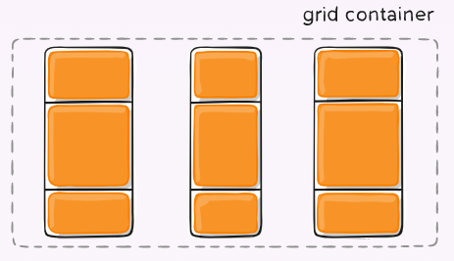
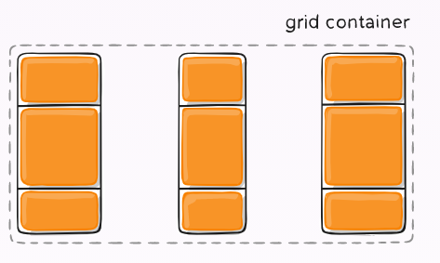
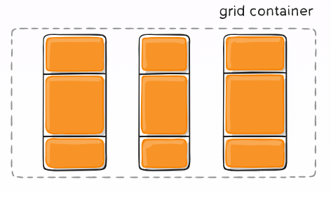
justify-content
Values:
stretch – resizes the grid items to allow the grid to fill the full width of the grid container
space-around – places an even amount of space between each grid item, with half-sized spaces on the far ends
space-between – places an even amount of space between each grid item, with no space at the far ends
space-evenly – places an even amount of space between each grid item, including the far ends

Slide 16
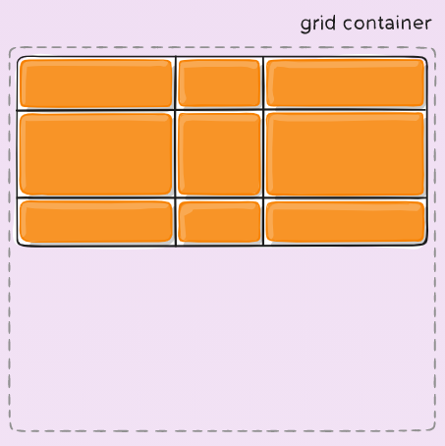
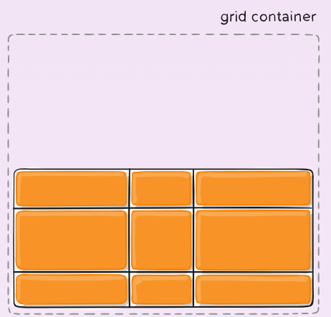
align-content
Sometimes the total size of your grid might be less than the size of its grid container. This could happen if all of your grid items are sized with non-flexible units like px. In this case you can set the alignment of the grid within the grid container. This property aligns the grid along the block (column) axis (as opposed to justify-content which aligns the grid along the inline (row) axis).
Values:
start – aligns the grid to be flush with the start edge of the grid container
end – aligns the grid to be flush with the end edge of the grid container

Slide 17
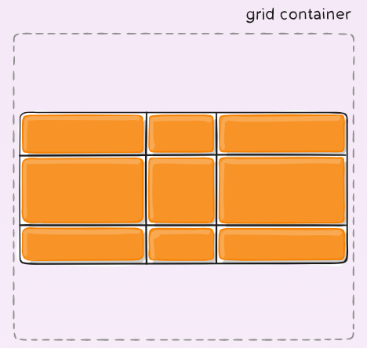
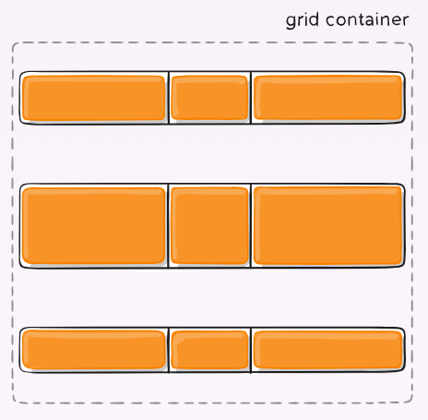
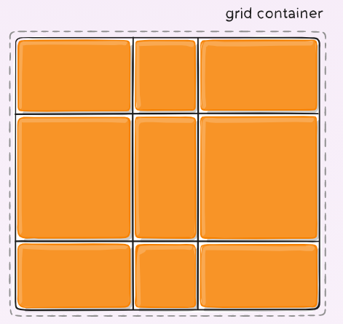
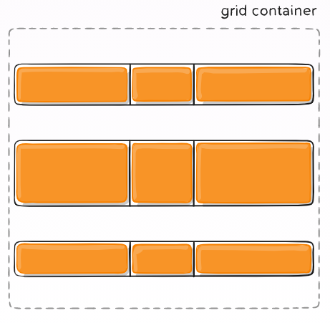
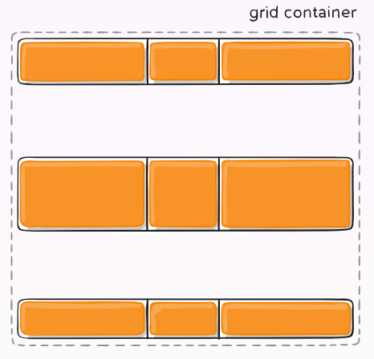
align-content
Values:
center – aligns the grid in the center of the grid container
stretch – resizes the grid items to allow the grid to fill the full height of the grid container
space-around – places an even amount of space between each grid item, with half-sized spaces on the far ends
space-between – places an even amount of space between each grid item, with no space at the far ends
space-evenly – places an even amount of space between each grid item, including the far ends

Slide 18
03
Properties for Children

Slide 19
grid-column-start, grid-column-end, grid-row-start, grid-row-end
Determines a grid item’s location within the grid by referring to specific grid lines. grid-column-start/grid-row-start is the line where the item begins, and grid-column-end/grid-row-end is the line where the item ends.
Values:
<line> – can be a number to refer to a numbered grid line, or a name to refer to a named grid line
span <number> – the item will span across the provided number of grid tracks
span <name> – the item will span across until it hits the next line with the provided name
auto – indicates auto-placement, an automatic span, or a default span of one

Slide 20
grid-column, grid-row
Shorthand for grid-column-start + grid-column-end, and grid-row-start + grid-row-end, respectively.
Values:
<start-line> / <end-line> – each one accepts all the same values as the longhand version, including span

Slide 21
grid-area
Gives an item a name so that it can be referenced by a template created with the grid-template-areas property. Alternatively, this property can be used as an even shorter shorthand for grid-row-start + grid-column-start + grid-row-end + grid-column-end.
Values:
<name> – a name of your choosing
<row-start> / <column-start> / <row-end> / <column-end> – can be numbers or named lines

Slide 22
justify-self
Aligns a grid item inside a cell along the inline (row) axis (as opposed to align-self which aligns along the block (column) axis). This value applies to a grid item inside a single cell.
Values:
start – aligns the grid item to be flush with the start edge of the cell
end – aligns the grid item to be flush with the end edge of the cell
center – aligns the grid item in the center of the cell
stretch – fills the whole width of the cell (this is the default)

Slide 23
align-self
Aligns a grid item inside a cell along the block (column) axis (as opposed to justify-self which aligns along the inline (row) axis). This value applies to the content inside a single grid item.
Values:
start – aligns the grid item to be flush with the start edge of the cell
end – aligns the grid item to be flush with the end edge of the cell
center – aligns the grid item in the center of the cell
stretch – fills the whole height of the cell (this is the default)

Slide 24


The FE Team
Gjorge Dimitrov
Olga Penovska
Front End Developer
Front End Developer

Slide 25

THANKS
Does anyone have any questions?
dimitrov.george.ludotech.co
penovska.olga@gmail.com

