Slide 1
Web Frontends Training
2014

Slide 2
Agenda
PonySDK
SmartCC
Webtrading
Webappsdk project
Less CSS
Samples
Exercices

Slide 3
Web apps
Administrative
SmartCC
Timesheet
..
Trading
Webtrading
OMS

Slide 4
PonySDK

Slide 5
PonySDK
Open Source
Google Web Tool kit leveraged without the pain of debugging GWT application and compilation
Developer write pure server side Java and the framework is doing the rest
JSON, WebSocket, Less…

Slide 6
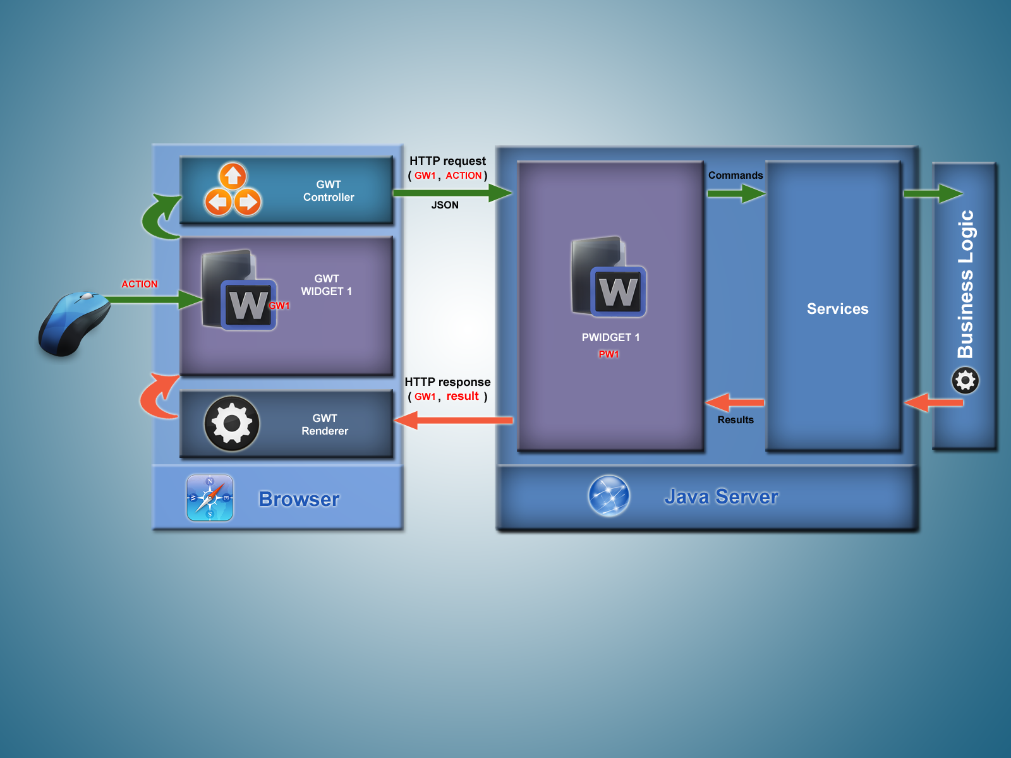
PonySDK

Slide 7
PonySDK
Event Bus
UI Components
Page model
Service generation
Spring : Server and Client configuration files
Server configuration file : loaded on web server startup
Client Configuration file : loaded each time a browser is launched

Slide 8
PonySDK
Most GWT widgets have a Pony version
PButton
PFlowPanel
PFlexTable
…
Form
DataGridActivity
PageActivity
The GWT showcase is good starting point to see the differents widgets: http://gwt.googleusercontent.com/samples/Showcase/

Slide 9
smartCC overview

Slide 10
smartCC Overview
smartTrade web application used for administration
Works with custom data sources
DB
JMX
STConnect
...
Based on PonySDK

Slide 11
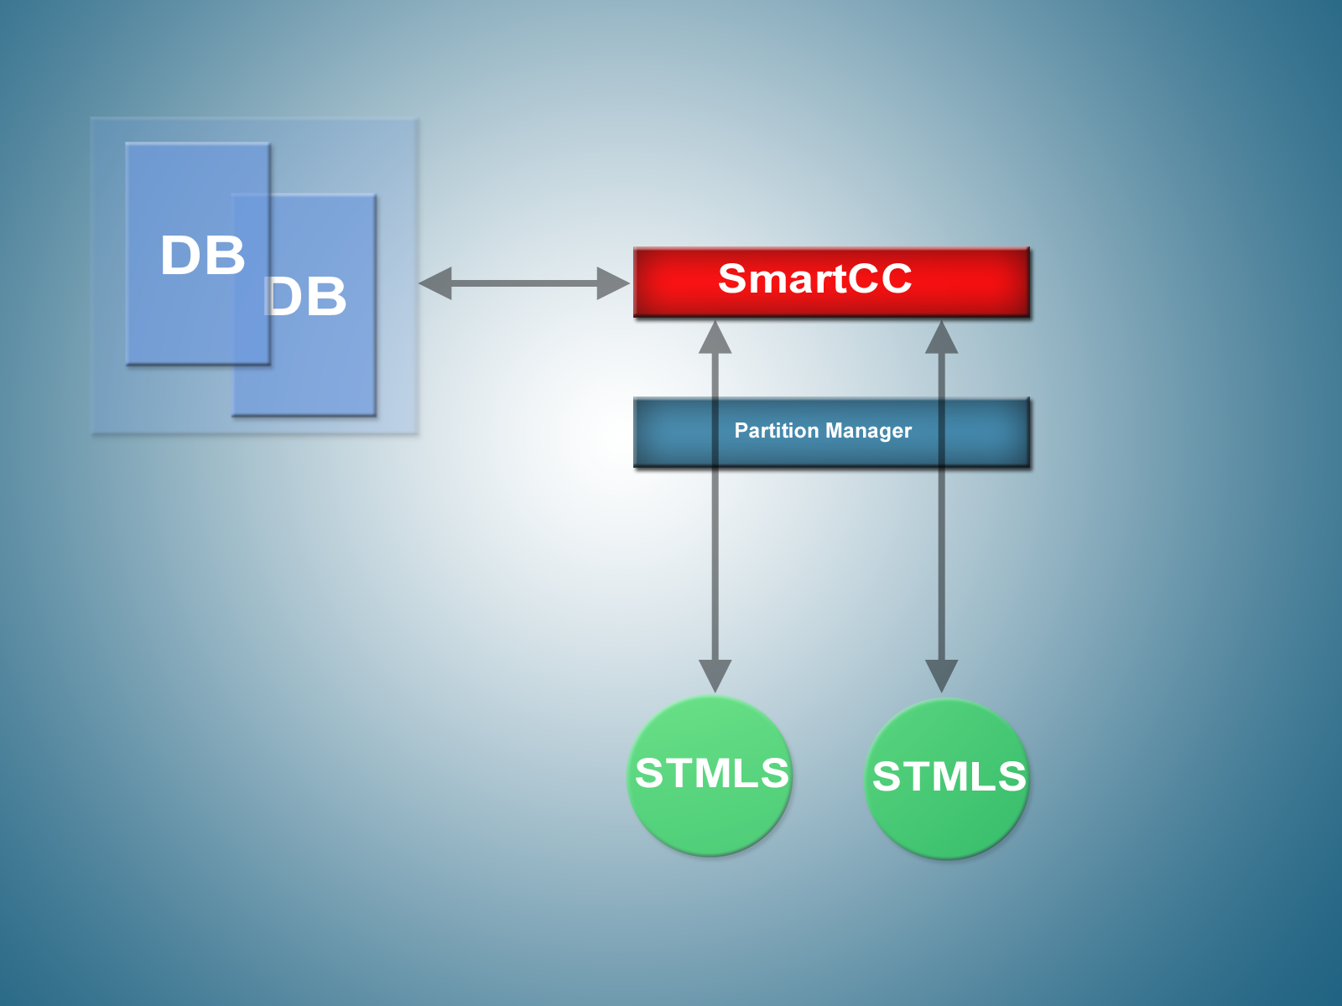
smartCC Overview

Slide 12
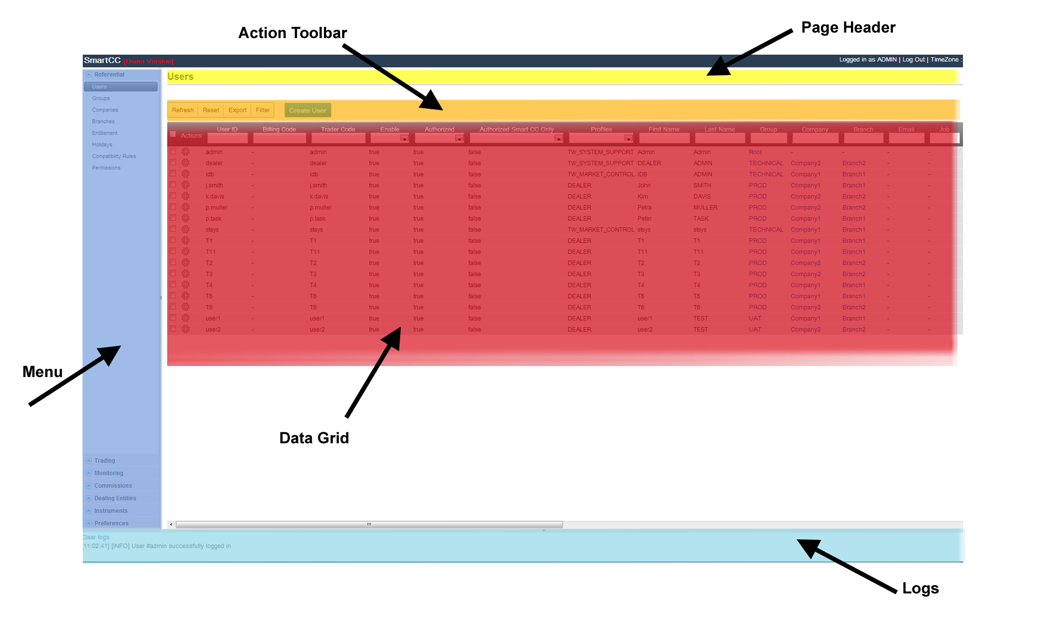
smartCC Layout

Slide 13
Webtrading

Slide 14
Webtrading
HTML5
Websocket, sound, etc.
No DB access
Communication is done through ST messages
Send message
STServiceSenderInvoker.get().sendLogon(logon);
Receive message
MessageDispatcher.get().addMessageListener(this);
@OnLogonResponse
public void onLogonResponse(final LogonResponse logonResponse) {...}

Slide 15
Project webappsdk

Slide 16
Project webappsdk
smartTrade layer used in all web application projects
smartCC
smartCS
Webtrading
OMS
Contains useful tools and widgets
DataGrid
Widgets (chosen listbox, notifications, …)
…

Slide 17
Less CSS

Slide 18
Less CSS
CSS pre-processor
Extends css with :
Variables
Functions
Mixins
…
Can be used in javascript to have a live preview with less.watch()

Slide 19
Samples

Slide 20
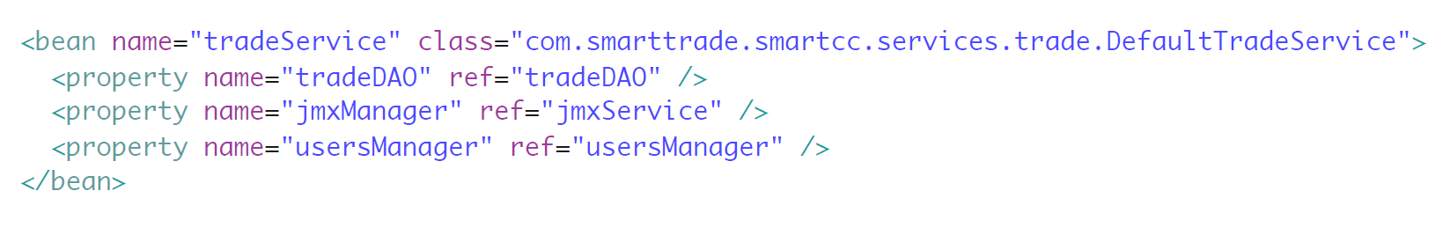
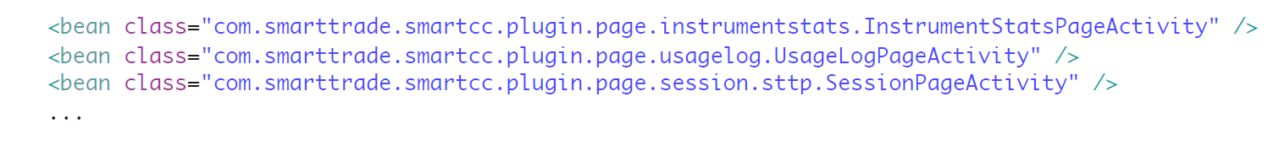
Samples (Configuration)
Server Configuration (server_application.xml)
Client Configuration (client_application.xml)
Page Injection
Activities/Views

Slide 21
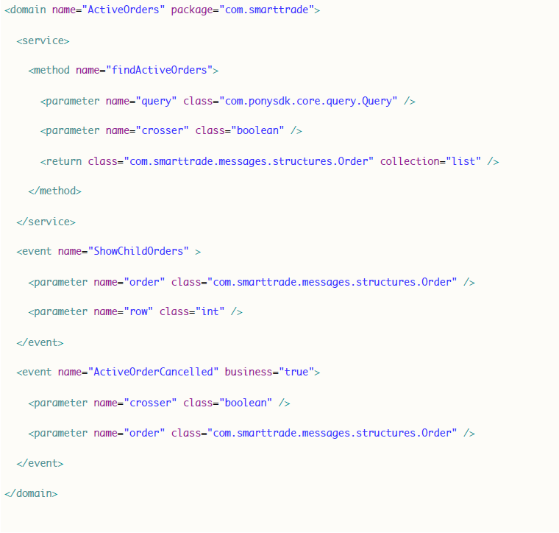
Samples (Generation)
File extension : xxxx.pony.xml
Method generation
Event generation
CRUD generation

Slide 22
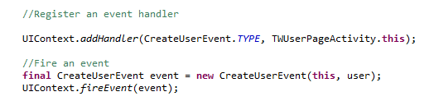
Samples (Events)
Two types of Events
Business
System
Handler

Slide 23
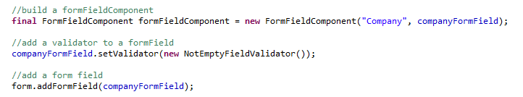
Samples (Form)
List of FormField
isValid()
Reset()
No UI logic
A FormField can have a validator
FormFieldComponent

Slide 24
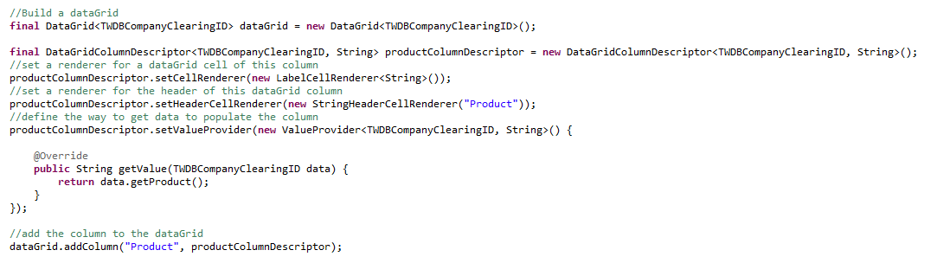
Samples (DataGrid)
Main component shown in most pages
Data Filtering
Data export
Paging
Contains a list of DataGridColumnDescriptor
A FormField can have a validator
FormFieldComponent

Slide 25
Exercices

Slide 26
Exercice 1 : Create a simple file explorer
Go to TrainingEntryPoint.start()
Use a PSplitLayoutPanel to display:
A PFlowPanel containing PLabel to display the folders/files names
A PHTML to display a file preview (txt and html files)
If the user click on a folder, display the files of this folder
If the user click on a txt or html file, display the content of the file
(You can use a PScrollPanel to add a scrollbar to the top and to the bottom of the split panel)

Slide 27
Exercice 2 : Display a list of users
Create a service
In User.pony.xml add 2 new methods findUsers and createUser
Generate the service and implements basically the 2 functions
Create 2 new pages
UserListPage and UserFormPage
Declare the 2 pages in training_client.xml
To display the users use a webappsdk.DataGrid<User>
Add 2 columns: login and name
In UserFormPage use 2 StringTextBoxFormField to get a login and a name
Use a Form to check that the fields are not empty when the user submit the form

Slide 28
Exercice 3 : Trading flow
In training_server.xml configure connector to connect to the crosser
In MarketPage
Request all securities and display it
Subscribe to the market when the user click on the symbol of a securities
Display the best bid/best offer of the market
Send a NewOrderSingle when the user click on the market (random price and quantity)
Display a notification with the order state (lastPrice, lastShare, status)
In training.less add some style
Try out live css update with less.watch()

