Slide 1
An OLAP Solution using Mondrian and JPivot
Sandro Bimonte
Pascal Wehrle

Slide 2
A tour of OLAP using Mondrian
Introduction (architecture, functionality)
Example installation and configuration
Derived architectures and products
Multidimensional expression language (MDX)
How to design a cube in Mondrian
Advanced configurations in Mondrian

Slide 3
Introduction
Architecture & Functionality

Slide 4
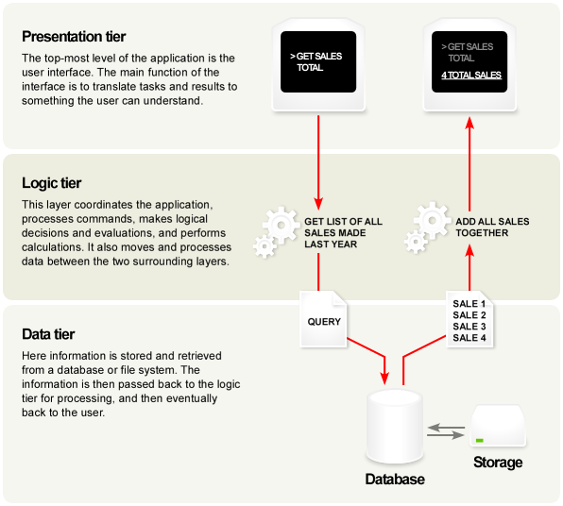

Slide 5
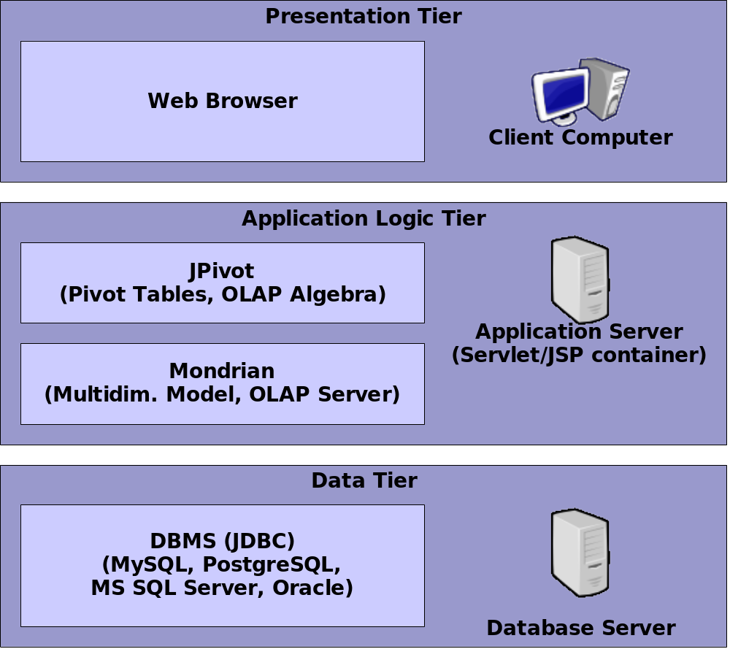
3 tier architecture

Slide 6
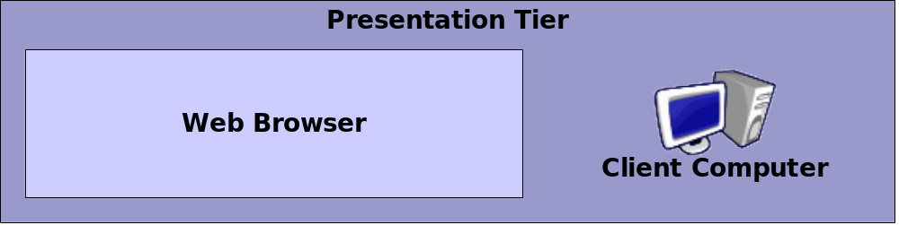
Functionality – presentation tier
Web interface in HTML
Javascript & HTML Forms for interaction
Managed by Web Component Framework (WCF, included in JPivot) on the server

Slide 7
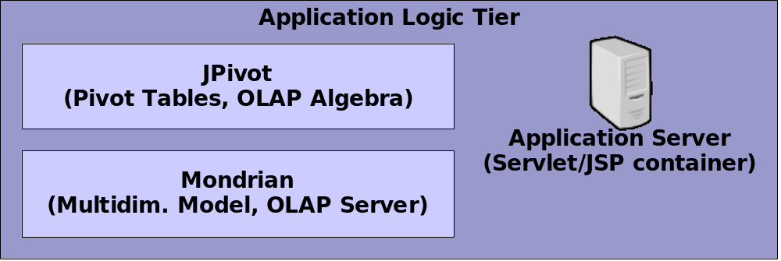
Functionality – application logic tier
JPivot: Pivot tables and OLAP operations
Execution of MDX queries by Mondrian
Hosted by Application Server (JBoss, Tomcat Servlet container etc.)

Slide 8
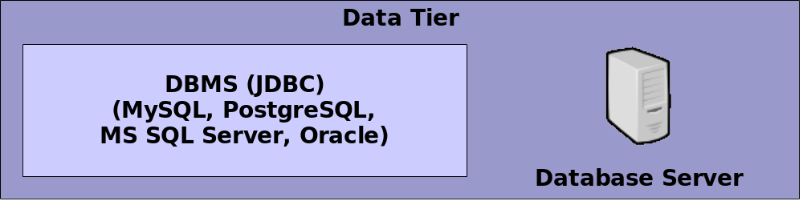
Functionality – data tier
Relational DBMS stores data according to ROLAP storage model
SQL queries generated by Mondrian are executed by DBMS
Computing of aggregates on data performed by DBMS as part of query

Slide 9
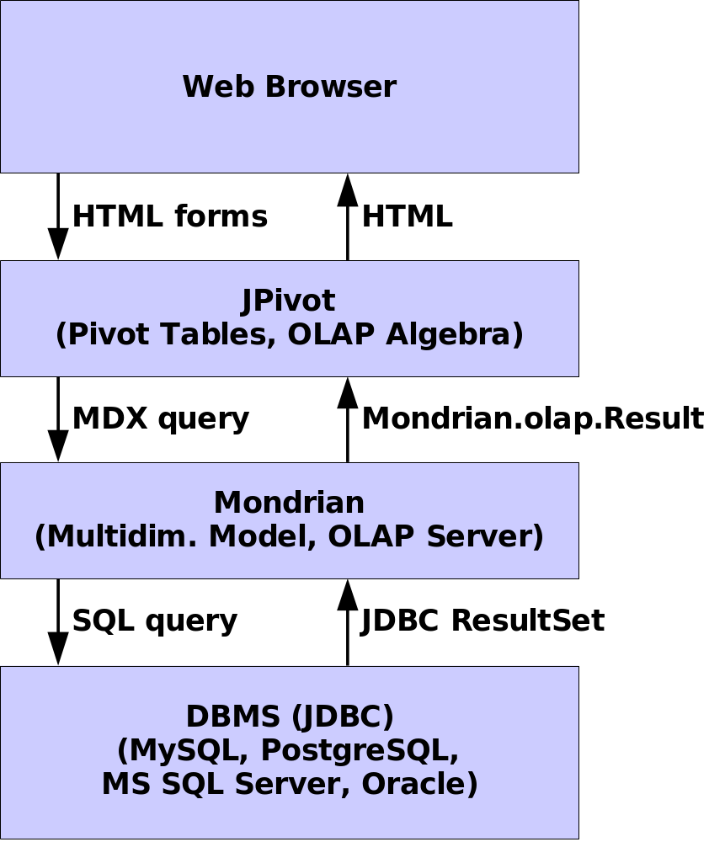
Functionality - Communication

Slide 10
Functionality – Features
Mondrian:
  ROLAP model mapping
  Cache for reuse of query results
  Usage of pre-computed aggregates
JPivot:
  Pivot table for advanced OLAP operations on warehouse data
  Visualization of warehouse data using charts

Slide 11
Example installation and configuration

Slide 12
DBMS: PostgreSQL - Installation
Download from:
http://www.postgresql.org
Installed version: 8.1
Installation type:
  Local standalone server (run as a service)
  Allow only local connections
  JDBC driver for communication with Java applications

Slide 13
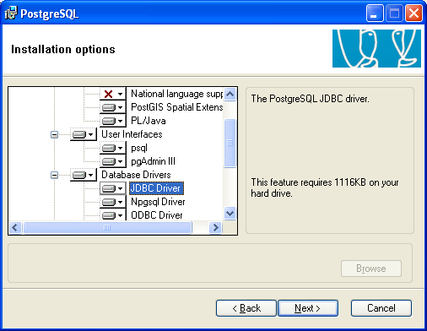

DBMS: PostgreSQL - Installation

Slide 14
DBMS: PostgreSQL - Configuration
Use pgAdmin III (included) to:
  Create dedicated user account
  Create an example database "Foodmart"
Load example data into the database
  Use provided MondrianFoodMartLoader to load an example data warehouse into the database Foodmart

Slide 15
DBMS: PostgreSQL - Configuration
Easiest way to use MondrianFoodMartLoader:
  Get Eclipse IDE, from http://www.eclipse.org
  Add the Web Tools Platform (WTP) plugin
  Download & unzip Mondrian (2.2.2)
  Import the mondrian.war from mondrian-2.2.2/lib
  include PostgreSQL JDBC, Apache log4j, eigenbase XOM and properties libraries (from PostgreSQL install and mondrian-src.zip/lib)

Slide 16
DBMS: PostgreSQL - Configuration
locate the mondrian-2.2.2/demo/FoodMartCreateData.sql file
Finally, run :
mondrian.test.loader.MondrianFoodMartLoader
-verbose -tables -data –indexes
-jdbcDrivers=org.postgresql.Driver
-outputJdbcURL=jdbc:postgresql://localhost/Foodmart
-outputJdbcUser=foodmart
-outputJdbcPassword=foodmart
-inputFile=demo/FoodMartCreateData.sql

Slide 17
Tomcat Servlet/JSP container - Installation
Download from:
http://tomcat.apache.org
Installed version: 5.5
Installation type:
  standard server (run as a service)
  Integrated with Eclipse Web Tools Platform (WTP) plugin

Slide 18
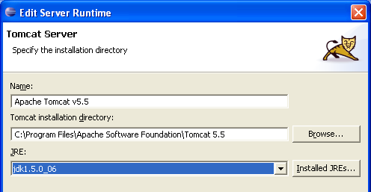
Tomcat Servlet/JSP container - Configuration
Create a new Eclipse project of type “Server” and follow instructions
Specify the server type (Apache Tomcat 5.5), host (localhost) and runtime configuration:

Slide 19
Mondrian+JPivot - Installation
Download from:
http://jpivot.sourceforge.net
Installed version: 1.6.0
Installation type:
  Import of deployment package as Eclipse project
  Uses Mondrian library included with JPivot package

Slide 20
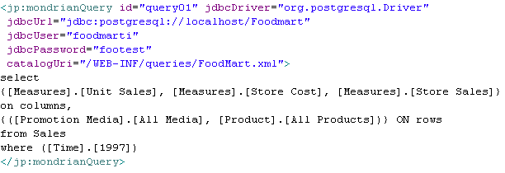
Mondrian+JPivot - Configuration
Edit WebContent\WEB-INF\queries\mondrian.jsp
Add JDBC connection parameters to the query

Slide 21
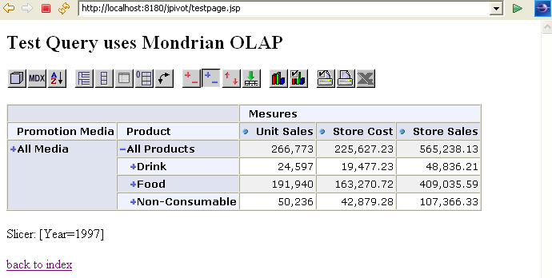
Mondrian+JPivot - Configuration
Run the JPivot web project on the server and enjoy…

Slide 22
Derived architectures & products
Business Intelligence (BI) suites:
  Pentaho
  JasperSoft
Custom solutions:
  JRubik
  BIOLAP
  your own project...

Slide 23
Pentaho : Overview
Open Source BI application suite made from free component applications
Official home of the Mondrian project
Reporting: Eclipse BIRT (Business Intelligence and Reporting Tools)
Analysis: Mondrian, JPivot
Data Mining: Weka (University of Waikato Machine Learning Project)
Workflow: Enhydra Shark, Enhydra JaWE

Slide 24
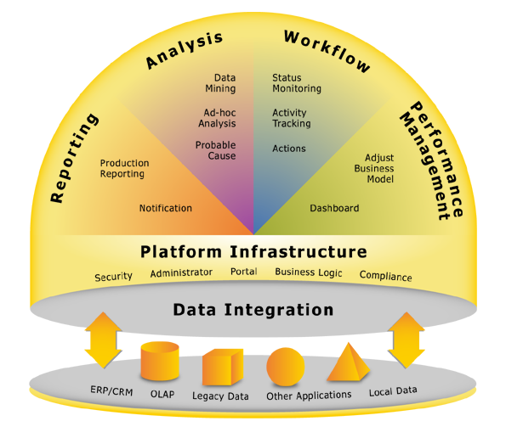
Pentaho : Architecture

Slide 25
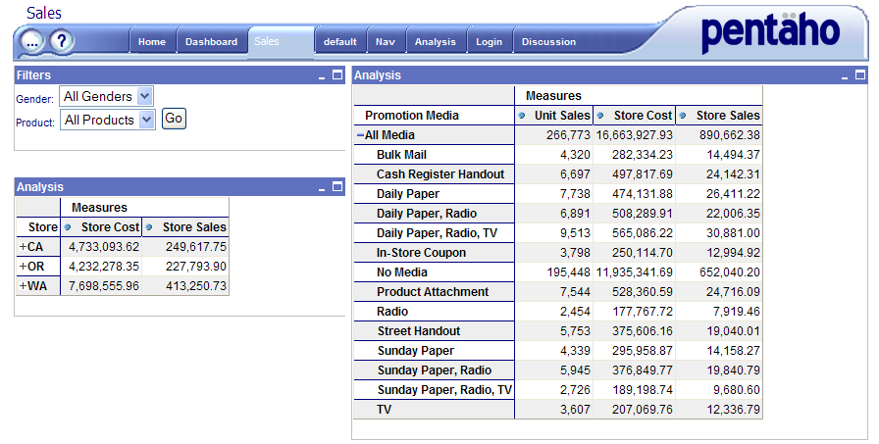
Pentaho: Analysis
Another skin for JPivot...

Slide 26
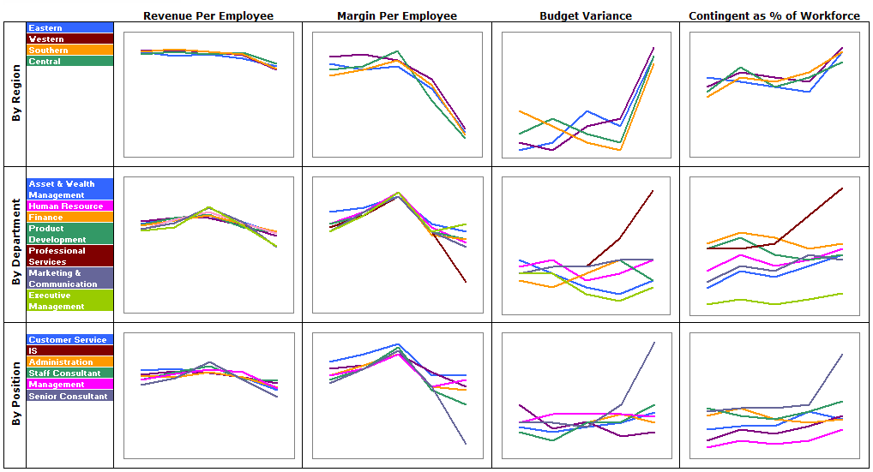
Pentaho: Analysis
But there's also this (using Apache Batik)...

Slide 27
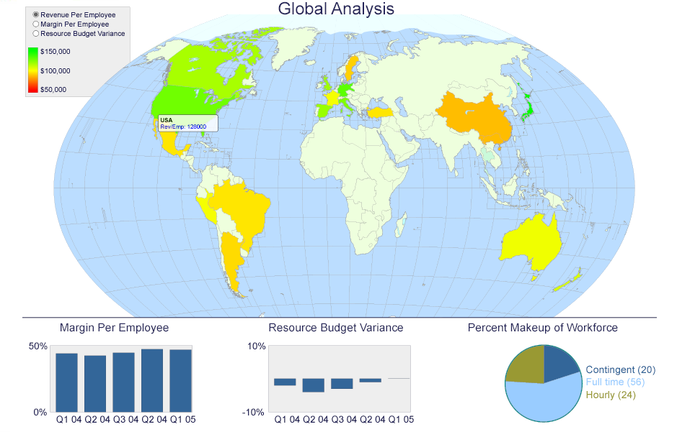
Pentaho: Analysis
...and this!

Slide 28
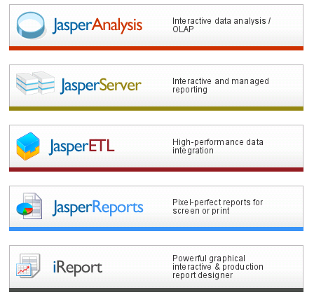
JasperSoft

Slide 29

JRubik
Java client with Swing UI
built using JPivot components
plugin interface for custom data visualization

Slide 30
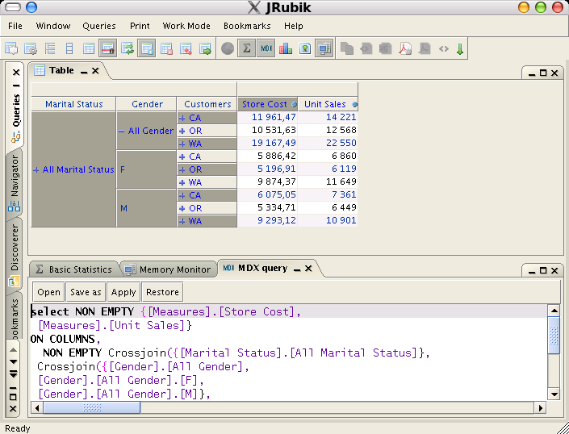
JRubik

Slide 31
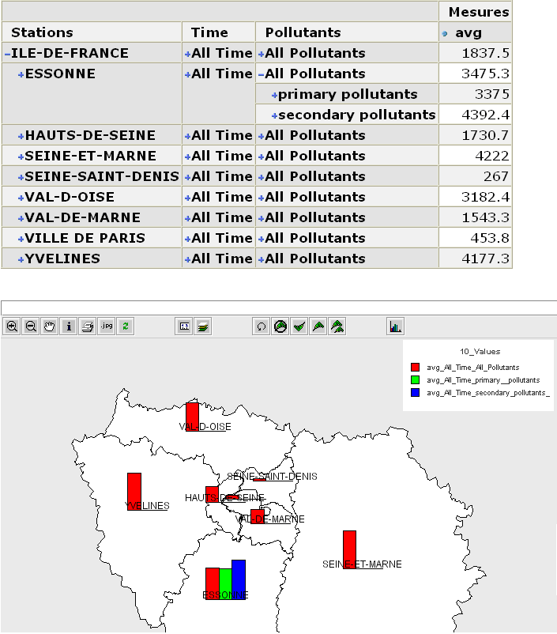
Spatial DW and Spatial OLAP
Integration of Spatial data in DW and OLAP
GeWOLap is OUR web based tree-tier solution: Spatial ORACLE, Mondrian and –JPivot + MapXtreme Java-

Slide 32
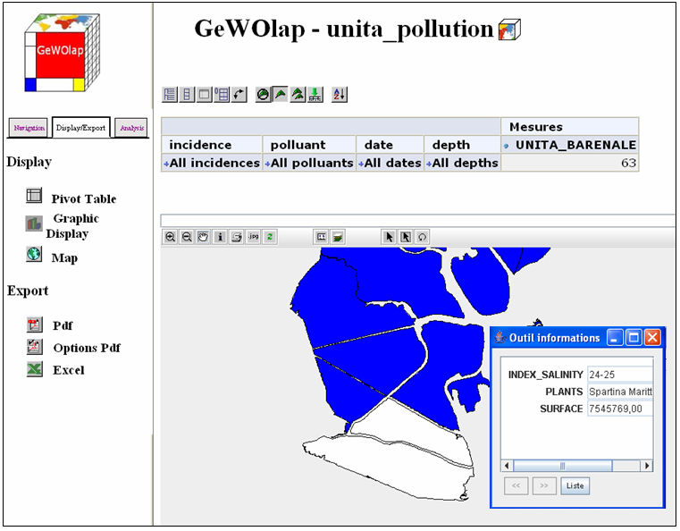
Spatial DW and Spatial OLAP
It supports Geographical Dimensions and Measures

Slide 33
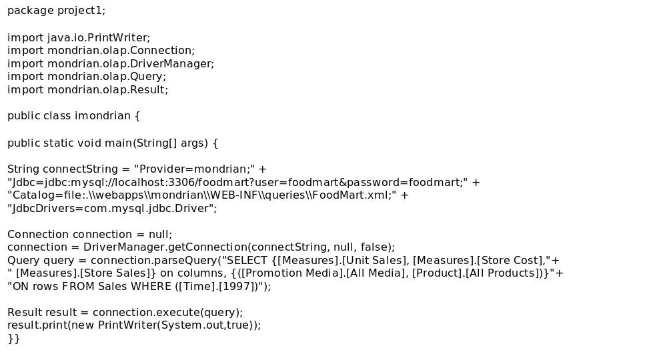
Your own application...

Slide 34
MDX: Basic Notions

Slide 35
First Example
A First example of a multidimensional query: Sum of sales for each year
SELECT
{([Measures].[Unit Sales])} ON COLUMNS,
[Time].[Year].Members ON ROWS
FROM SALES

Slide 36
MDX Grammar (1/3)
SELECT axis {, axis }
FROM cube name
WHERE slicer
Axes are dimensions and/or Measures
Slicer represents the selection predicate

Slide 37
MDX Grammar (2/3)
Terminal are :
Set {}
Tuple ()
Cube elements names (cubes, dimensions, levels, members and properties) []
ON ROWS and ON COLUMNS represent the configuration of the pivot table

Slide 38
MDX Grammar (3/3)
Point Operator .
access to a dimension member
[Time].[1997] member 1997 of the level Year
access to a level of a dimension
[Time].[Year] Year Level
access to an operation
[Time].[Year].Members operation Members

Slide 39
Set Example
An expression, which is a set of tuples of members, is used to specify an axis
{([Time].[1997]),
([Time].[1998]),
([Time].[1998].[9-1998])}

Slide 40
Tuples (1/2)
Tuples must be coherent
  Each coordinate has to include member belonging to the same dimension
  They can belong to different levels
{([Time].[1997], [Store].[Canada]),
([Time].[1998], [Store].[USA]),
([Time].[1998].[9-1998], [Store].[Canada])}

Slide 41
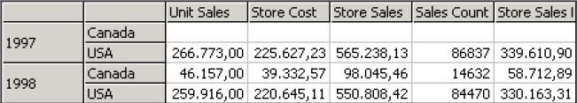
Tuples (2/2)
SELECT {([Measures].Members)} On COLUMNS,
{([Time].[1997],[Store].[Canada]),
([Time].[1997],[Store].[USA]),
([Time].[1998],[Store].[Canada]),
([Time].[1998],[Store].[USA])}
ON ROWS
FROM [SALES]

Slide 42
CROSSJOIN
An axe can be defiend as a cartesian product of different sets
CROSSJOIN(set1,set2,…)
CROSSJOIN({[Time].[Year].Members},
{[Store].[USA],[Store].[Canada]})

Slide 43
Operations
Operations having set as output:
x.Members = set of members of a level or dimension
x.Children = set of children of a member x
DESCENDANTS (x, l)= set of descendants of a member x at the level l

Slide 44
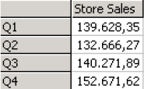
Descendants example
SELECT {([Measures].[Store Sales])} On COLUMNS,
DESCENTANTS ([Time].[1998], [Quarter])
ON ROWS
FROM [SALES]

Slide 45
Slicer
WHERE permits to selection a part of the cube
It is specified using members which do not belong to dimensions axes: ON ROWS and ON COLUMNS
SELECT {([Measures].[Unit Sales])} ON COLUMNS,
{([Time].[Year].Members)} ON ROWS
FROM SALES
WHERE ([Store].[USA].[NY])
Slice on the state of New York
It is not possible to have a slice with more than one member of the same dimension
WHERE ([Store].[USA].[NY], [Store].[USA].[Texas])
IT IS NOT CORRECT

Slide 46
Calculated Members
They are used to calculate measures and do comparison
WITH MEMBER specify the name and
AS’ ‘ its associates formula
WITH MEMBER [Measures].[Store Profit] AS
‘[Measures].[Store Sales]- [Measures].[Store Cost]’
SELECT {([Measures].[Unit Sales])} ON COLUMNS,
{([Time].[Year].Members)} ON ROWS
FROM SALES
WHERE ([Store].[USA].[NY])

Slide 47
Operations on Members
x.CURRENTMEMBER Current member in a dimension or a level
m.PREVMEMBER Member that preceds the member m in their level
m.NEXTMEMBER Member that follows the member m in their level

Slide 48
A Complex Example
WITH MEMBER [Measures].[Sales Difference] AS
‘([Measures].[Store Sales], [Time].CurrentMember)
-
([Measures].[Store Sales], [Time].PrevMember)’
SELECT {([Measures].[Sales Difference])} ON COLUMNS,
{([Time].[Year].Members)} ON ROWS
FROM SALES
WHERE ([Store].[USA].[NY])

Slide 49
Numeric Functions
SUM (set, expression)
MAX (set, expression)
AVG(set, expression)
MIN(set, expression)
AVG([Time].Members, [Measures].[Store Profit])

Slide 50
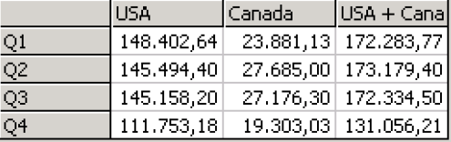
Example of numeric function
WITH MEMBER [Store].[USA+Canada] AS ‘SUM({[Store].[USA],[Store].[Canada]},[Measures].[Store Sales])’
SELECT {([[Store].[USA]),([Store].[Canada]),([Store].[USA+Canada] )} ON CULUMNS,
DESCENTANTS ([Time].[1998], [Quarter])
ON ROWS
FROM [SALES]

Slide 51
How to design a Cube in Mondrian

Slide 52
Outline
Cube
Measure
Dimension
  Shared dimensions
  Multiple Hierarchies
  Parent-child hierarchies
  Snowflake schema
Calculated members
User-defined functions
Named Set

Slide 53
Cube
A cube is a named collection of measures and dimensions
<Cube name="Sales">
<Table name="sales_fact_1997"/>
...
</Cube>
The fact table is defined using the <Table> element
You can also use the <View> and <Join> constructs to build more complicated SQL statements

Slide 54
Measure (1)
The Sales cube defines two measures, "Unit Sales" and "Store Sales".
<Measure name="Unit Sales” column="unit_sales"
aggregator="sum" datatype="Integer" formatString="#,###"/>
<Measure name="Store Sales" column="store_sales"
aggregator="sum" datatype="Numeric" formatString="#,###.00"/>
Each measure has a name, a column in the fact table, and an aggregator
  usually "sum", but "count", "mix", "max", "avg", and "distinct count"

Slide 55
Measure (2)
An optional formatString attribute specifies how the value is to be printed
  48.123,45: Two decimals
datatype attribute specifies how cell values are represented in Mondrian's cache, and how they are returned via XML for Analysis

Slide 56
Dimension (1)
<Dimension name="Gender" foreignKey="customer_id">
<Hierarchy hasAll="true" primaryKey="customer_id">
<Table name="customer"/>
<Level name="Gender" column="gender" uniqueMembers="true"/>
</Hierarchy>
</Dimension>
foreignKey attribute in <Dimension> is the name of a column in the fact table
The <Hierarchy> element has primaryKey attribute
By default, a Hierarchy has a top level called 'All', with a single member called 'All {hierarchyName}'.
  It is also the default member of the hierarchy
  <Hierarchy> element has:
    allMemberName and allLevelName attributes override the default names of the all level and all member
    hasAll="false", the 'all' level is suppressed
      The default member of that dimension will now be the first member of the first level

Slide 57
Dimension (2)
uniqueMembers attribute in Level is used to optimize SQL generation
  TRUE if values of a given level column in the dimension table are unique across all the other values in that column across the parent levels
ordinalColumn and nameColumn attributes of the Level tag
  ordinalColumn specifies a column in the Hierarchy table that provides the order of the members in a given Level
  nameColumn specifies a column that will be displayed
[Time].[2005].[Q1].[1] : ordinalColumn 1,2,..
January: nameColumn January, February…

Slide 58
Shared dimensions
<Dimension name="Store Type">
<Hierarchy hasAll="true" primaryKey="store_id">
<Table name="store"/>
<Level name="Store Type" column="store_type" uniqueMembers="true"/>
</Hierarchy>
</Dimension>
<Cube name="Sales">
<Table name="sales_fact_1997"/>
...
<DimensionUsage name="Store Type" source="Store Type"foreignKey="store_id"/>
</Cube>
<Cube name="Warehouse">
<Table name="warehouse"/>
...
<DimensionUsage name="Store Type" source="Store Type" foreignKey="warehouse_store_id"/>
</Cube>

Slide 59
Multiple hierarchies
<Dimension name="Time" foreignKey="time_id">
<Hierarchy hasAll="false" primaryKey="time_id">
<Table name="time_by_day"/>
<Level name="Year" column="the_year" type="Numeric"
uniqueMembers="true"/>
<Level name="Quarter" column="quarter" type="Numeric" uniqueMembers="false"/>
<Level name="Month" column="month_of_year" type="Numeric"
uniqueMembers="false"/>
</Hierarchy>
<Hierarchy name="Time Weekly" hasAll="false" primaryKey="time_id">
<Table name="time_by_week"/>
<Level name="Year" column="the_year" type="Numeric"
uniqueMembers="true"/>
<Level name="Week" column="week"
uniqueMembers="false"/>
<Level name="Day" column="day_of_week" type="String"
uniqueMembers="false"/>
</Hierarchy>
</Dimension>
Note the common foreignKey: time_Id
Note the level tag attribut Type {String, Numeric}, say to SQL if use the apices ‘ or not

Slide 60
Parent-child hierarchies (1)
Bank_site
agence_id
bank_id
full_name
CA
All
0
1
CA
CA_VU
CA_LaCote
1
2
CA_VU
2
3
CA_PlaceW
Bank
1
4
CA_LaCote
CA_PlaceW

Slide 61
Parent-child hierarchies (2)
<Dimension name=“Bank_site" foreignKey="employee_id">
<Hierarchy hasAll="true" allMemberName="All Bank_site " primaryKey=" Bank_id">
<Table name=" Bank_site "/>
<Level name=“Bank" uniqueMembers="true" type="Numeric"
column=“bank_id" nameColumn="full_name"
parentColumn=“agence_id" nullParentValue="0">
</Level>
</Hierarchy>
</Dimension>
parentColumn attribute is the name of the column which links a member to its parent member
nullParentValue attribute is the value which indicates that a member has no parent
Closure is used to improve performances and to allows aggregation: Distinct Count

Slide 62
Snowflake schemas
<Cube name="Sales">
...
<Dimension name="Product" foreignKey="product_id">
<Hierarchy hasAll="true" primaryKey="product_id" primaryKeyTable="product">
<Join leftKey="product_class_id" rightAlias="product_class" rightKey="product_class_id">
<Table name="product"/>
<Join leftKey="product_type_id" rightKey="product_type_id">
<Table name="product_class"/>
<Table name="product_type"/>
</Join>
</Join>
...
</Hierarchy>
</Dimension>
</Cube>
<Join> is used to build snowflake dimensions
"Product" dimension consists of three tables: product, product_class, product_type
The fact table joins to "product" (via the foreign key "product_id")
"product" is joined to "product_class" (via the foreign key "product_class_id")
"product_class" is joined to "product_type" (via the foreign key "product_type_id").

Slide 63
Property
<Property name="Management Role" column="management_role" >
Define a property for all members of a level
The role of an Employee:
SELECT {[Store Sales]} ON COLUMNS
FROM Sales
WHERE [Employees].[Employee].Management. CurrentMember.Properties("management_role") = “projet manager")

Slide 64
Calculated members
WITH MEMBER [Measures].[Profit]
AS '[Measures].[Store Sales]-[Measures].[Store Cost]', FORMAT_STRING = '$#,###'
SELECT {[Measures].[Store Sales], [Measures].[Profit]} ON COLUMNS,
{[Product].Children} ON ROWS
FROM [Sales]
WHERE [Time].[1997]
<CalculatedMember name="Profit" dimension="Measures" visible= " true ">
<Formula>[Measures].[Store Sales] - [Measures].[Store Cost]</Formula>
<CalculatedMemberProperty name="FORMAT_STRING" value="$#,##0.00"/>
</CalculatedMember>
<Formula> is an well-formed MDX formula
visible="false" user-interfaces hide the member

Slide 65
User-defined function (1)
User defined functions permit to extend MDX language and so Mondrian schema language using Java Code
A user-defined function must have a public constructor and implement the mondrian.spi.UserDefinedFunction interface
import mondrian.olap.*;
import mondrian.olap.type.*;
import mondrian.spi.UserDefinedFunction;
/**
* A simple user-defined function which adds one to its argument.
*/
public class PlusOneUdf implements UserDefinedFunction {
// public constructor
public PlusOneUdf() {
}
public String getName() {
return "PlusOne";
}
public String getDescription() {
return "Returns its argument plus one";
}
public Syntax getSyntax() {
return Syntax.Function;
}
public Type getReturnType(Type[] parameterTypes) {
return new NumericType();
}
public Type[] getParameterTypes() {
return new Type[] {new NumericType()};
}
public Object execute(Evaluator evaluator, Exp[] arguments) {
final Object argValue = arguments[0].evaluateScalar(evaluator);
if (argValue instanceof Number) {
return new Double(((Number) argValue).doubleValue() + 1);
} else {
// Argument might be a RuntimeException indicating that
// the cache does not yet have the required cell value. The
// function will be called again when the cache is loaded.
return null;
}
}
public String[] getReservedWords() {
return null;
}
}

Slide 66
User-defined function (2)
<Schema>
...
<UserDefinedFunction name="PlusOne" class="com.acme.PlusOneUdf">
</Schema>
WITH MEMBER [Measures].[Unit Sales Plus One]
AS 'PlusOne([Measures].[Unit Sales])'
SELECT
{[Measures].[Unit Sales]} ON COLUMNS,
{[Gender].MEMBERS} ON ROWS
FROM [Sales]

Slide 67
Named sets
WITH SET [Top Sellers] AS
'TopCount([Warehouse].[Warehouse Name].MEMBERS, 5, [Measures].[Warehouse Sales])'
SELECT
{[Measures].[Warehouse Sales]} ON COLUMNS,
{[Top Sellers]} ON ROWS
FROM [Warehouse]
WHERE [Time].[Year].[1997]
<Cube name="Warehouse">
...
<NamedSet name="Top Sellers">
<Formula>TopCount([Warehouse].[Warehouse Name].MEMBERS, 5, [Measures].[Warehouse Sales])</Formula>
</NamedSet>
</Cube>

Slide 68
Advanced configurations in Mondrian
Aggregates and Caching
Mondrian and XMLA

Slide 69
Aggregates and Caching

Slide 70
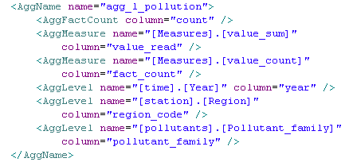
Aggregate Tables
An aggregate table contains pre-aggregated measures build from the fact table
It is registered in Mondrian's schema, so that Mondrian can choose to use whether to use the aggregate table rather than the fact table, if it is applicable for a particular query.

Slide 71
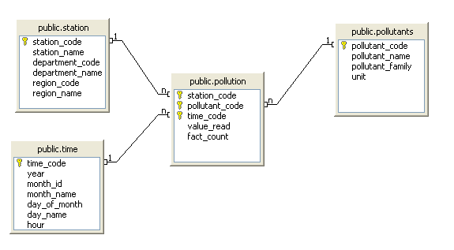
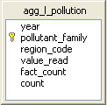
Aggregate Tables : Use Case
STAR SCHEMA
Select [Measures].value_read, [Measures].fact_count, [station].[Region].Members on columns,
CROSSJOIN({[Pollutant].[Pollutant_family].Members},{[time].[Year].Members})
FROM Cube1

Slide 72
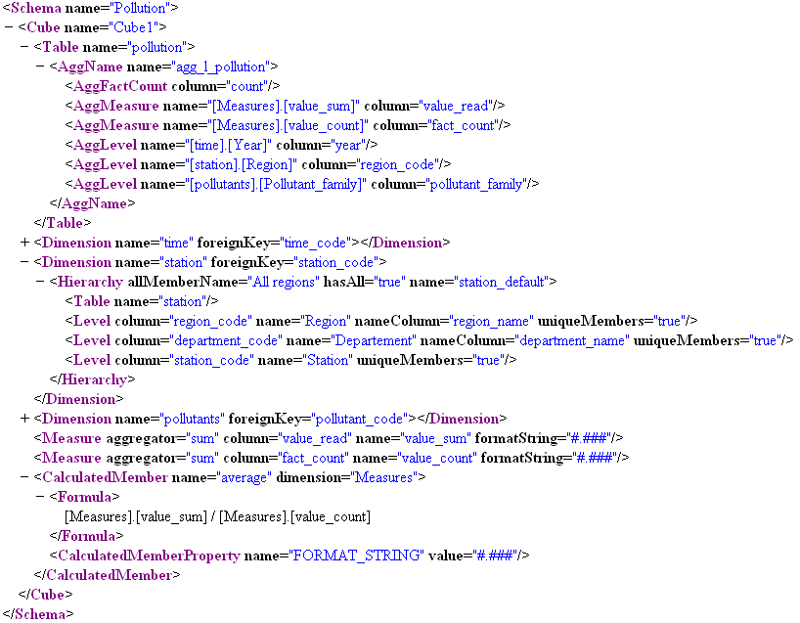

Slide 73
Aggregate Tables: Schema
<AggName name is the name of the Aggregate Table associated at levels specified in <AggLevel name>
<AggLevel name= "xxxx" column= " xxx"/>
  column indicates wich column associate to the level indicated in name attribute
<AggFactCount column= > is an obligatory value
<AggMeasure name= "xxx" column= "xxx"/>
  column indicates wich column associate to the measure indicated in name attribute

Slide 74
Aggregate Tables: Rules
In the example Aggregate Table has the default name: agg_l_pollution and the same columns names than the fact table: value_read, region_code…
This permits to Mondrian to recognize tables as Aggregate Table automatically
Rules can be set with a file.xml defined in a property
  <TableMatch id="ta" posttemplate="_agg_.+" />
  _agg_l_pollution

Slide 75
Aggregate Tables: properties
Property
Type
Default Value
Description
mondrian.rolap.aggregates.Use
boolean
false
If set to true, then Mondrian uses any aggregate tables that have been read. These tables are then candidates for use in fulfilling MDX queries. If set to false, then no aggregate table related activity takes place in Mondrian.
mondrian.rolap.aggregates.Read
boolean
false
If set to true, then Mondrian reads the database schema and recognizes aggregate tables. These tables are then candidates for use in fulfilling MDX queries. If set to false, then aggregate table will not be read from the database.

Slide 76
Access-control
Mondrian provides Rules to access to Cubes… too
<Role name="California manager">
<SchemaGrant access="none">
<CubeGrant cube="Sales" access="all">
<HierarchyGrant hierarchy="[Store]" access="custom" topLevel="[Store].[Store Country]">
<MemberGrant member="[Store].[USA].[CA]" access="all"/>
<MemberGrant member="[Store].[USA].[CA].[Los Angeles]" access="none"/>
</HierarchyGrant>
<HierarchyGrant hierarchy="[Customers]" access="custom" topLevel="[Customers].[State Province]" bottomLevel="[Customers].[City]">
<MemberGrant member="[Customers].[USA].[CA]" access="all"/>
<MemberGrant member="[Customers].[USA].[CA].[Los Angeles]" access="none"/>
</HierarchyGrant>
<HierarchyGrant hierarchy="[Gender]" access="none"/>
</CubeGrant>
</SchemaGrant>
</Role>

Slide 77
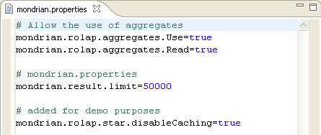
Result Cache
Mondrian caches results
Speeds up repeated drill down/roll up operations
On by default, needs explicit “disable”:

Slide 78
Mondrian and XMLA

Slide 79
XMLA
XML for Analysis (XMLA) is a de facto « standard» API for OLAP
XMLA allows client applications to talk to multidimensional data sources.
XMLA is a specification for a set of XML message interfaces that use the Simple Object Access Protocol (SOAP) to define data access interaction between a client application and an analytical data provider working over the Internet
Using a standard API, XMLA permints to access to multidimensional data from varied data sources through web services that are supported by multiple vendors (Microsoft, Mondrian, etc…)

Slide 80
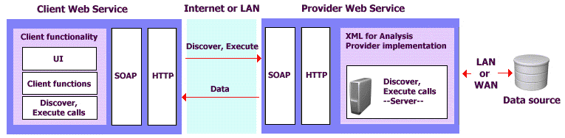
XMLA

Slide 81
Mondrian as XMLA provider
MortaliteEU
SQL Server
In datasources.xml
<?xml version="1.0"?>
<DataSources>
<DataSource>
<DataSourceName>MortaliteEu</DataSourceName>
<DataSourceDescription>
  Données sur la mortalité en Europe
</DataSourceDescription>
<URL>http://localhost:8080/jpivot/xmla</URL>
<DataSourceInfo>
Provider=mondrian; Jdbc=jdbc:microsoft:sqlserver://localhost:1433;DatabaseName=mortalityEU ; JdbcDrivers=com.microsoft.jdbc.sqlserver.SQLServerDriver;
Catalog=/WEB-INF/schema/MortaliteEU.xml;
JdbcUser=sa1; JdbcPassword=‘test’
</DataSourceInfo>
<ProviderName>Mondrian Perforce HEAD</ProviderName>
<ProviderType>MDP</ProviderType>
<AuthenticationMode>Unauthenticated</AuthenticationMode>
</DataSource>
Jdbc
MortaliteEU.xml
Mondrian
XMLA
Client
Jpivot

Slide 82
XLMA Query in JPivot
<jp:xmlaQuery
id="query01"
uri="http//localhost:8080/jpivot/xmla"
catalog="mortalityEU">
select {[Measures].[Ndeaths]} on columns,
{([Countries], [diseases])}on rows
from mortalityEU
where ([temps].[2000])
<jp:xmlaQuery/>

Slide 83
Contacts
Sandro Bimonte
INSA Lyon
  Sandro.Bimonte@insa-lyon.fr
  http://liris.cnrs.fr/~sbimonte/index.htm
Pascal Wehrle
INSA Lyon
  Pascal.Wehrle@insa-lyon.fr

