Slide 1


Measuring Software Sustainability

Slide 2
Outline
Objective
Introduction
Software Sustainment
Sustainment team
Sustainment organization
Life Cycle
Sustainment Process Model
Measures
Validation and Sustainability Assessment
Summary

Slide 3
Objective
To provide a context for evaluating sustainability
To discuss a set of measures developed by Software Engineering Institute (SEI), at Carnegie Mellon Unv. PA

Slide 4
Introduction
A common problem: the results are inconclusive as to the status of the sustainment activity
Software Sustainment: interchangeable with “software maintenance”
Software maintainability: software system or component can be modified to correct faults, improve performance or other attributes, or adopt to a change environment
Software Sustainability: to modify a software system based on customer needs and deploy these modifications

Slide 5
Software Sustainability
Sustainment organizations
Sustainment team
(The customers)
Operational domain
Software Artifacts
Sustainability measure is a combine measure of all 4 areas

Slide 6
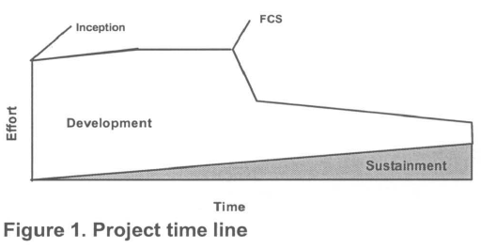
Software Life Cycle
Hypothetical software project
Classical software life cycle does not account for evolutionary software development, legacy system modernization, or incremental replacement.
Sustainment activities start early in the life cycle even before the first customer ship (FCS)
Sustainment activities usually of a smaller scale than development activities
Shift from development to sustainment is usually caused by a decrease in resources allocated to the development process

Slide 7
Sustainment Process Model
Assumption: IEEE maintenance standard used to differentiate it from the lower-level processes reporting and correcting defects
IEEE maintenance Process:
Problem identification
Classification: corrective, adoptive, perfective, or emergency
Prioritization: analyzing modification request to determine to accept, reject, or further evaluate

Slide 8
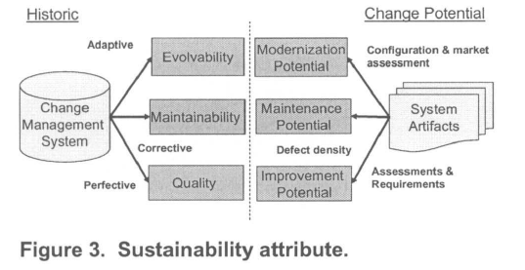
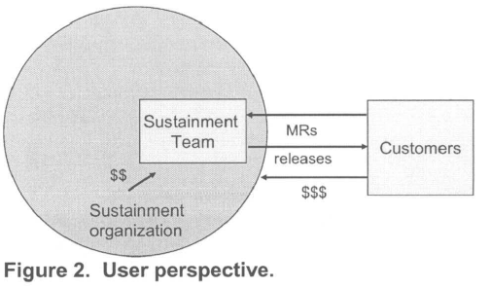
Sustainability Attribute
Dimensions of Sustainability Attribute
Explicit and implicit customer needs
Classification of corrective, adaptive and perfective defects
adapted users perspective the most comprehensive view of the process
To measure the sustainment process of the exchange between the sustainable team and the customer
Measuring historic attributes of evolvability, maintainability and quality as well as the
Potential for modernization, maintenance and improvement

Slide 9
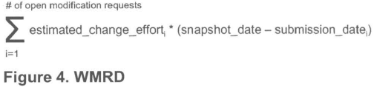
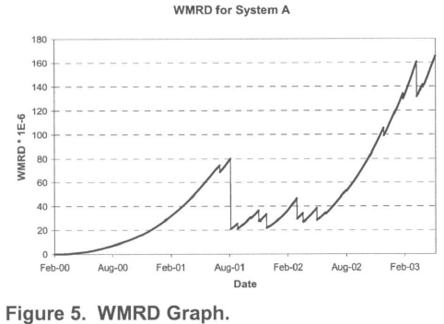
Measures
Historic Measures: Indirect measures of explicit needs. Measure of the ability of the sustainment team to perform adaptive, corrective and perfective maintenance process.
e.g: to measure the evolvability of a system. Direct measures of 3 attributes if the adaption process: the effort, time and number of adoption requests made
WMRD= Weigheted Modification Request Days
Measures the historic capacity of a sustainment team to satisfy each classification of MR from a user perspective
Decreasing WMRD improved sustainability
Increasing WMRD deteriorated sustainability

Slide 10
Measures
Change Potential Measures: capture the potential modification request to close the gap between the actual and desired properties of the system
Modernization Potential (adaptive): difference between current tech and the target tech (estimating cost of modernization)
Maintenance Potential (corrective): system defect prediction model
(#of predicted undiscovered defects) x (average effort required to repair each defect )
Improvement Potential (perfective): difference between existing system qualities and desired system qualities
Cross-over Effects must be considered

Slide 11
Validation and Sustainability Assessment
WMRD has been the topic of extensive argument and discussion among the authors and between the authors and external reviewers, and has been considerably evolved through this process
Several sustainment assessments have also been performed, and the collected data is being analyzed to further validate the measure.
None of the data collected so far indicates that the measure is invalid for its intended use in measuring the exchange of modification requests and software releases between the sustainment team and the customer
Assessment:
An assessment is performed in three steps.
First, a questionnaire is completed by the sustainment team.
Second, an on-site visit is conducted to correct any deficiencies in the data and agree on a procedure for completing the assessment (including assigning roles and responsibilities).
The final analysis of the data is performed by the assessment team.

Slide 12
Summary
Measuring software sustainability provides a basis for measured improvement
Sustainability measures created and overall, comprehensive set of measures of sustainability
The measure is sensitive to changes in the sustainment organization, the sustainment team, the operational domain and the maintainability of the software artifacts

