Slide 1

TELECOM CUSTOMER CHURN CLASSIFICATION
CSE 454
Sedef Erdoğdu
1801042102

Slide 2
Contents
Project Explanation
Data Preprocessing
Target Variable Visualization (Churn)
Feature Selection
Logistic Regression Classification Implementation
Evaluation Model

Slide 3

Project Explanation
Churn rate is a metric that describes the number of customers that cancelled or did not renew their subscription with the company.
The aim of the Project is classifying the potential churn customers based on numerical and categorical features.

Slide 4
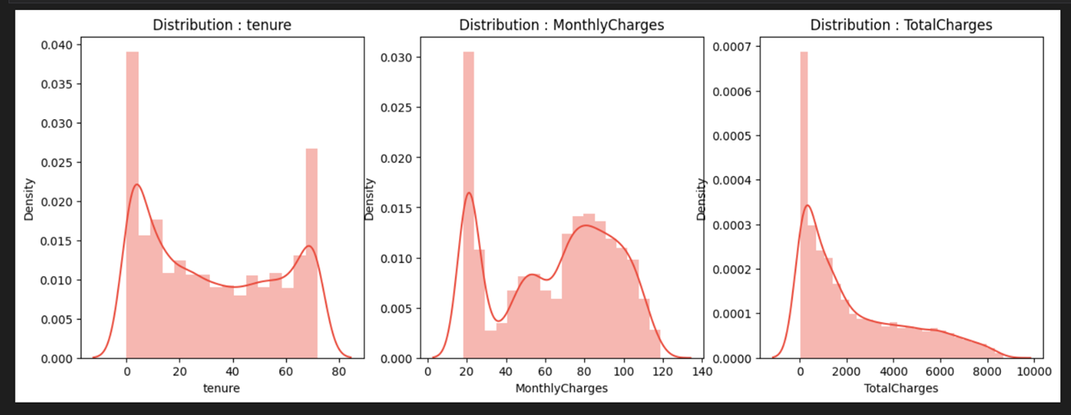
Data Preprocessing
Data cleaning for missing data
Normalization

Slide 5
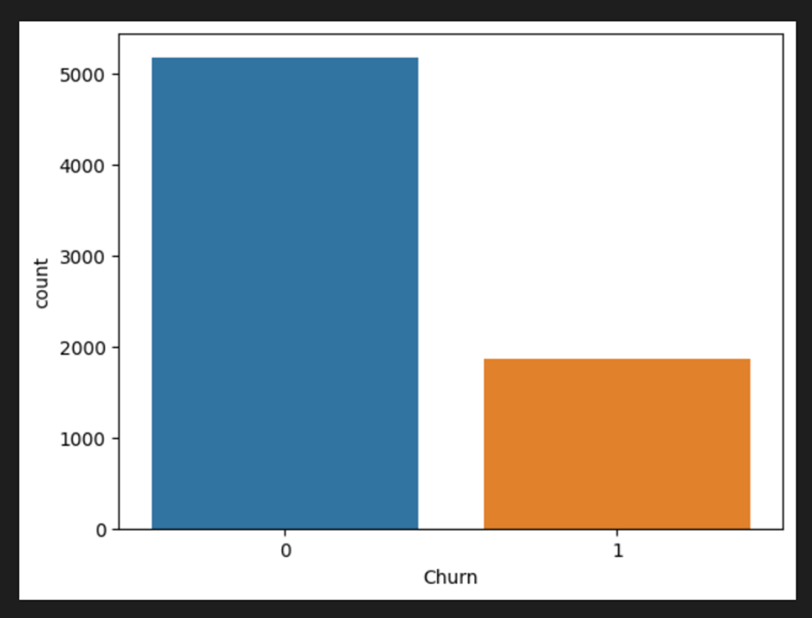
Target Variable Visualization (Churn)

Slide 6
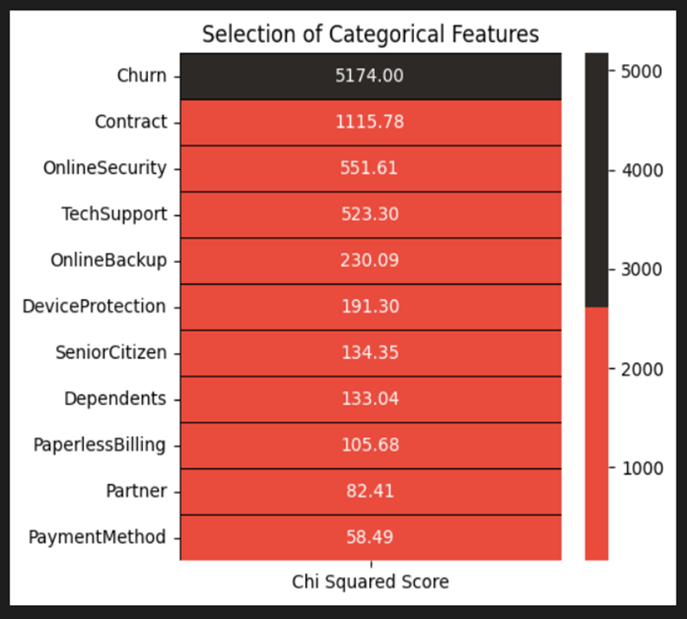
Feature Selection
Feature Selection for Categorical Features
Chi-Square Test

Slide 7
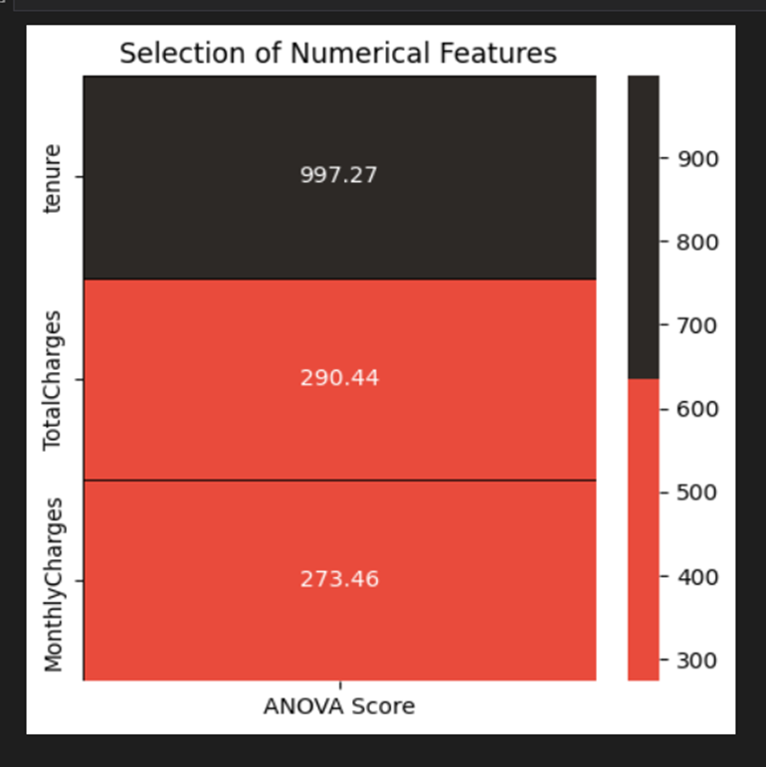
Feature Selection
Feature Selection for Numerical Features
ANOVA Test

Slide 8
Logistic Regression Classification Implementation
Logistic regression is a supervised learning classification algorithm used to predict the probability of a target variable. Logistic Regression Classification is a simple and efficient method that uses the logistic function (also called the sigmoid function) to model the probability of an instance belonging to a certain class.
The logistic function is defined by a sigmoid function.

Slide 9
Logistic Regression Classification Implementation
Logistic regression includes:
Sigmoid function
Cost function
Gradient descent function.
Predict function

Slide 10
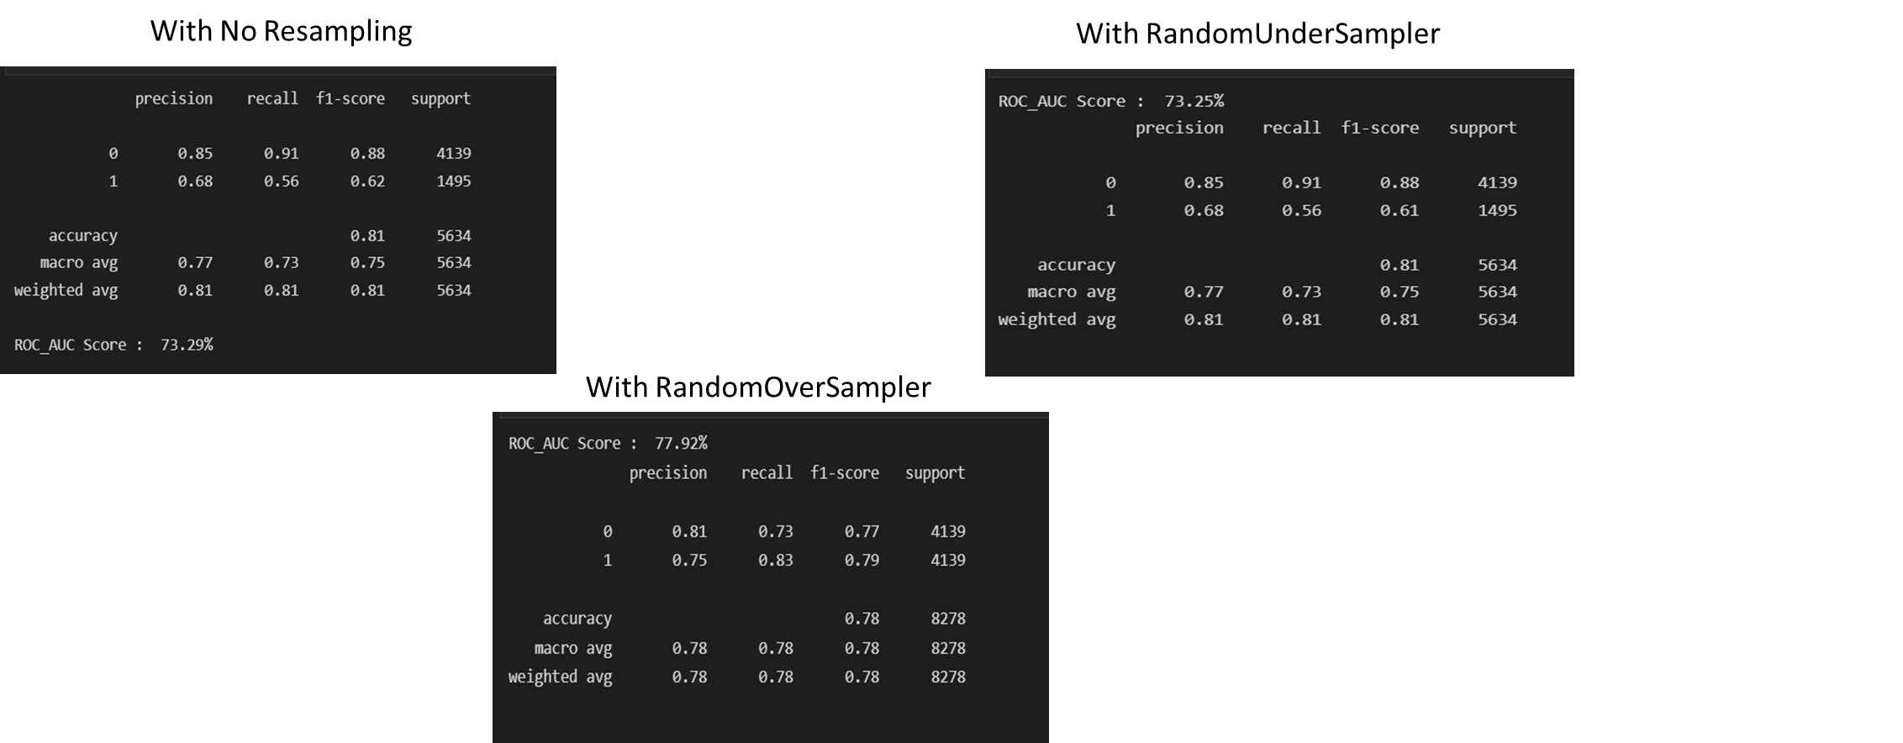
Evaluation Model

Slide 11
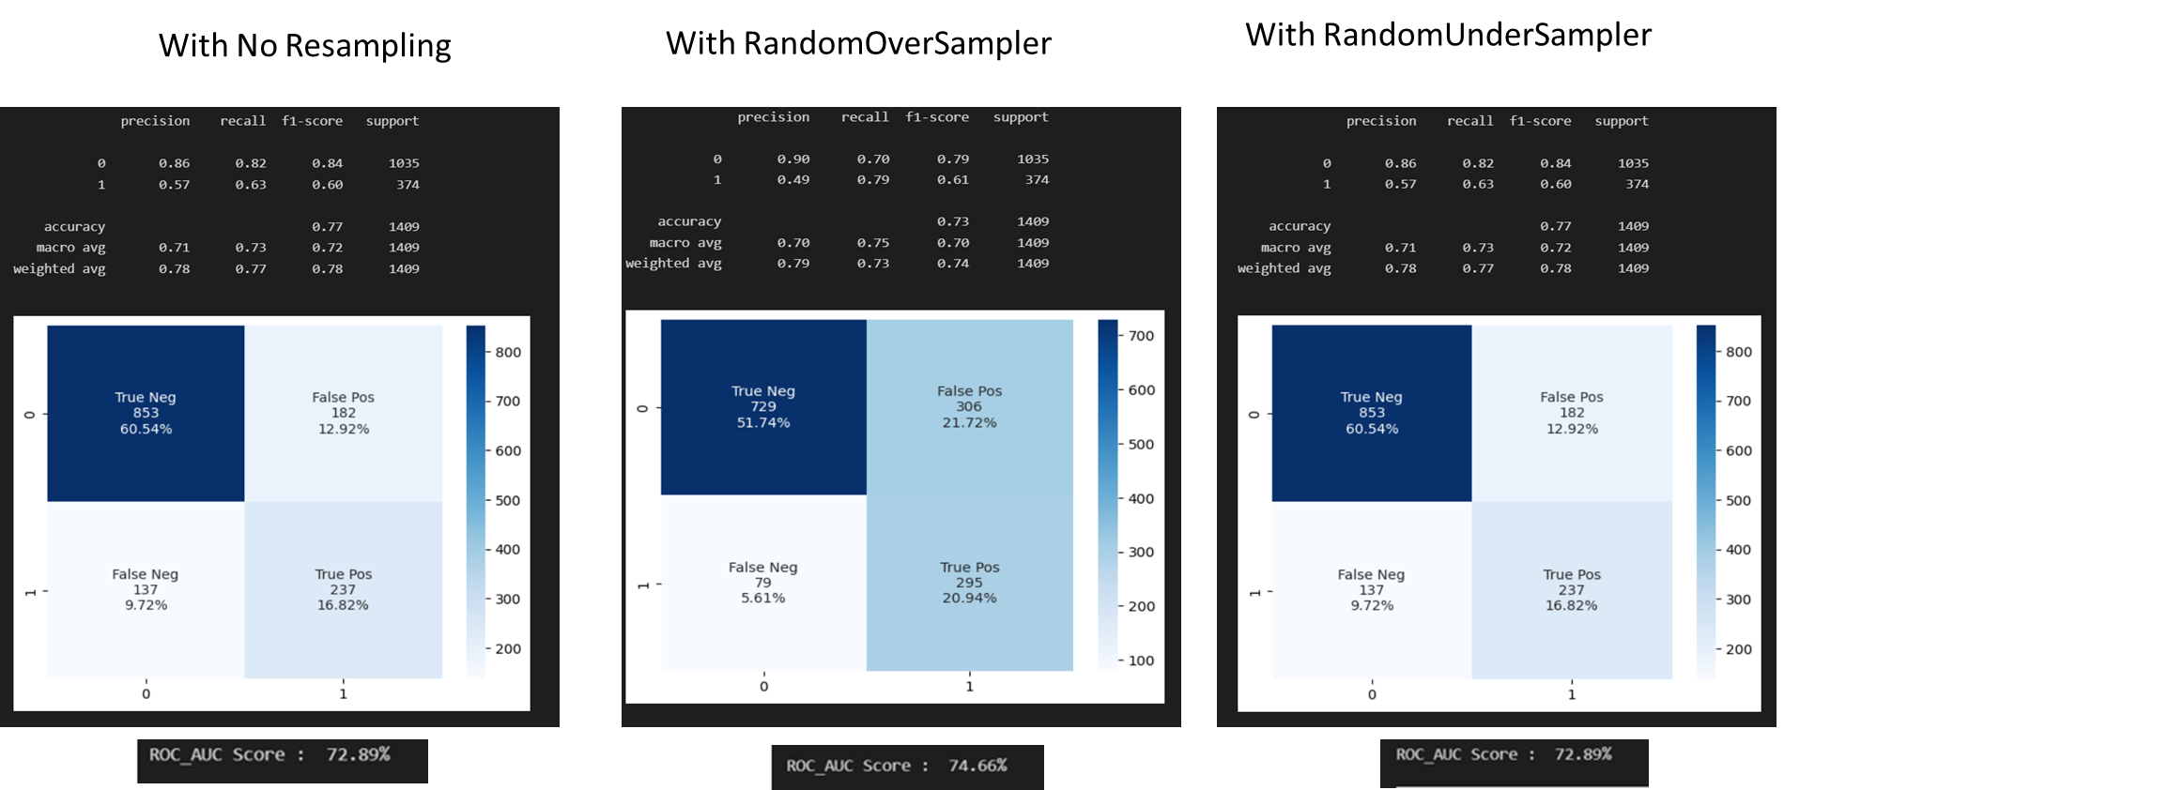
Decision Tree

Slide 12
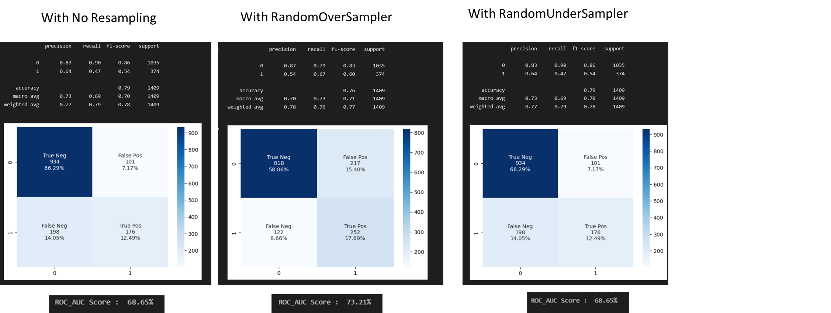
Random Forest

