Slide 1



Data learning
Курс “Машинное обучение”
Лабораторная работа
Course “Machine Learning” — Laboratory work
Data Analysis Laboratory
Topic: Linear regression and outlier detection (Variant 1-13)
[Surname] I.O., [Group], Variant 1-13
2023

Slide 2
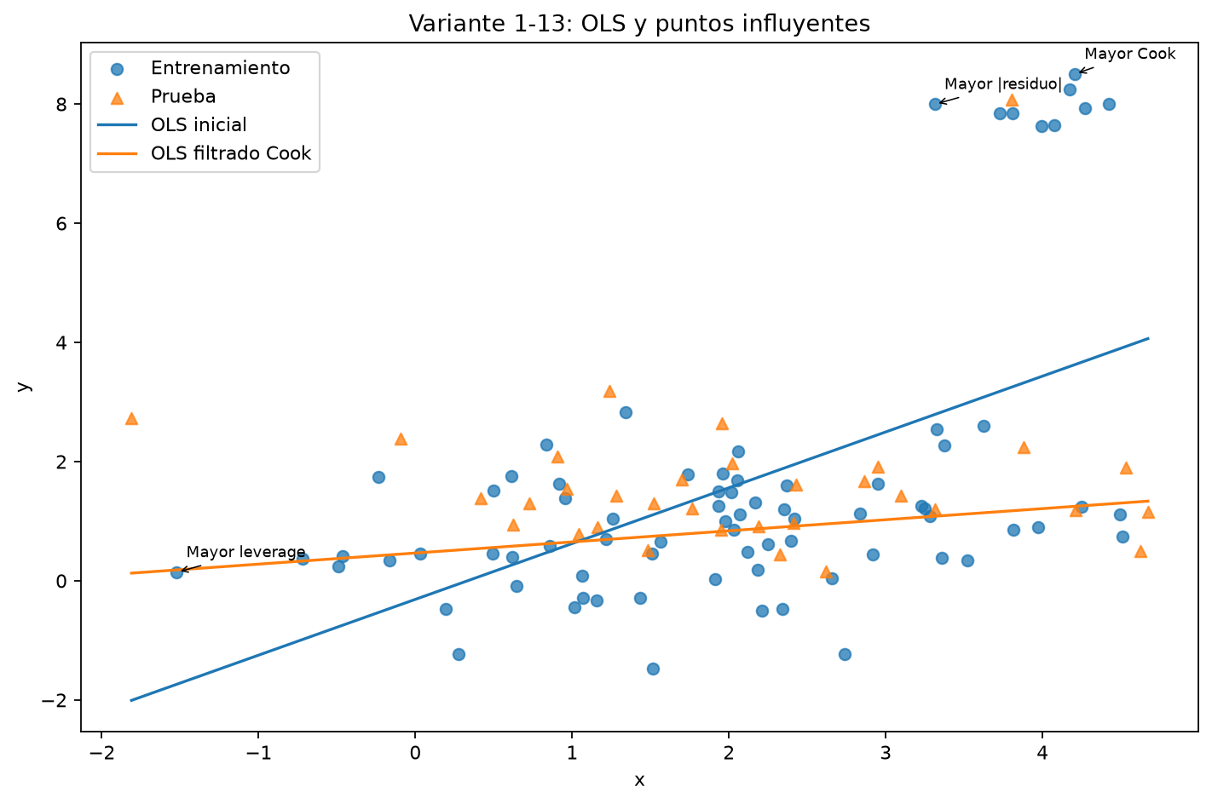
Initial data
Dataset: 110 observations, variables x (input) and y (output).
Holdout split 70/30 (random_state=42): 77 training, 33 test.
The relationship is roughly linear, with a group of extreme points at x≈3–4.5, y≈7–8.5.

Slide 3
Methods and formulas used
Model: y = β0 + β1·x + ε
OLS: β1 = Σ(xi−x̄)(yi−ȳ) / Σ(xi−x̄)² ; β0 = ȳ − β1·x̄
R² = 1 − SSE/SST
Standardized residuals: ri = ei / (σ̂·√(1−hi))
Leverage: hi (diagonal of the hat matrix)
Cook's distance: Di = (ei² / (p·σ̂²)) · hi / (1−hi)²
Filtering threshold: Di > 3·mean(D)

Slide 4
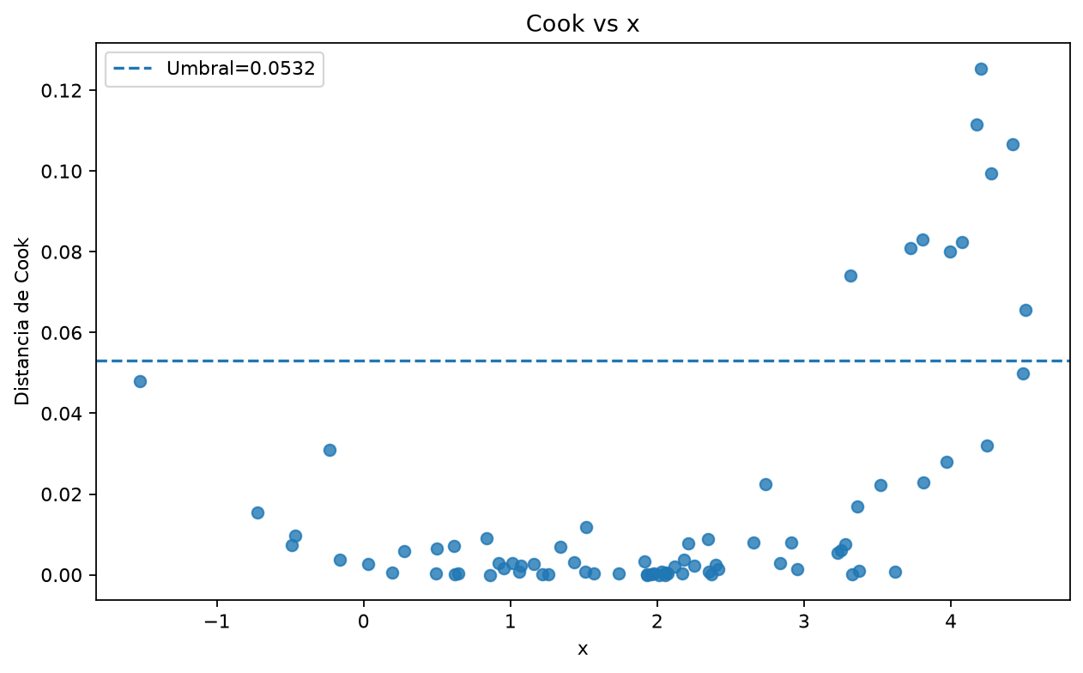
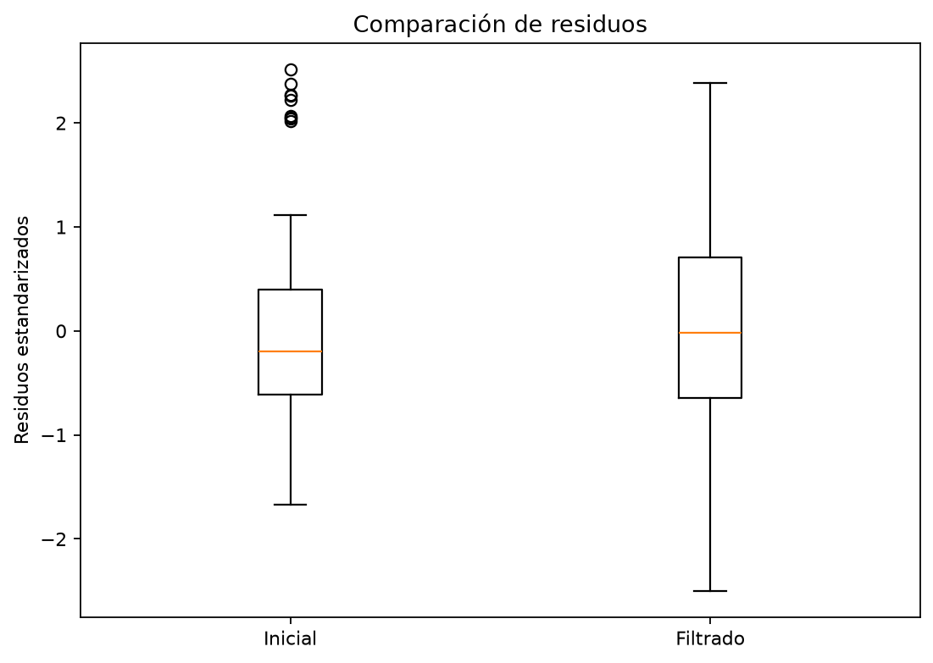
Research results
Initial OLS model: ŷ = −0.311776 + 0.936361·x
R² train = 0.290399 ; R² test = −0.935444
Max |standardized residual| = 2.513206 ; max leverage = 0.097313 ; max Cook = 0.125413
Cook threshold = 0.053161 → 10 observations excluded (n train = 67)
Filtered model: ŷ = 0.465597 + 0.186327·x
R² train = 0.067465 ; R² test = −0.376683

Slide 5
Conclusions
1. The initial OLS regression explains only a limited fraction of the variability and generalizes poorly (negative test R²).
2. Standardized residuals, leverage and Cook's distance are complementary diagnostics; no single indicator is sufficient.
3. After removing the 10 observations with Cook above the threshold, the slope changes from 0.936 to 0.186: those points strongly influenced the line.
4. The test R² improves from −0.935 to −0.377, but remains unsatisfactory.
5. Observations should not be removed automatically: check whether they are measurement errors or legitimate cases; explore nonlinear or robust models.

