Slide 1
Note: This tutorial is obsolete in the sense that from version SEDFIT 94 on, 6-channel data can be sorted easily with the following two steps :
Use the function in Loading Options→Save 6-channel data in 3 Subsets
Use the function in Loading Options→Sort Eq. Data
The following tutorial is only a work-around if you are using an older SEDFIT
version.

Slide 2
Data For This Tutorial:
We have an equilibrium run using 2 cells, #1 and #3, each with a 6-channel centerpiece, run at three speeds, 9k,10k,and 11k rpm, with absorbance scans taken at 1 wavelength (280nm).
Download the data by following the link
http://www.analyticalultracentrifugation.com/images/data1.zip
Before you begin, if intensity data (*.ri files) were collected from the equilibrium run,
convert the files to absorbance data (*.ra) by loading all the scans at once, then, from
the Loading Options, “save intensity data as absorbance data.
Now, scan files will also be listed as *.ra

Slide 3
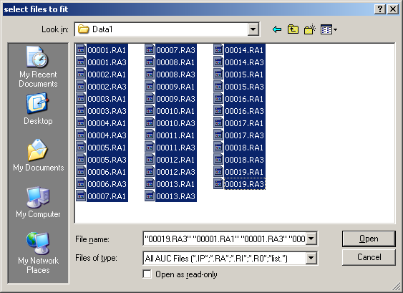
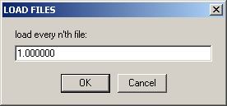
List all absorbance scans from the run. Highlight all the scans
and Open.
Open every scan, hit OK

Slide 4
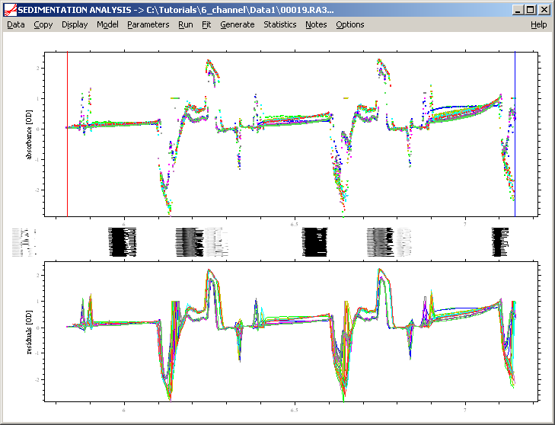
All the scans are opened in one window. Notice the 3 sectors of the 6-channel
center piece.

Slide 5
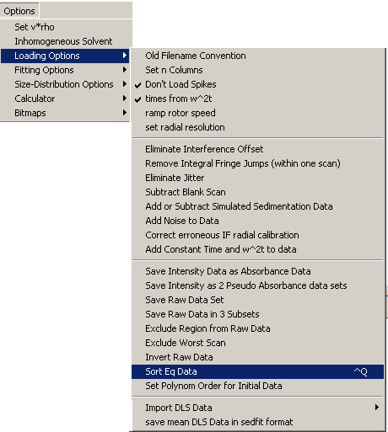
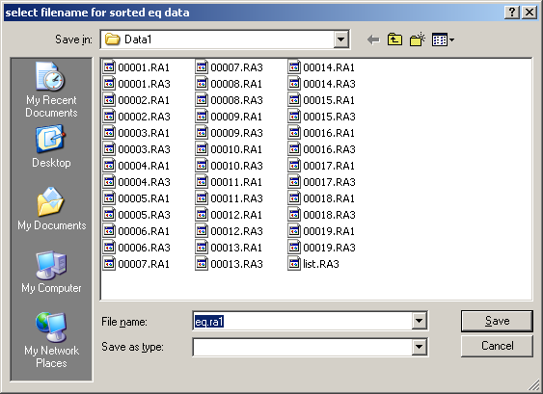
Use the “sort EQ data” loading option to save only the last scan from each cell at each speed and to list the wavelength and speed in the file name.
This window appears next. Find the proper
folder, and hit save

Slide 6
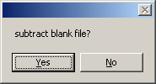
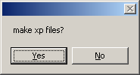
Then
If you have blank scans, subtract them here. After you
hit “Yes”, find the blank scan to subtract and save.
and
Hit “No” here. There is no need to make .xp files
at this point.

Slide 7
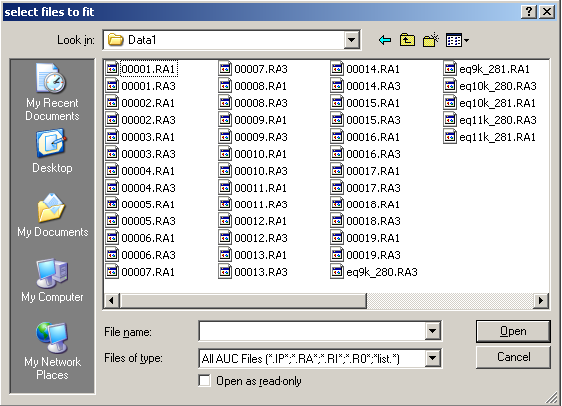
A list of all the scan files looks like this, with the 6 sorted scans at the end containing
both speed and wave length.
We now need to break each of these sorted scan files into sectors matching the 3
compartments of the 6-channel center piece.

Slide 8
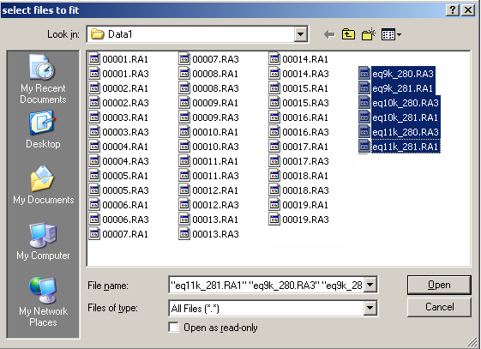
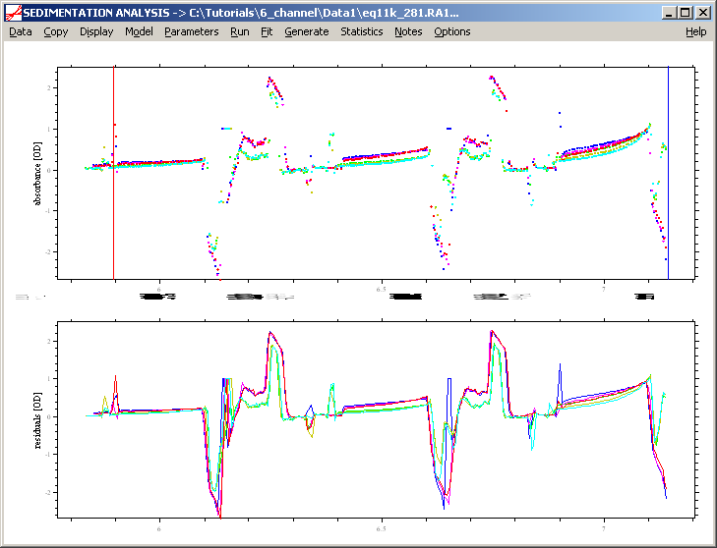
So, first open all the sorted EQ scans
at once.

Slide 9
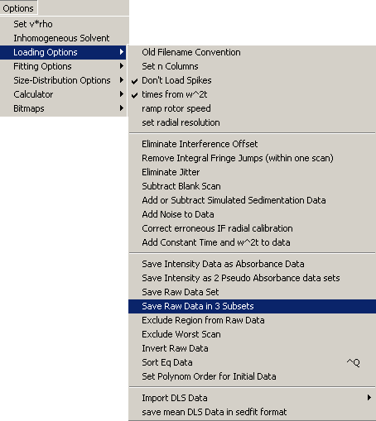
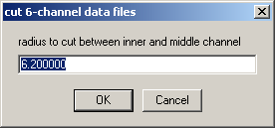
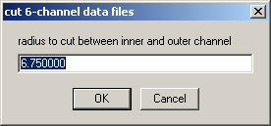
Then, from loading options,
“save the raw data in 3 subsets” to sort
The data into the three sectors of the
6-channel center piece.
Hit OK for these next 2 windows

Slide 10
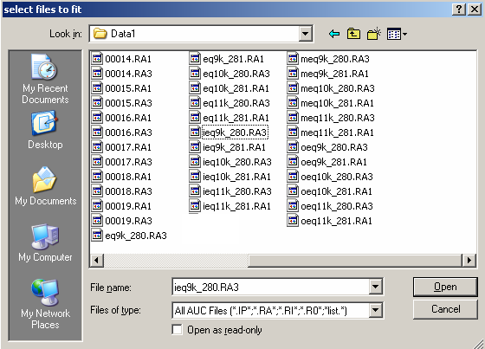
Now, the sorted scan files are listed by sectors. File names will start with
either “i” for inner sector, “m” for middle or “o” for outer sector. and will still have
the speed and wave length information in the file name.

Slide 11
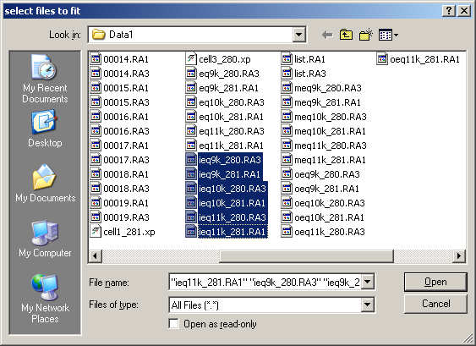
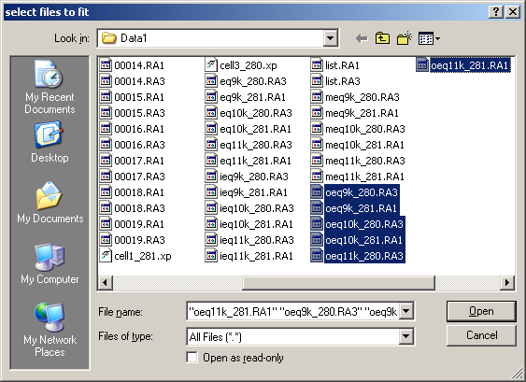
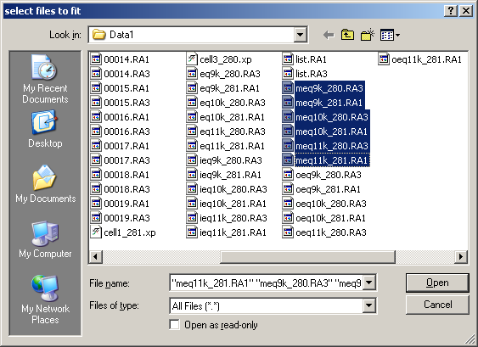
(here I have only highlighted the files of each sector, so that you can see the different names)

Slide 12
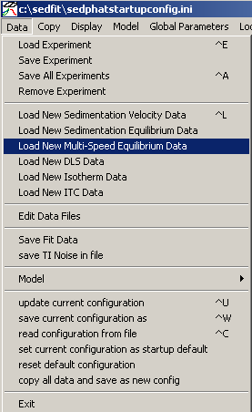
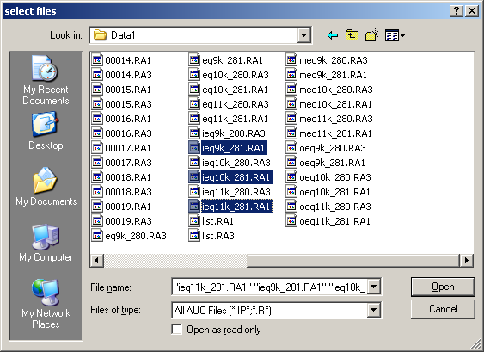
To analyze, from the Sedphat startup window, hold down the
Control key and highlight all the files from one cell, from one
sector at each speed and open.
If you have only a single speed, use the function
“Load New Sedimentation Equilibrium Data” instead

Slide 13
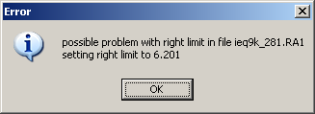
When this message comes up, hit “ok”.
(It just means that the outermost radial points of the different files are not all the same, this is no problem here. However, sometimes the XLA scans are truncated, bad scans, with only a few data points. That would show up here, and you could see that from the radius value shown.)

Slide 14
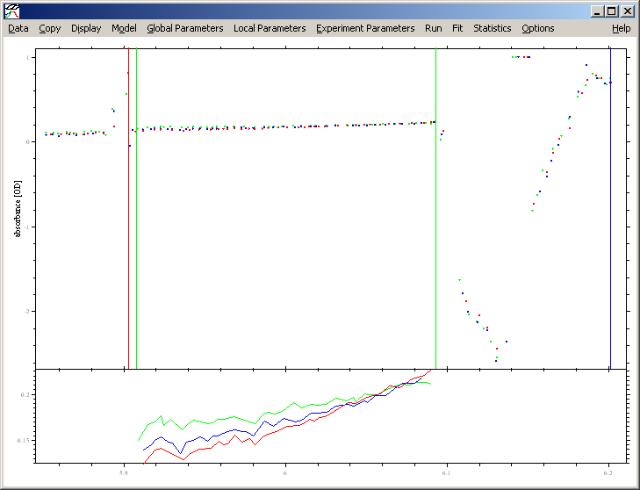
All three speeds from the inner sector of cell # 1

Slide 15
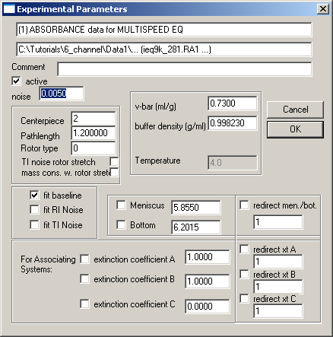
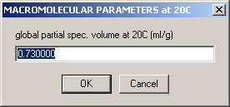

The experimental Parameters window will open too.
The default value here is 2,
so remember to change it to
6 in this case.
Also, enter other parameters,
like extinction coefficients, etc.
Then, save this multi-speed experiment
and give it a unique name

Slide 16
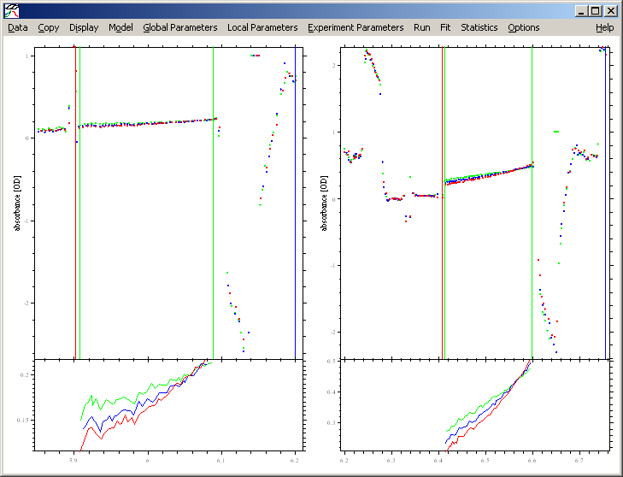
Using the same procedure, you can open the middle sector scans from cell # 1 and
load them in the same window and then the outer sector scans………………..
Cell # 1, inner sector at 9k,10k and 11k
Cell # 1, middle sector at 9k, 10k and 11k.
save the second multi-speed experiment, as well

Slide 17
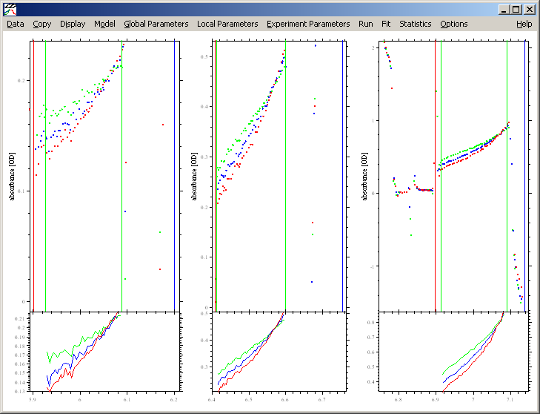
Cell # 1. 3 experiments loaded, each from a different sector and each containing
scans from 3 speeds at one wave length.
Inner sector middle sector outer sector

Slide 18
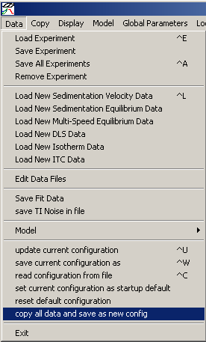
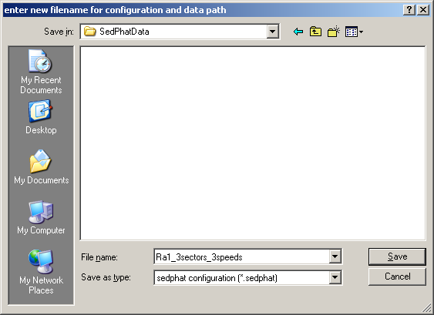
Save this configuration

