Slide 1
Captcha Recognition using Deep Learning
PROJECT STATUS REPORT – WEEK 13 PRESENTATION
Sukhdeep Singh (44442467)

Slide 2


Dataset
And its security features
The captcha dataset used consists of 4 to 5 characters challenges, these images fall into two domains
Clear captcha (no occluding lines and noise): A lot of WordPress websites still use this kind of text based captcha, which can be easily recognised by multitude of OCR and other attacks.
Noisy captcha with occluding lines and noise: As an added security measures some of the website this variant.
Number of Images: >20000
Description: Labelled by name, i.e filename represents the solution of captcha making it easy to validate the solution of the model. Different sizes, backgrounds and security features in the captchas.

Slide 3
Revised Scope (narrowed)
Are some captcha(s) challenges more difficult than others?
What techniques help design a secure captcha? (limited the discussion to specific types of captcha)
What techniques improve the learnability of CV algorithms to crack captcha? (limited to discussion to image segmentation & noise removal only)
Can we extend the same principle/learning to extract handwriting from text?
Which statistical techniques/classifier help us achieve highest accuracy in recognizing the captcha challenges?
Deploy the model as an API which can take the image input from a remote device such as phone
Further scope: Is the recognition trained on distorted images good enough to read product names and fetch its prices?

Slide 4
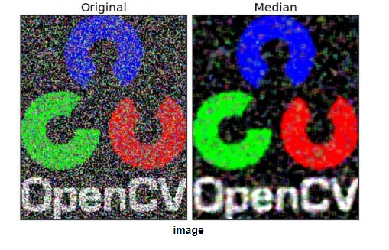
Techniques Used
To recognize the captcha Text
OCR with PyTesseract
KNN with Image segmentation
Neural network with Noise filtering (Median blur)

Slide 5
OCR – PyTesseract
In this conventional technique I use the inbuilt python OCR library called PyTesseract and attempt to read the images by the OCR using image_to_string function.
This technique is a hit/miss in terms of accuracy achieving 50% validation accuracy, on clear captchas whereas the OCR accuracy seems to drop fast when testing against noisy captchas.
In this case no pre-processing was done, and results are compiled by running the OCR on the set of labelled clear captchas and small subset of labelled noisy captchas (20)
OCR is configured with flag “--psm 10” to readout the single characters

Slide 6
KNN with Image Segmentation
In this technique I use opencv library to do image manipulation i.e. segmentation of the individual characters by identifying the boundaries and then try to classify the captcha segments by using a KNN classifier.
In this version I have a library of known segments of the characters i,e 0,1,….9 and A – Z which are use to calculate the Euclidean distance for classifying the segmented character.
The passed image is broken into segments by identifying the contours and in case the characters overlap we take the mean distance as boundary. Each segment is predicted by the knn model and the result is 4 char output for the captcha result.
Model performs significantly better than OCR on clear captchas, noisy ones are still hit or miss.

Slide 7
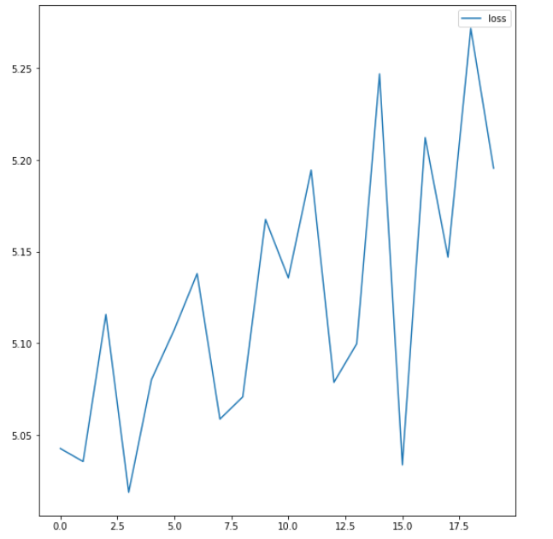
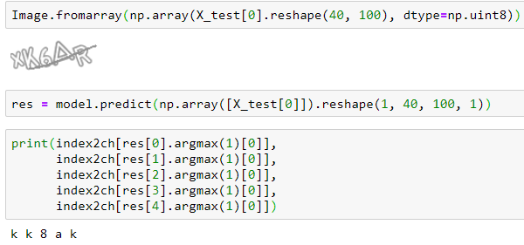
Neural Net
With Noise Filtering
In this technique I use a neural network with architecture similar to LeNeT-5, the top for layers are used for the learning of the features and the bottom 5 layers serve as outputs for the captcha characters.
To remove the salt and pepper noise we use the median blur function from OPEN CV2, for handling the occluding line efforts are still in progress. Accuracy on noisy ~55% and on clear captchas ~85%
Model still needs tuning and here are is an overview of current state:

Slide 8
Challenges + Further reporting
My experience of dealing with noisy images was limited and given the vast scope of noises available today in the captcha images it is difficult to develop a sophisticated & generalised solution. Some of the security counter measures (certainly there are more) I came across which I have not tackled in the scope of this project:
Skewed and Random rotation
Animated captchas
Variable font size/ spacing
Varied charset
For the final report in addition to tracking the accuracy of the various models, I intend to track how each of the models performs on the different categories of captcha. See how basic pre-processing & normalization can help in the recognition rates of the different models.

