Slide 1


geecorn
login
password
Login

Slide 2
geecorn
login
password
Login

Slide 3
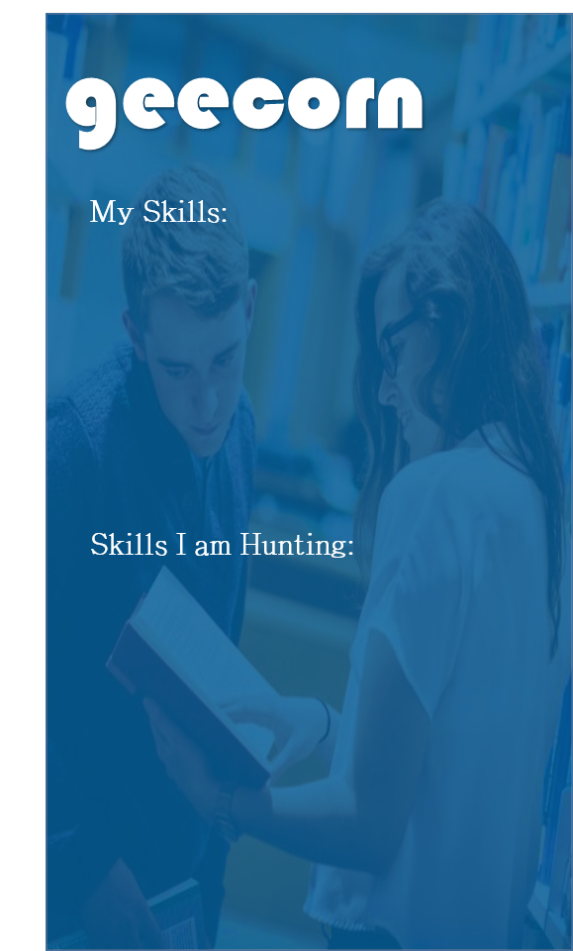
geecorn
My Skills:
Discover Geeks
Skills I am Hunting:

Slide 4


geecorn

Slide 5


geecorn
245
Python | Linux | Big Data | JS
Geecorn Score
Flutter | Unity-3D | SolidWorks
Skills I know
Skills I am looking to learn
Alex Johnson
The best thing about a boolean is even if you are wrong, you are only off by a bit. But still it hurts to know that either we will match or we won’t!
Like
Short Bio

