Slide 1
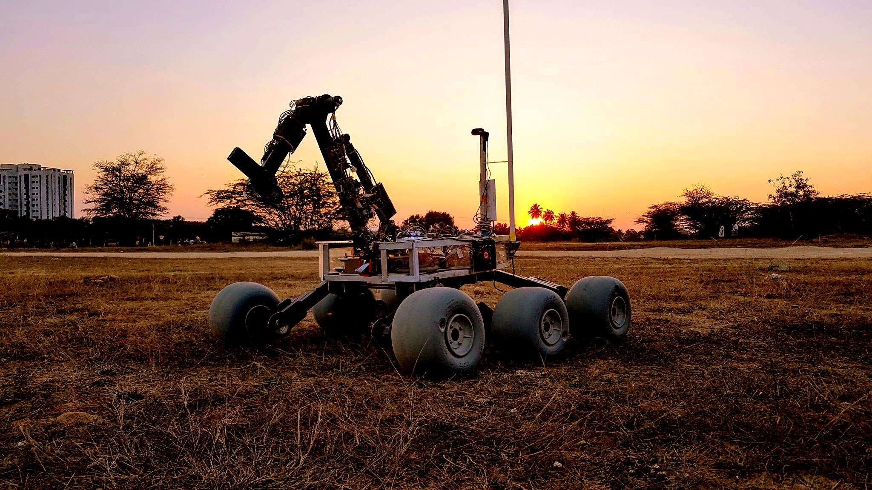

SCIENCE TASK

