Slide 1
COVID RACCOON
Enough of Thanos, let the raccoon now fight the real Covid virus

Slide 2
Characters
PowerPoint has been used to design raccoon characters.
This power-point consists of all those characters.

Slide 3


Raccoon: Walking

Slide 4


Raccoon: Jumping

Slide 5
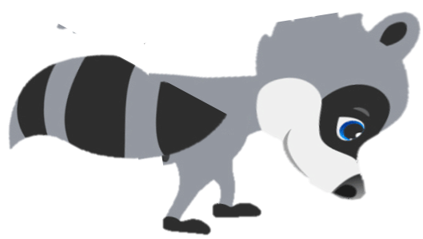
Raccoon: Dodging

Slide 6
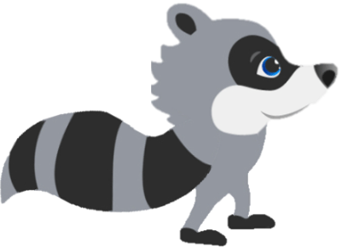
Raccoon: Dodging

Slide 7

City
COVID RACCOON

Slide 8

City
COVID RACCOON: SAVE THE CITY

Slide 9
City
COVID RACCOON: SAVE THE CITY

Slide 10
City
COVID RACCOON: SAVE THE CITY

Slide 11
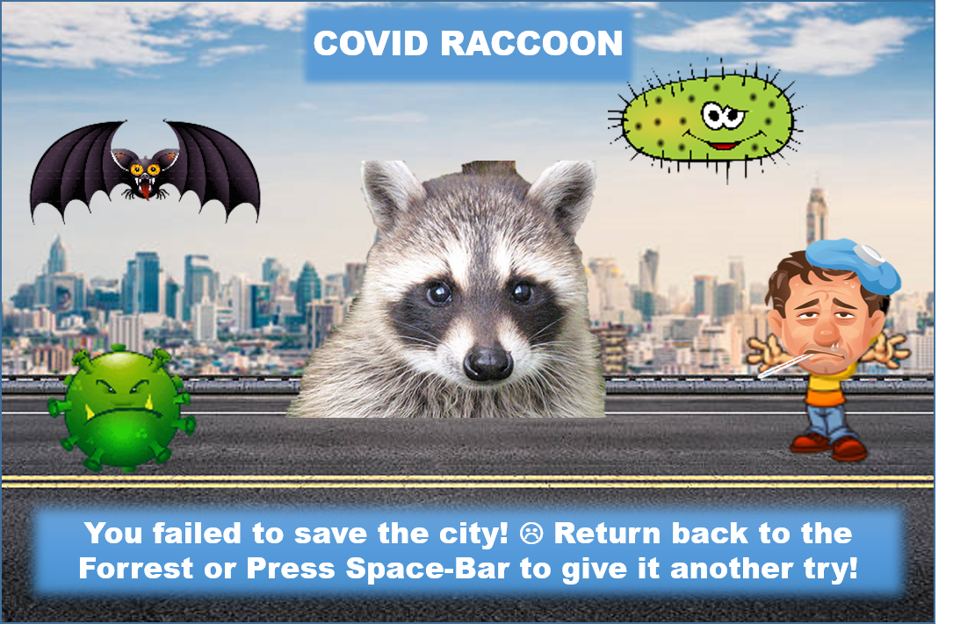

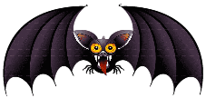
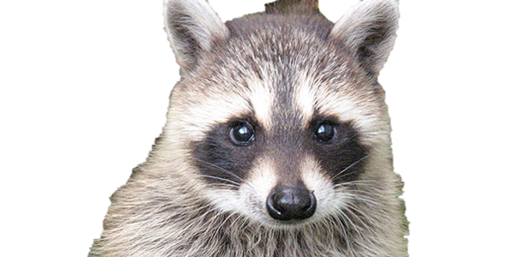
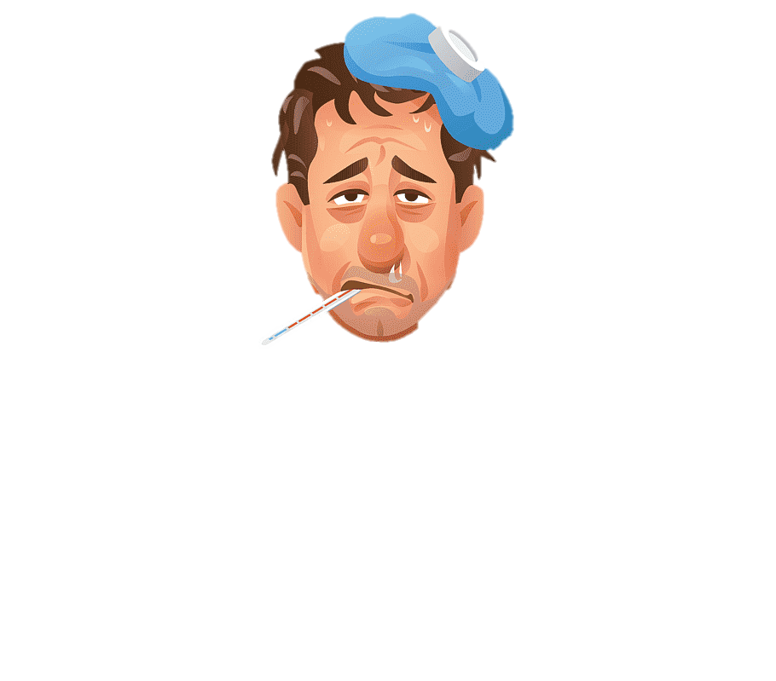


City
COVID RACCOON
You failed to save the city! ☹ Return back to the Forrest or Press Space-Bar to give it another try!

Slide 12

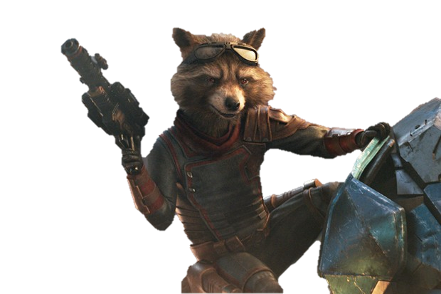
City
COVID RACCOON
Congrats! You sanitized the City! Now try to sanitize the town with increased difficulty! All the best!

Slide 13
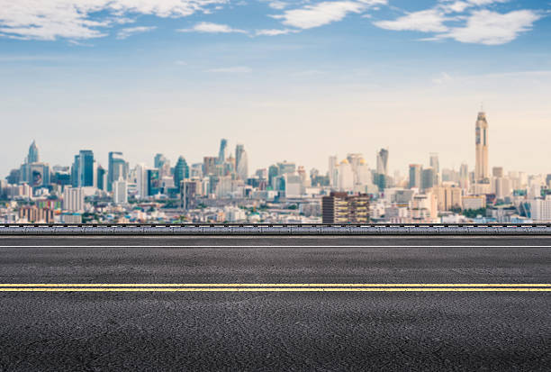
v
v
v

Slide 14
v
v
v

Slide 15
v
v
v

Slide 16
