Slide 1
COVID RACCOON
Enough of Thanos, let the raccoon now fight the real Covid virus

Slide 2
Characters
PowerPoint has been used to design raccoon characters.
This power-point consists of all those characters.

Slide 3
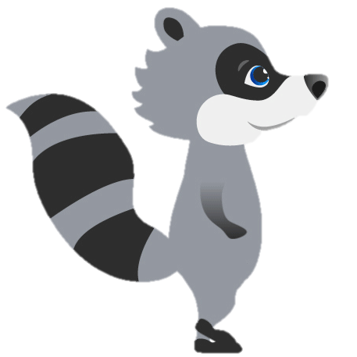
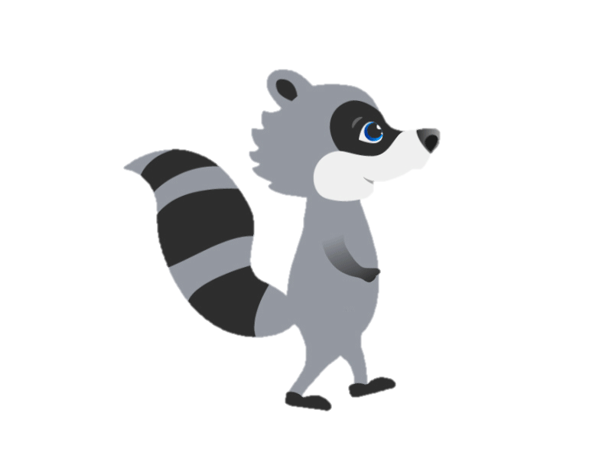
Raccoon: Walking

Slide 4

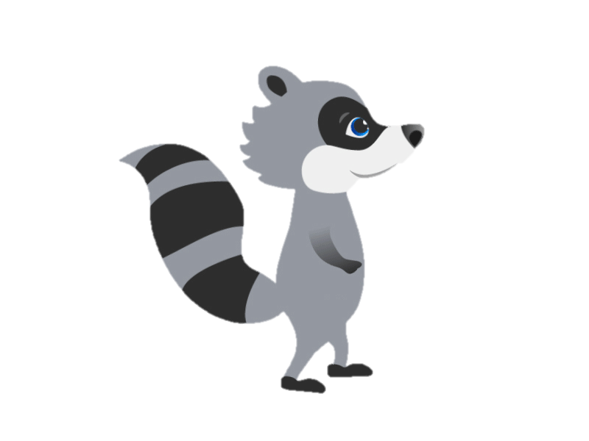
Raccoon: Jumping

Slide 5
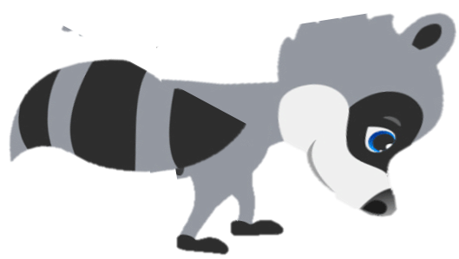
Raccoon: Dodging

Slide 6
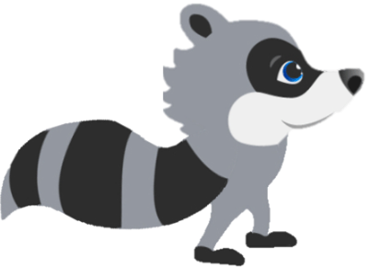
Raccoon: Dodging

Slide 7


City
COVID RACCOON

Slide 8
City
COVID RACCOON

Slide 9
City
COVID RACCOON

