Slide 1

Hack for Homelessness
Team Hungrant

Slide 2
Methodology
A web app interface that allows the user and authority to be connect via http requests.
The functionalities in the solution include:
Make my contribution
NGO Check
Raise the Message (Spread Awareness)
Register a Homeless
Share a Homelessness moment
My Reward Points
The project focuses on connecting the users all over the world and becoming a helping hand for the homeless people by assisting the authorities to reach the right users and receiving the reward points accordingly.
The project also helps individuals make contributions in terms of monetary, clothes, blankets, daily commodities, etc.

Slide 3









Process Flow
Make my Contribution
NGO Details
Details about NGOs and charities
Spread Awareness
User and their contribution details
My Reward Points
Shelter and Food details
Server
User
Register
Homeless
Registered homeless people details
Share a
Moment

Slide 4
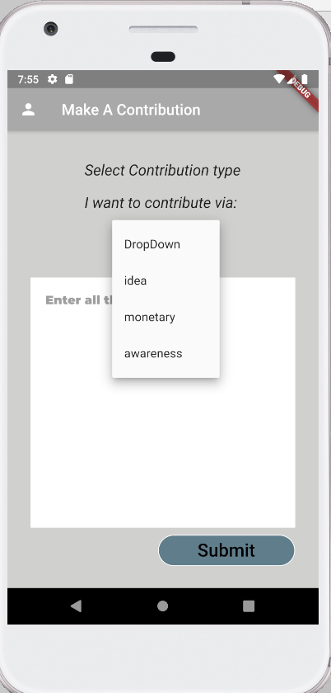
User Contribution
Enables Users to Contribute in terms of Monetary and Ideas.
Also allows users to spread awareness about various campaign programs.
Enables reward points based on each milestone attained.

Slide 5
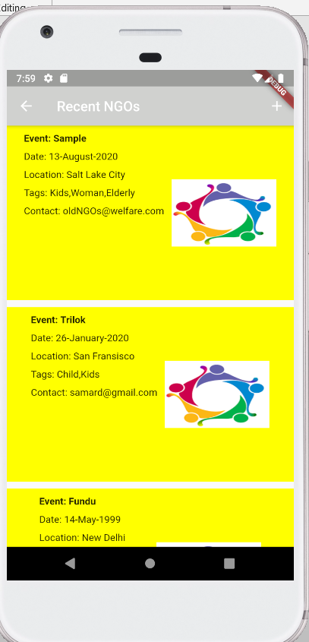
NGO Campaigns and Charities
Charity events and other campaigns can be uploaded by the admins.
These events help in getting insights of how the homelessness can be eradicated from the places.
Specific tags suggest who are the targeted people, for example women or children or disabled ones.
These data can be browsed in real time by all the app users.

Slide 6
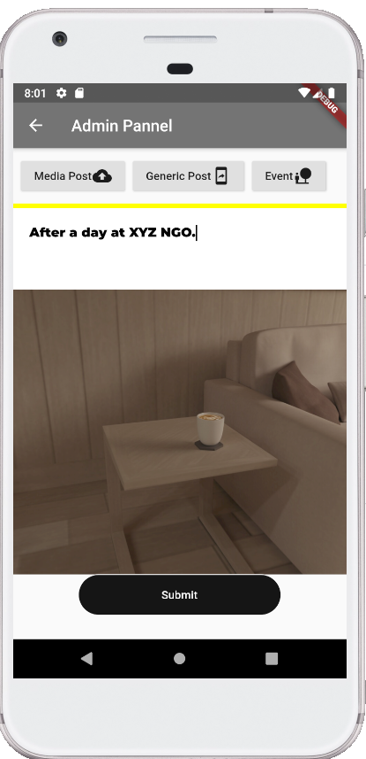
Share Moments
Share your Homelessness moment.
Found anything worth sharing? A room or a person shivering in the cold in a need of blanket? Everything can be shared via this function.
Currently this feature is getting upgraded for generic audience

Slide 7
Improvements in the current product
Biometric scan is under progress.
Real time location tracking and sharing.
Robust and secure transaction system.
Improving features and functionality.

Slide 8
Thank You…
Let’s make this world a better place to live in…
☺ ☺ ☺ ☺

