Slide 1









Outline
Background information
LA588
Web mapping-spring 2023
Sedi Ghiasi
Prof, Seeger
Methodology
Improvments
Contribution
Methodology
Results
Discussion
Credit: https://www.britannica.com/place/Des-Moines

Slide 2

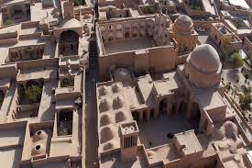
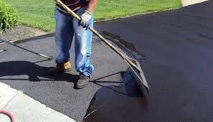

Importance of Urban Microclimate
A report published by the Organization for Economic Co-operation and Development (OECD) indicates that GHG emissions will increase 50% by 2050, if the current global policies on mitigating climate change remain unchanged (OECD, 2010).
Microclimate definition
Climate near the ground
Microclimate is the suite of climatic conditions measured in localized areas near the earth's surface

Slide 3
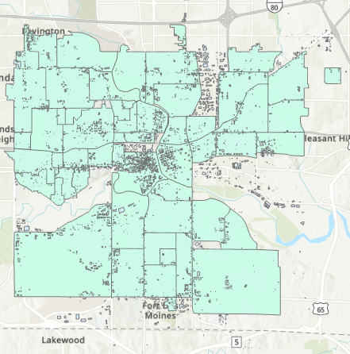
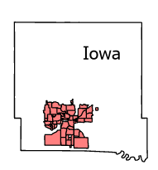
City of Des Moines
56 neighborhoods
123,627 buildings
Trees(raster)
join
buildings(raster)
Calculated field
buildings(excel)

Slide 4
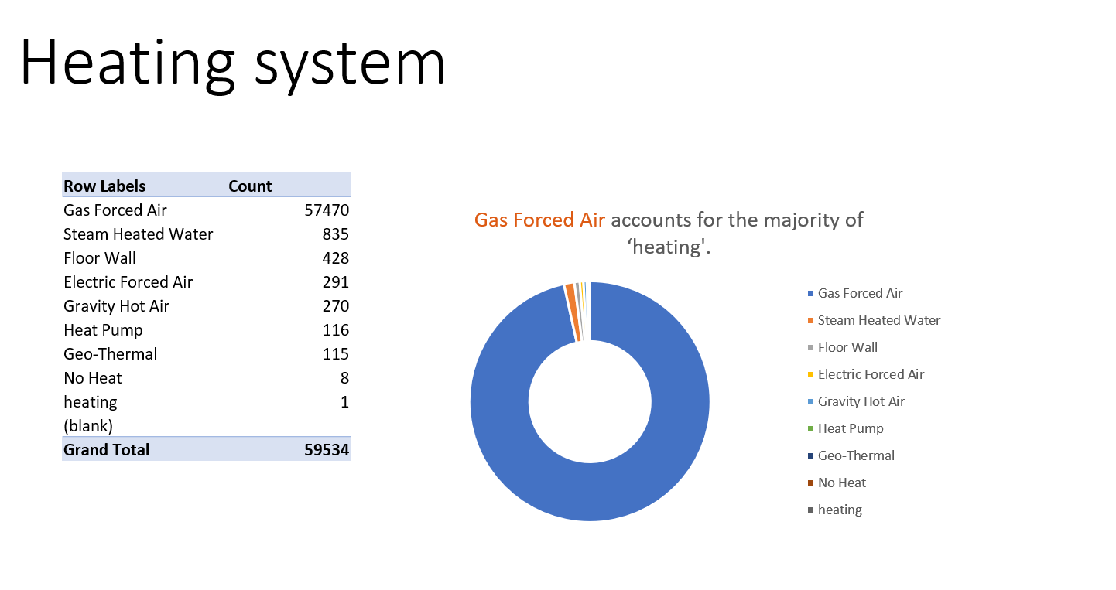
Data visualization using excel.

Slide 5
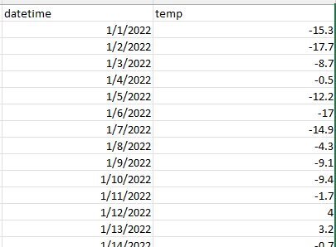
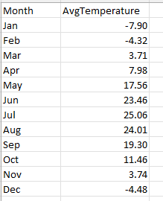
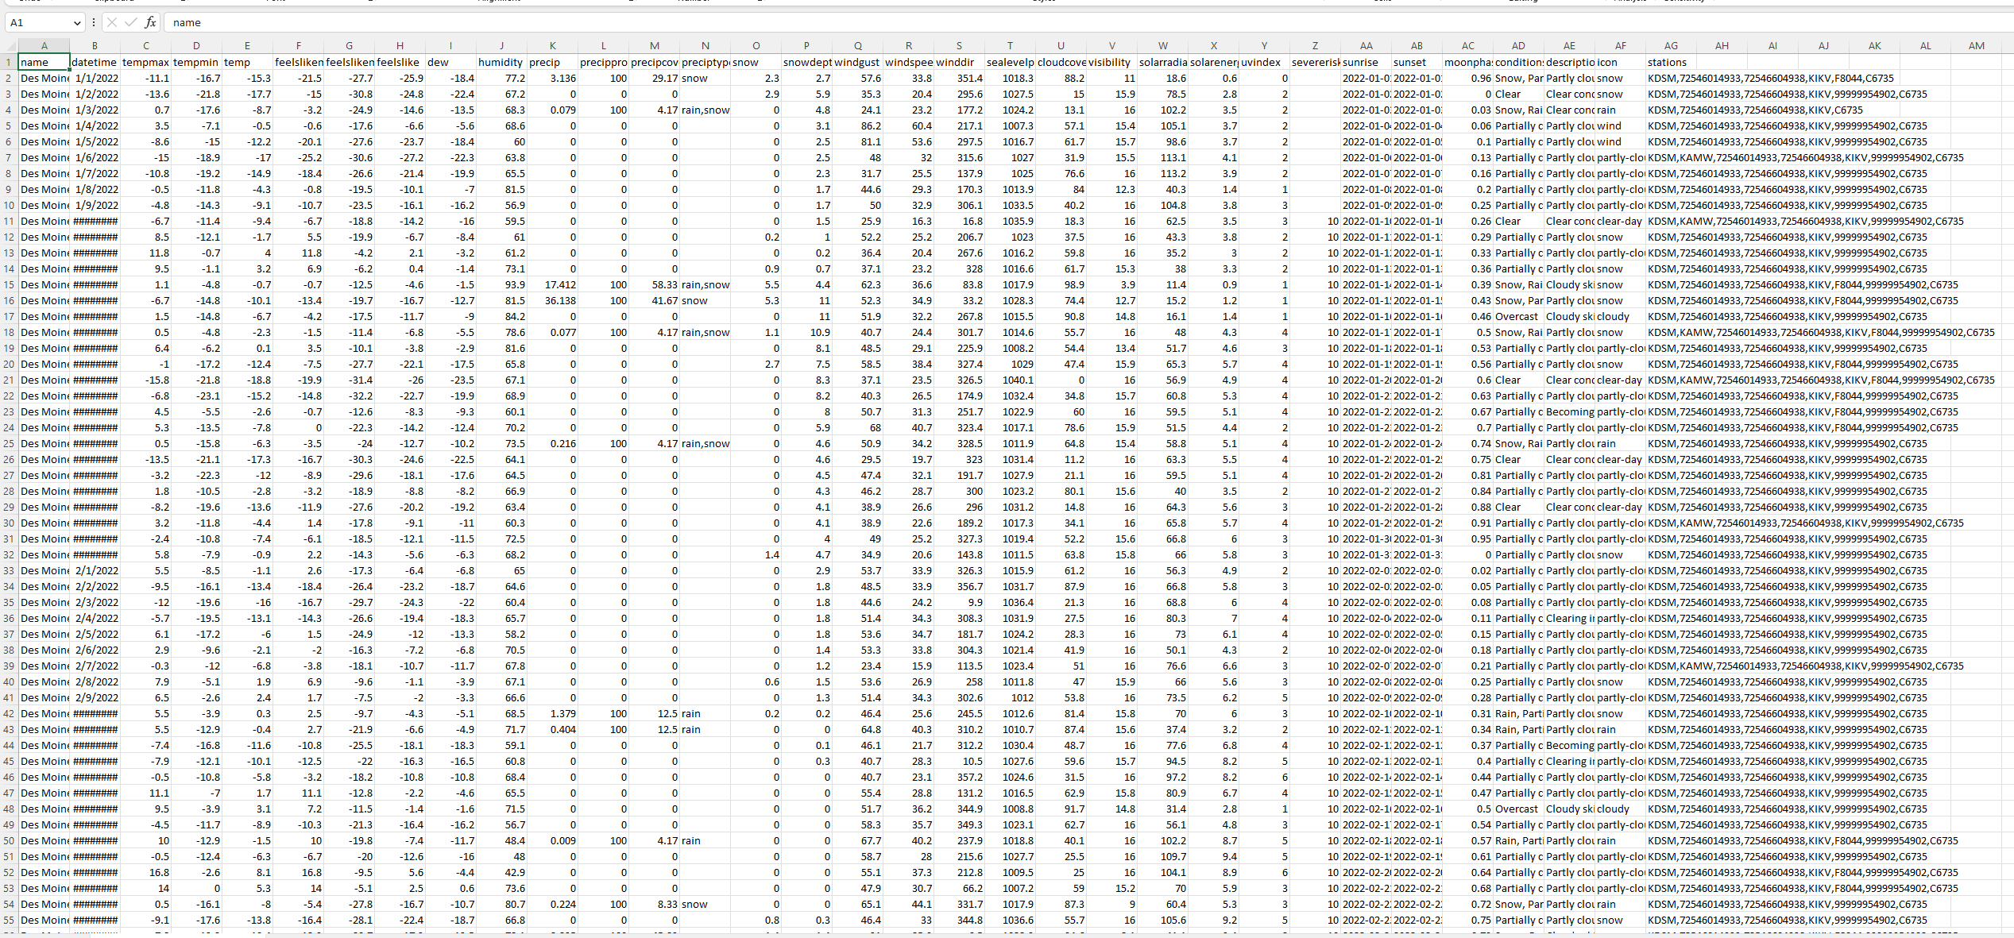
Challenge 1- cleaning excel file
1-Dropping unnecessary columns
2-Converting datetime to Date format(MM/DD/YY)
3- Calculating temp per month

Slide 6
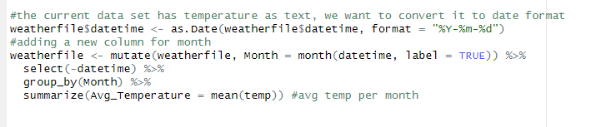
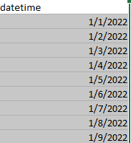
Challenge 1
"%Y-%m-%d" : Year-month-day
"%m/%d/%y" : Month/day/year (short year)
"%m/%d/%Y" : Month/day/year (full year)
"%d/%m/%Y" : Day/month/year
"%b %d, %Y" : Month abbreviation-day-year (e.g. Jan 01, 2023)
"%A, %B %d, %Y" : Weekday, month, day, year (e.g. Sunday, January 01, 2023)
"%Y-%m-%d %H:%M:%S" : Year-month-day hour:minute:second

Slide 7
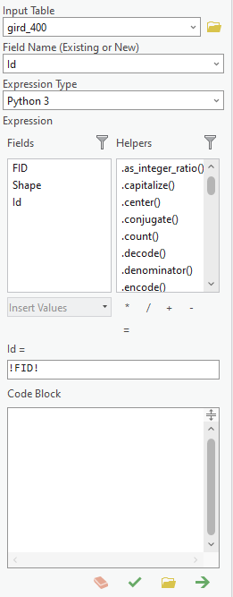

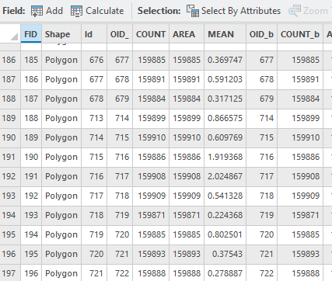
Challenge 2- Importing shapefiles from Arc GIS pro
Error in fix.by(by.x, x) : 'by' must specify a uniquely valid column
names(building_excel)
> names(building_excel) [1] "OID_b" "FID" "COUNT_b" "AREA_b" "MEAN_b"
An identifier in Arc GIS pro
after reading it using the st_read() function from the sf package in R, the FID column get disappeared, as it is not a required attribute of the shapefile format
,so I had to create an equivalent column.

Slide 8

Challenge 3- Data privacy
Due to privacy concerns, the numerical values presented in this project have been altered. The data used in this project is real, but the specific values have been changed to protect the privacy of individuals involved. This project represents original research conducted as part of a PhD program
Source:
https://aomc.com/connecticuts-data-breach-law-matches-consumer-concerns/

