Slide 1
A Systemic Approach for the Analysis and Prevention of Medical Errors
Peter J. Fabri MD, PhD, FACS
Professor of Surgery; Professor of Industrial Engineering
University of South Florida

Slide 2
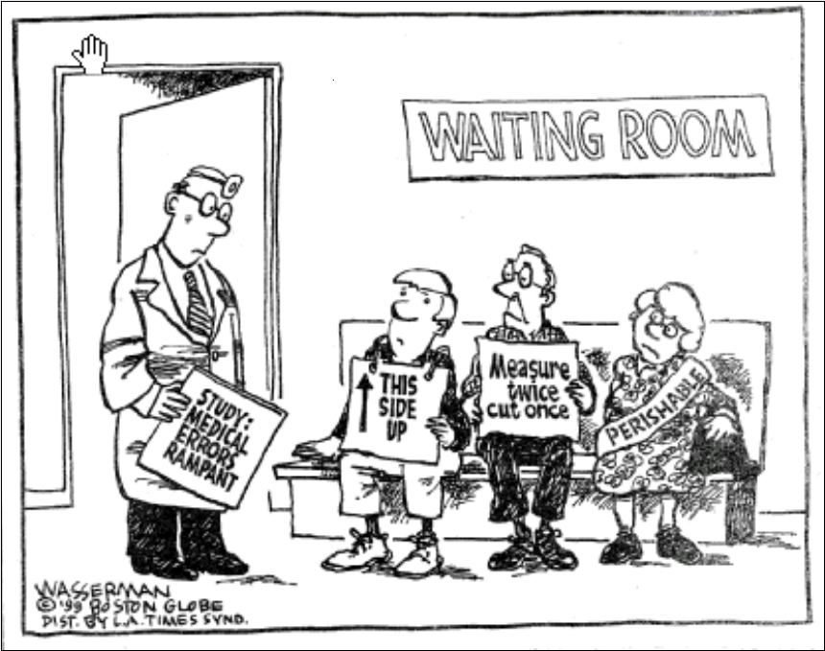

Slide 3
Why?
American healthcare is broken
The most sophisticated healthcare in the world is unsafe, expensive, inefficient, wasteful, error-prone, and uneven
Healthcare costs are unsustainable
Access to care is inequitable
Healthcare delivery is not patient-centered

Slide 4
US Healthcare?
American medicine is on a collision course with the American economy.
The US health care budget is approaching 20% of the total GDP and has been declared “unsustainable”.
There will be (soon!) a payment mechanism for physicians which penalizes poor performance.
The only way to assure high quality (and survival!) is to measure important outcomes, understand what leads to them, and FIX THE CAUSES.
IT’S NOT ABOUT THE MONEY!!!!!!!

Slide 5
50 years ago
Most graduates of US medical schools did a one year internship and went into practice (GP)
Most physicians were in solo, private practice
Pharmaceuticals were limited
Technology was limited
Knowledge base was manageable
Physicians were expected to be “walking repositories” of all knowledge

Slide 6
Today
All US medical school graduates must do a minimum of 3 years of accredited residency
Most do a subsequent subspecialty fellowship
The knowledge base is exponentially larger
The pharmacopeia is exponentially larger
Technology is complex
AND- all of the information is available on a smart phone!

Slide 7
Today
Healthcare is a $2.3 trillion dollar industry
Social expectations have changed
Error is now recognized as a fundamental component of human performance
Focus on “quality improvement” over the past 50 years has changed US industry, but not healthcare

Slide 8
Solution?
Modern physicians need the tools to be able to understand, interpret, analyze, apply, and critically evaluate (not just memorize)
The toolbox that was sufficient in 1960 is no longer adequate
Physicians must realize that healthcare delivery is “dangerous” and become active participants in making it “safer”

Slide 9
IOM Report- 2001 “Crossing the Quality Chasm”
Healthcare should be SEPTEE
Safe
Effective
Patient-centered
Timely
Efficient
Equitable

Slide 10
2012
There is no evidence that healthcare has improved
It is likely that it is actually worse
The “Massachusetts Program” underwent major modification in August, 2012 because it “broke the bank” without meeting the original expectations
Focusing on “the money” is not likely to make healthcare SEPTEE!

Slide 11
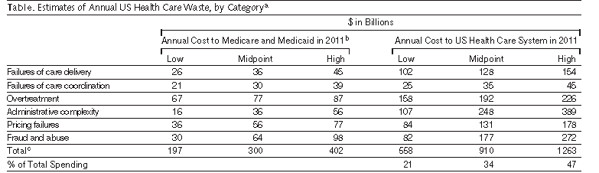
Eliminating Waste in US Health Care DM Berwick, AD Hackworth. JAMA 4/11/12

Slide 12
Why me?
Academic Surgeon for 40 years
Numerous academic leadership positions
Sustained national and international roles in medical education
Ten years ago I recognized that the failures in healthcare were due to “systems and process problems”, NOT management and finance!
I returned to school and earned a PhD in Industrial Engineering

Slide 13
Traditional Medical View
Medicine
Everything Else

Slide 14
Optimal Medical View
Psychology
Engineering
Medicine
Business
Arts/Humanities
Social Sciences

Slide 15
Error
From Plato to modern times, error has been considered a “moral” issue, blameworthy
In the 1970’s, 3 events triggered a new understanding of human error- Three Mile Island, Chernobyl, Tenerife
Cognitive science has demonstrated that error is associated with the same neural processes as learning
Human Error is now recognized as a “science”
“Medical Error” was only recognized in the 1990’s
ERROR is an inescapable component of our activities which must be “managed”

Slide 16
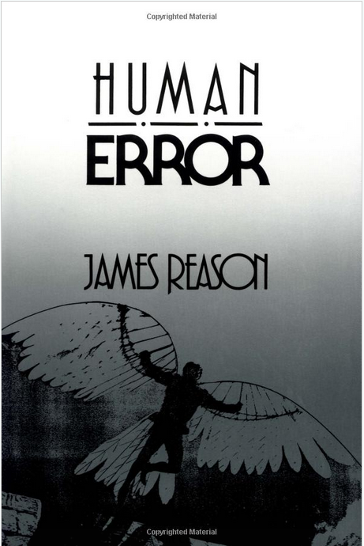

Slide 17
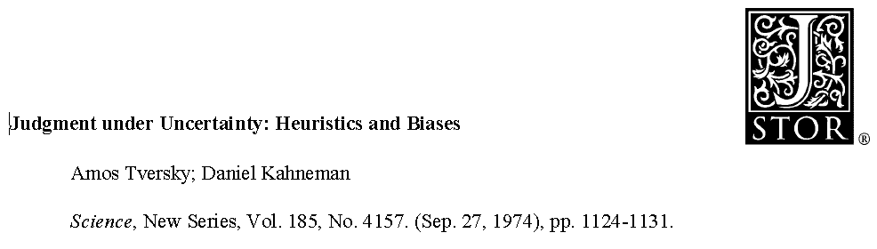
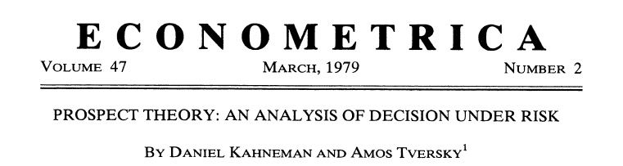
Heuristics and Bias

Slide 18

2011

Slide 19
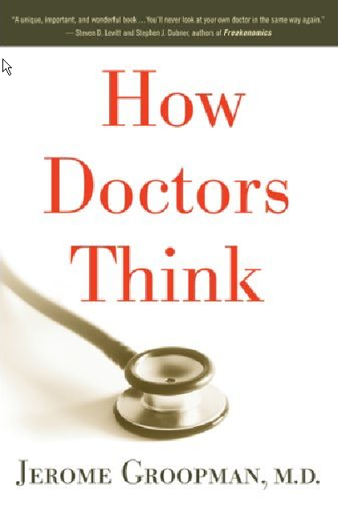

Slide 20
Physician Error
10 to 15 percent of all patients either suffer from a delay in making the correct diagnosis or die before the correct diagnosis is made
The failure to diagnose reflects unsuspected errors made while trying to understand a patient's condition
Groopman, NYReview of Books, Nov 5, 2009

Slide 21
Physician Bias
anchoring- overvaluing initial data
availability- recalling recent or dramatic cases
attribution- conclusions from preconceptions
Groopman, NYReview of Books, Nov 5, 2009

Slide 22
Heuristics and Bias
Physicians identify solutions using “Rules”
Physicians are particularly susceptible to certain biases
anchoring, availability, representativeness (Tversky and Kahneman, Groopman)
Physicians (in general) don’t understand uncertainty, variability, causation
Physicians don’t understand the unreliability of “small numbers”

Slide 23
“Medical training is, evidently, no defense against the power of framing.”
Kahneman, D. Thinking, Fast and Slow. 2011. p 367

Slide 24
error a planned sequence of mental or physical activities that fails to achieve its intended outcome (Reason)
Event
mistake- deficiency or failure in the judgmental and/or inferential processes involved in the selection of an objective or in the specification of the means to achieve it (the wrong thing)
slip- failure in the execution and/or storage stage of an action sequence (the right thing done incorrectly)
Outcome
near miss- an error which is identified before any injury/damage occurs
adverse event- an error which results in injury/damage

Slide 25
Acquiring Competence
First, we learn and practice “piece by piece”
Knowledge-based decisions
Over time, we bundle the pieces into individual rules, performing in “chunks”
Rule-based decisions
With experience, the behavior becomes automatic
Skill-based performance
Novices usually make “planning mistakes”
Experts make “execution slips” based on automaticity and bias

Slide 26
Background
Reason’s Approach to Error
Type of Error | Classification | Timing
Knowledge based | Knowledge based mistake | Evaluation/Planning
Rule based | Rule based mistake | Evaluation/Planning
Skill based | Lapse (storage) Slip (execution) | Execution

Slide 27
Major Sources of Error
Automaticity- the stage of expertise in which activities have become internalized and can be performed without focused thinking. (Necessary precursor to “slips”).
Bias- absence of equipoise; systematic favoring of a specific outcome:
Anchoring bias
Affirmation bias
Framing bias
Availability heuristic
Attribution bias
*Groopman, 2009

Slide 28
Important Error Concepts
Sources of Error
Systems
Technical/mechanical
Human
Solutions to Error
Engineer it out
Create alarms to identify dangerous situations
Identify it early to minimize the damage

Slide 29
Current “Dogma”
Evidence from HRO’s identifies system flaws as responsible for most errors, recommends reengineering
Evidence from aviation identifies communication errors as responsible for most errors, recommends “crew resource management”

Slide 30
Causes of Medical Error
Is healthcare comparable to “high reliability organizations”?
Can we learn important lessons from nuclear power plants and aviation crew resource management?
Is medical error about “systems” or about “humans”?

Slide 31
Prospective Study of Medical Error
All patients undergoing major surgery
Identified all complications of surgery
Determined if error had occurred, type of error, impact on patient outcome

Slide 32
Prospective Study over 1 Year
operations = 9830
complications = 332
outcome score 3,4 or 5 = 50%
errors = 78%
mistakes = 20%
slips = 58%

Slide 33
Error Classification
Error Classification Type | Number | Percentage
Error of Omission | 4 | 1.50%
System Error (organizational error) | 14 | 5.40%
Failure to Use Established Protocol | 14 | 5.40%
Communication Error | 15 | 5.80%
Equipment Failure (mechanical error) | 20 | 7.70%
Delay Error | 28 | 10.80%
Error In Diagnosis | 32 | 12.30%
Incomplete Understanding of Problem | 59 | 22.70%
Carelessness/Inattention to Detail | 76 | 29.20%
Judgment Error | 77 | 29.60%
Technique Error | 165 | 63.50%

Slide 34
Interpretation
It is possible to identify and classify error in surgical complications
Almost 80% of complications are associated with error
1/4 during evaluation; 3/4 during execution
Errors contribute estimated 50% to the outcome
50% result in disability or death
Most errors are human factor errors, specifically technique, judgment, incomplete understanding, inattention to detail
Systems failure and communication errors appear to be uncommon causes of surgical complications

Slide 35
Interpretation
“Sentinel Events” are often related to systems failure
There were no “sentinel events” in this series, but over 300 complications
Surgical complications may represent a very different phenomenon related to the planning and performance of a specific procedure

Slide 36
Role of Systems in Minimizing Risk
Error is unavoidable
Error increases with automaticity (slips) and expertise (bias)
Most error is NOT caused by systems- it is caused by humans.
BUT properly designed systems can often decrease the likelihood of error, particularly due to automaticity and bias

Slide 37
Caveat
Just because a “system” might have prevented an error (had it existed at the time) DOES NOT MEAN
That the absent system “caused” the error

Slide 38
Improvement
The only way to know what to improve is to understand the processes involved
The only way to improve something is to measure it
The only way to avoid “rule-based” mistakes is to be aware of our susceptibility to them
The only way to learn from our mistakes is to analyze them

Slide 39
Glossary
Process
A coordinated set of interrelated activities that result in a product/outcome
System
A set of interconnected and interdependent processes with a common goal
Model
a simplified (usually) representation of a complex system used to understand and predict
Optimization
Given a fixed set of resources, maximizing the output or minimizing the cost

Slide 40
Systems Engineering A Brief History
Taylor (late 1800’s)- Scientific Management
time-motion; efficiency (Henry Ford)
Shewhart (1920’s and 30’s)- process control charts
Western Electric rules and analysis
Deming (after WWII)- TQM
quality management; PDSA cycles
Dantzig (after WWII)- Linear Programming
optimization
Ishikawa (1960’s)- Cause and Effect Analysis
fishbone diagram

Slide 41
Systems Engineering A Brief History
DoD (1949 and later revisions)
Failure Mode and Effects Analysis (FMEA)
Toyota (1950’s)
Root Cause Analysis and the 5 Why’s
Toyota (1950’s)
LEAN
Discrete event simulation/stochastic modeling (1960 and later)
Motorola (1980’s)
Six Sigma

Slide 42
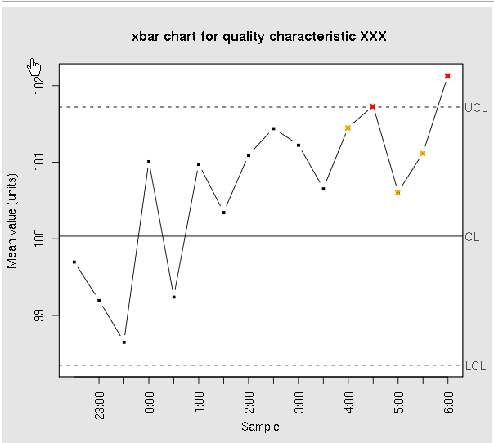
Process Control Walter Shewhart (1891-1967)

Slide 43
Deming TQM concepts
Do the right thing
Do it well
Ask the people who actually do it how to do it better
Continuously work to improve it
PDSA cycle
Plan, Do, Study, Act (repeat)

Slide 44
Root Cause Analysis (RCA) looks back
Detailed analytical method to identify the root causes of an actual failure or adverse event
Requires “facilitator” with deep knowledge of the method
“Retrospective” analysis AFTER something has occurred
Very susceptible to hindsight bias
Purpose- to identify the most fundamental reasons why something failed

Slide 45
RCA Tools
Flowcharting
creating a chart with all activities and their relationship, emphasizing the timeline
Fishbone Diagram (Ishikawa)
a diagram of events emphasizing grouping and cause/effect
Brainstorming
a process to “encourage” people to think broadly about events and solutions

Slide 46
Failure Mode and Effects Analysis (FMEA) looks forward
Identify ways that a process can fail (failure modes)
Identify the most likely consequences (effects)
Characterize likelihood, severity, undetectability; determine priority scores
Identify failure modes that could cause the greatest harm and proactively fix them

Slide 47
LEAN The “Toyota Way”
Do the right thing, the right way, at the right time
Optimize the “supply chain” (e.g. JIT inventory)
Focus on eliminating waste and delay
Four “S” approach:
Step 1. Find out the problem
Step 2. Find out what creates the problem
Step 3. Think about how to overcome the problem and focus on a solution and plan the implementation
Step 4. Implement the solution
The Five “Why’s”
The Virginia Mason Institute and Clinic (Seattle) is the leading source of health care LEAN information

Slide 48
Six-Sigma The Motorola System
Based on “normal” statistics
Focuses on variability in outcome
Decreased variability means increased quality
Creates programs to minimize variability
Six-Sigma means fewer than 3.4 defects per million operations
“Black Belts” in Six-Sigma are awarded after training and experience

Slide 49
LEAN- Six Sigma
Combines the best of both methods
Addresses “supply chain”, waste and delay, variability, and “metrics”
Can be thought of as a “technical” advance on Total Quality Management from the 40’s

Slide 50
Standardizing Care
“Quality is inversely proportional to variability” (Montgomery)
“Every system is perfectly designed to achieve the result it gets” (Batalden)
Designing systems composed of processes which actively minimize variability will improve the outcome.

Slide 51
Physician Practice
Clinicians basically practice the way they did 35-45 years ago
Areas for improvement
information systems
efficiency
decision support systems
laboratory interpretation
communication
safety

Slide 52
Dealing with Uncertainty
There are 3 kinds of “processes”:
Deterministic
Probabilistic
Stochastic
Medicine is “taught” deterministically
But medicine is actually stochastic
Physicians must learn to deal with variability and uncertainty!
This means they must become proficient in probability and statistics (no longer part of US medical education)

Slide 53
A familiar example
Sensitivity and Specificity
Apply to laboratory tests
Are of interest to clinical pathologists
Predictive value of +/- tests
Apply to patients
Are of interest to treating physicians
These are “conditional probabilities”
The “difference” is the probability of the disease.

Slide 54
Conditional Probability
Bayes Theorem P(+|D)=P(D|+) x P(+)/P(D)
sensitivity = P(+|D)
specificity = P(-|ND)
pvp = P(D|+)
pvn = P(ND|-)
serum gastrin level- 100% sensitive
ZES- in the absence of a family history, the probability that a patient with an ulcer and an elevated gastrin level has ZES is less than 1 in 1000!!!!

Slide 55
Example (of many!)
Aspirin versus Acetaminophen
ASA is loosely “associated” with Reye’s Syndrome (incidence- < 1/million)
ASA is currently recommended for prevention of coronary artery disease and embolic stroke
Acetaminophen is the #1 mechanism of suicide in the UK
Acetaminophen is the #1 cause of acute liver failure in the US (26000 admissions/yr)
Acetaminophen (single dose-two tabs) produces liver enzyme elevation in normal volunteers
Acetaminophen now has a “black box” warning
What do we use in hospitals? Acetaminophen!

Slide 56
Another Example
No evidence of disease versus evidence of no disease
Colon cancer follow-up
Pulmonary embolus evaluation
Hemodynamic assessment (PCWP)

Slide 57
An Important Consideration
Education (Knowing)
generalizable information
not intended for immediate use
often tested by multiple choice exam
75% is “okay”
Training (Being able to do)
requires transfer!
specific information
repetition with feedback
intended for use
often tested by hands on demonstration
less than 100% isn’t acceptable

Slide 58
Education vs Training
Accomplished differently
Measured differently
Degree of mastery different
Medical school and residency include both!
We need to identify what is “education” and what is “training” and act appropriately

Slide 59
A Recommendation
Health Care Students should be required to study logic, probability, statistics, cognitive psychology
Trainees should be required to learn about error, teamwork skills, structured problem solving
Faculty should be required to learn about disruptive behavior, leadership, and REAL risk management
All three should regularly be involved with error analysis, problem solving, probability based decision analysis, and team training

Slide 60
Our Curriculum 4 years, 1 ½ hours each week
Year 1- Human Error and Patient Safety
summer- Advanced Excel, Probability and Statistics
Year 2- Models, Systems, Optimization and Linear Programming
Advanced Excel and Solver
Year 3- Data Mining- theory and techniques
MiniTab, R, RExcel, Matlab
Scholarly project (18 months)
Year 4- Quality, LEAN, Six Sigma

Slide 61
Patient Safety Education Program (PSEP)
On October 10th and 11th, 2012, the University of South Florida conducted a two day, intensive program in Patient Safety education
30 institutional leaders (faculty, educators, hospital leaders, GME leaders, etc) participated
Our vision- that every medical school graduate, every hospital leader, and every physician will be formally trained in Patient Safety

Slide 62
Graduate Course in Patient Safety
3 credit hour, doctoral level course
Students from Engineering, Medicine, Nursing, Public Health
Faculty from Engineering, Medicine, Nursing, Public Health
Students assigned to interprofessional groups
Mandatory group projects to recommend solution to an active patient safety problem

Slide 63
Summary
Fixing the problems with healthcare will require identifying
better systems of healthcare delivery
better methods of resource utilization
better methods of minimizing error
better ways for doctors to use existing information

Slide 64
Goals for Practice Improvement
Reliable, quantitative outcome measures
Standardization
Failure Mode and Effects Analysis

Slide 65
Perhaps we’ll learn that….
correlation does NOT mean prediction
association does NOT mean cause and effect
many “important” journal articles are retracted every year because of faulty analysis
expertise actually leads to INCREASED bias
many of the “rules” that we learn in clinical medicine don’t actually make sense

Slide 66
Summary
Although “systems” problems exist, the majority of “errors” in clinical practice appear to be HUMAN ERROR
Many errors are due to “bias and heuristics” and “prospect theory” (Kahneman).

Slide 67
Conclusion
Medical Error is common
Most of it is due to unintended clinician mistakes
Much of it is caused by our lack of understanding of how to use data

Slide 68
Conclusion
We need to understand
our susceptibility to bias
our systems are full of holes
medicine isn’t about right and wrong; it’s about probability
hand-offs are fraught with risk
hierarchy inhibits communication
measure twice, cut once

Slide 70
Some “Light” Reading
on bias- The Wisdom of Crowds (Surowiecki)
on distributions rather than concrete numbers – The Flaw of Averages (Savage)
on outliers- The Black Swan (Taleb)
on physician error- How Doctors Think (Groopman)
on probability- The Drunkard’s Walk (Mlodinow)

Slide 71
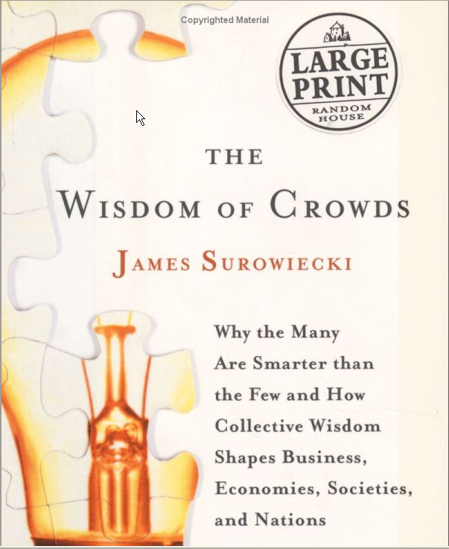

Slide 72


Slide 73
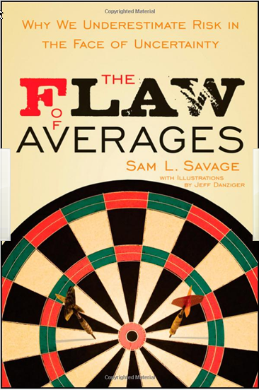

Slide 74
Perspective Controlling Health Care Spending — The Massachusetts Experiment Zirui Song, B.A., and Bruce E. Landon, M.D., M.B.A., NEJM: 2012; 366:1560-1561 April 26, 2012
One lesson is already resoundingly clear: the growth of health care spending threatens the sustainability of every other public service, from education, to public health, to infrastructure, to defense. Indeed, health care spending is the most important determinant of our growing national debt. In a society of limited resources, the imperative for cost control now comes from outside health care. Payment reform may well be a reasonable beginning, but fundamental reform of the delivery system is needed if we are to truly succeed.

