Slide 2
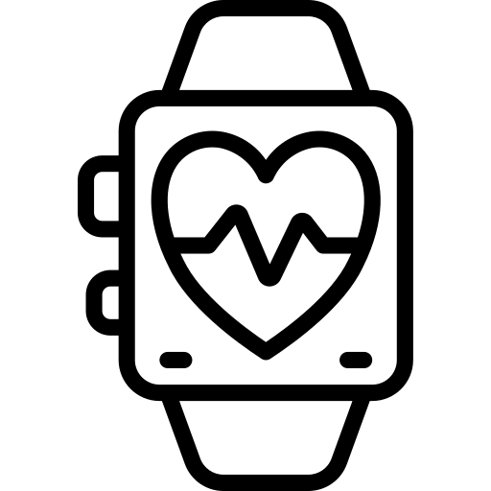
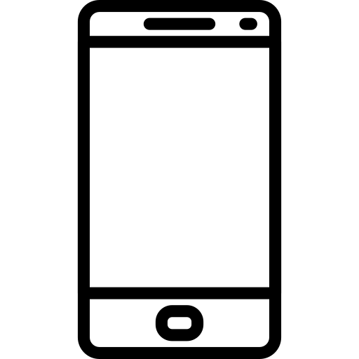








Choose Your Meal – Come ’N’ Eat
The customer’s fitness data, activity status, calendar and stress level are collected by Smartwatch and Smartphone.
This data is transmitted to our servers.
The data from the customer is stored and analyzed in our backbone.
The results are pushed to the customer’s device.
As soon as the customer gets the meal suggestions, he can choose from different meal proposals.
As soon as he decided for one meal, the order is processed to the food deliverer.

Slide 3




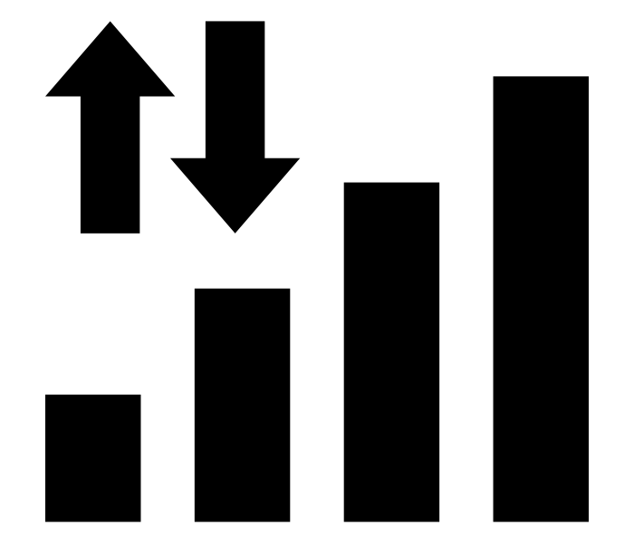

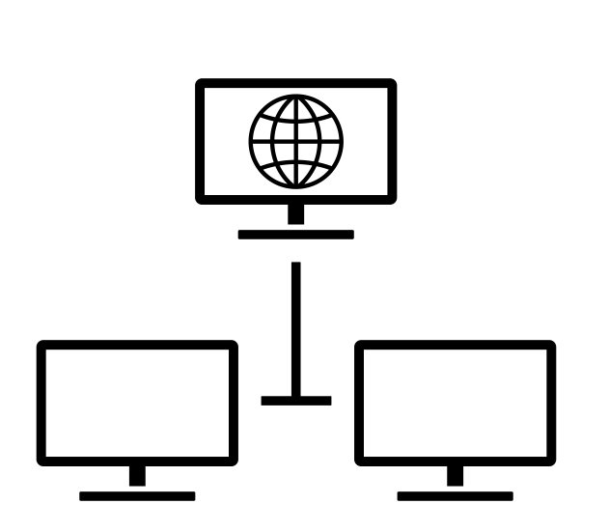
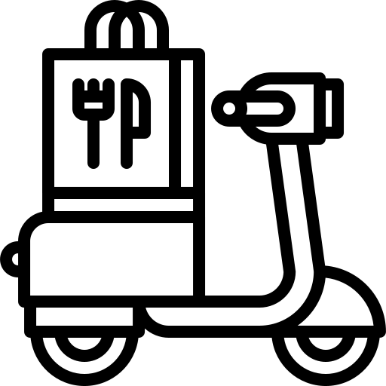
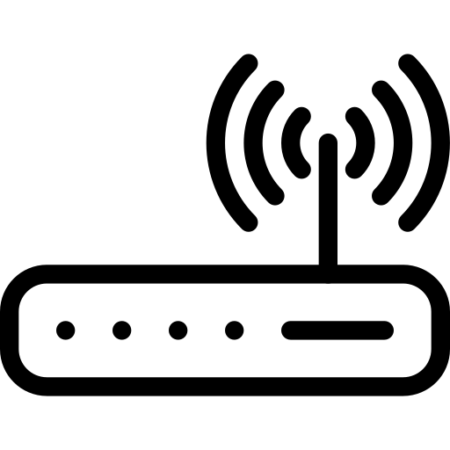

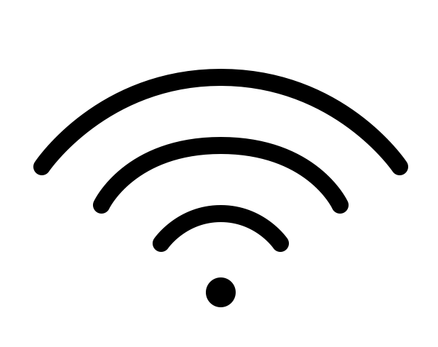
Star Topology
Mesh Topology
Ad hoc

Slide 5
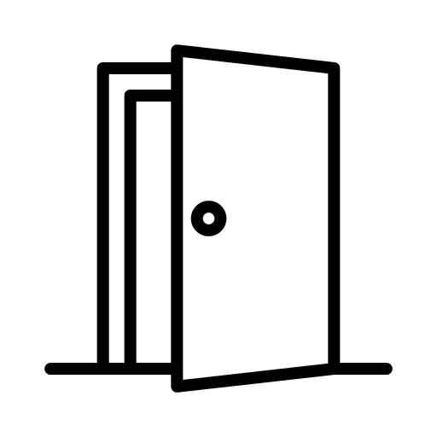
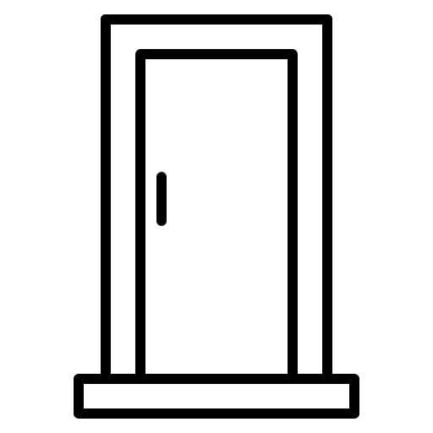

NFC Authorization Process – Come ’N’ Eat
Customer
NFC Token
Customer
NFC Token
Deliverer
Is NFC tag A4B6GH5 active and is deliverer 1234567 associated?
Mr. Max
A4B6GH5
Mr. Max
A4B6GH5
1234567
The customer get’s a NFC tag with a token which is associated to the account and to every order which is placed though Come ‘N’ Eat.
As soon as the customer places an order through Come ’N’ Eat, the chosen food deliverer is attached to the NFC tag and the tag is activated.
When the deliverer arrives at the home of the customer, we check if the NFC tag is active in our data base and if the deliverer is the one who is attached to the tag.
If the check is successful, we grant access to the home. Otherwise the door will stay locked.

