Slide 1


THEME 02: NUMBER SYSTEMS
Worksheet 7– Binary Addition and Subtraction
PhD. Ruperto P. Bonet Chaple

Slide 2
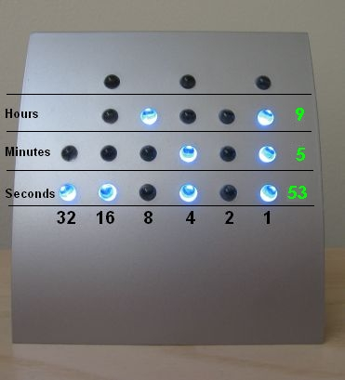
BINARY NUMBER SYSTEM
What is the binary representation of 5?

Slide 3
BINARY ARITHMETIC OPERATIONS
BINARY ADDITION
Complete the blanks with numbers on the following table
a) Identify analogies and differences
b) Write the binary addition rules based on your experience

Slide 4
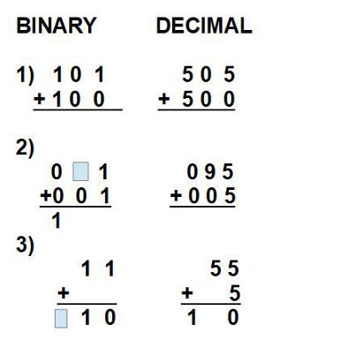
BINARY ADDITION RULES

Slide 5
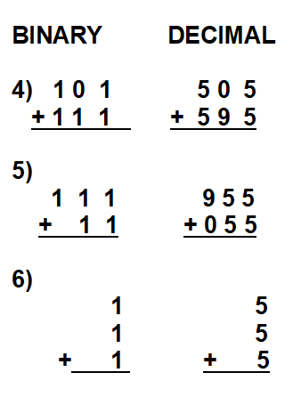
BINARY ADDITION RULES

Slide 6
BINARY ADDITION RULES
0 + 0 =0
  1 + 0 =1
1 + 1 = 0, carry 1
EXERCISE: WRITE THE SUBTRACTION RULES

Slide 7
BINARY SUBTRACTION RULES
0 – 0 = 0
1 - 0 = 1
1 – 1 = 0 0 - 1 = 1, Borrow 1

Slide 8
BINARY SUBTRACTION RULES
0 – 0 = 0
1 - 0 = 1
1 – 1 = 0 0 - 1 = 1, Borrow 1
BINARY DECIMAL
1 0 1 0
- 0 1 - 0 5

Slide 9
CONCLUSIONS
We have learnt BINARY ADDITION AND
SUBTRACTION
RULES
INCLUDING THE NEW RULES:
1 + 1= 0, CARRY 1
0 – 1=1, BORROW 1
ON THE NEXT EXERCISES YOU WILL GET THE ABILITY WITH
THESE ARITHMETICS OPERATIONS

