Slide 1
SiMLeng PROJECT Genlogistic vs Logistic
NOTE ON BINARY CLASSIFICATION
RUPERTO P. BONET
rpbonetch@gmail.com

Slide 2
NOTE ON BINARY CLASSIFICATION
This note is based on the analysis of Binary Classification
with Logistic function and how it can be improved relaxing
its shape.
This experiment has been designed using Pima Indias,
Sonar and Ionosphere datasets, which are related to
making prediction and binary classification.

Slide 3
DATASETS
DATASETS | PIMA INDIAS | SONAR | IONOSPHERE
TRAINING SET | 200 | 124 | 210
TESTING SET | 332 | 84 | 141

Slide 4
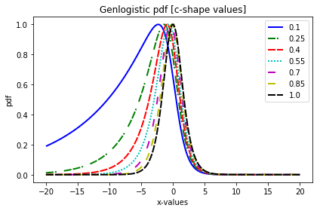
GENLOGISTIC PDF

Slide 5
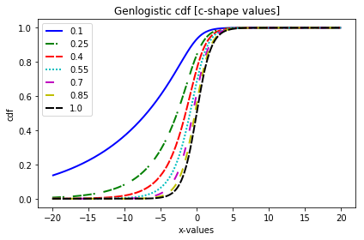
GENLOGISTIC CDF

Slide 6
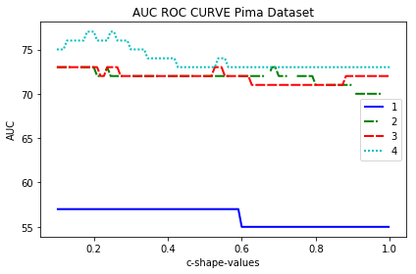
PIMA INDIAS DATASET
PCA SUBSET[90%]= [‘npreg’,’glu’,’bp’,’skin’]
Labels represent the quantity of features used
in the prediction following the shown order

Slide 7
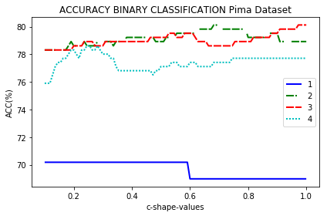
PIMA INDIAS DATASET
PCA SUBSET[90%]= [‘npreg’,’glu’,’bp’,’skin’]
Labels represent the quantity of features used
in the prediction following the shown order

Slide 8
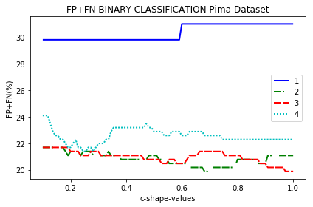
PIMA INDIAS DATASET
PCA SUBSET[90%]= [‘npreg’,’glu’,’bp’,’skin’]
Labels represent the quantity of features used
in the prediction following the shown order

Slide 9
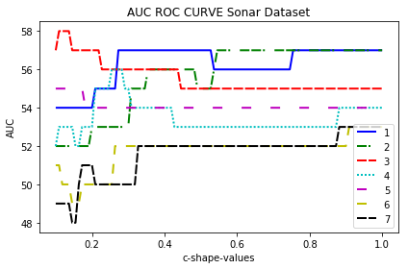
SONAR DATASET
PCA SUBSET[90%]= 19 features
Labels represent the quantity of features used
in the prediction following the shown order

Slide 10
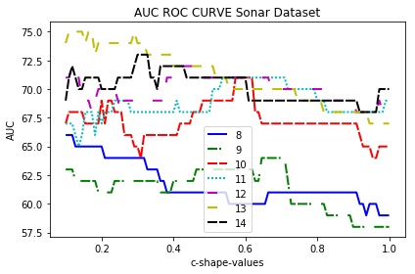
SONAR DATASET
PCA SUBSET[90%]= 19 features
Labels represent the quantity of features used
in the prediction following the shown order

Slide 11
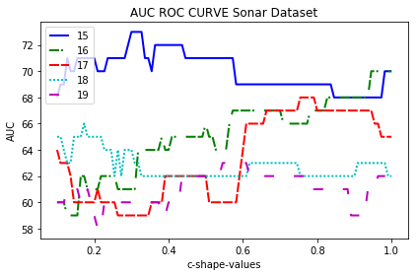
SONAR DATASET
PCA SUBSET[90%]= 19 features
Labels represent the quantity of features used
in the prediction following the shown order

Slide 12
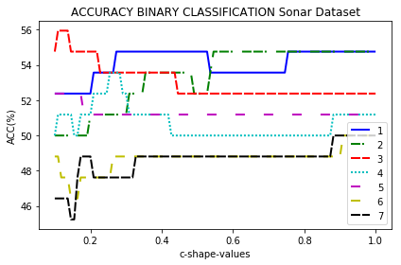
SONAR DATASET
PCA SUBSET[90%]= 19 features
Labels represent the quantity of features used
in the prediction following the shown order

Slide 13
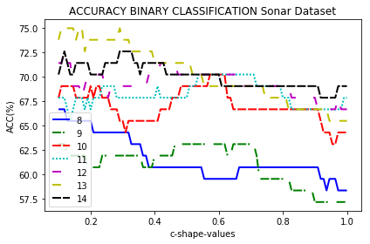
SONAR DATASET
PCA SUBSET[90%]= 19 features
Labels represent the quantity of features used
in the prediction following the shown order

Slide 14
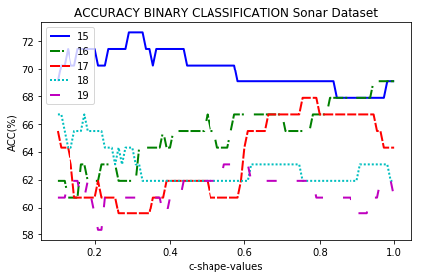
SONAR DATASET
PCA SUBSET[90%]= 19 features
Labels represent the quantity of features used
in the prediction following the shown order

Slide 15
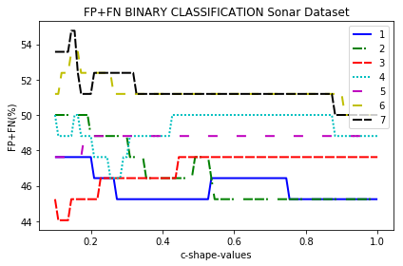
SONAR DATASET
PCA SUBSET[90%]= 19 features
Labels represent the quantity of features used
in the prediction following the shown order

Slide 16
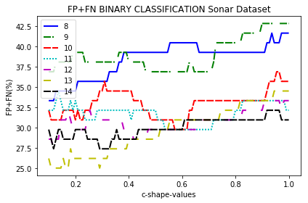
SONAR DATASET
PCA SUBSET[90%]= 19 features
Labels represent the quantity of features used
in the prediction following the shown order

Slide 17
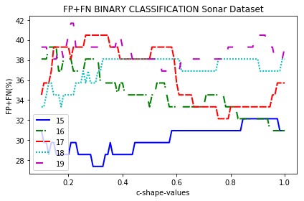
SONAR DATASET
PCA SUBSET[90%]= 19 features
Labels represent the quantity of features used
in the prediction following the shown order

Slide 18
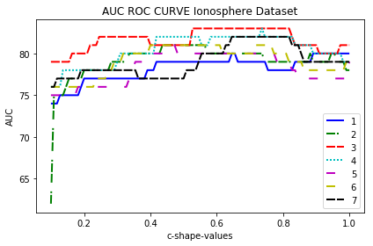
IONOSPHERE DATASET
PCA SUBSET[90%]= 17 features
Labels represent the quantity of features used
in the prediction following the shown order

Slide 19
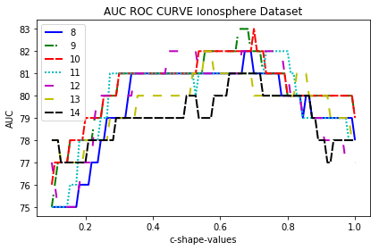
IONOSPHERE DATASET
PCA SUBSET[90%]= 17 features
Labels represent the quantity of features used
in the prediction following the shown order

Slide 20
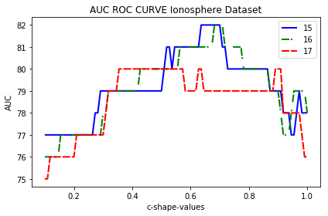
IONOSPHERE DATASET
PCA SUBSET[90%]= 17 features
Labels represent the quantity of features used
in the prediction following the shown order

Slide 21
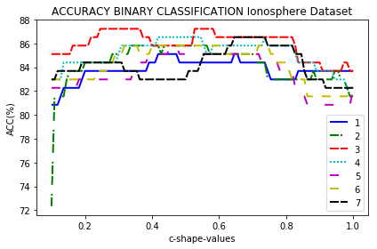
IONOSPHERE DATASET
PCA SUBSET[90%]= 17 features
Labels represent the quantity of features used
in the prediction following the shown order

Slide 22
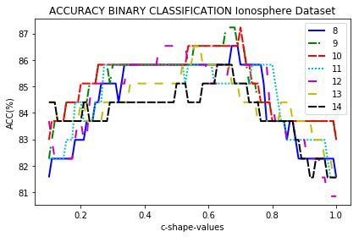
IONOSPHERE DATASET
PCA SUBSET[90%]= 17 features
Labels represent the quantity of features used
in the prediction following the shown order

Slide 23
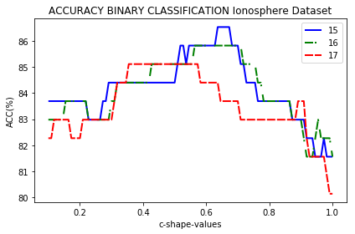
IONOSPHERE DATASET
PCA SUBSET[90%]= 17 features
Labels represent the quantity of features used
in the prediction following the shown order

Slide 24
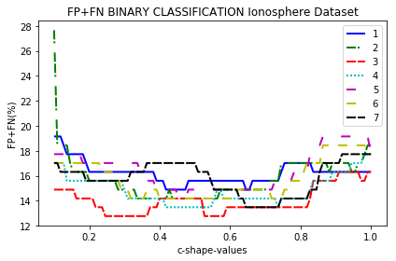
IONOSPHERE DATASET
PCA SUBSET[90%]= 17 features
Labels represent the quantity of features used
in the prediction following the shown order

Slide 25
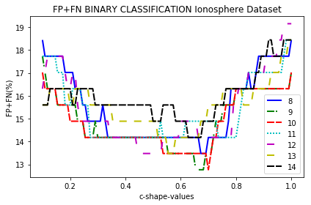
IONOSPHERE DATASET
PCA SUBSET[90%]= 17 features
Labels represent the quantity of features used
in the prediction following the shown order

Slide 26
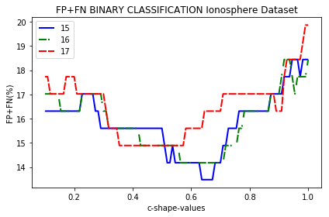
IONOSPHERE DATASET
PCA SUBSET[90%]= 17 features
Labels represent the quantity of features used
in the prediction following the shown order

Slide 27
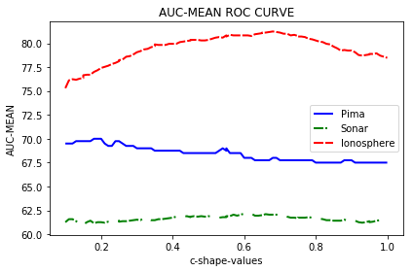
COMPARISON BETWEEN DATASETS
AUC MEAN(%)

Slide 28
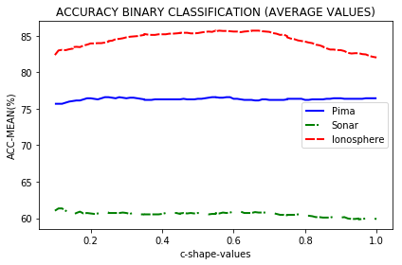
COMPARISON BETWEEN DATASETS
ACC MEAN(%)

Slide 29
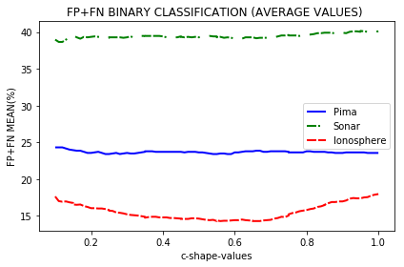
COMPARISON BETWEEN DATASETS
(FP+FN) MEAN(%)

Slide 30
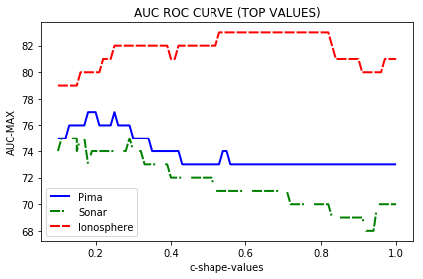
COMPARISON BETWEEN DATASETS
AUC TOP VALUES(%)

Slide 31
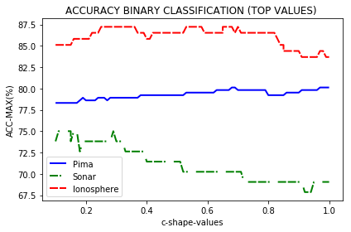
COMPARISON BETWEEN DATASETS
ACC TOP VALUES(%)

Slide 32
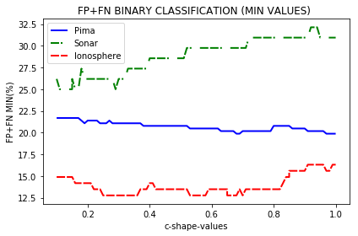
COMPARISON BETWEEN DATASETS
(FP+FN) MINIMUN VALUES(%)

Slide 33
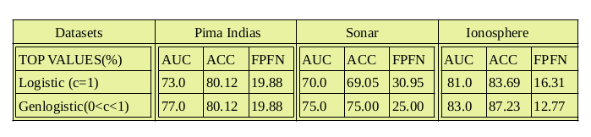
PRELIMINARY CONCLUSIONS
Results seem to indicate that Genlogistic function could reduce the false positive/ negative rate more than Logistic predictions. The following table shows the above observations:

Slide 34

GENLOGISTIC?
YES

Slide 35
COMPUTATIONAL TOOLS
Implementation of GenLogistic model in Statsmodels package
Code entitled :Genlogistic.py on Python3.6.7
https://github.com/sednabcn/SiMLeng/tree/BinaryClassificationGenlogistic

