Slide 1
SiMLeng PROJECT
Lumped Sample Collocation Prediction Method
RUPERTO P. BONET
rpbonetch@gmail.com

Slide 2
INTRODUCTION
A numerical method based on PCA features selection and lumping transformations of samples in combination with One-Dimensional Radial Basis Functions Collocation method is implemented.
This experiment related to the prediction and binary classification has been designed using Pima Indias, Sonar and Ionosphere datasets.

Slide 3
FEATURES-SAMPLE LUMPING TRANSFORMATIONS
SUM
PCA
FEATURES
95%
PCA
FEATURES
90%
AVERAGE
PCA
FEATURES
85%
LINEAR COMBINATIONS WITH
LEARNING PARAMETERS

Slide 4
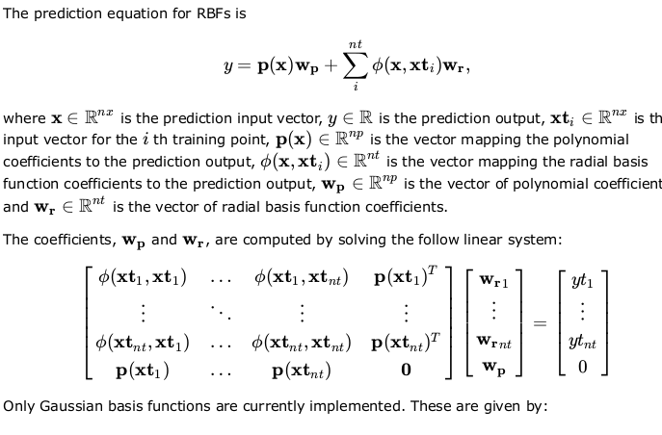
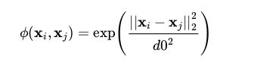
RADIAL BASIS FUNCTIONS
( https://media.readthedocs.org/pdf/smt/)

Slide 5
FEATURES-SAMPLE LUMPING COLLOCATION TRAINING METHOD
TRAINING DATASET
(X1,X2,….Xp)
p features
n samples in Xi
TRAINING
RBF(X,wj,CDF(Z))
Σxi
Σxi/p
ΣѳXi
X
Z=F(X,y)=[CDF(Xi)]^yi*[1-CDF(Xi)]^(1-yi)
I=1,2,…,n
TRANSFORMATIONS

Slide 6
FEATURES-SAMPLE LUMPING COLLOCATION PREDICTION METHOD
TESTING DATASET
(X1,X2,….Xp)
p features
m samples in Xi
PREDICTION
RBF(X) GIVEN Wj
Σxi
Σxi/p
ΣѳXi
X
TRANSFORMATIONS

Slide 7
DATASETS
DATASETS | PIMA INDIAS | SONAR | IONOSPHERE
TRAINING SET | 200 | 124 | 210
TESTING SET | 332 | 84 | 141

Slide 8
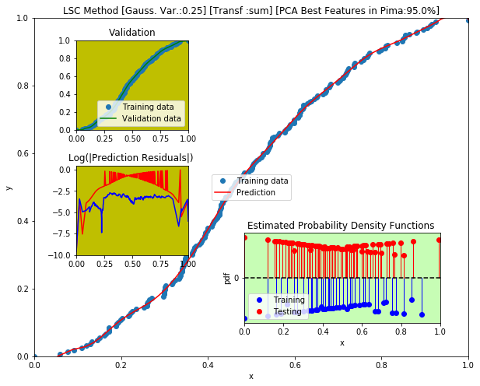
LSC METHOD [RBF+ Const Poly ]

Slide 9

LSC METHOD [RBF+ Const Poly ]

Slide 10
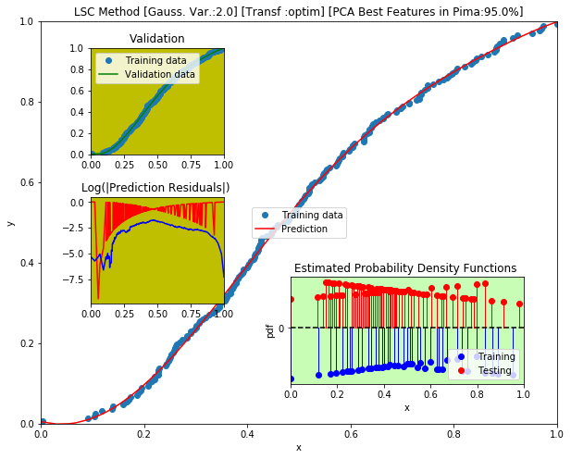
LSC METHOD [RBF+ Const Poly ]

Slide 11
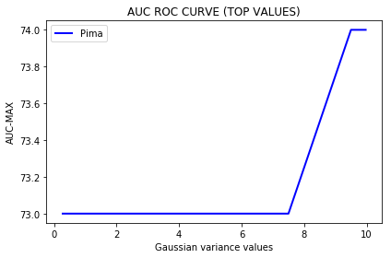
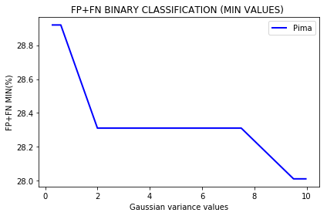
LSC METHOD [PCA 95%,RBF+ Const Poly ]

Slide 12
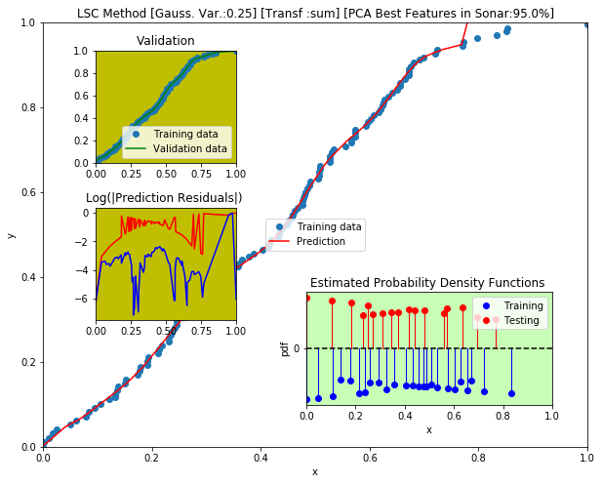
LSC METHOD [RBF+ Const Poly ]

Slide 13
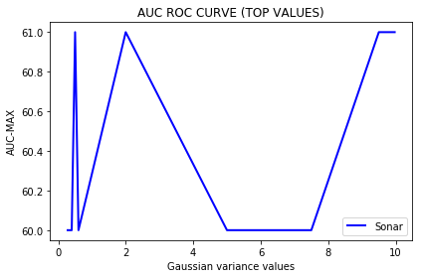
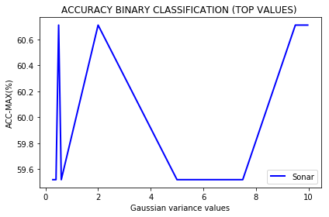
LSC METHOD [PCA 95%,RBF+ Const Poly ]

Slide 14
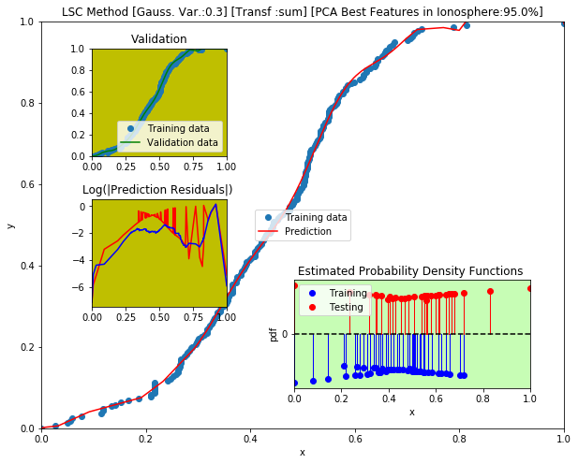
LSC METHOD [RBF+ Const Poly ]

Slide 15

LSC METHOD [RBF+ Const Poly ]

Slide 16
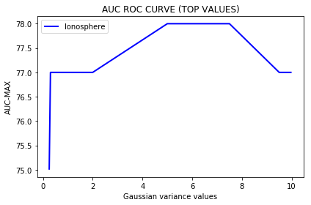
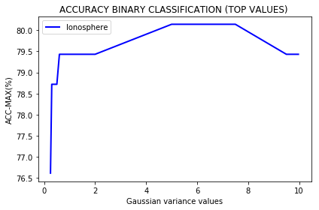
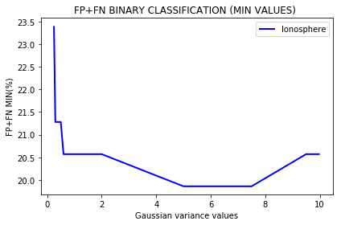
LSC METHOD [PCA95%,RBF+ Const Poly ]

Slide 17
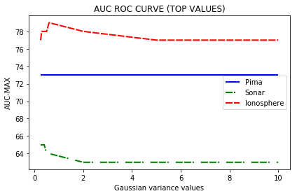
LSC METHOD [RBF +CONST POLY]
COMPARISON BETWEEN DATASETS

Slide 18
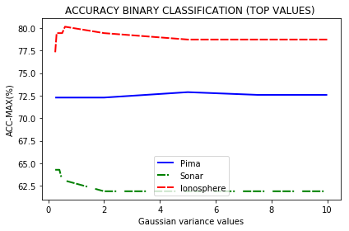
LSC METHOD [RBF +CONST POLY]
COMPARISON BETWEEN DATASETS

Slide 19
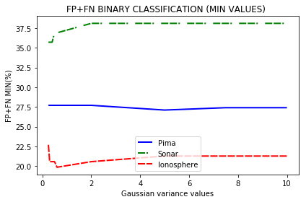
LSC METHOD [RBF +CONST POLY]
COMPARISON BETWEEN DATASETS

Slide 20
PRELIMINARY CONCLUSIONS
The Lumped Sample Collocation Prediction Method is a global method which depends on Cumulative Distribution Function [cdf] used to compute the learning curve. Results seem to indicate that it has the same precision as linear methods. Best results were obtained adding features/sample columns and selecting the training points/labels as collocation points. Radial Basis Functions are employed to get the learning parameters.

Slide 21

Lumped sample with
Activation Functions?
YES

Slide 22
COMPUTATIONAL TOOLS
Implementation of LSC method in smt package
Code entitled :lump_rfb.py on Python3.6.7
https://github.com/sednabcn/SiMLeng/tree/BinaryClassification-LSCollocation

