Slide 1
AG
AdmitGuard
Admission Data Validation & Compliance System
Zero tolerance for bad data. Zero friction for good candidates.
PG Diploma in AI-ML & Agentic AI Engineering • IIT Gandhinagar • February 2026

Slide 2
THE PROBLEM
Zero Validation at Entry
Complex Eligibility Rules
Candidate data entered into Google Sheets with no restrictions. Anyone can type anything.
IIT-specific rules on CGPA, work experience, age, documents staff unaware of every rule.
Errors Caught Too Late
No Exception Audit Trail
Ineligible candidates reach document verification after interview panel time is invested.
Borderline cases approved informally. No documentation. No accountability.
Impact: Wasted counselor hours • Candidate experience damage • Compliance risk with IIT/IIM partners

Slide 3
THE SOLUTION — AdmitGuard
Real-Time Validation
Strict + Soft Rules
Structured Exceptions
12 eligibility rules enforced as operator fills the form. Wrong data blocked instantly.
Hard blocks for non-negotiable rules. Exception toggles for borderline cases.
Every override requires a rationale with approved keywords. Nothing bypassed silently.
Audit Trail
Config-Driven Rules
Zero Infrastructure
Every submission saved with timestamp, exception details, and flag status.
All 12 rules in one JSON object. Update thresholds without touching any code.
Single HTML file. Runs in browser. No server, no database, no deployment.

Slide 4
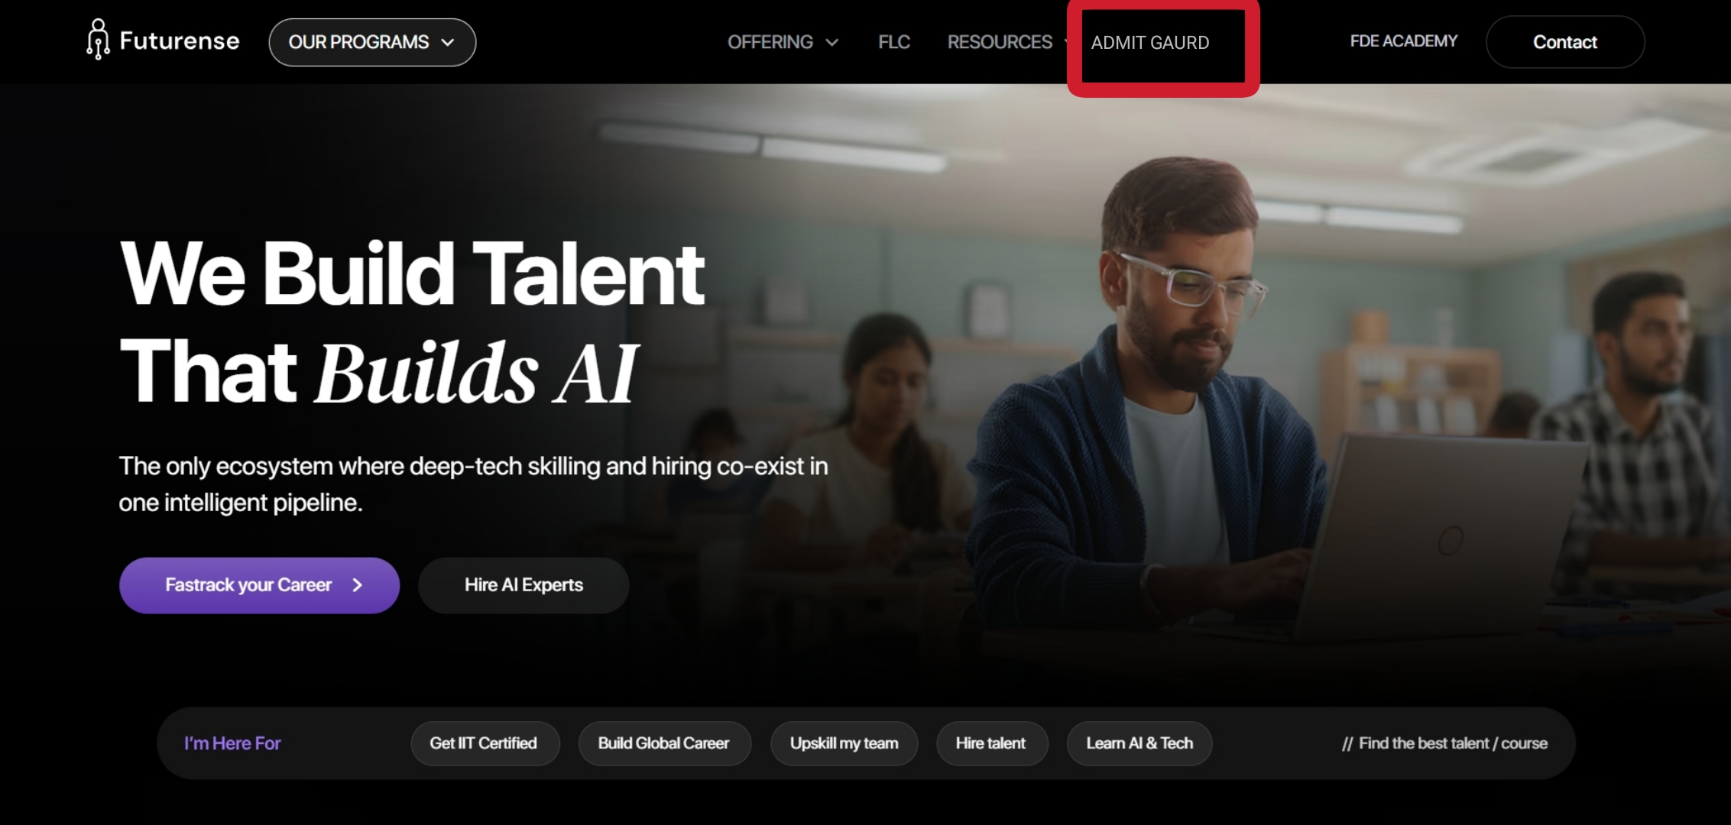

Slide 5
REQUIREMENTS COVERAGE
FR # | Requirement | Priority | Status
FR-1 | Form-based data entry (11 fields) | Must Have | ✅
FR-2 | Real-time field-level validation | Must Have | ✅
FR-3 | Strict rules block submission | Must Have | ✅
FR-4 | Soft rule exception toggle + rationale | Must Have | ✅
FR-5 | Rationale keyword + length validation | Must Have | ✅
FR-6 | Exception count computed & displayed | Must Have | ✅
FR-7 | Submission success screen | Must Have | ✅
FR-8 | Config-driven rules (JSON object) | Should Have | ✅
FR-9 | Audit log with timestamps | Should Have | ✅
FR-10 | Dashboard — stats & charts | Good to Have | ✅
FR-11 | Export to CSV | Good to Have | ✅
FR-12 | Light / Dark mode toggle | Good to Have | ✅

Slide 6
THE RULES ENGINE — 12 Rules
STRICT RULES (7)
SOFT RULES (4)
SYSTEM RULE (1)
Full Name
Email (unique)
Phone Number
Qualification
Interview Status
Aadhaar Number
Offer Letter Logic
Date of Birth (age 18–35)
Graduation Year (2015–25)
Score (≥60% or ≥6.0 CGPA)
Screening Score (≥40)
Auto-computed. Not editable.
If exceptions > 2
on one candidate
→ Flag for Manager Review
Exception requires:
• ≥ 30 characters
• Keyword: 'approved by' / 'special case' / 'documentation pending' / 'waiver granted'

Slide 7
HOW IT WORKS
01
02
03
04
05
Operator Opens Form
Fills 11 Fields
Real-Time Validation
Exception Toggle
Submit + Save
Strict Violation
Soft Violation
Exception Granted
Clean Submission
Red error shown
Submit blocked
No override possible
Amber warning shown
Exception toggle appears
Rationale required
Rationale validated
≥30 chars + keyword
Field accepted
All rules pass
Data saved to storage
Audit log updated

Slide 8
Built in 2 days.
Solves a real problem.
Ready to scale.
12
3
0
Rules Enforced
Views Built
Server Required
PG Diploma in AI-ML & Agentic AI Engineering • Week 1 Vibe Coding Project • IIT Gandhinagar • February 2026

