Slide 1
The OASIS KMIP Standard:
Interoperability for the Cryptographic Ecosystem
Santhosh Kumar Edukulla santhoshedukulla@apache.org

Slide 2
The OASIS KMIP Standard:
Often used cryptographic ecosystem in enterprises, problems.
Interoperability solution in terms of KMIP
KMIP and KMIS Overview
Free KMIP\KMIS Library

Slide 3

Problems:
In an enterprise, often, each cryptographic environment has its own key management system
In an enterprise, often, each cryptographic environment has its own protocol
Multiple platforms, multiple application infrastructures EX: C++, JAVA , .NET, windows, Linux etc.
Multiple key distribution mechanisms, varied storages for secured keys,
security issues, not so easy retrievals, standards, compliances etc.
Managing key lifecycles, key continuance, version issues etc.

Slide 4


















Problem 1:
Enterprise Cryptographic Environments
Collaboration &
Content Mgmt
Systems
File Server
Portals
Disk
Arrays
Production
Database
Backup
System
VPN
LAN
WAN
Replica
Backup
Disk
Enterprise
Applications
eCommerce
Applications
CRM
Staging
Business
Analytics
Backup
Tape
Email
Dev/Test Obfuscation
Key Management System
Key Management System
Key Management System
Key Management System
Key Management System
Key Management System
Key Management System
Key Management System

Slide 5
Problem2:
Enterprise Cryptographic Environments
Collaboration &
Content Mgmt
Systems
File Server
Portals
Disk
Arrays
Production
Database
Backup
System
VPN
LAN
WAN
Replica
Backup
Disk
Enterprise
Applications
eCommerce
Applications
CRM
Staging
Business
Analytics
Backup
Tape
Email
Dev/Test Obfuscation
Disparate, Often Proprietary Protocols
Key Management System
Key Management System
Key Management System
Key Management System
Key Management System
Key Management System
Key Management System
Key Management System

Slide 6












Solution : KMIP as an interoperable protocol supports enterprise cryptographic environments:
Enterprise Cryptographic Environments
Portals
Collaboration &
Content Mgmt
Systems
File Server
Disk
Arrays
Production
Database
Backup
System
VPN
LAN
WAN
Replica
Backup
Disk
Enterprise
Applications
eCommerce
Applications
CRM
Staging
Business
Analytics
Backup
Tape
Email
Dev/Test Obfuscation
Key Management Interoperability Protocol
Enterprise Key Management

Slide 7
Its an open standard, easier to maintain, reduces complexity, solves interoperability problem. Formulated by OASIS(Organization for the advancement of structural information standards)
The Key Management Interoperability Protocol (KMIP), enables key lifecycle management, it supports legacy and new cryptographic-enabled applications, supporting symmetric keys, asymmetric keys, digital certificates, and other shared secrets
KMIP offers developers, templates to simplify the development and use of KMIP-enabled applications.
KMIP defines the protocol for cryptographic client and key-management server communication. It tries to establish a single, comprehensive protocol for the communication between enterprise key management systems and encryption systems. It’s a binary protocol format with TTLV format.
Defines all cryptographic entities as managed objects, attributes, operations supported etc.
Supports various key lifecycle operations supported include generation, submission, retrieval, and deletion of cryptographic objects.

Slide 8
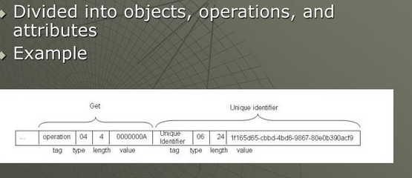
As mentioned earlier, it’s a binary protocol with TTLV format.

Slide 9
KMIP protocol flow:
Key Client
Key Server
API
API
Internal representation
Internal representation
KMIP Encode
KMIP Decode
KMIP Encode
KMIP Decode
KMIP
Transport
Transport

Slide 10

KMIP Technical Committee was established in OASIS in April 2009
  Submissions included at the time of TC creation included draft specification, usage guide and use cases
  Initial membership included most significant vendors in cryptographic solutions and key management and has continued to grow.
KMIP V1.0 standard approved end-September 2010
Current KMIP Version: 1.2

Slide 11
Purpose is to define what any implementation of the specification must
adhere to in order to claim conformance to the specification
  Define the use of KMIP objects, attributes, operations, message elements and authentication methods within specific contexts of KMIP server and client
  interaction.
  Define a set of normative constraints for employing KMIP within a particular environment or context of use.
  Optionally, require the use of specific KMIP functionality or in other respects define the processing rules to be followed by profile actors.
Three profiles defined in V1.0
  Secret data
  Symmetric key store
  Symmetric key foundry
Profiles are further qualified by authentication suite
  TLS V1.0 / V1.1
  TLS V1.2

Slide 12
KMIS is a kmip implementation which can run as service, providing cryptographic key management facilities to various enterprise entities like applications etc. Enterprise application these days are agile and are of varied platforms.
Enterprise applications for their cryptographic requirements, needs to communicate with KMS. So, different applications in different platforms need to know about KMIP, instead KMIS does that in an abstracted way and provides machine independent way of communicating with KMS.
It acts as an interface between KMS(Key Management Solution\Server) and enterprise applications through easy to use API.s
KMIP library can run as an agent and well be integrated with applications, but, using an agent based solution tightly couples the applications with a given agent, and different agents are required for different application platforms.
Few vendors provides KMIP, KMIS facilities.
The current implementation aims to solve this dependency and decouples dependencies, through an abstracted simple easy to use service in a secured way.

Slide 13

KMS <= = > KMIS <= = > Applications
Components:
KMS : Key Management Server, HSM Appliance, where actual keys are generated, stored, maintained, destroyed etc.
KMIS: Key Management Integration Service, An Integration Service operating between enterprise entities and KMS.
Different enterprise entities.

Slide 14

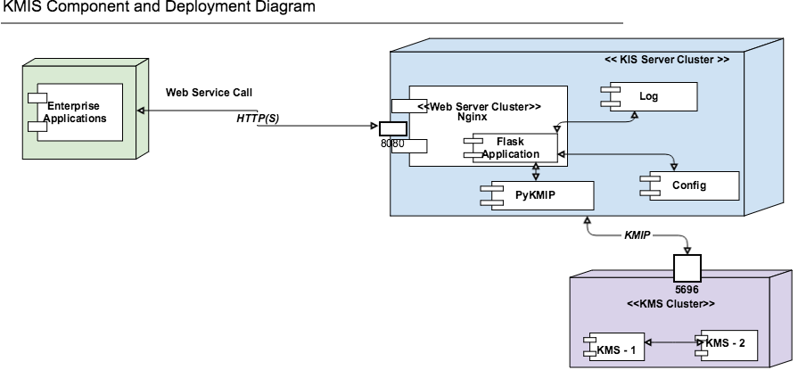

Slide 15

  http://docs.oasis-open.org/kmip/spec/v1.2/os/kmip-spec-v1.2-os.html
  http://xml.coverpages.org/KMIP/KMIP-FAQ.pdf
  Github Links:
  https://github.com/sedukull/pykmip-ws
  https://github.com/OpenKMIP/PyKMIP
Notes:
Join by april 9th

