Slide 1
Operational Metadata Modeling and Pipeline Observability in Snowflake
SEDAR SAHIN

Slide 2
Industry Problem: Limited Pipeline Observability in Modern Data Platforms
Difficult downstream impact analysis
Limited execution traceability
Semi-structured ingestion trade-offs
Governance without enforced constraints

Slide 3
PROJECT OBJECTIVE
Design operational metadata schema
Enable recursive lineage traversal
Analyze distributed query execution
Evaluate clustering & pruning behavior
Implement governance & temporal tracking

Slide 4
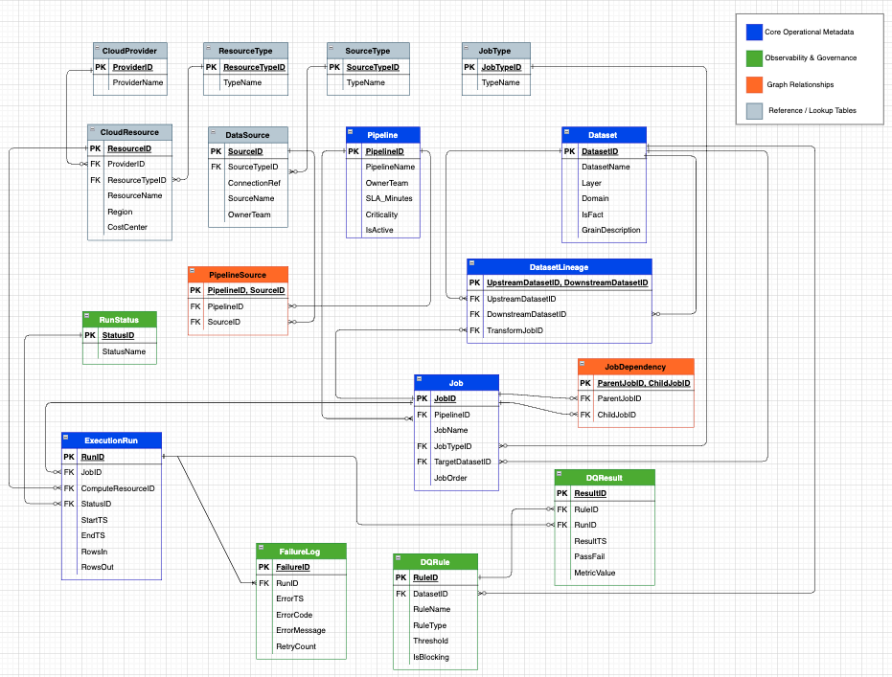

Slide 5
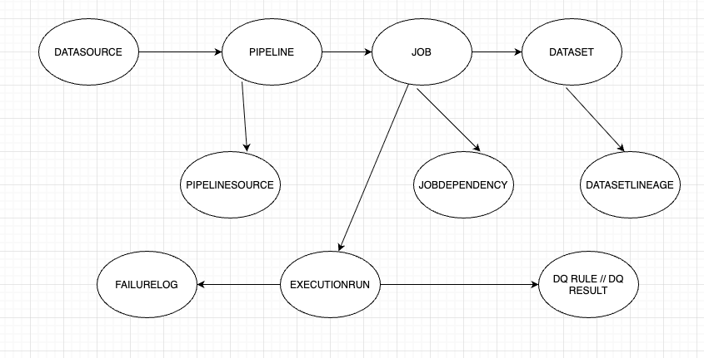
Positioning the OPS Layer in Modern Data Architecture
Bronze/Silver/Gold store business data
OPS schema stores operational metadata
Observes pipelines across all layers
Enables lineage, monitoring, and governance

Slide 6
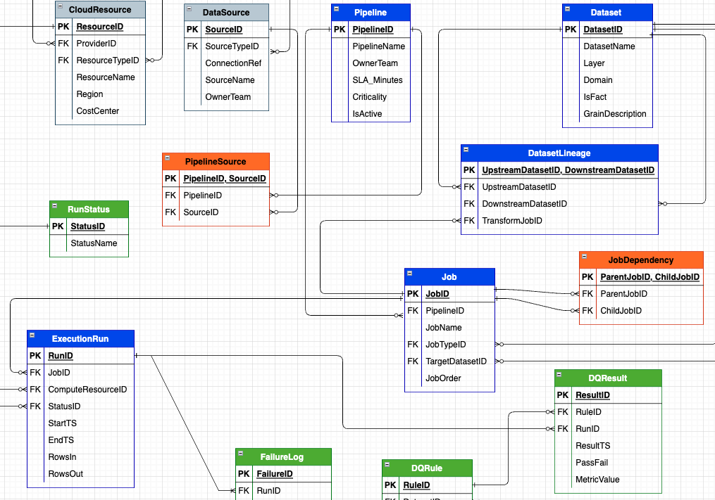
PROJECT OBJECTIVE
Centralized operational metadata
Clear separation of pipeline vs dataset responsibilities
Execution traceability across distributed compute
Foundation for lineage and monitoring layers
Normalization is foundational — observability and optimization are the primary contributions.

Slide 7
Graph-Based Lineage Modeling
Directed Acyclic Graph (DAG) representation
Upstream and downstream dataset dependencies
Many-to-many dataset relationships
Foundation for recursive transitive closure
Designed to represent DAG structure; cycle detection handled at query level.

Slide 8
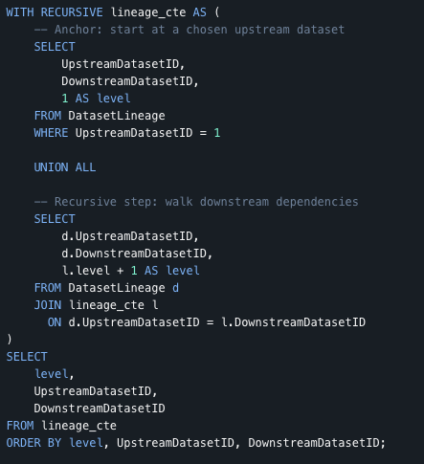
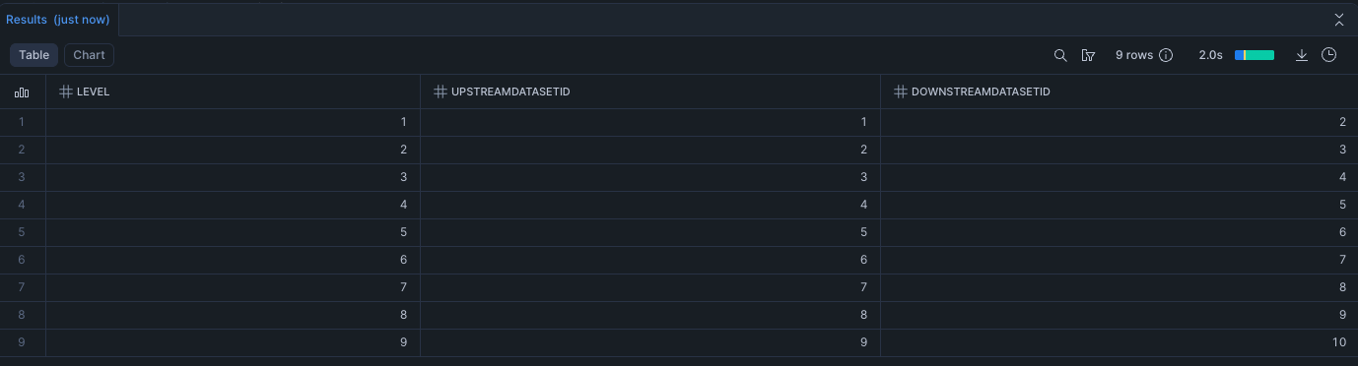
Recursive Lineage Traversal

Slide 9
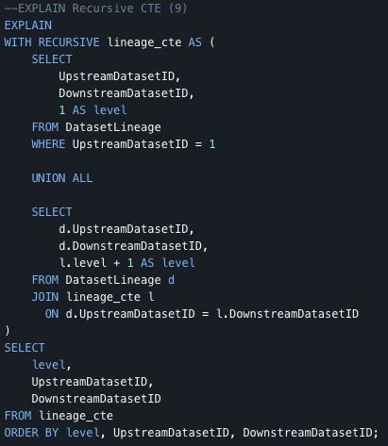
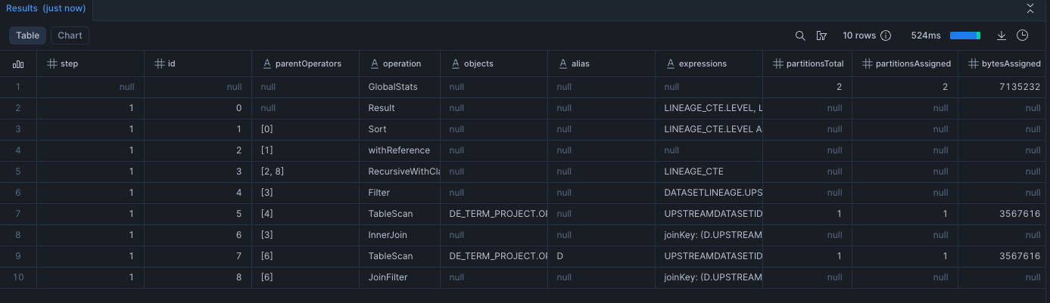
Logical Plan Analysis with EXPLAIN
EXPLAIN shows logical operator tree; Query Profile shows distributed execution costs.

Slide 10
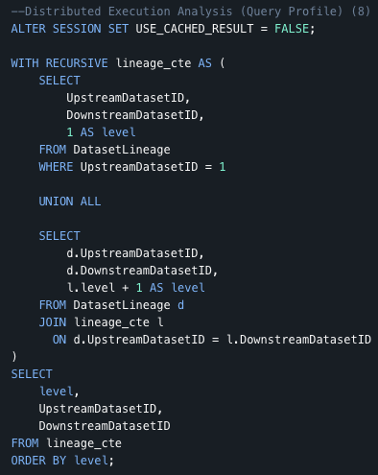
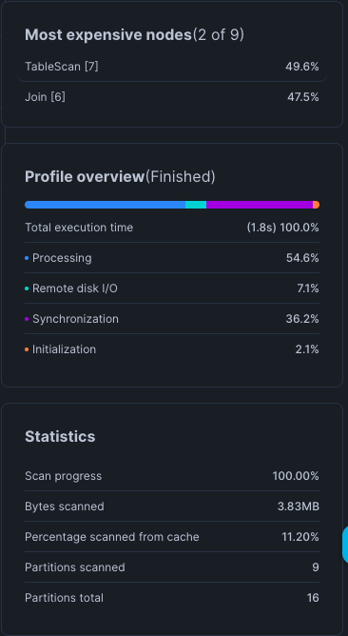
Distributed Execution Analysis (Query Profile)
Recursive query executed in distributed engine
Join-dominant workload observed
Micro-partition scan behavior analyzed
Processing vs synchronization cost breakdown

Slide 11
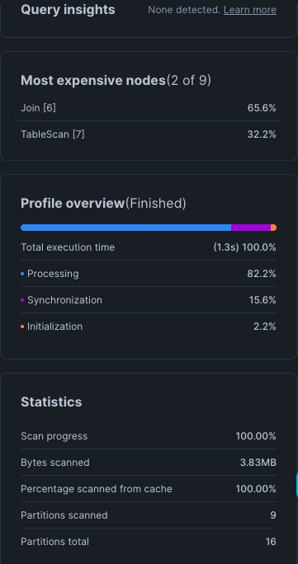
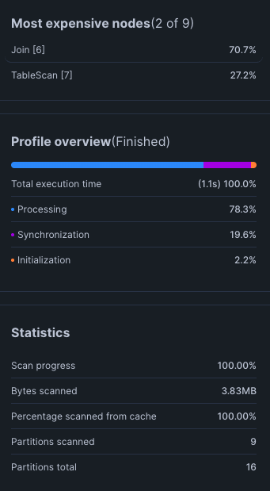
Clustering Strategy & Micro-Partition Evaluation
Recursive workload is join-dominant (~70%)
Partition pruning unchanged after clustering
Scan reduction ≠ runtime reduction
Optimization must align with workload pattern

Slide 12
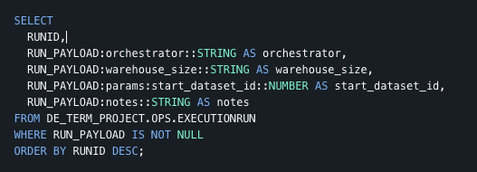
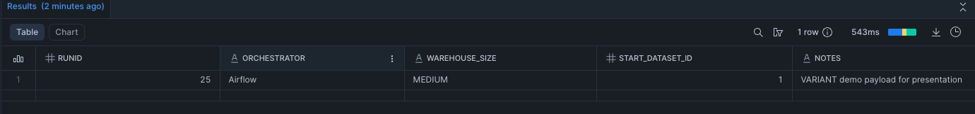
Semi-Structured Operational Metadata with VARIANT
VARIANT is Snowflake’s native semi-structured data type
Snowflake stores VARIANT in columnar micro-partitions.”

Slide 13
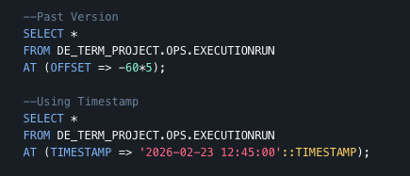
Temporal Querying & Recovery with Snowflake Time Travel
Query historical versions of tables
Recover accidentally modified data
Zero-copy architecture
Configurable retention period
Time Travel is metadata-based, not full data duplication.

Slide 14
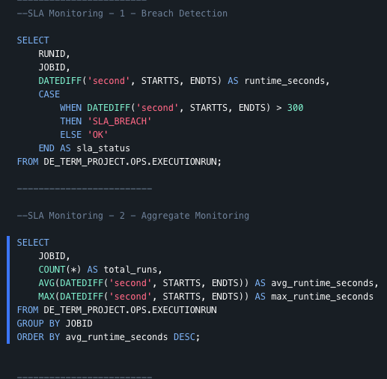
SLA Monitoring & Operational Observability
Per-run SLA breach detection
Aggregated job-level monitoring
Runtime-based threshold evaluation
Operational alerting capability

Slide 15
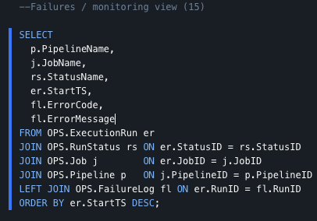
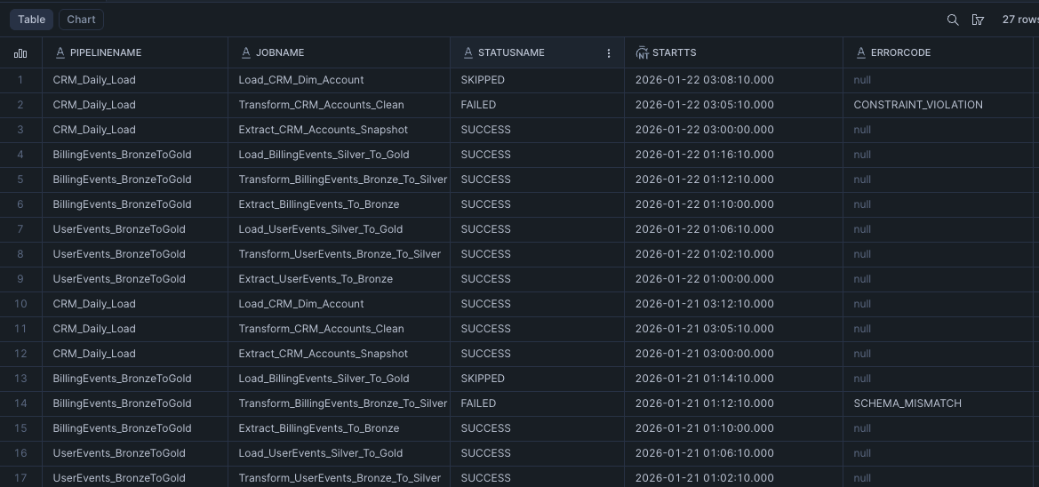
Operational Failure Monitoring
Unified pipeline-level failure visibility
Joins execution runs with status and failure logs
Displays error codes and error messages
Ordered by most recent execution

Slide 16
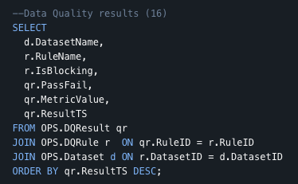
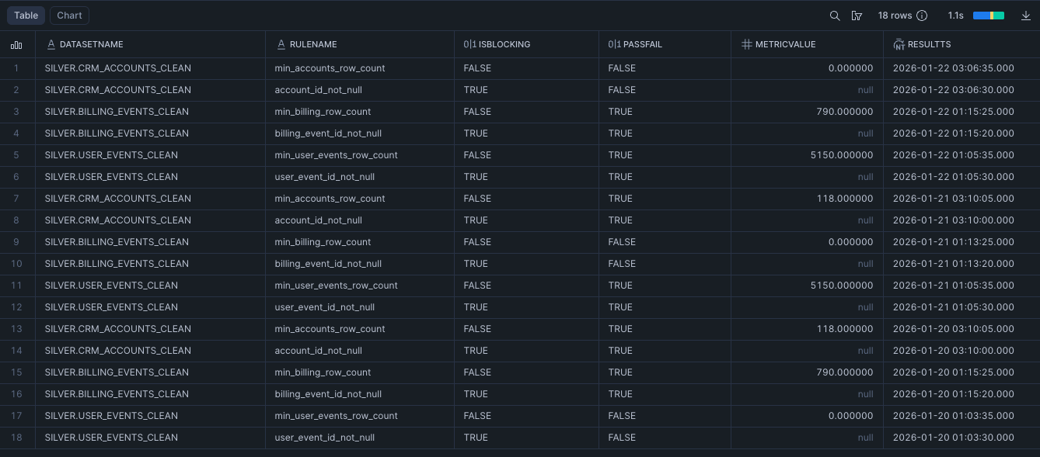
Data Quality Observability
Connects DQ rules to datasets
Flags blocking vs non-blocking rules
Displays metric values and pass/fail status
Enables rule-level monitoring over time

Slide 17
REFERENCES
Snowflake Inc. (2025). Referential Integrity Constraints
https://docs.snowflake.com/en/sql-reference/constraints-overview
Snowflake Inc. (2025). Recursive Common Table Expressions (CTEs)
https://docs.snowflake.com/en/user-guide/queries-cte
Snowflake Inc. (2025). EXPLAIN and Query Profile
https://docs.snowflake.com/en/user-guide/ui-query-profile
Snowflake Inc. (2025). Clustering Keys & Micro-Partitioning
https://docs.snowflake.com/en/user-guide/tables-clustering-keys
Snowflake Inc. (2025). Semi-Structured Data (VARIANT)
https://docs.snowflake.com/en/user-guide/semistructured-overview
Snowflake Inc. (2025). Time Travel & Data Retention
https://docs.snowflake.com/en/user-guide/data-time-travel
Garcia-Molina, H., Ullman, J. D., & Widom, J. (2008).
Database Systems: The Complete Book. Pearson Education.
Medallion Architecture (2024).
Bronze, Silver, Gold Data Design Pattern.
https://www.databricks.com/glossary/medallion-architecture

Slide 18
AI USAGE
Artificial intelligence tools were used in a limited and assistive capacity during this project.
Specifically, AI was used to generate synthetic sample data for the Bronze layer in order to simulate realistic event streams for testing lineage traversal, Medallion transformations, and observability queries.
AI was also used as a language-assistance tool to refine documentation and presentation phrasing.

