Slide 1


Sidharth Mahotra
Supercharge
Google Collab With
side-by-side-Colab
Swipe for more

Slide 2
Sidharth Mahotra
Have you ever felt a pang of frustration with Google Colab's vertical cell output layout?
Allow me to unveil the reasons why this design choice can sway productivity:
Swipe for more

Slide 3
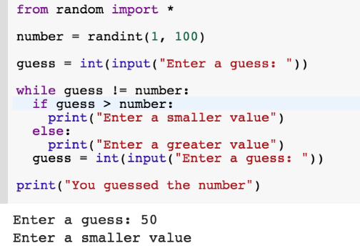

Sidharth Mahotra
Google Collab vertical cell output layout: Issues
Cell Output Below
Constant scrolling between code and results, especially with lengthy outputs
Limited visibility when comparing code and its corresponding output
Inefficient use of wide-screen monitors
Difficult debugging experience when outputs are large charts or data tables
Swipe for more

Slide 4
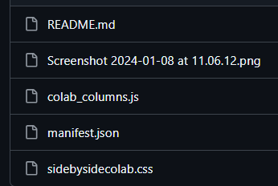

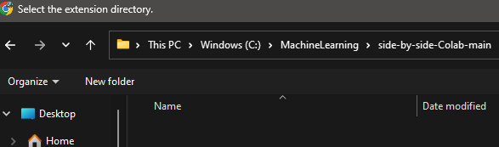
Sidharth Mahotra
Solution: Side-by-Side Colab Chrome Extension
This tool transforms the Google Colab interface, elegantly positioning the output of each code cell in a column right beside its source, enhancing your coding experience.
To install the extension, follow these steps:
Download the CSS, JavaScript, and JSON files from the Side-by-Side Colab GitHub repository. :https://github.com/guy-singer/side-by-side-Colab
Place the files in a directory on your system.
Open Google Chrome ->Settings ->Extensions -> Manage extensions
Enable Developer Mode in the Extensions section.
Click ‘Load unpacked’ and select the directory with the downloaded files.
Restart Google Colab to see the changes.
Swipe for more

Slide 5
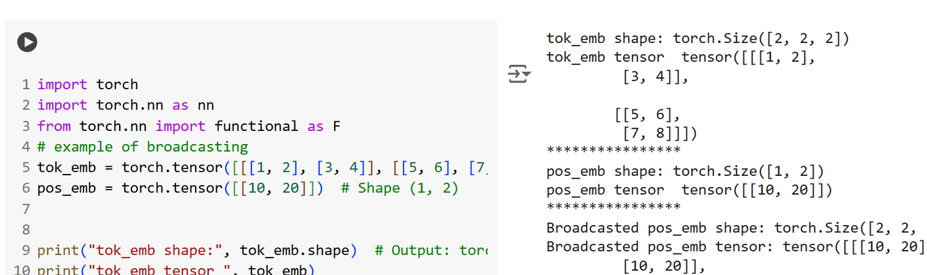
Sidharth Mahotra
Result
Side by side Cell Op
Cell Op

Slide 6

Sidharth Mahotra
If you
helpful, please like and share it
find this

