Slide 1

Predict Earthquake Magnitude And Identify High-risk Regions Based On Historical Earthquake Data
Name :
Sheena Anilkumar Patel

Slide 2
Introduction
Data Collection and Exploration
Methodology
Results
Discussion
Conclusion

Slide 3
Introduction
Problem Statement:
Predict earthquake magnitude using historical data.
Identify high-risk regions for earthquakes based on clustering historical earthquake occurrences.
Objectives:
Use decision tree for magnitude prediction.
Apply DBSCAN (Density-Based Spatial Clustering) to cluster geographical regions prone to earthquakes.
Extract actionable insights for disaster preparedness.
Dataset Background:
The dataset includes historical earthquake records from 1/1/2001 to 1/1/2023
Rows: 1603
Columns: 19
Source: https://www.kaggle.com/datasets/warcoder/earthquake-dataset?select=earthquake_1995-2023.csv

Slide 4
Column descriptions:
magnitude: The magnitude of the earthquake date_time: date and time cdi: The maximum reported intensity for the event range mmi: The maximum estimated instrumental intensity alert: The alert level - “green”, “yellow”, “orange”, and “red” tsunami: "1" for events in oceanic regions and "0" otherwise sig: A number describing how significant the event is. Larger numbers indicate a more significant event. This value is determined on a number of factors, including: magnitude, maximum MMI, felt reports, and estimated impact net: The ID that Identifies the network - source of information for this event. nst: The total number of seismic stations used to determine earthquake location. | dmin: Horizontal distance from the epicenter to the nearest station gap: The largest azimuthal gap between azimuthally adjacent stations (in degrees). In general, the smaller this number, the more reliable is the calculated horizontal position of the earthquake. Earthquake locations in which the azimuthal gap exceeds 180 degrees typically have large location and depth uncertainties magType: The method or algorithm used to calculate the preferred magnitude for the event depth: The depth where the earthquake begins to rupture latitude / longitude: coordinate system by means of which the position or location of any place on Earth's surface can be determined and described location: location within the country continent: continent of the earthquake hit country country: affected country

Slide 5
Data Collection and Exploration
Data Collection:
Earthquakes are recorded by a seismographic network. Each seismic station in the network measures the movement of the ground at that site.
Exploratory Data Analysis (EDA) :
Pie chart
Histogram
Frequency table
Covariance
Box plot
Treemap
Text table
Map view

Slide 6
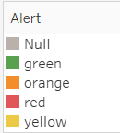
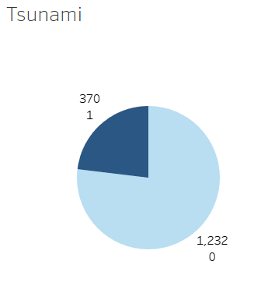
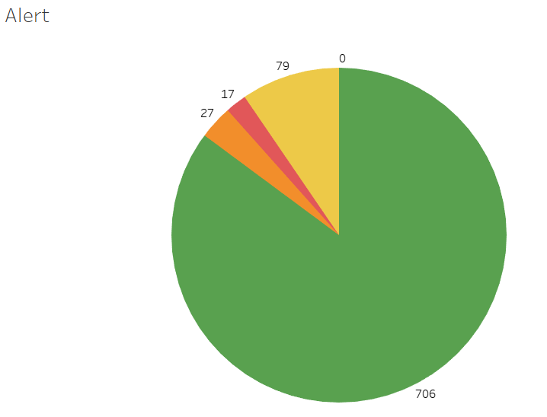


Exploratory Data Analysis (EDA) :
Pie chart

Slide 7
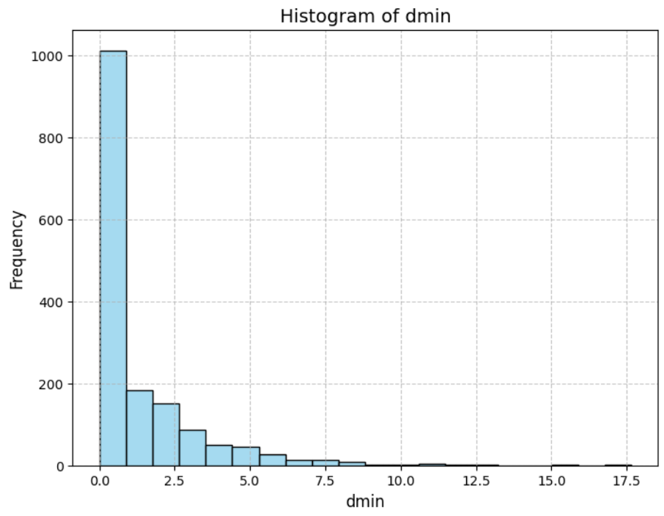
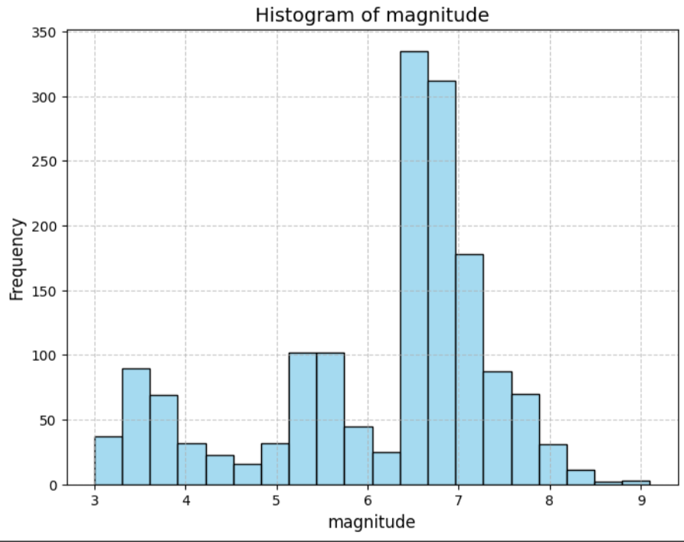
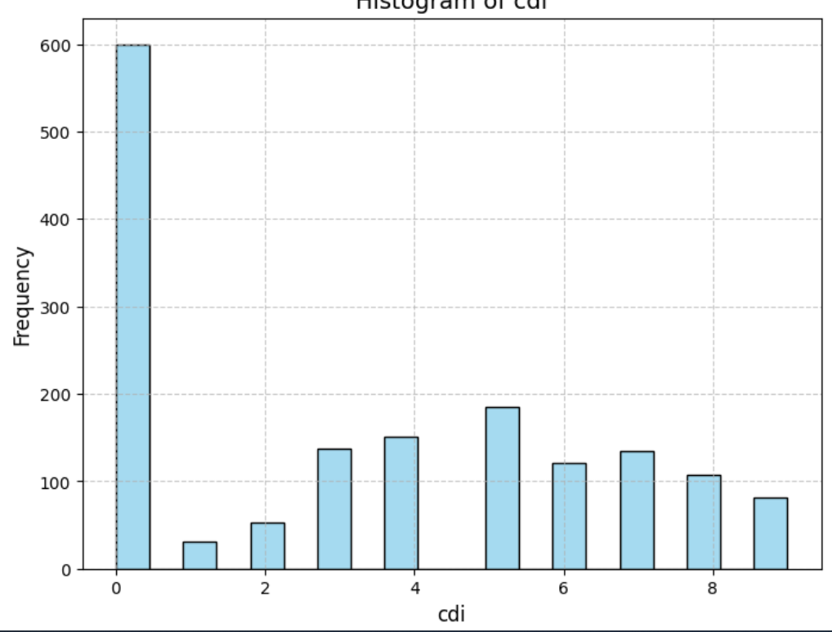
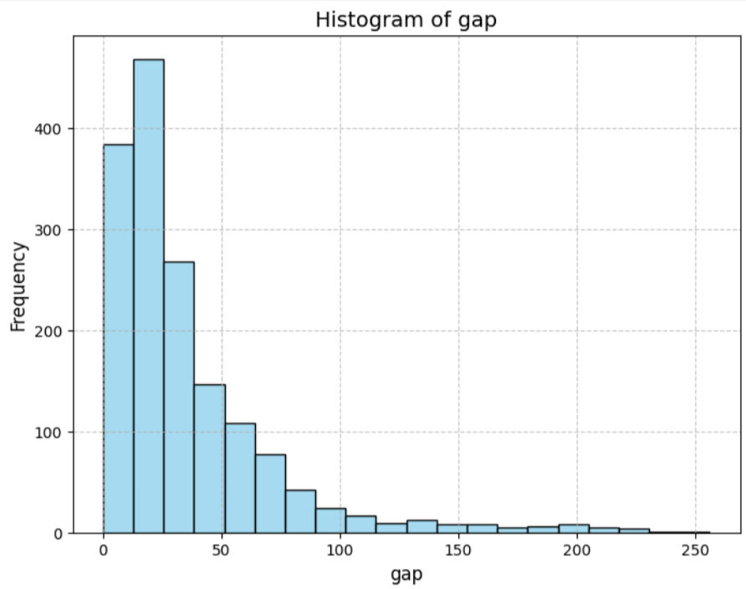
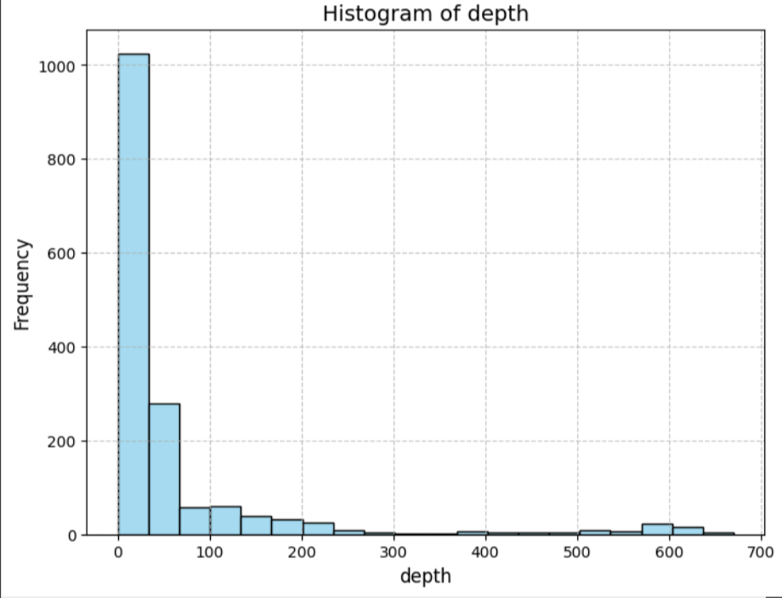
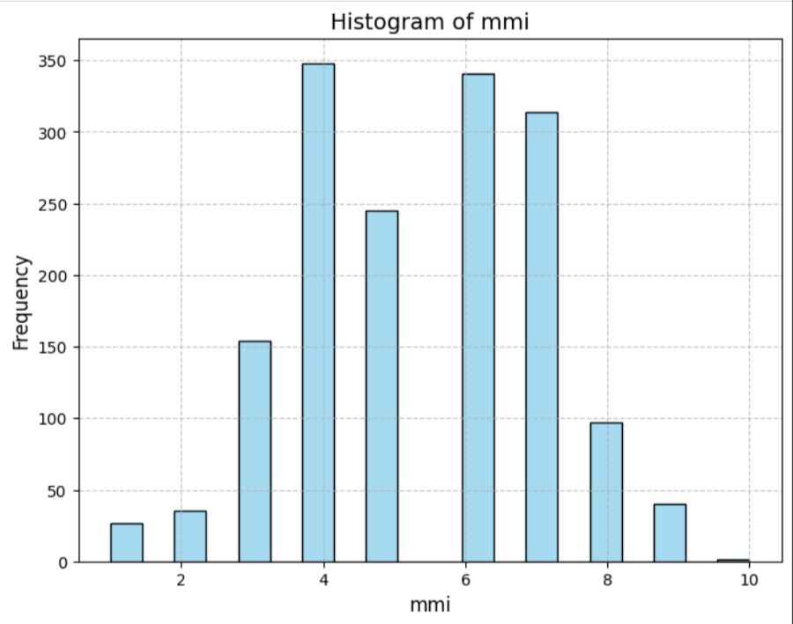
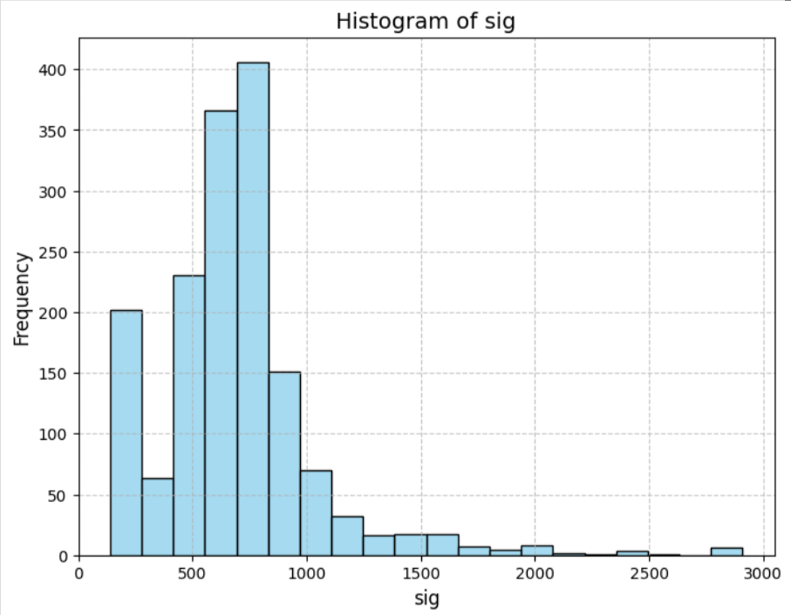
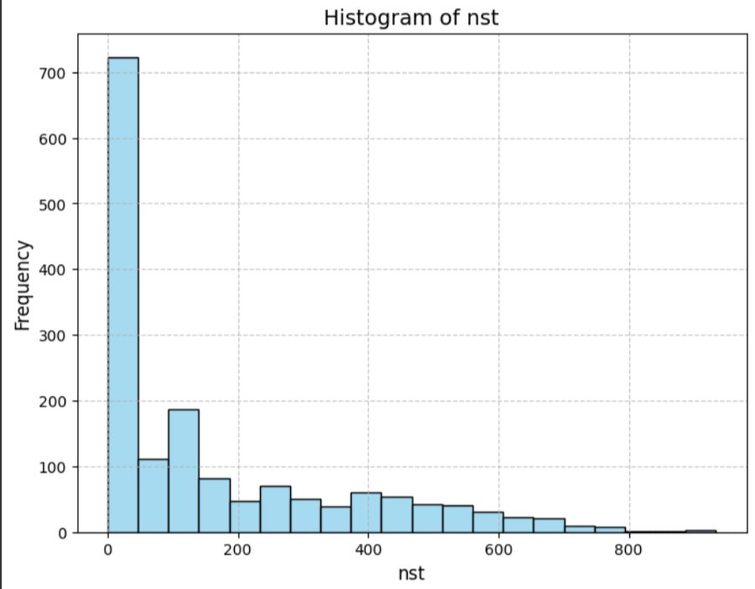
Exploratory Data Analysis (EDA) :
Histogram

Slide 8
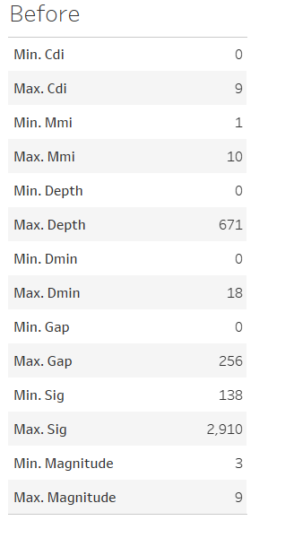
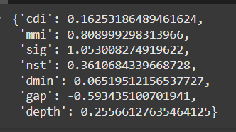
Exploratory Data Analysis (EDA) :
Frequency table
Covariance

Slide 9
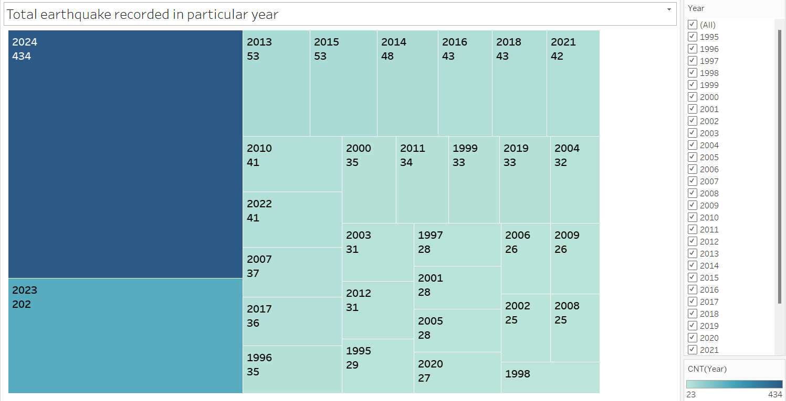
Exploratory Data Analysis (EDA) :
Treemap

Slide 10
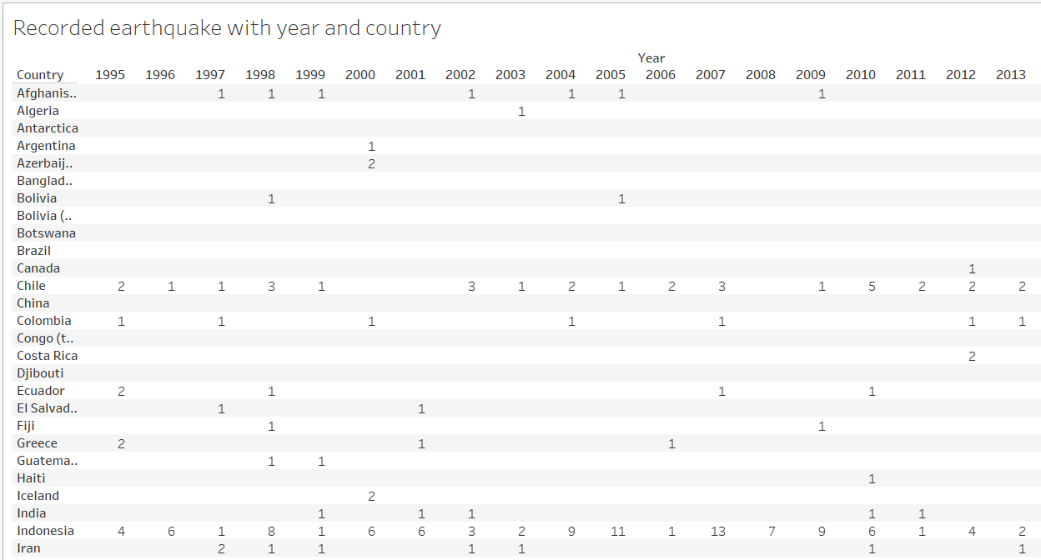
Exploratory Data Analysis (EDA) :
Text table

Slide 11
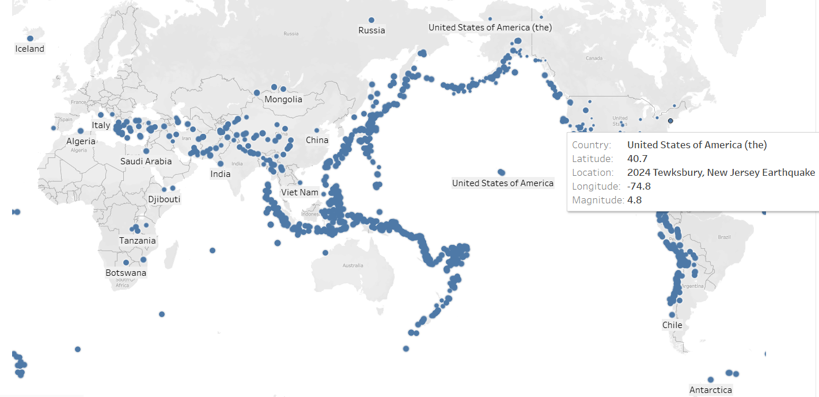
Exploratory Data Analysis (EDA) :
Map view

Slide 12
Data Preprocessing
Handling missing values
Data transformation
Dealing with Outliers

Slide 13
Handling missing values :
Handling missing values for numeric data with Average
- Magnitude
- Cdi
- Mmi
- Sig
- Dmin
- Gap
- Depth

Slide 14
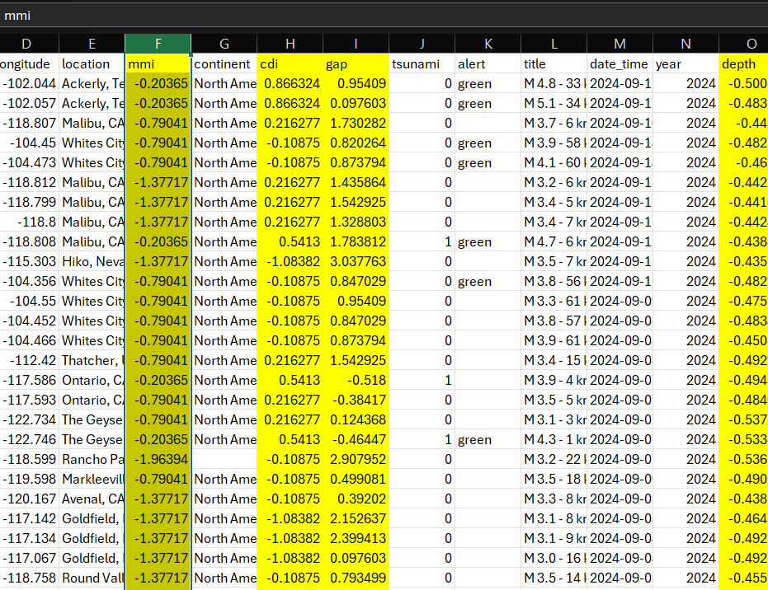
Data transformation :
Calculate z score for numeric data type attributes:
Magnitude
Cdi
Mmi
Sig
Dmin
Gap
Depth

Slide 15
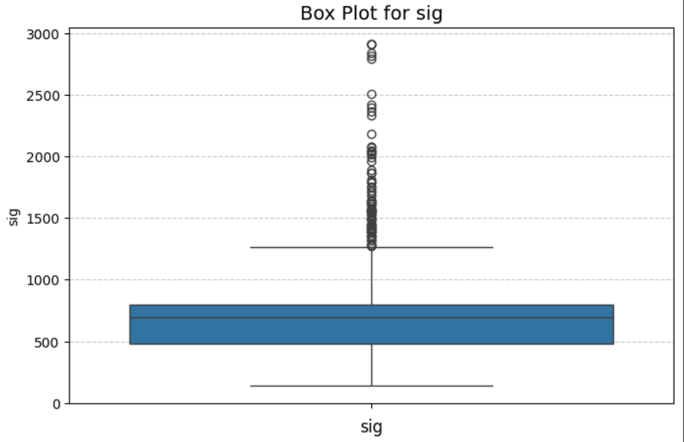
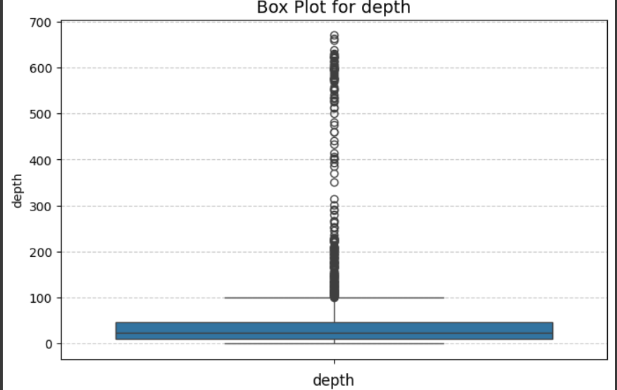
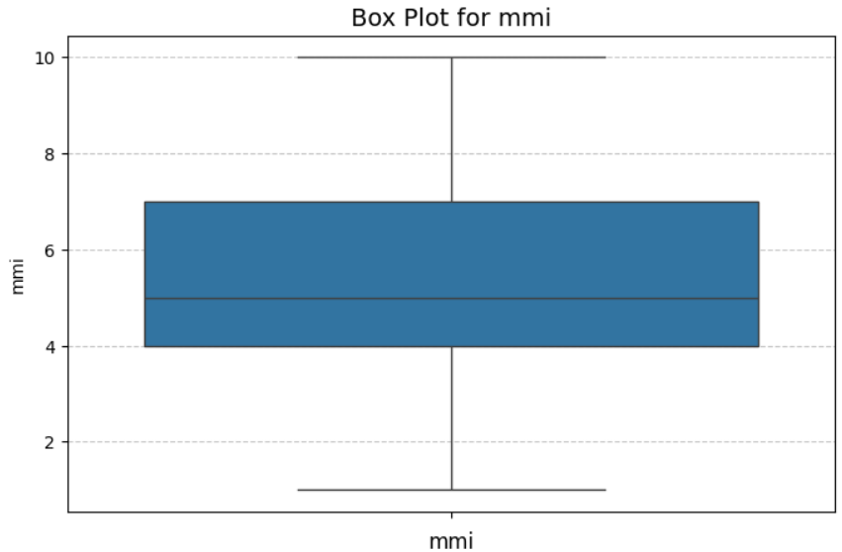
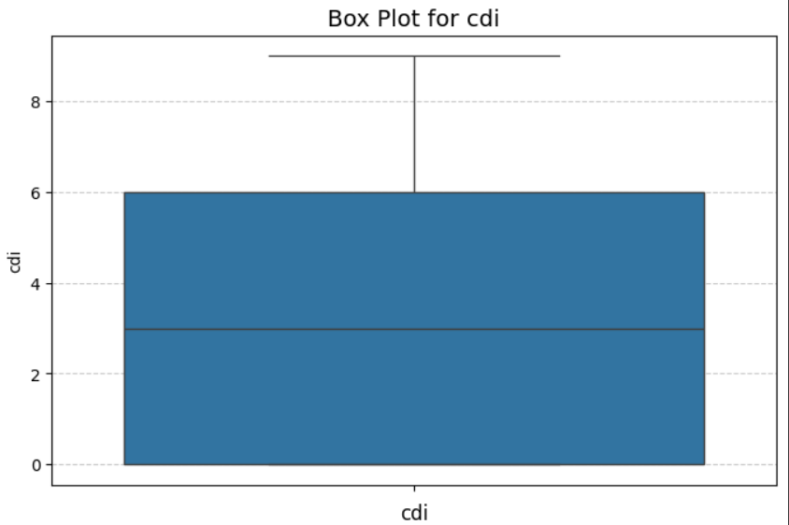
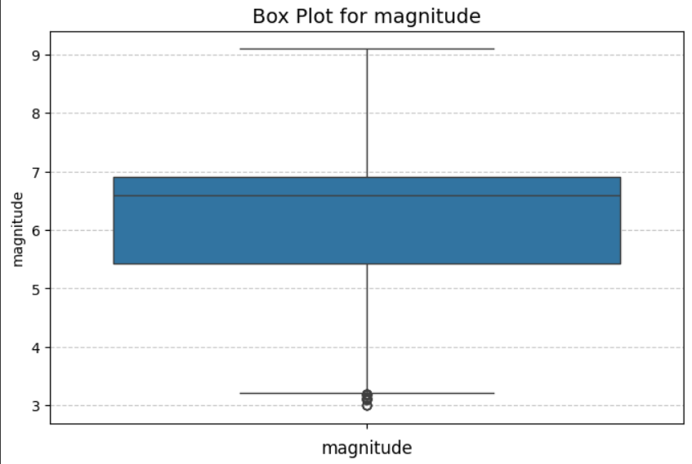
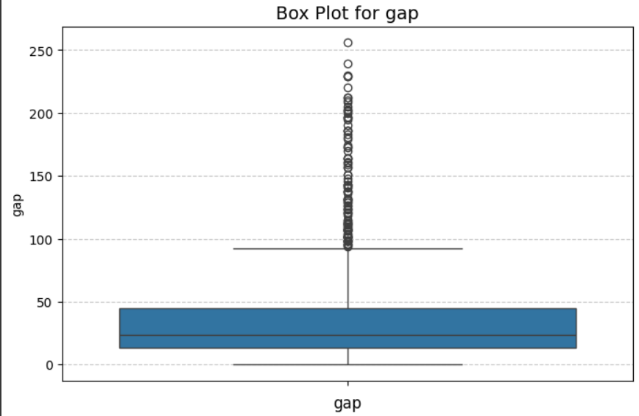
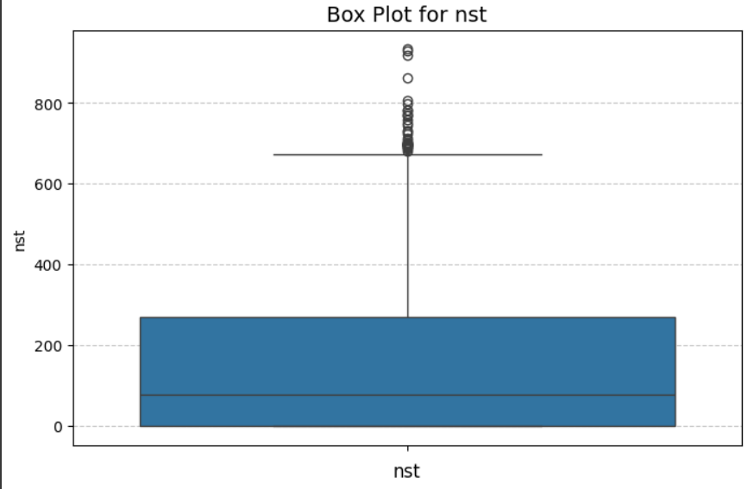
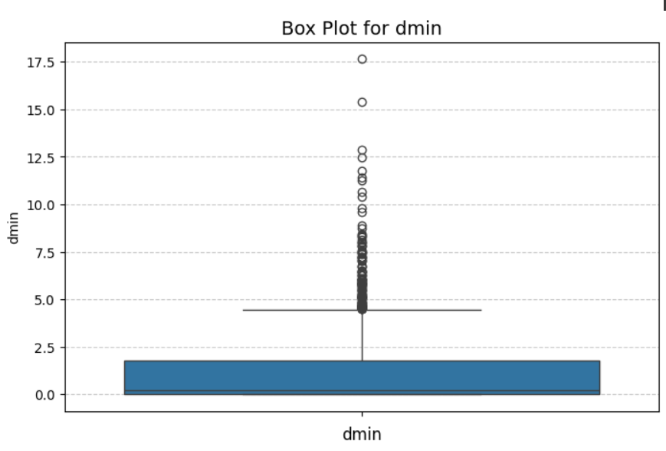
Dealing with outliers :
Box plot

Slide 16
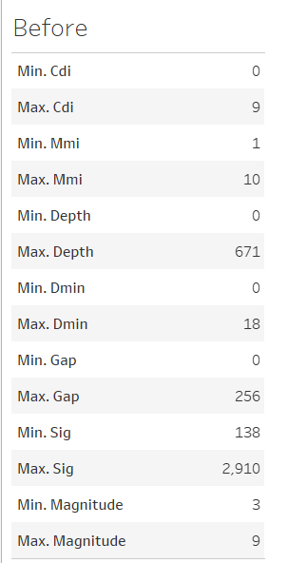
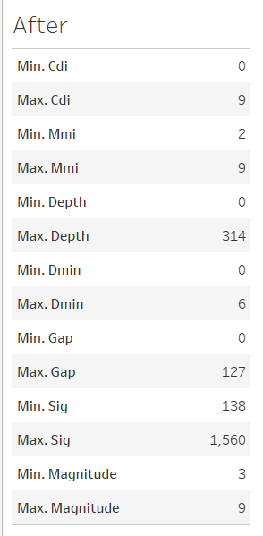

Dealing with outliers :

Slide 17
Methodology:
Data Mining Technique
Decision Tree & KNN - Predict Earthquake Magnitude
Clustering - Identify High-risk Regions Based On Historical Earthquake Data

Slide 18
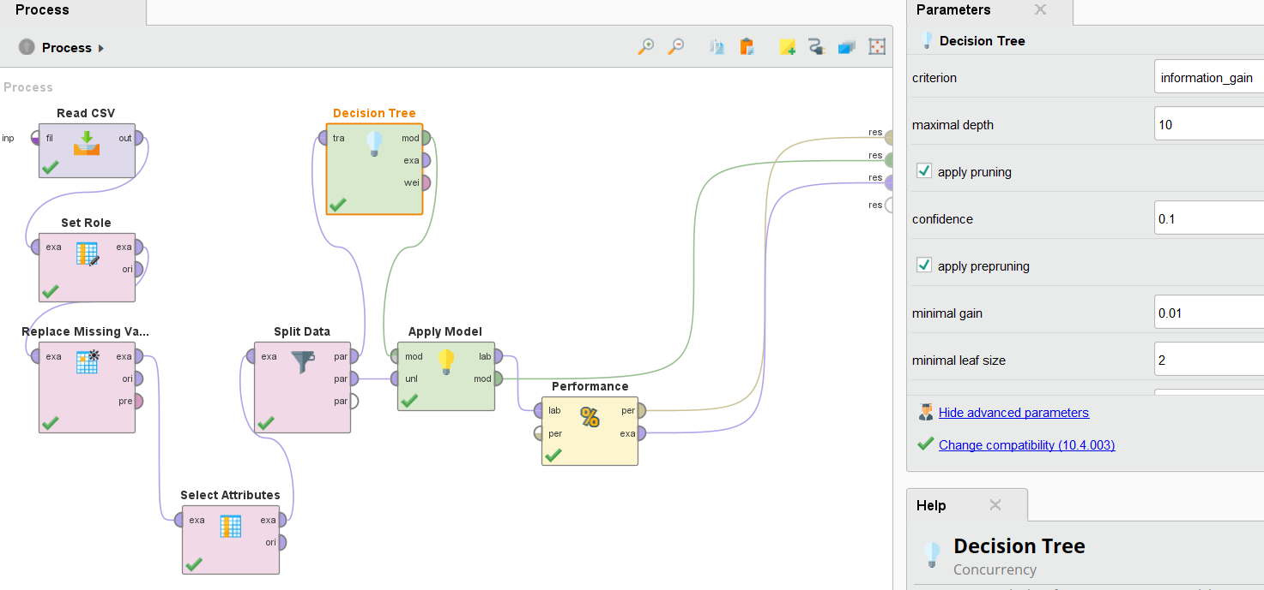
Decision Tree : Predict earthquake magnitude

Slide 19
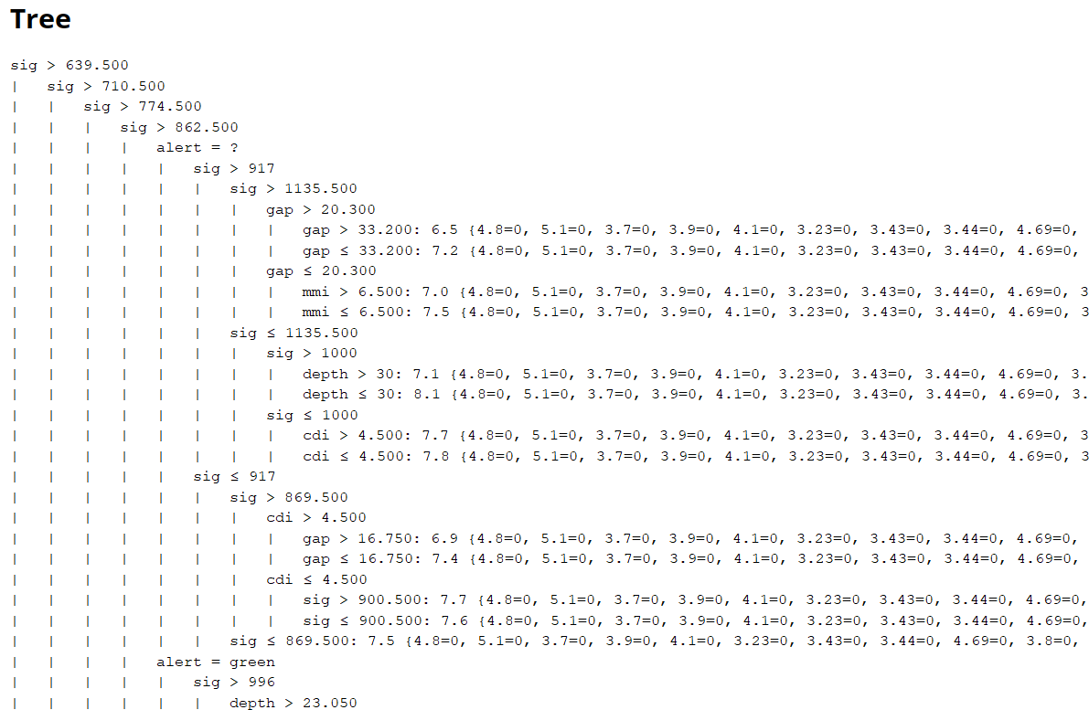
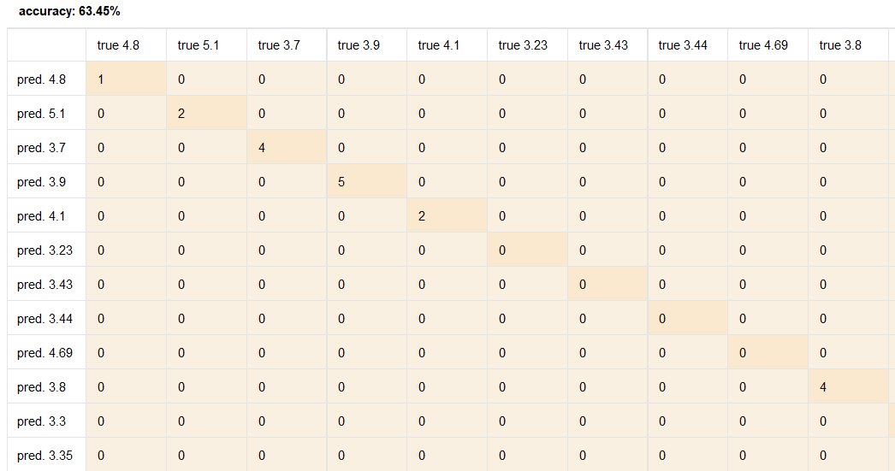
Decision Tree : Predict earthquake magnitude

Slide 20
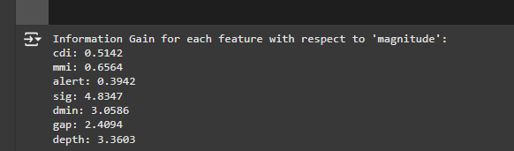
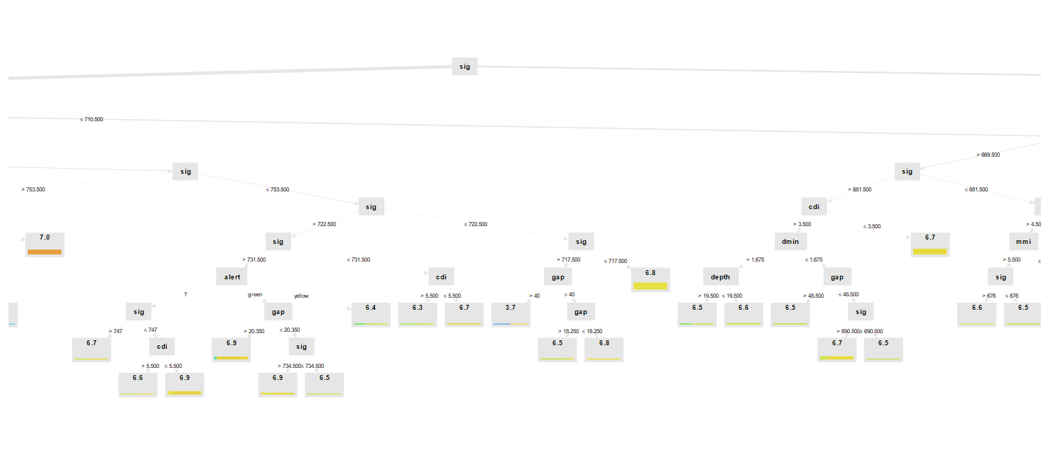
Decision Tree : Predict earthquake magnitude

Slide 21
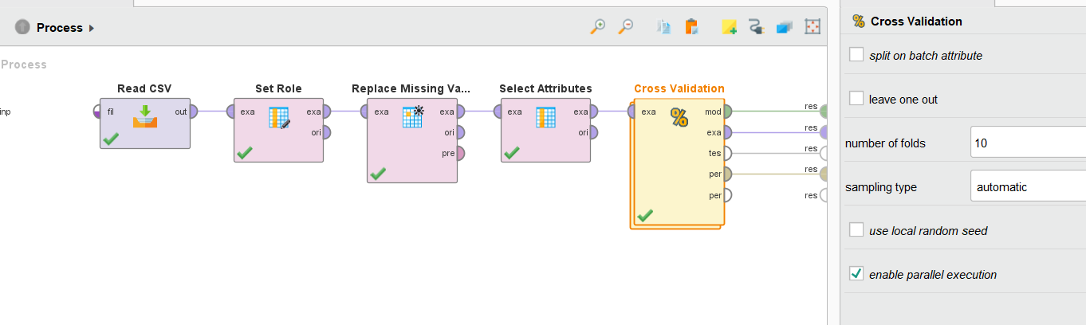
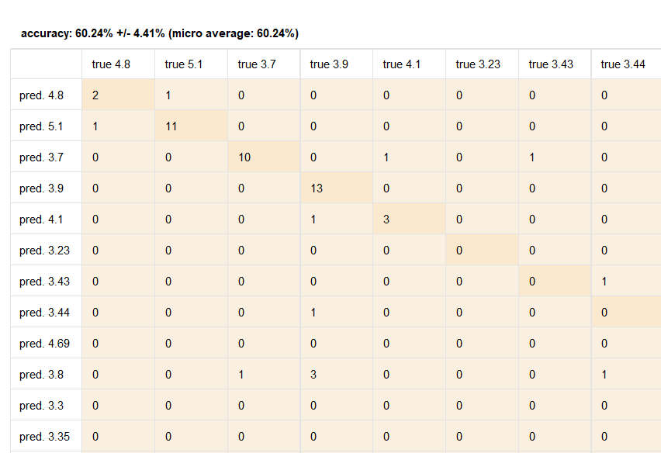
Decision Tree : Predict earthquake magnitude

Slide 22
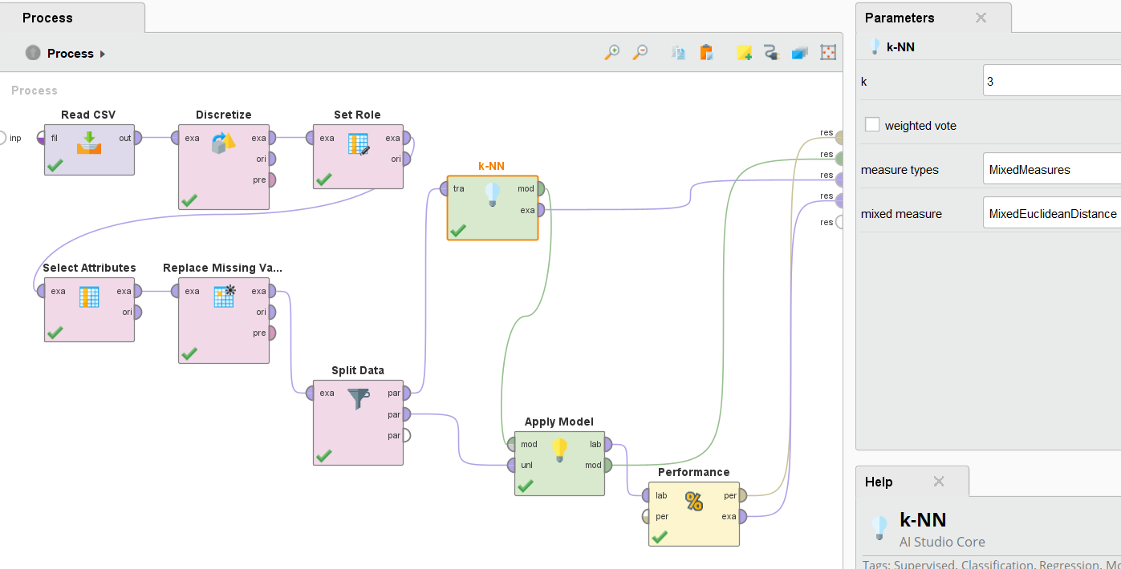
KNN : Predict earthquake magnitude

Slide 23
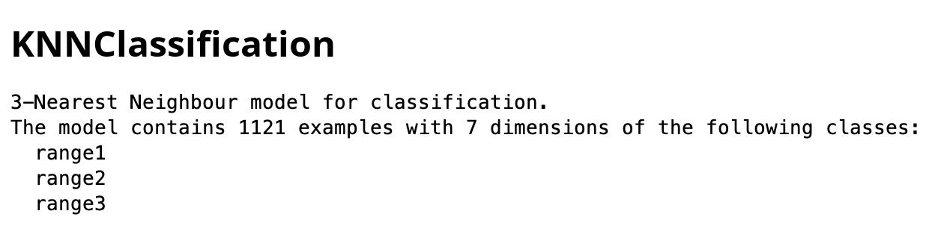
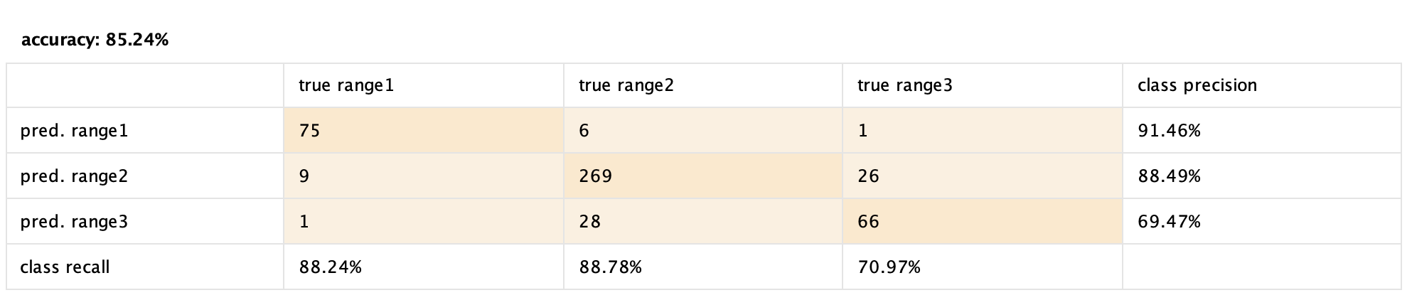
KNN : Predict earthquake magnitude

Slide 24
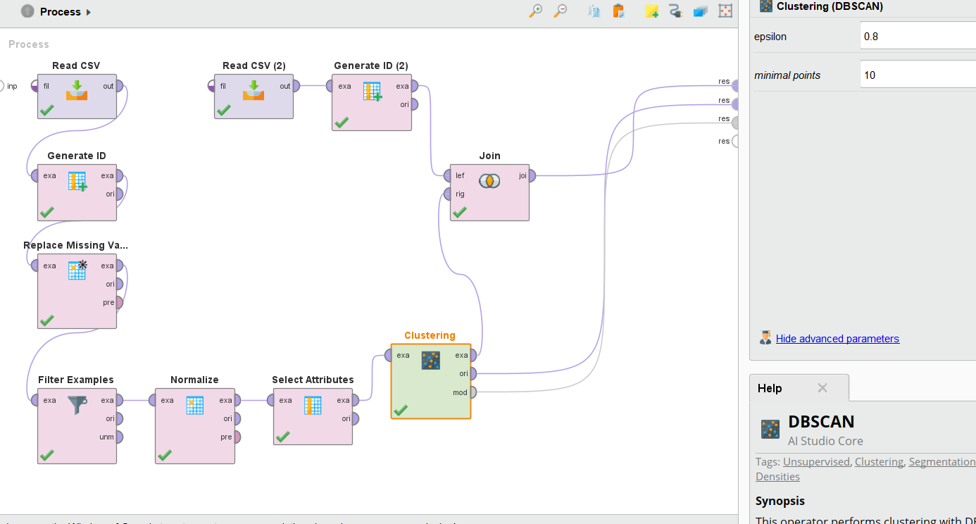
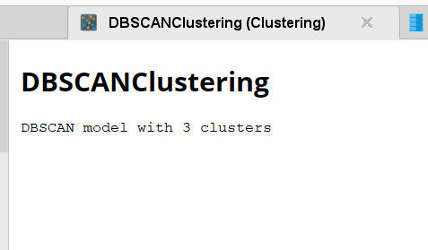
Clustering - Identify High-risk Regions Based On Historical Earthquake Data

Slide 25
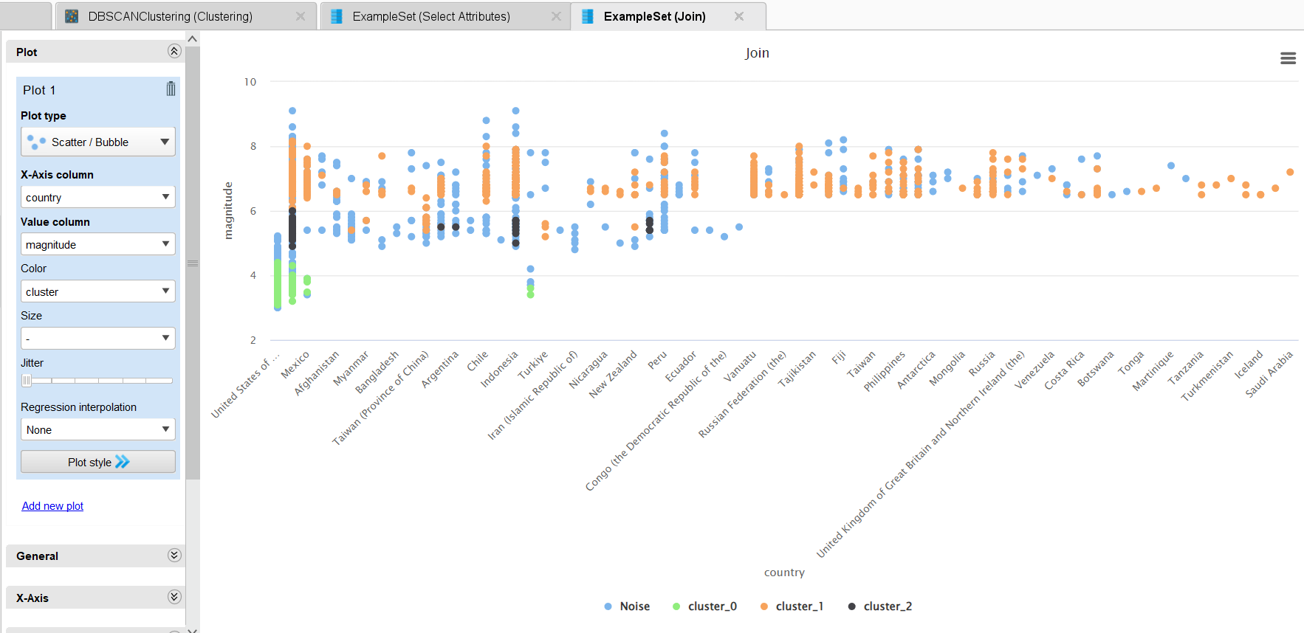
Clustering - Identify High-risk Regions Based On Historical Earthquake Data

Slide 26
Results:
Decision Tree
(split)
Decision Tree
(cross validation)
KNN

Slide 27
Discussion:
Analysis in Context:
Magnitude Prediction:
decision tree is around 63% accurate in predicting earthquake magnitudes based on historical data.
For some data records decision tree is overestimating or underestimating certain magnitudes.
Knn on other hand is more accurate in predicting earthquake than decision tree
Cluster Analysis:
DBSCAN helps in highlighting the spatial patterns in the clustering results.
Helps in Identify regions prone to high-magnitude earthquakes (e.g., clusters with higher average magnitude).
It also Highlight noise points (outliers)
Recommendations:
Focus on disaster preparedness in high-risk regions identified through clustering.
Use predictive models to issue early warnings for potential high-magnitude earthquakes.
Improve data collection and preprocessing for more accurate predictions.

Slide 28
Discussion:
Limitations and Challenges:
Data Limitations:
Potential biases in historical earthquake records.
Incomplete or missing data affecting model accuracy.
Model Trade-offs:
DBSCAN sensitivity to parameters (epsilon and min_samples).

Slide 29
Conclusion:
Summary of Findings:
Decision tree is not effective, but KNN is effectively predicted earthquake magnitudes with a measurable accuracy, precision, and recall.
DBSCAN clustering successfully identified high-risk regions, with some noise points indicating isolated events.
Insights from the dataset can help improve disaster preparedness and resource allocation.
Impact on Research or Practice:
Encourages the adoption of machine learning techniques in seismology and disaster management.
Provides a framework for identifying high-risk areas for future studies.
Future Research:
Experiment with other clustering algorithms (e.g., K-Means, Hierarchical Clustering) for comparison.
Incorporate additional features (e.g., tectonic plate boundaries, population density) to enhance predictions and clustering.
Develop real-time models to integrate new earthquake data dynamically.

Slide 30
Questions???

Slide 31
Thank You ☺

