Slide 1
ERS.io Employee Reimbursement System
Author: Ben Wilson, Cory Hamilton, Aleksandra Howell, Chris Karpowicz
Department: SEED
Date: 04/28/2017
Notes:
Template version: 9/26/2012

Slide 2
ERS.io Inputs
Technologies
Environment
Java 1.8
JDBC
SQL
Servlets
Freemarker
HTML
CSS
Bootstrap
JavaScript
Tomcat 8.x
Postgres
Git
Maven
IntelliJ

Slide 3
ERS.io Requirements
Employee
Manager
An Employee can login (just username)
An Employee can view the Employee Homepage
An Employee can logout
An Employee can submit a reimbursement request
An Employee can view their pending reimbursement requests
An Employee can view their resolved reimbursement requests
An Employee can view their information
An Employee can update their information
A Manager can login (just username)
A Manager can view the Manager Homepage
A Manager can logout
A Manager can approve/deny pending reimbursement requests
A Manager can view all pending requests from all employees
A Manager can view all resolved requests from all employees and see which manager resolved it
A Manager can view all Employees
A Manager can view reimbursement requests from a single Employee

Slide 4
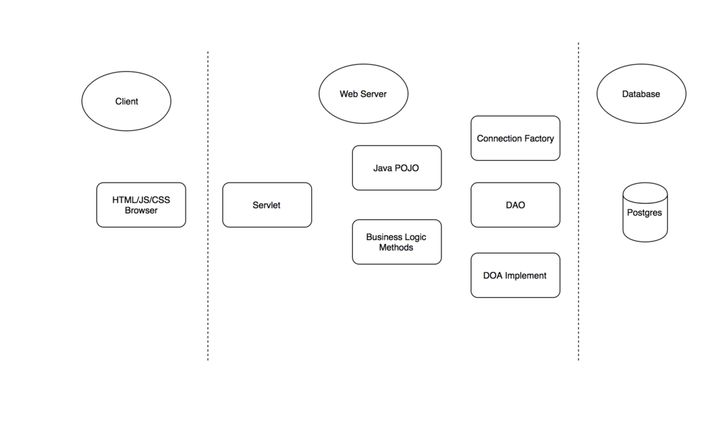
ERS.io Data Flow

Slide 5
ERS.io Lessons Learned
What did you learn?
  Merge Conflicts are real and need to be worked through
  TDD would help to pinpoint bugs later in the process
What worked well?
  Pair programming
  Co-location at Capital One Café at Short Pump Town Center
What would you do differently?
  Get Core Horizontal functionality working earlier on
Notes:
Click to add notes
+100 points for finding this

