Slide 1
Where New Yorkers Drink

Slide 2
Project Overview
Nightlife in NYC
Different ways to characterize it:
People working
Relaxing
Exercising
Drinking…?

Slide 3
Where do New Yorkers Drink?
Sources for understanding drinking culture in NYC
Bars and restaurants
Liquor stores
Bodegas
At home
Yelp data - Dive bars
Observational/based on human activity
311 data

Slide 4
311 Complaints
Tons of different types of complaints in the 311 data set
I focused on 2 categories:
Public drunkenness
Public urination
Dataframe cleaning:
Created point geometry based on incident latitude and longitude
Removed complaints of underage drinking
Kept only complaints filed between 8 pm and 4 am
Left with 874 complaints against drinking and 316 against urination between 2010 and 2018
Mapped onto a NYC neighborhood shapefile:

Slide 5
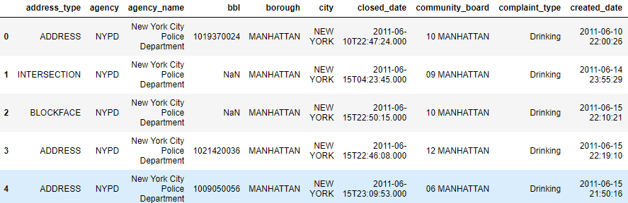
Sample Data

Slide 6
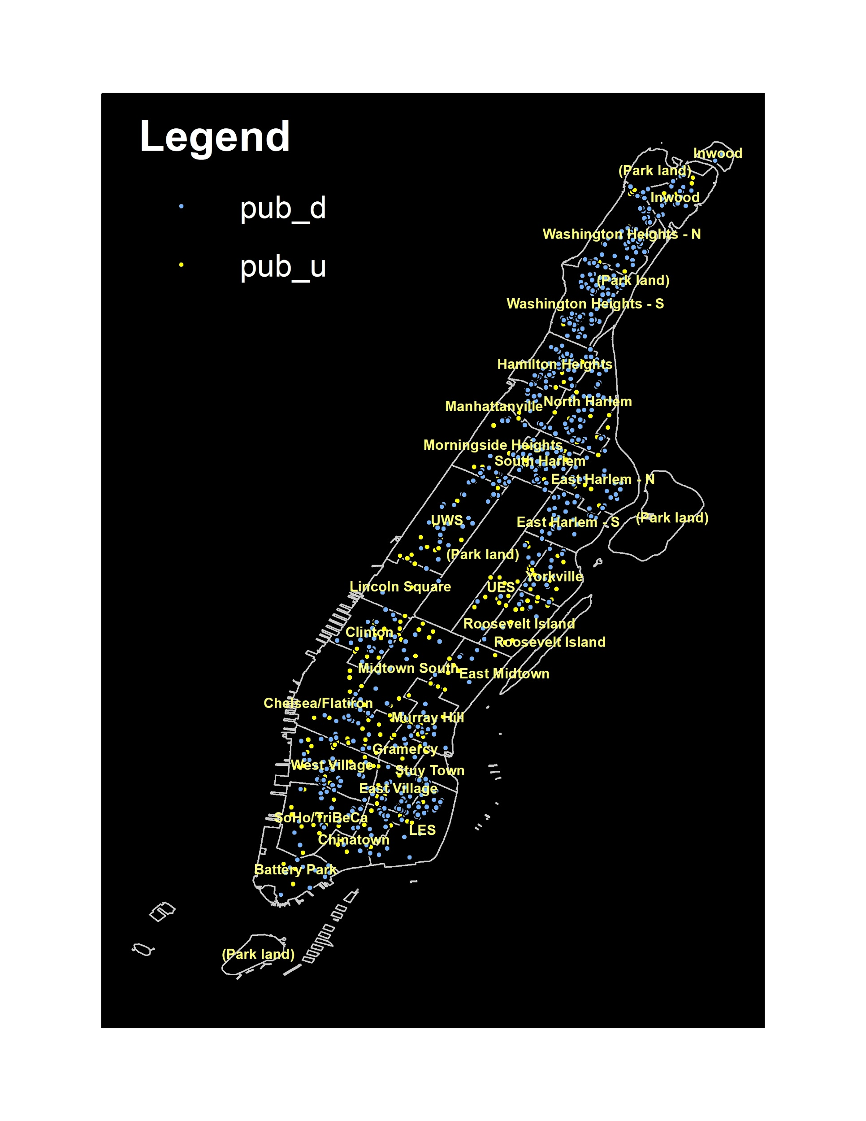
Initial Plot
Plot of all 311 complaints together
Public drunkenness in blue
Public urination in yellow

Slide 7
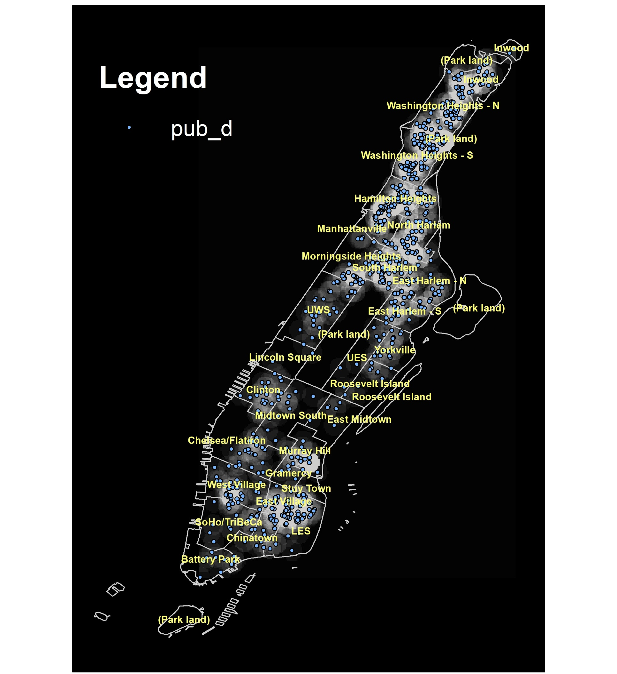
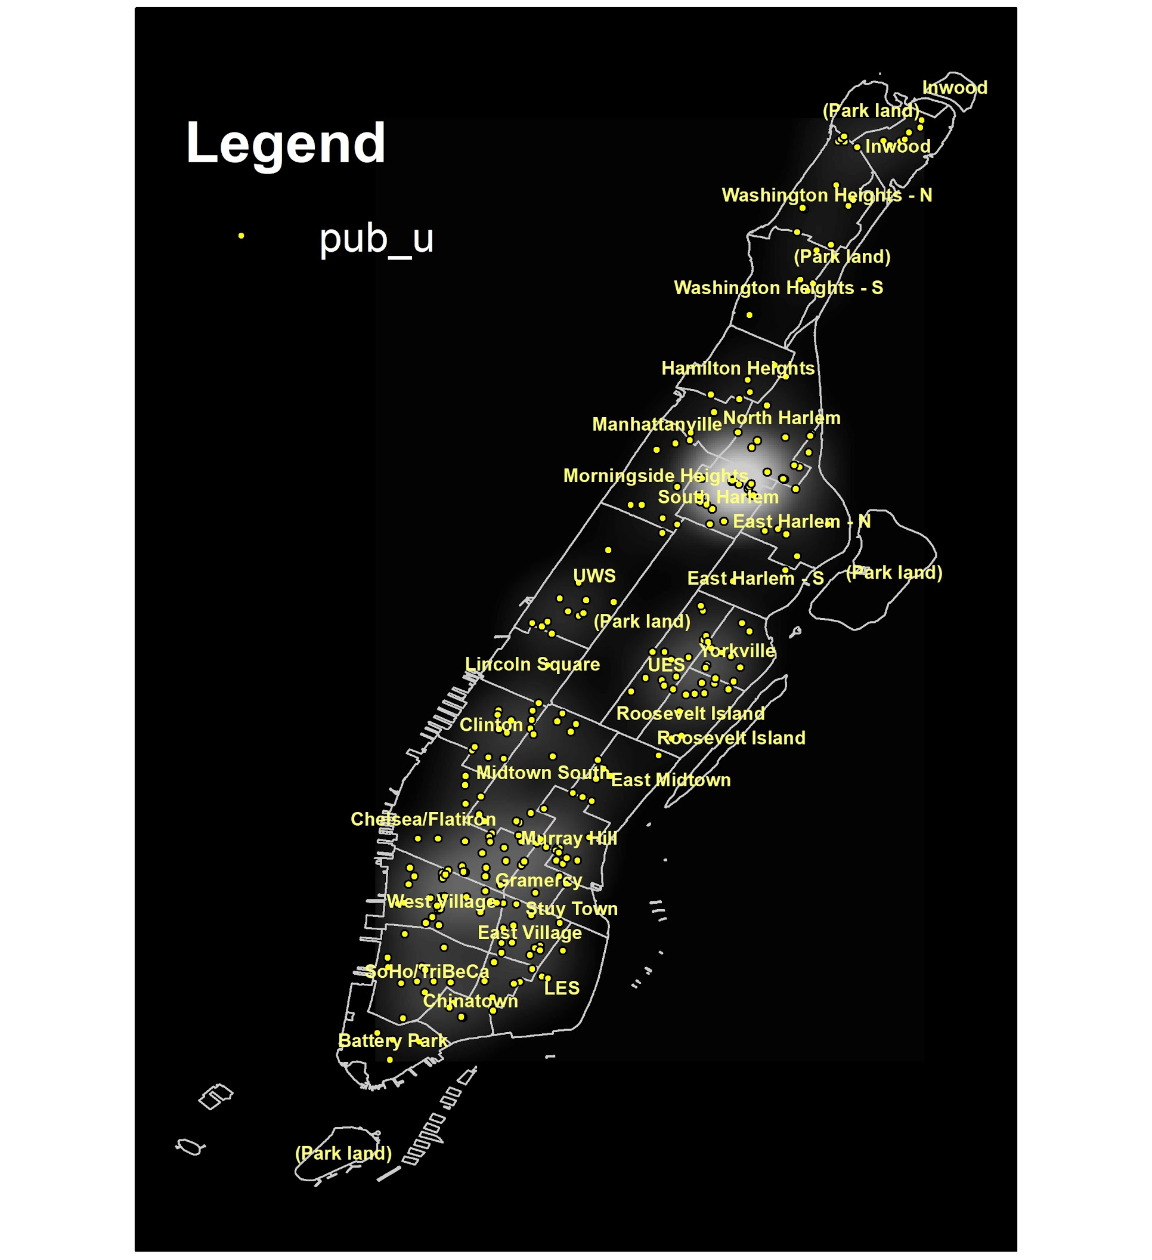
Kernel Density Comparison

Slide 8
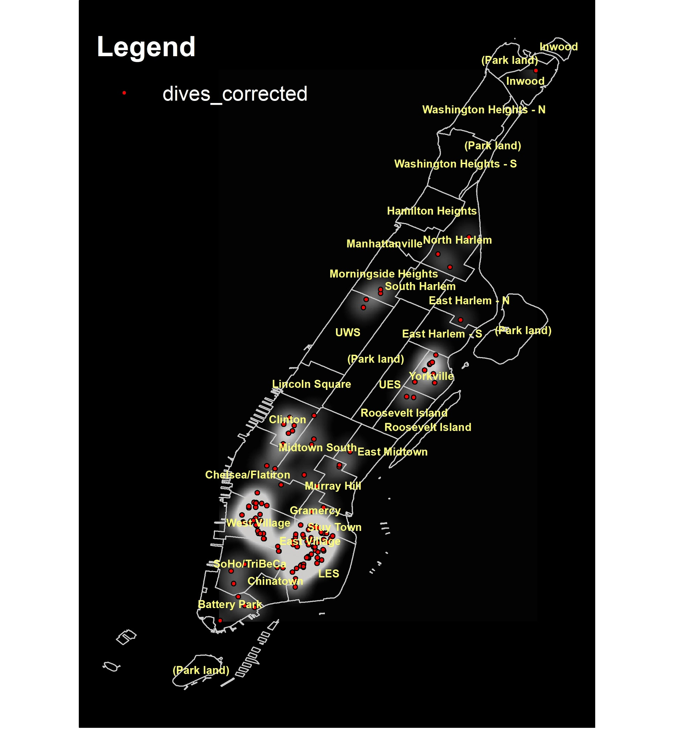
Dive Bars
Pulled data from Yelp API
Restricted to “dive bars” located in Manhattan with $1
134 $1 dive bars
Found correlation between cheapest dive bars in Manhattan and 311 complaints

Slide 9
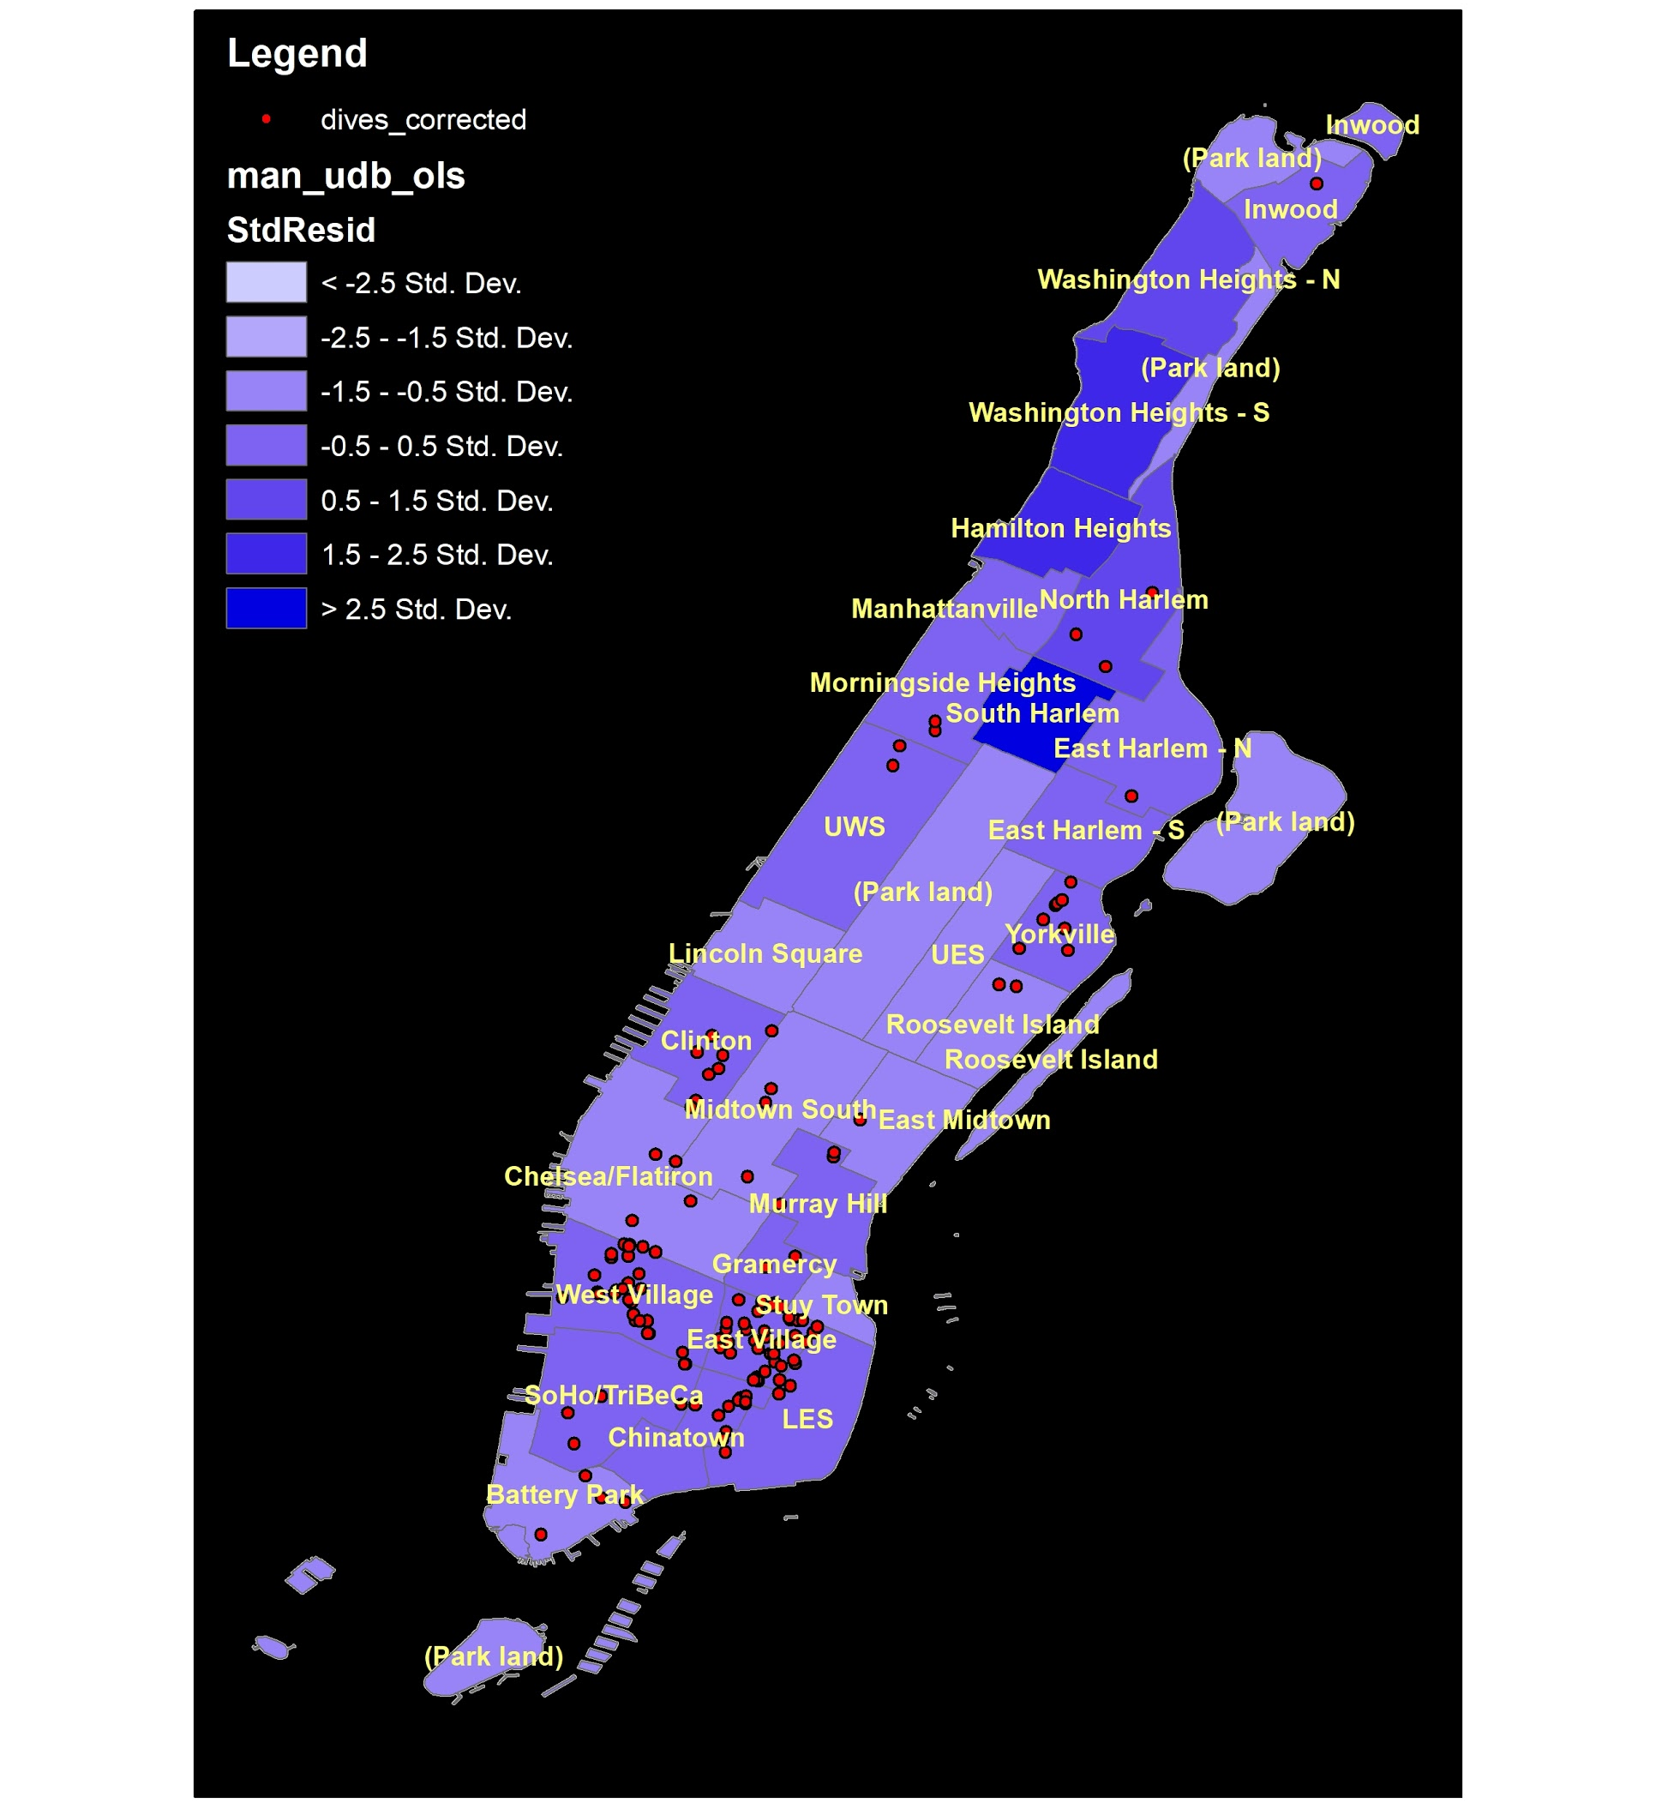
OLS Map
Notes:
Again, between dive bars and all complaints

Slide 10
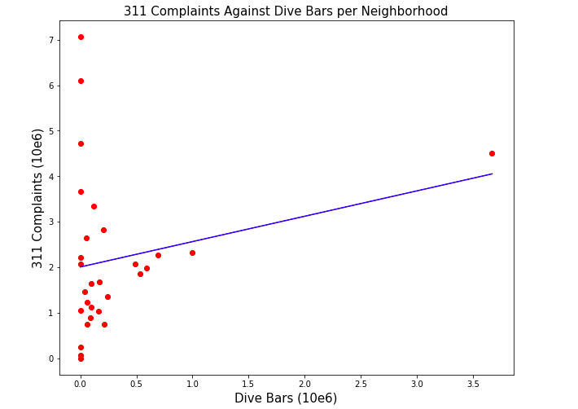
Correlation Between 311 Complaints and Dive Bars
Notes:
Would have performed GWR but my data set was very small (only 29 rows)
Took total number of 311 complaints per neighborhood and divided it by the “shape area” column
Then scaled both of them up by 10e6 for interpretability
P value of .234 → not statistically significant (assuming alpha of .05)

Slide 11
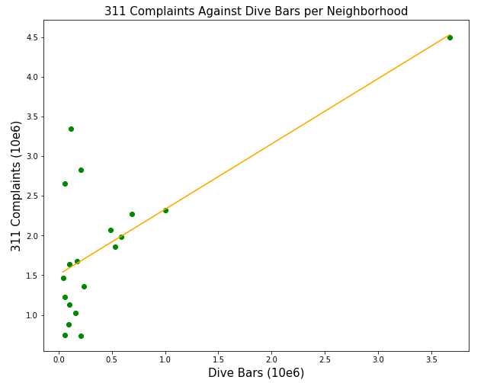
Correlation for Neighborhoods with Dive Bars
Notes:
P value of .001
Outlier is the East Village

Slide 12
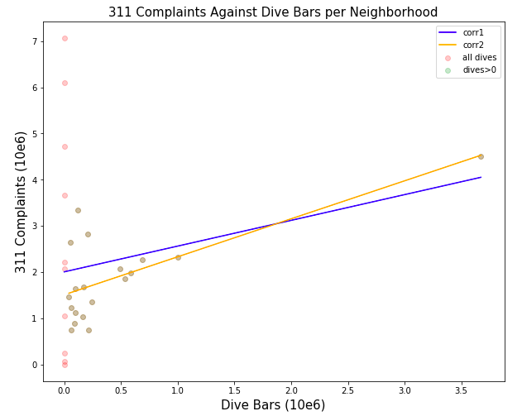
Correlation Comparison

Slide 13
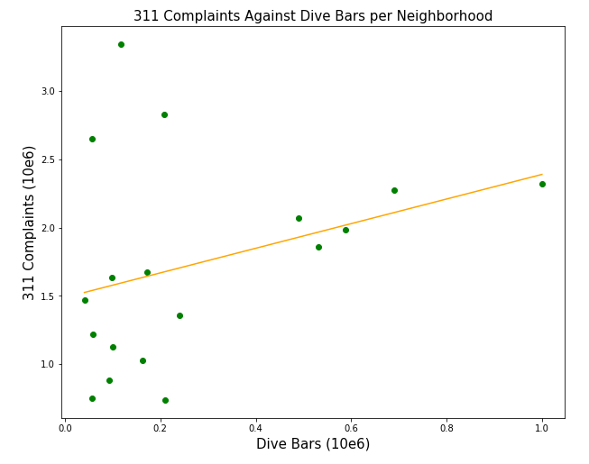
Correlation After Removing Outlier
Notes:
East Village was an outlier
Removed it but then OLS model has an R squared value of .107
So there’s a lot more going on here that must explain the why public drunkenness and urination occurs in a particular neighborhood besides dive bars

Slide 14
Conclusion
We see overlap and correlation between dive bars, public drunkenness, and public urination at night
These plots could be used to determine next steps for different public services:
Public urinals similar to strategy implemented in Paris in summer 2018

