Slide 1
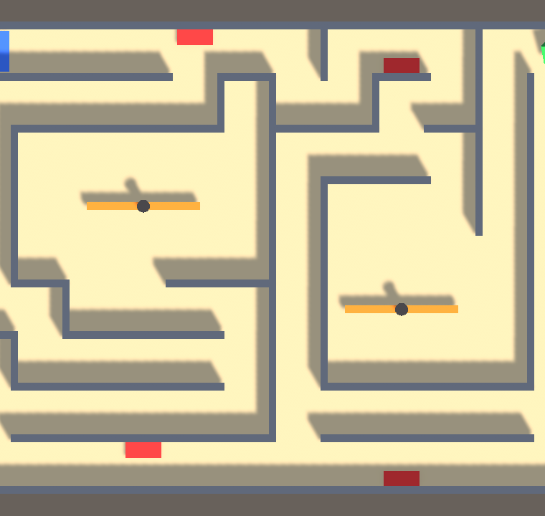
Echo Maze
GAME DESIGN MIDTERM
A maze where every failed run comes back as a ghost, and touching your past self costs a life.
Ahmed Abdelsalam · Mohamed Emad · Omar Wael · Omar Jawad
DMVR504 Game Design and Development · ESLSCA University · Fall 2026
Notes:
Introduce the team and the game in one breath: Echo Maze is a top-down maze where your failures come back to haunt you, literally. Every run that ends in death replays as a ghost called an Echo.

Slide 2
The pitch
Your mistakes don’t disappear. They come back, and they’re in your way.
GENRE
PLATFORM
AUDIENCE
HOOK
Top-down puzzle-action maze
PC, keyboard, built in Unity 6
12+, fans of short skill puzzles
Failed runs replay as deadly ghosts
Notes:
Most games reset the level when you die. Echo Maze keeps a trace of every attempt, so the difficulty depends on how you played. Inspiration, ideas only: Mario Kart time-trial ghosts, Super Meat Boy replays, The World’s Hardest Game timing.

Slide 3
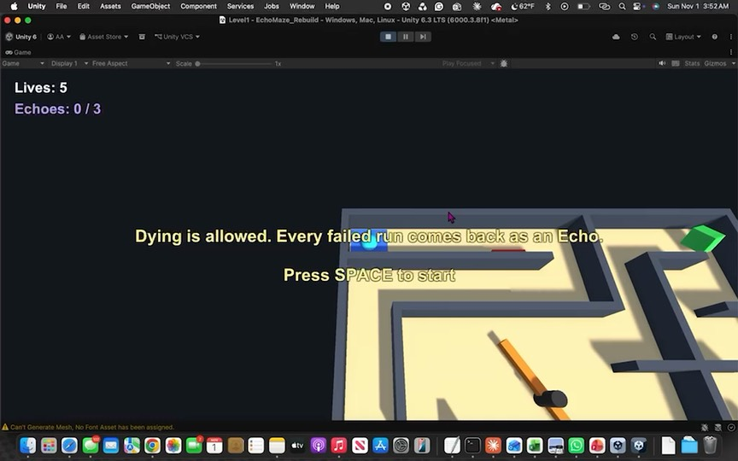
How to play
Goal
Roll the ball to the green cube. 3 levels.
Lose a life
Spikes, spinner arms, or a moving Echo. 5 lives per level.
The Echo
Each death replays as a ghost. It waits 2 s, flickers, then moves. Max 3.
WASD / arrows to roll · SPACE to start · R to restart
Notes:
Walk through the three rules. Point at the HUD in the screenshot: Lives and Echoes at top left, the level tip in the middle. Colour is meaning: green goal, red danger, violet is your past.

Slide 4
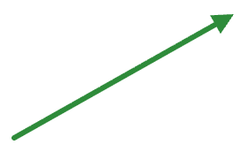

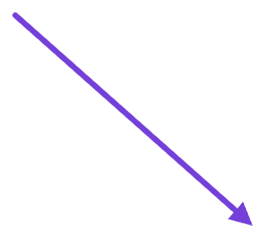
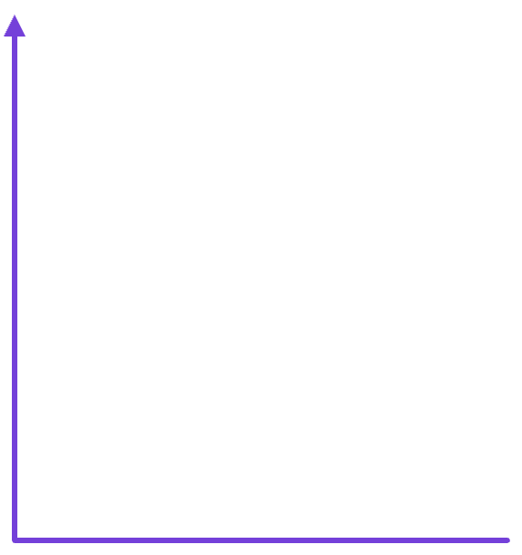
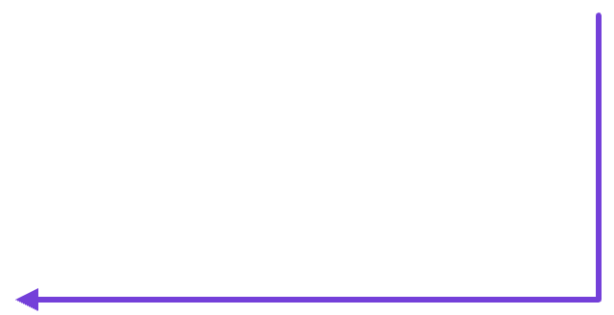
Core loop
Every death changes the level, so every retry is a new puzzle.
Reach goal → next level
Read the maze
Roll to the goal
Time spinners, dodge Echoes
Die → run becomes an Echo
Respawn · Echoes wait 2 s, then replay
Notes:
The player plans a route, executes it with careful movement, and either reaches the goal or dies. A death adds an Echo, so the next attempt is a new puzzle. That is why players keep going.

Slide 5
MDA: rules → behaviour → feeling
Mechanic (we built) | Dynamic (player does) | Aesthetic (player feels)
Each death replays as an Echo; touching it costs a life | Remembers Echo paths, avoids dying on the main route | Challenge, discovery, “chased by myself”
Echo waits 2 s, flickers 0.5 s; max 3 | Rushes off the start pad; manages Echo count | Tension, then relief: fair, never hopeless
Ball moves by force (momentum); spinners turn at a fixed speed | Slows before spinner rooms, watches the rhythm, commits | Mastery when you slip through the gap
5 lives, instant restart with R | Retries quickly and experiments | “One more go” motivation
We designed backward (Lecture 3): feeling first, “your mistakes haunt you”, then the behaviour, then the rule.
Notes:
Read one row out fully: the Echo rule makes players plan around their own past, which creates challenge and the feeling of being chased by yourself. Mention the target aesthetics: challenge, discovery, light fantasy.

Slide 6
Five design principles, applied
Clear goals
Feedback
Progression
Intro tip per level; the goal is the only green object
Death message names the cause; Echo flickers before moving
Bigger mazes, more spikes, spinners 50 → 60 → 75°/s
Meaningful choice
Fairness
How we test each
Level 3: ≈46 m past 2 spinners or ≈66 m past 3 spike strips
2 s safe window, 3-Echo cap, 5 lives per level
Ask testers: goal clear? knew what killed you? which route, why? anything unfair?
Notes:
For each principle: the decision, its effect on the player, and how we test it. The full table with all four parts is in the design document, section 3.

Slide 7
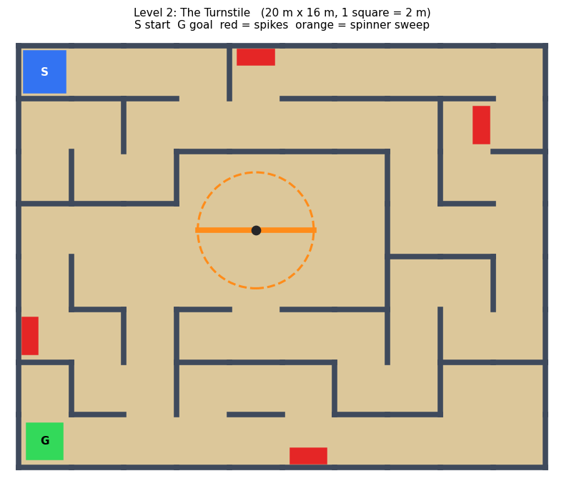
Three levels, rising difficulty
Level | Size | Walls · spikes | Spinners
1 First Echo | 16 × 12 m | 11 · 3 | 1 at 50°/s
2 The Turnstile | 20 × 16 m | 29 · 4 | 1 at 60°/s
3 Crowded Past | 24 × 18 m | 25 · 5 | 2 at 75°/s
Level 2 map: you must cross the spinner room
Notes:
Level 1 teaches the spinner and the Echo rule in a small space. Level 2 forces a spinner crossing. Level 3 gives the route choice and two spinners spinning opposite ways. Maps of all three are in the repo under Docs/LevelMaps.

Slide 8
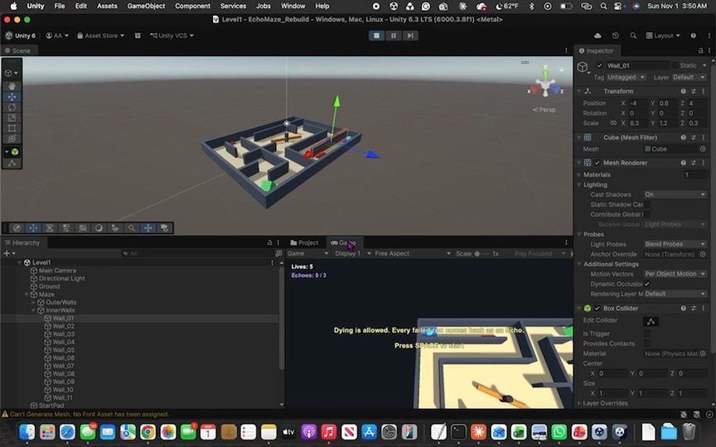
Built by hand in the editor
Walls = Cubes (L5)
Under Maze › OuterWalls / InnerWalls, set by Position and Scale, copied with Duplicate
Hazards = prefabs (L2, L5)
Spikes and Spinner placed under Hazards, like the PickUp prefab
Solid vs trigger (L5)
Walls block the ball; spikes, arms, Echoes and the goal are triggers
Notes:
No script builds the maze. Every wall is its own object you can click. Wall length = squares × 2 + 0.3 on a 2 m grid; thickness 0.3, height 1.2. Example: Wall_01 in Level 1 has Scale X 8.3 at Position (−4, 0.6, 4).

Slide 9
Five short scripts
Script | From | What it does
PlayerController | Lecture 4 | OnMove input, AddForce in FixedUpdate; records the run; OnTriggerEnter by tag
CameraController | Lecture 4 | Stores an offset in Start, follows in LateUpdate
Rotator | Lecture 4 | transform.Rotate × Time.deltaTime; spinners and the goal
EchoGhost | New | Waits, flickers, then replays the saved path on a loop
GameManager | New | Lives, Echoes, messages, win / lose, loads the next level
The two new scripts use only lecture building blocks: public fields, Start, Update, FixedUpdate, if, and a List.
Notes:
Three scripts are the Roll a Ball scripts with small additions. Beyond the slides we used List, Instantiate, Destroy, Invoke, SceneManager.LoadScene and Keyboard.current. Each is one line, and the breakdown doc explains them.

Slide 10
How an Echo works
1
2
3
4
Record
Die
Wait
Replay
Every physics step the ball adds its position to a list
GameManager makes an Echo prefab copy and hands it the list
2 s hidden with its collider off, then a 0.5 s flicker
One position per step, same speed as you, on a loop
Recorded in FixedUpdate and replayed in FixedUpdate, so the Echo moves exactly like you did (Lecture 4’s fixed physics step).
Notes:
Point out the fairness choices: harmless while waiting because you respawn where it starts, a flicker warning, and at most 3 Echoes with the oldest destroyed.

Slide 11
Testing changed the design
38 m = 38 m
4 / 4
Level 2 had no real choice
Automated play tests pass
The safe route was as short as the spinner route. We moved walls so the spinner room is on the only path.
Walls are solid, every hazard costs a life, Echoes replay, the goal wins, Game Over after 5 deaths.
Next: playtests with real players. Questions: goal clear? knew what killed you? which route, why? anything unfair?
Notes:
Be honest: the automated tests check that the game works; they do not replace playtesting with people. Human playtest notes will be added before the final submission.

Slide 12
Done now, and for the final
Midterm: done
Final: planned
Movement, walls, follow camera
Spikes and spinners
Echo record, replay, delay, cap
Lives, Game Over, restart
3 levels, HUD messages
Echoes press switches, open doors
Sound effects and music
Best time, fewest deaths
Main menu, 2–3 more levels
Human playtests and tuning
Notes:
The big final idea: turn failures into tools. An Echo standing on a switch could hold a door open for you, so dying in the right place becomes part of solving the level.

Slide 13
Questions?
Play it, break it, and tell us where you died.
github.com/seehaman/EchoMaze
Unity 6 · open Assets/Scenes/Level1 · press Play, then SPACE
Notes:
Have the project open in Unity, ready to demo: Level 1, die once on purpose to show the Echo, then show Maze › InnerWalls in the Hierarchy if asked how the maze was built.

