Slide 1
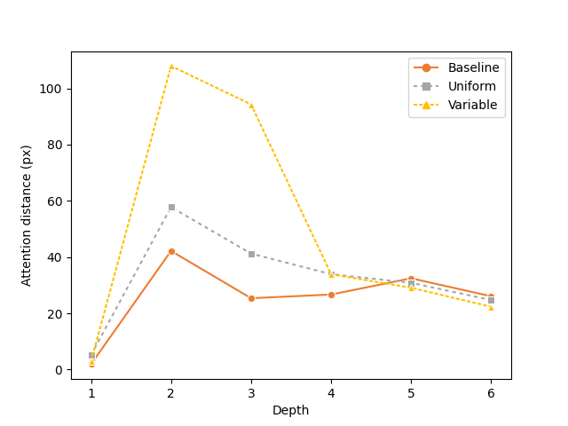
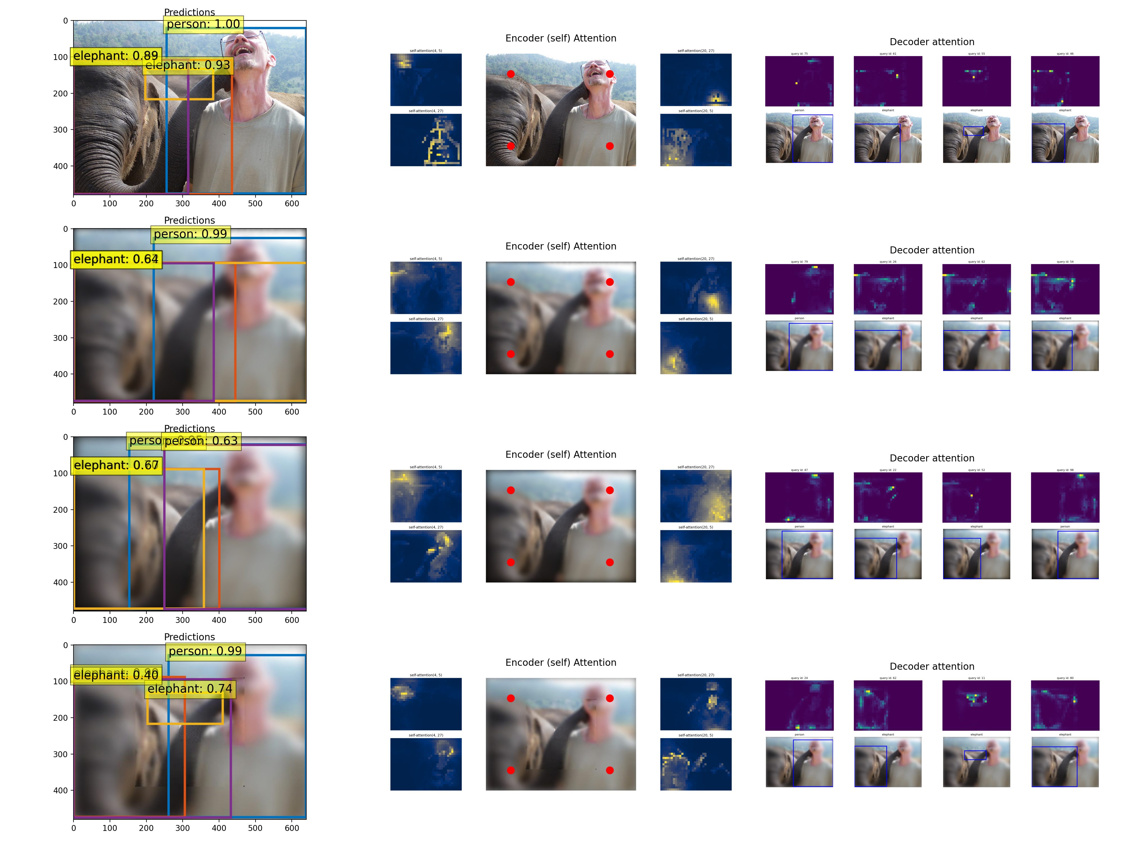
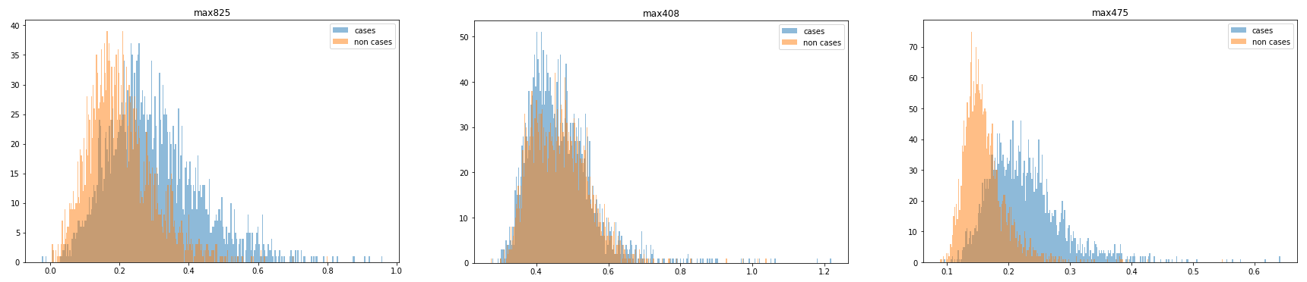
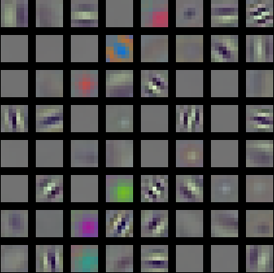
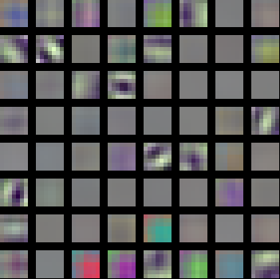
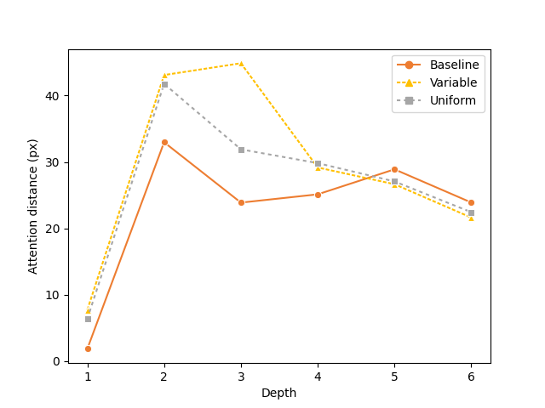
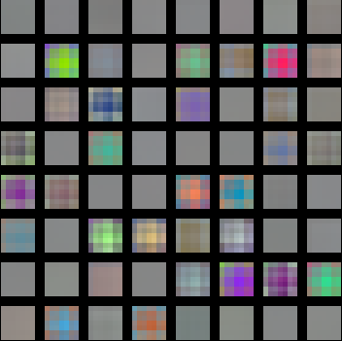
(a)
(d)
(g)
(i)
50
High resolution
Low resolution
Baseline
100
Uniform
Variable
40
80
30
60
20
40
(b)
(e)
10
20
0
0
0.4
0.6
0.8
1.0
1.2
(h)
(j)
70
40
(c)
(f)
60
50
30
40
Attention distance (px)
Number of neurons
20
30
20
10
10
0
0.1
0.2
0.3
0.4
0.5
0.6
0
3
4
5
6
1
2
Layer depth
Activation value
Notes:
Id 00006894

