Slide 1
C240B / STAT C245B Project Presentation I – Proposal Sociological statistical inference by survival analysis
Z. Tom Hu
Sijin Wu

Slide 2
Introduction
This is the first chapter in our text focused on estimation within the road map for
targeted learning. Now that we’ve defifined the research question, including our data,
the model, and the target parameter, we are ready to begin. For the estimation of a
target parameter of the probability distribution of the data, such as target parameters
that can be interpreted as causal effffects, we implement TMLE. The first step in this
estimation procedure is an initial estimate of the data-generating distribution P0, or
the relevant part Q0 of P0 that is needed to evaluate the target parameter.

Slide 3
Background
Let’s start our discussion with studies where Y is binary, such as in our mortality study example. When Y is binary, there is no difference between the conditional mean or conditional probability distribution, so this distinction plays no role

Slide 4
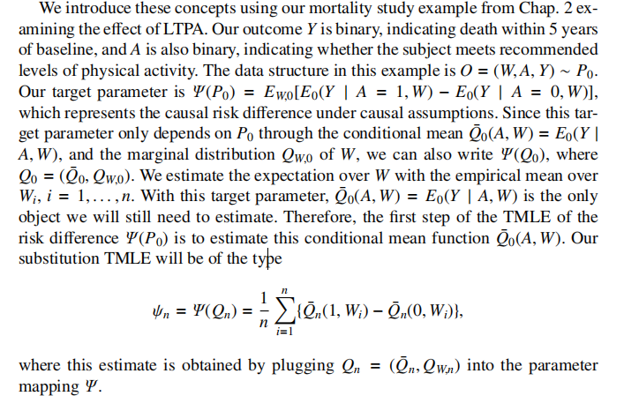
Background

Slide 5
Data
China Family Panel Studies（CFPS）
https://opendata.pku.edu.cn/dataverse/CFPS
China Family Panel Studies (CFPS) is a nationally representative, annual longitudinal survey of Chinese communities, families, and individuals launched in 2010 by the Institute of Social Science Survey (ISSS) of Peking University, China.
The CFPS is designed to collect individual-, family-, and community-level longitudinal data in contemporary China. The studies focus on the economic, as well as the non-economic, wellbeing of the Chinese population, with a wealth of information covering such topics as economic activities, education outcomes, family dynamics and relationships, migration, and health.
We have the whole CFPS data recorded in 2010, 2012, 2014, 2016, 2018 which can provide rich information to do social statistic inference. Each size of them is about 30000 individuals and 1000 variables.

Slide 6
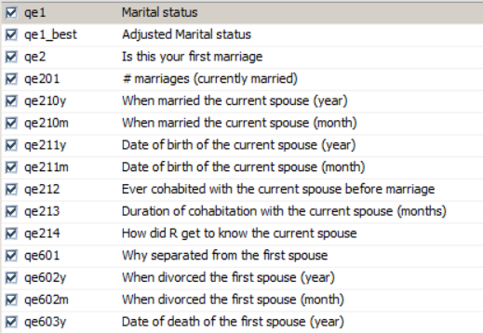
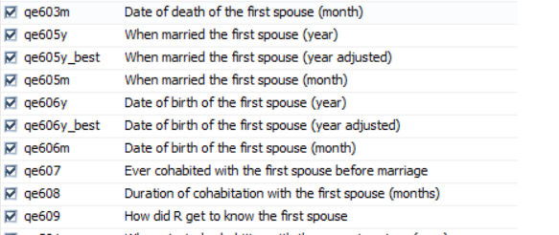
Data
The datasets are stored in the .dat format originally, and for the convenience of our future analysis, we transported them into .csv format.
If we want to focus on marriage status, there will be specific information.

Slide 7
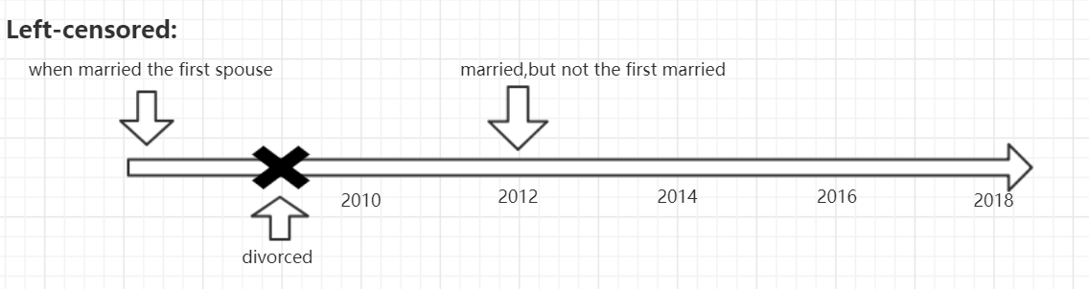
Censored Data
There are 2 kinds of censored data.

Slide 8
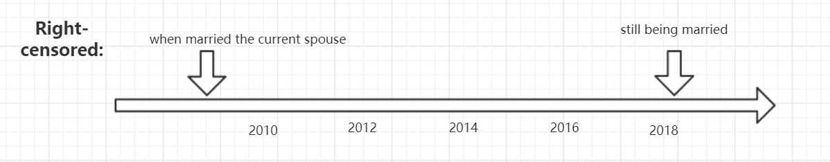
Censored Data

Slide 9
The target parameter
Take the length of a marriage as the example :
We can estimate the marriage survival function of one group of people who are born in the 1980s in Beijing with the same education conditions.
Also, we can compare the influence on marriages’ duration caused by different conditions.

Slide 10
Following work
The current challenges will be re-arrange the data that we need and select the targeted variables.
The following work will be focused on how to use the survival analysis methods to inference the social events, like the marriage duration.
Once we complete the survival analysis by the targeted learning method, we want to use some other non-target learning methods to compare the results.

