Slide 1
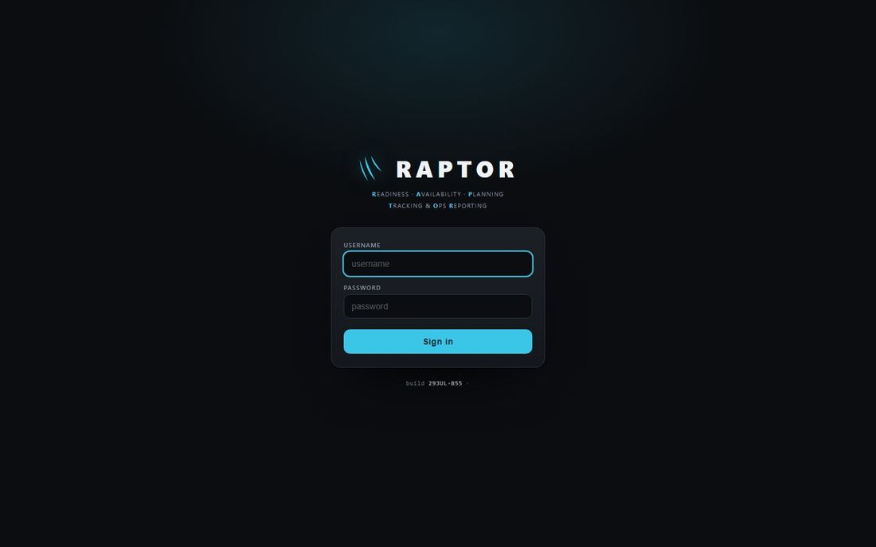
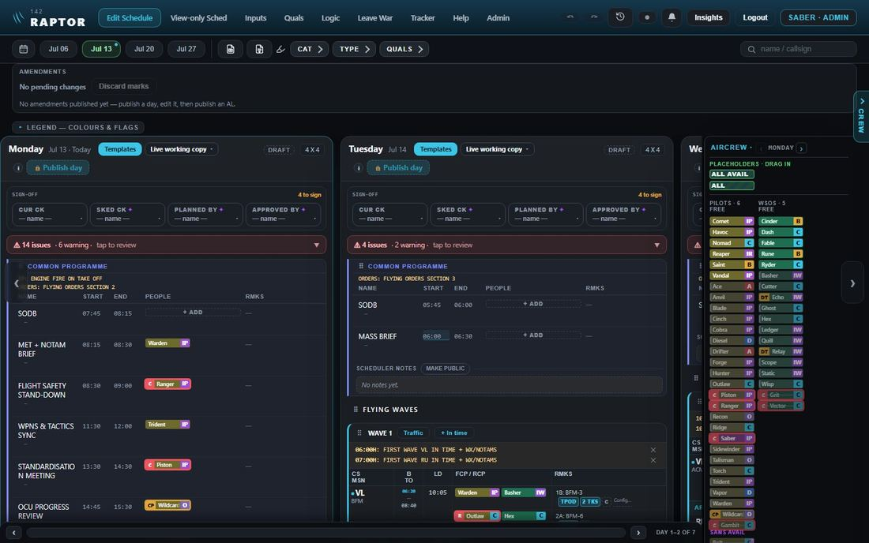
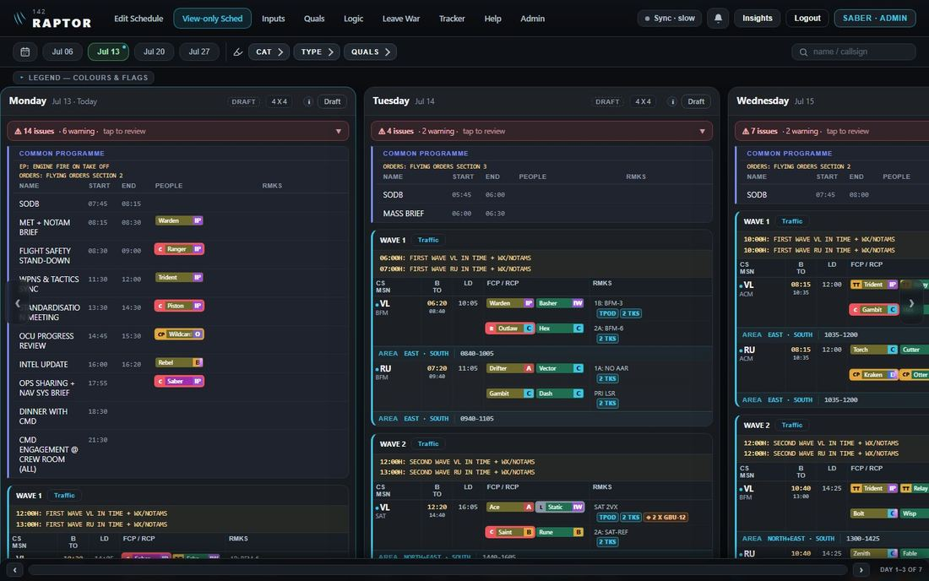
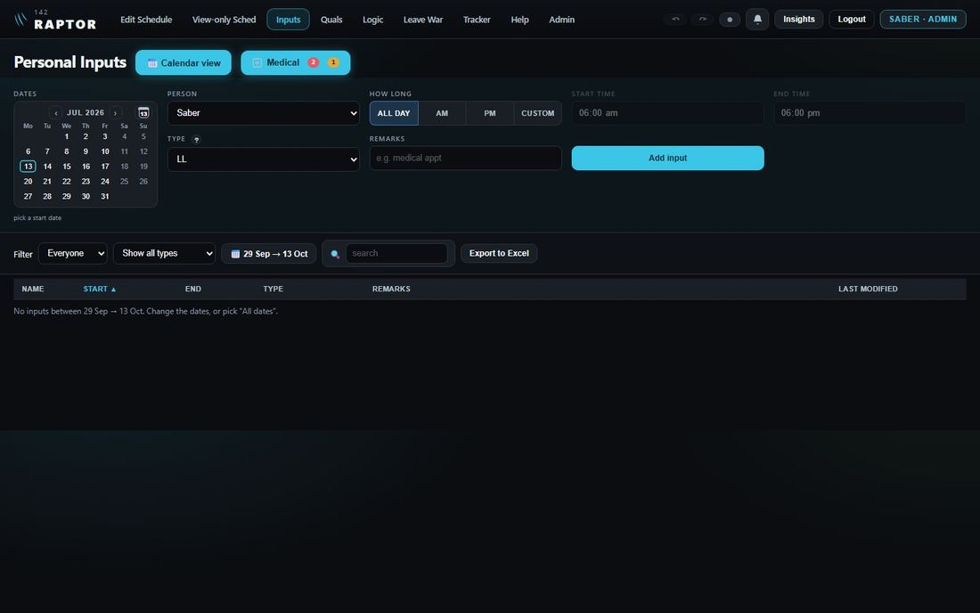
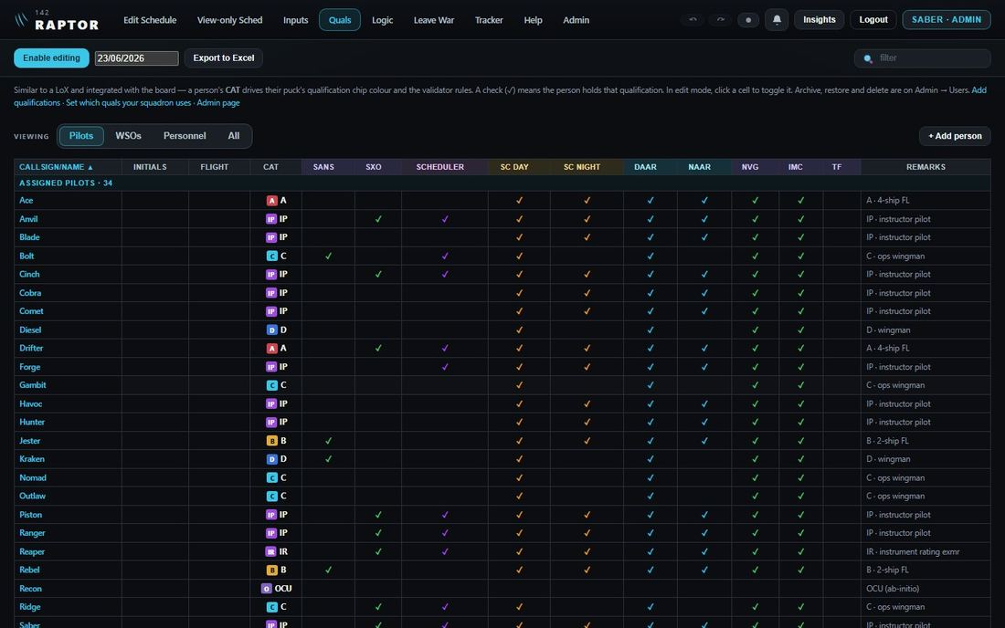
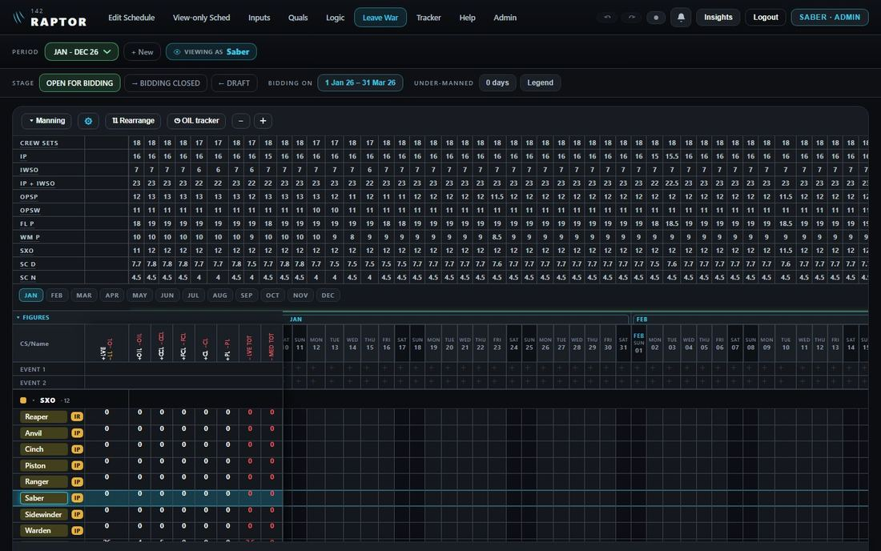
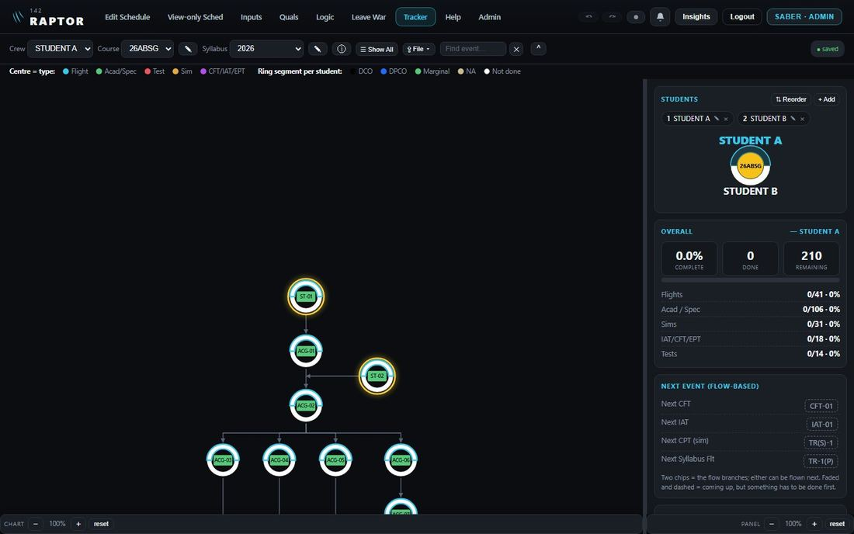
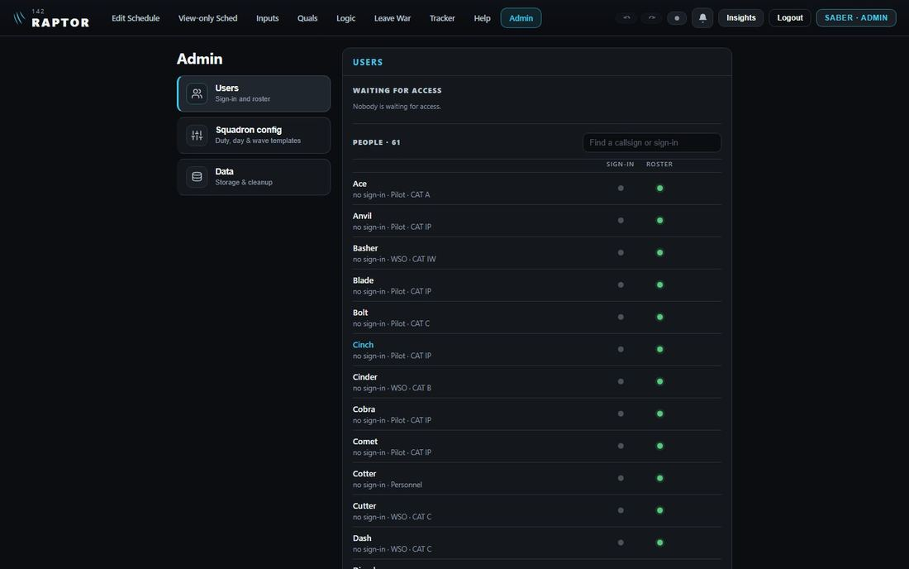
How RAPTOR works — every journey
Everyone
Admin only
Sign in, then pick a page from the top bar. Each numbered journey has its own slide.
Sign in
THE TOP BAR
Edit Schedule
View-only Sched
Inputs
Quals
Leave War
Tracker
Admin · Logic
1 Sign in, or ask for access
2 Make a schedule (7 slides)
6 Read the schedule (2 slides)
7 File an input or a medical (2 slides)
8 Update quals
9 Bid for leave (2 slides)
11 The Tracker (8 slides)
12 Let people in, add a person
3 Publish a day
10 Run the Leave War (3 slides)
13 Post out, archive, delete
4 Amend a published day
14 Squadron settings and rules (2 slides)
5 Alternate plans
15 Print, export and data
The two work flows — how these follow one another — are slides 2 and 3.
On every page:
16 Undo, redo and the change history
17 What happens by itself (4 slides)
RAPTOR · how the app works · 1 / 42

Slide 2
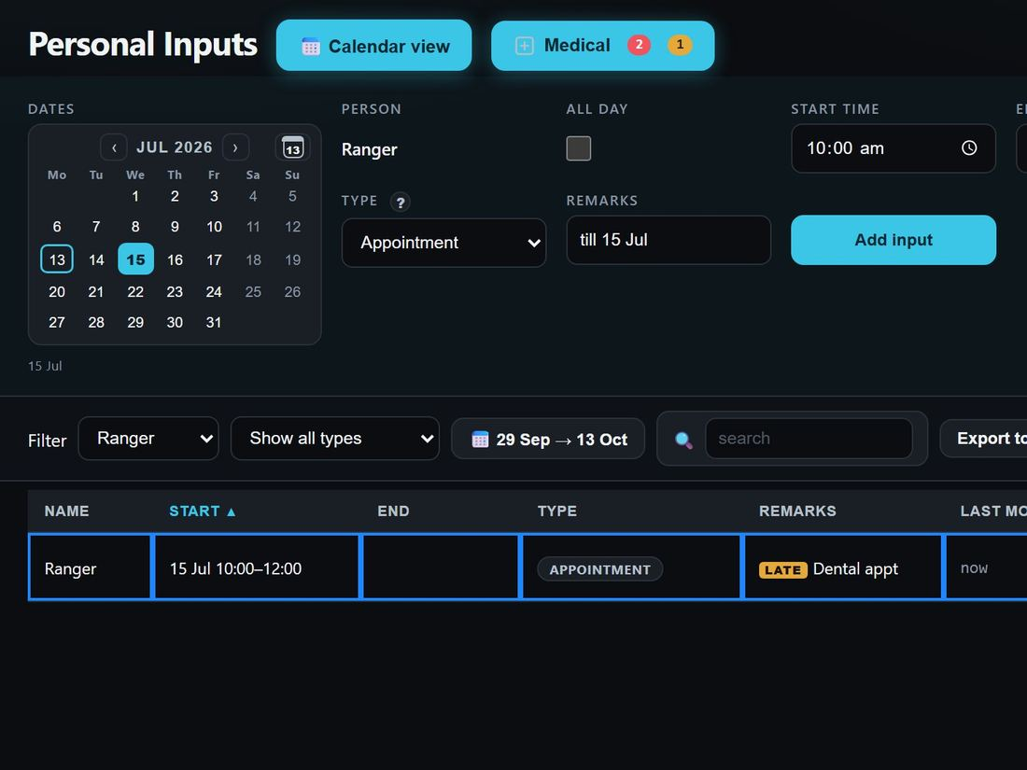
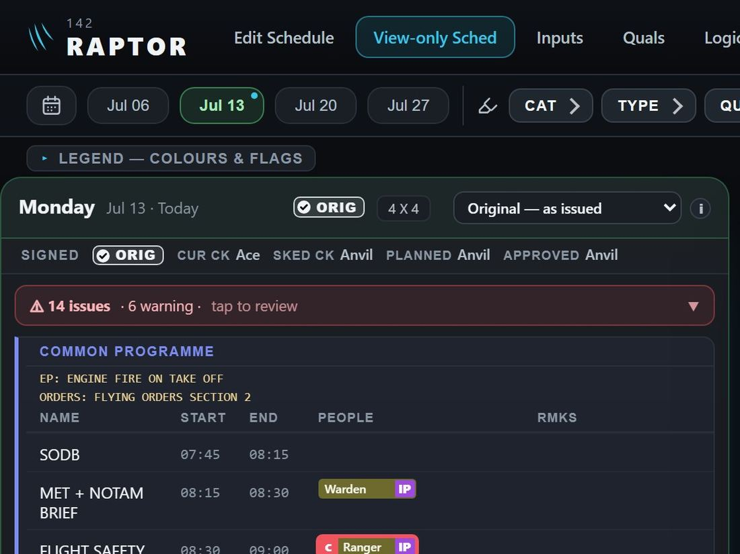
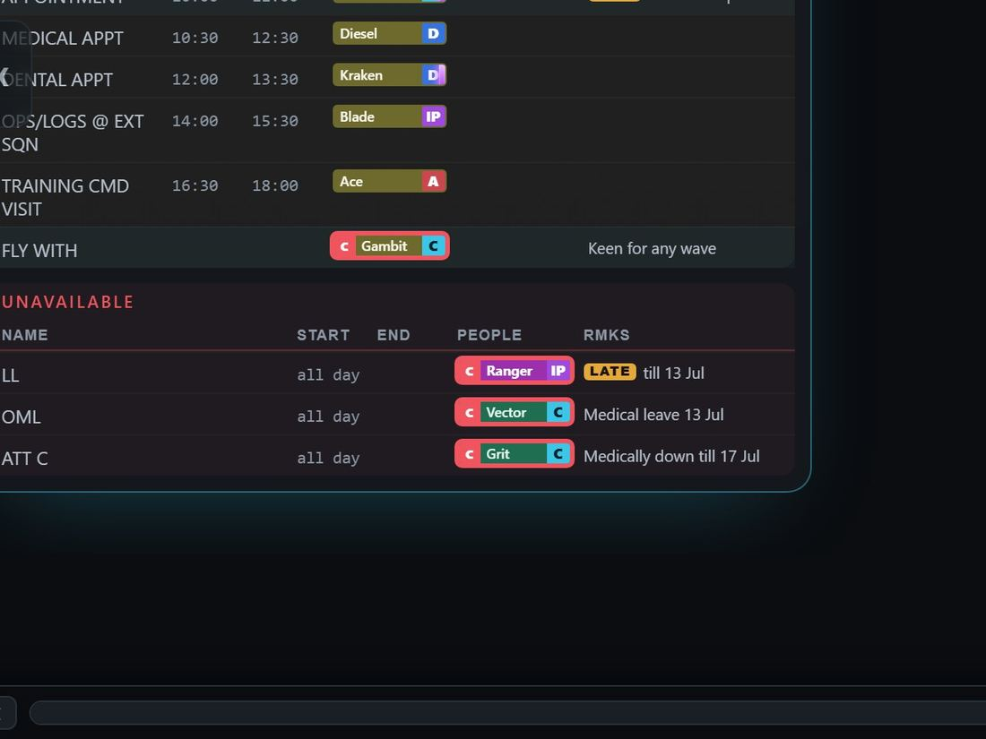
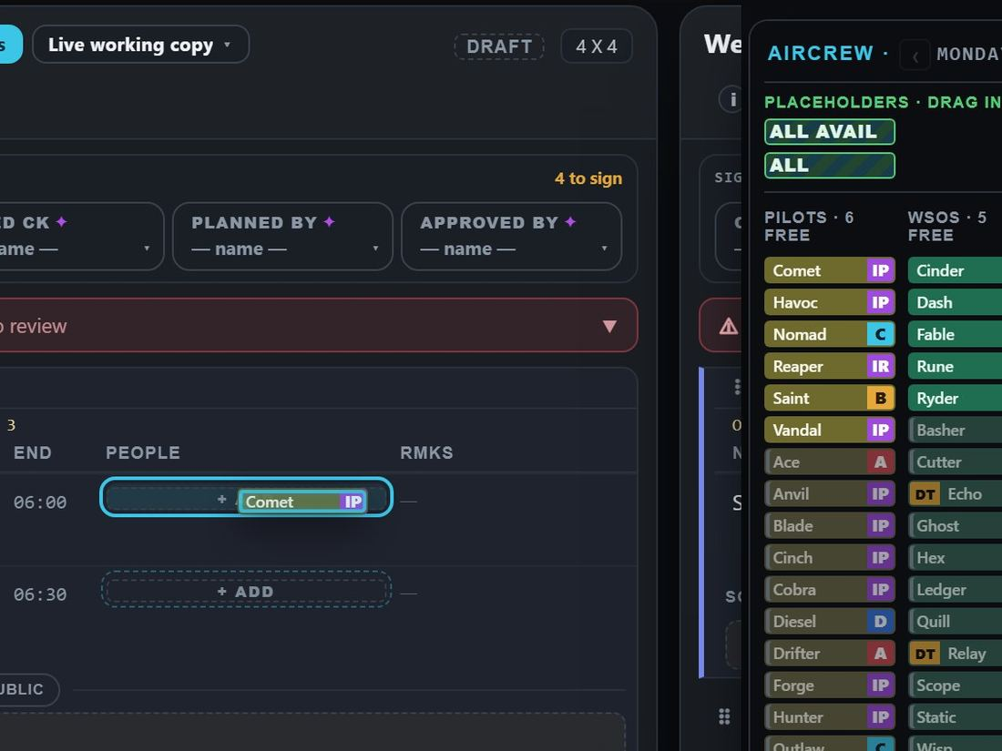
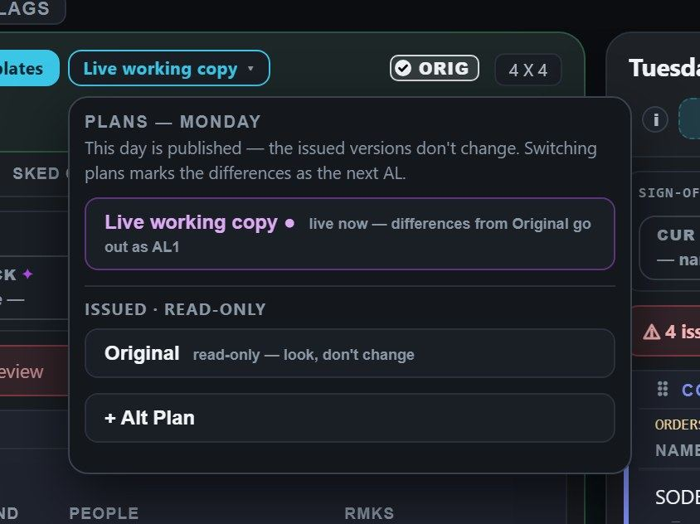
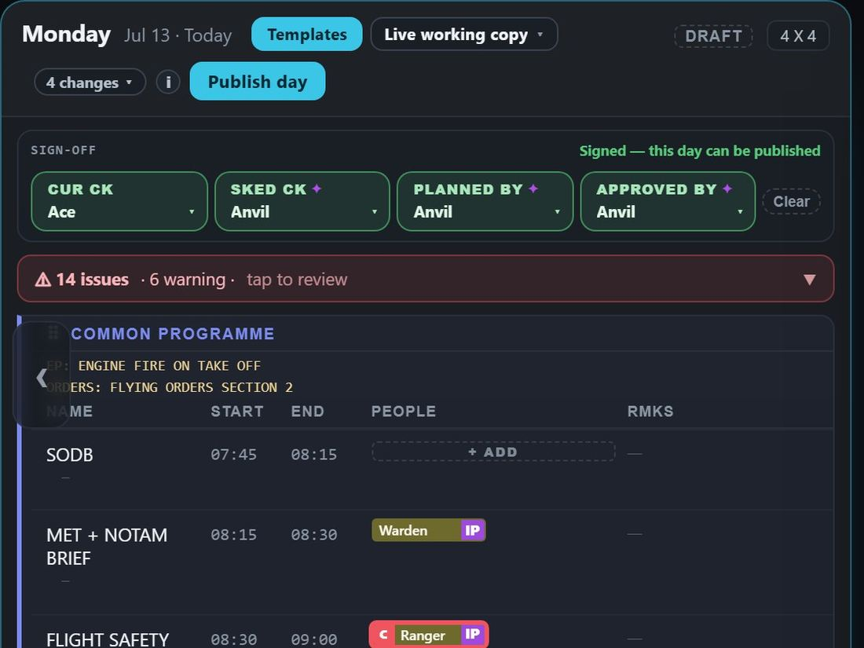
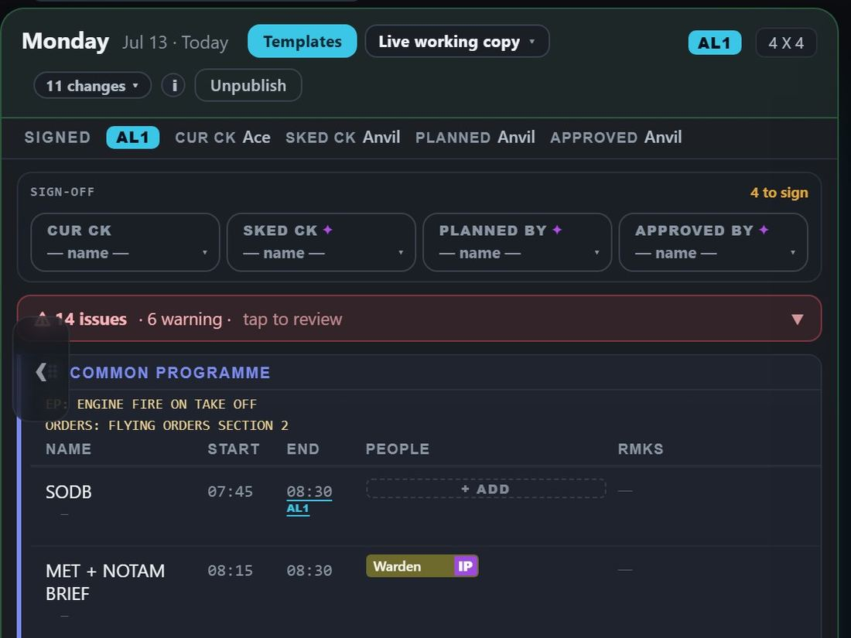
The work flow — the life of a day
Who does what, in the order it happens. Under each stage: the slide that shows it.
Everyone
File inputs and leave bids
Everyone reads the issued day
Something changes: a late input
slides 17, 20
slide 15
slides 17, 39
Admin — the scheduler
Build the day from who is free
Try an alternate plan
Sign off and publish — ORIG
Amend: sign again, publish AL1
slide 5
slide 14
slide 12
slide 13
AL1 goes out
Alongside the day: Quals (slide 19), the Tracker (25), Admin (33 on); what spreads by itself (39).
RAPTOR · how the app works · 2 / 42

Slide 3
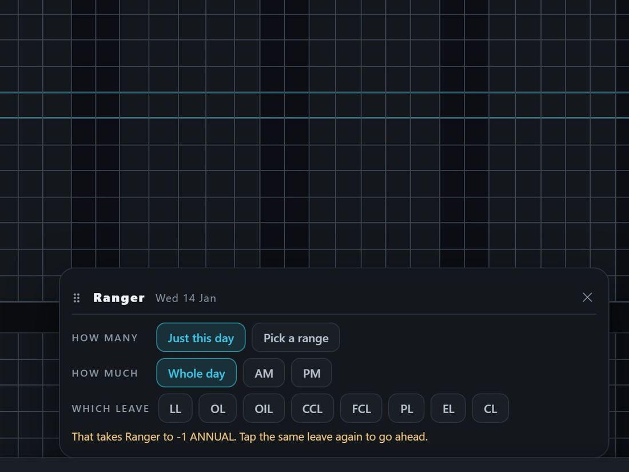
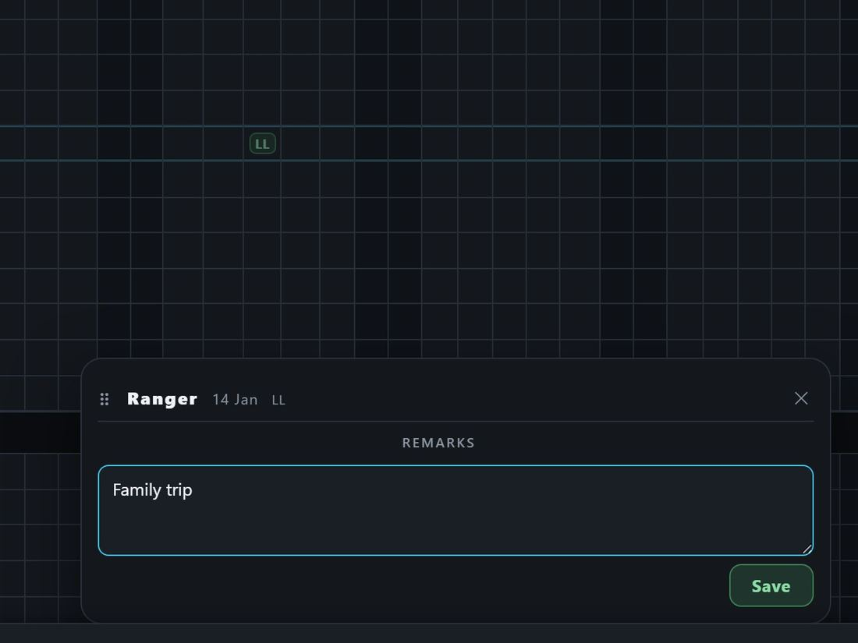
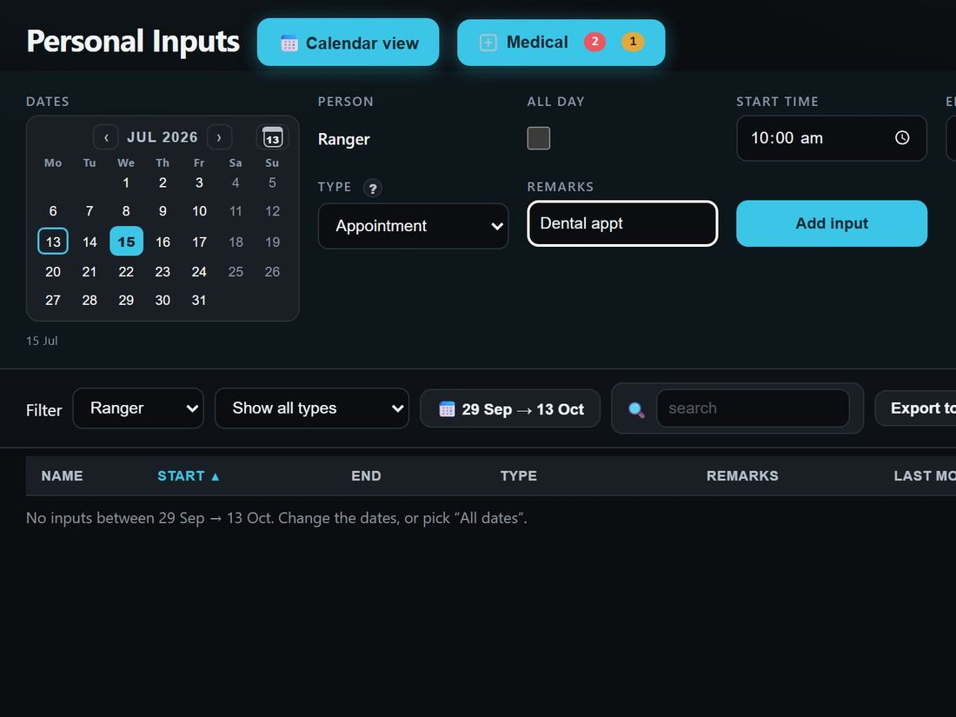
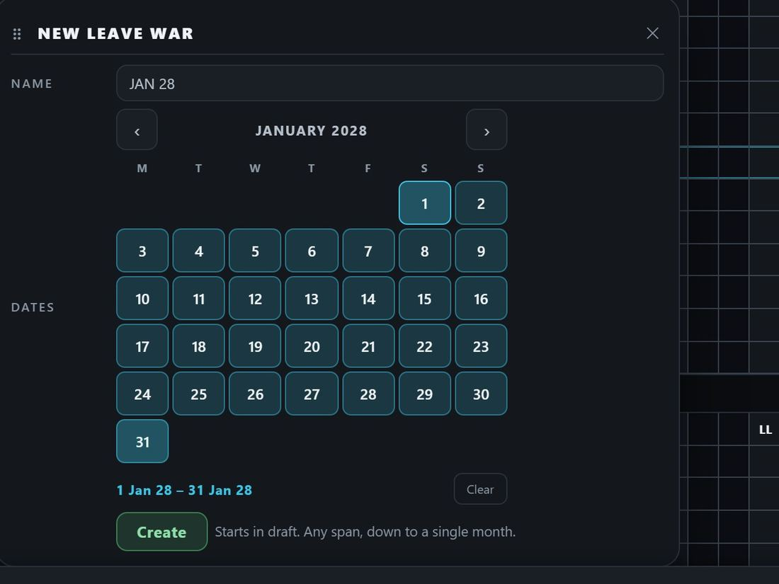
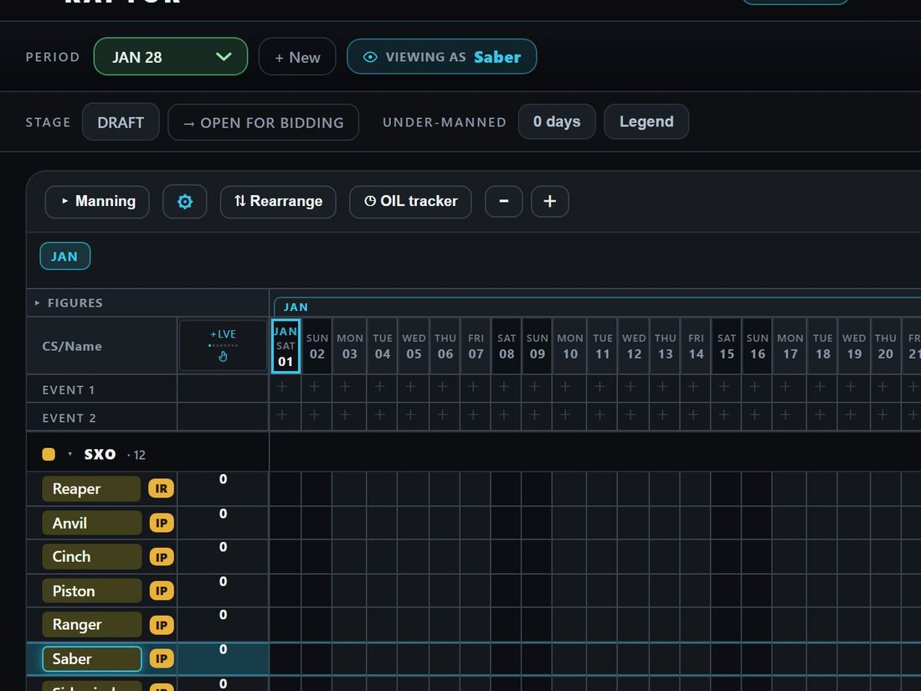
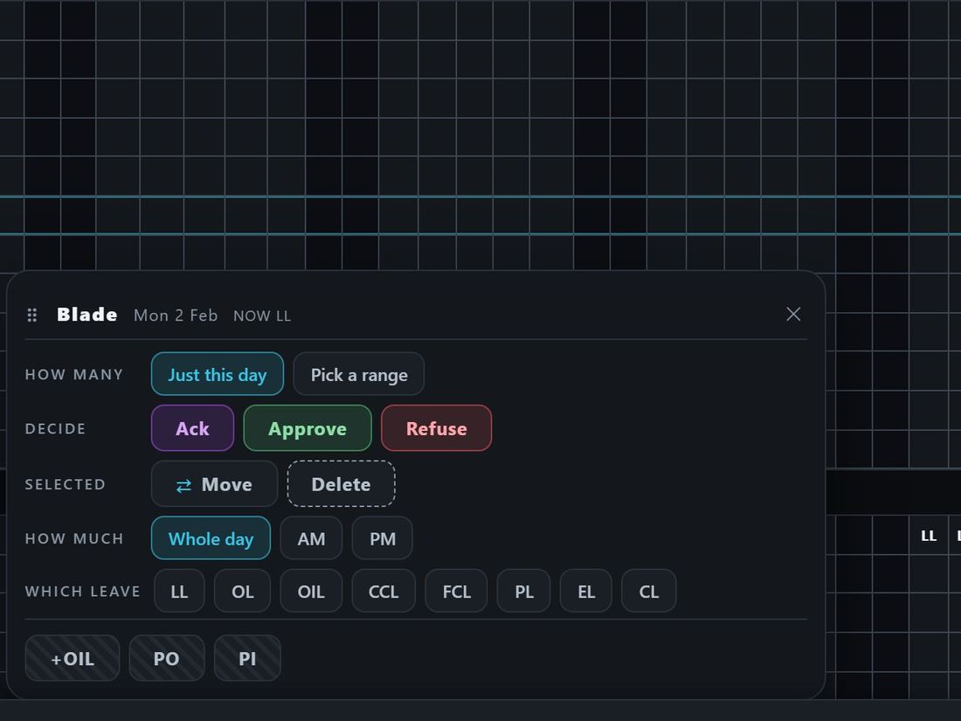
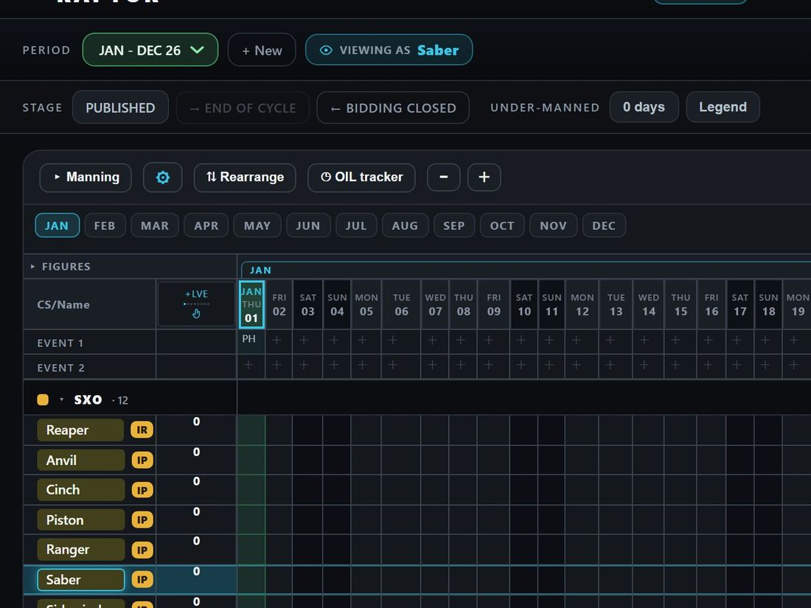
The work flow — the Leave War
A leave period from start to finish, as the app runs it. Under each stage: the slide that shows it.
Everyone
Members bid on their own row
Members add their remarks
A change later: through Inputs
slide 20
slide 20
slides 17, 39
Admin
Create the period (starts in Draft)
Open it for bidding
Close it; approve — leave reaches Inputs
Publish: locked for members
slide 22
slide 22
slides 22, 39
slide 22
The admin can decide bids in any stage but Draft, and can still add leave directly on the war; an approved leave on a published war is changed by stepping back to Bidding closed or on Inputs (D418).
RAPTOR · how the app works · 3 / 42

Slide 4
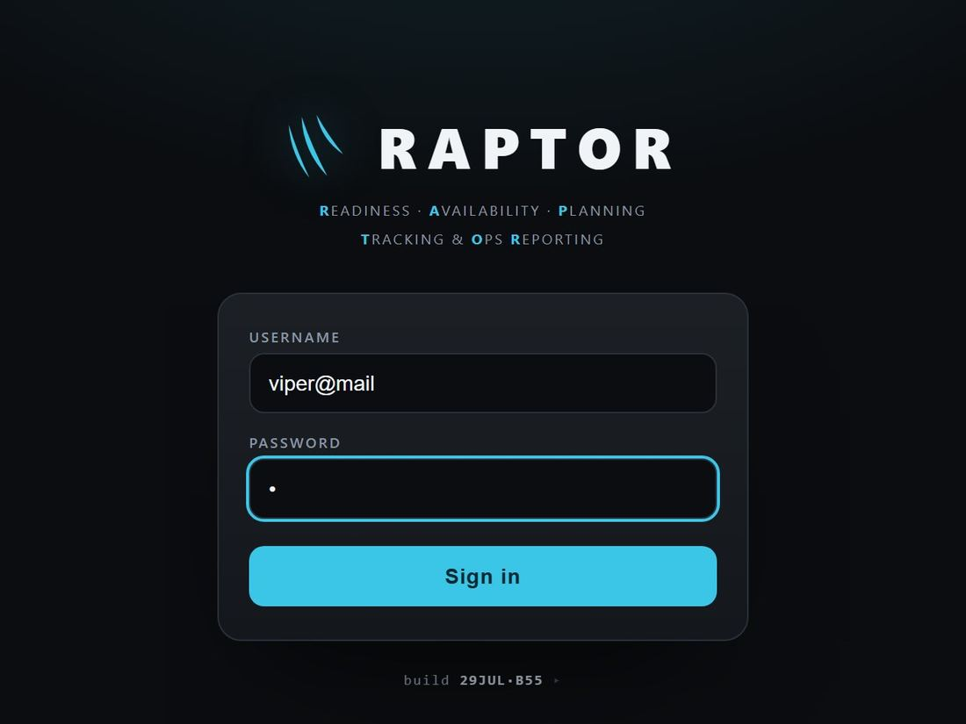
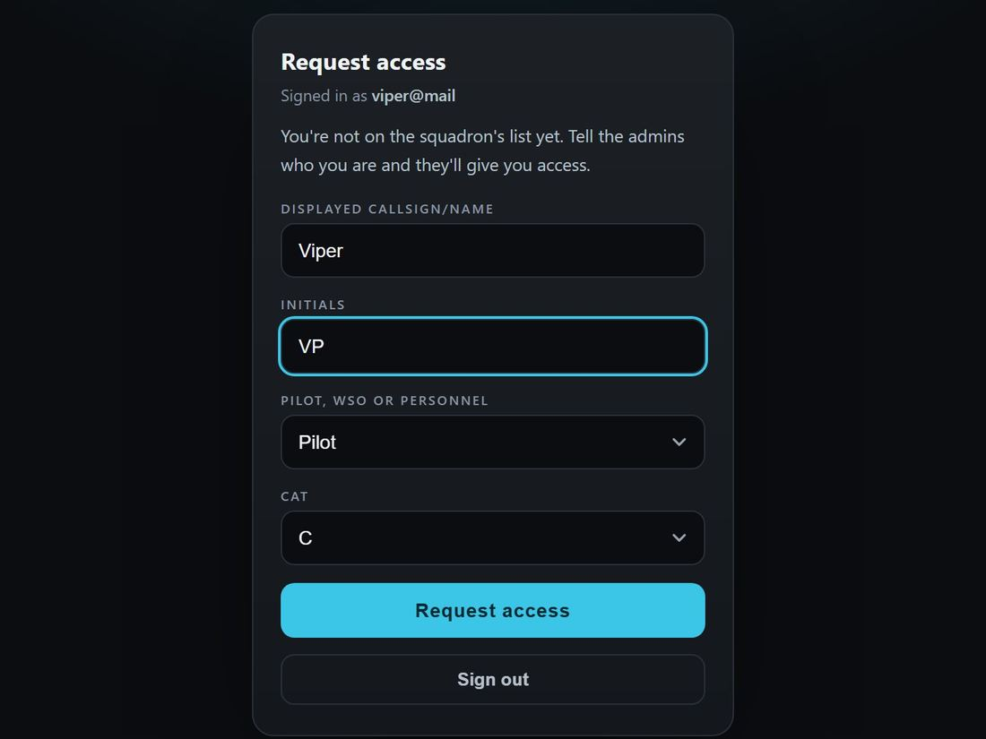
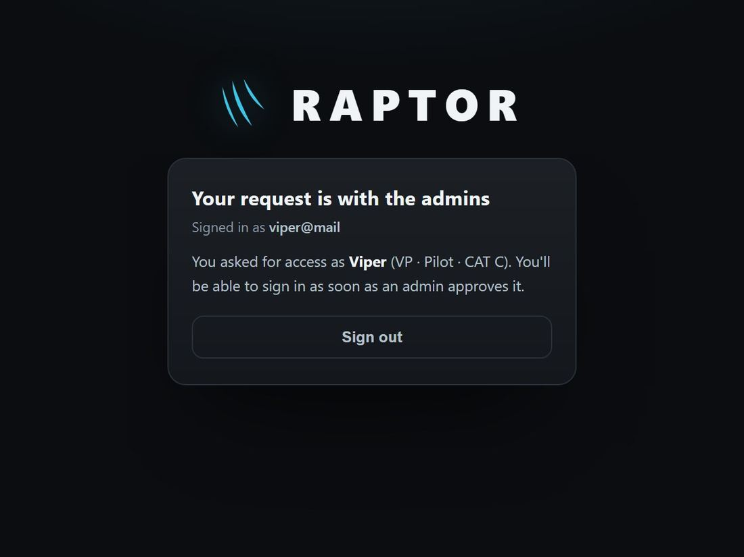
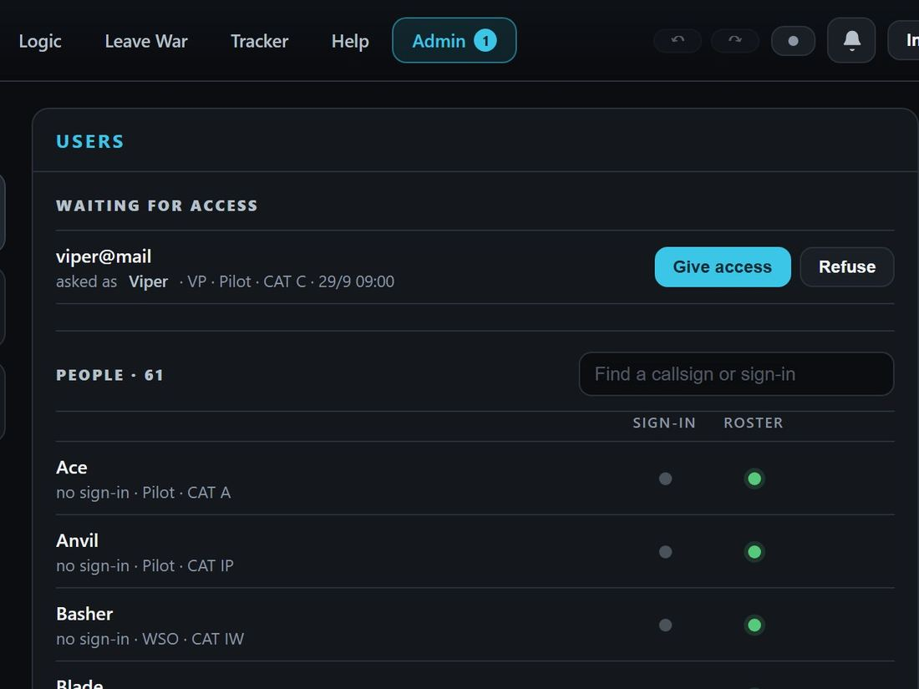
JOURNEY 1
1
click
what you should see
Sign in, or ask for access
Everyone
Where The sign-in card → Admin → Users
7
4
8
1
5
2
3
6
1
Type the defence mail
4
Not on the list: your name
"Your request is with the admins"
7
Admin shows 1 waiting
2
Type a password
5
Pilot, WSO or personnel
8
Give access (or Refuse)
3
Sign in
6
Request access
What to test
By hand, in the running app
Automated tests that cover it
A wrong password on a real account shows "Incorrect username or password."
A sign-in nobody knows opens Request access; Personnel hides the CAT box.
Signing in again while waiting shows the waiting screen, not the form.
The admin sees a 1 on the Admin tab, "1 waiting for access" and the bell lit.
Give access opens New person already filled in; he then signs in as a member.
accounts-ui.test.tsx request → waiting; the Admin tab counts it
accounts-newperson.test.tsx Give access filled in; the bell lights
onedoor-users.test.tsx Give access / Refuse; Post in asked
accounts.test.ts a new user joins either way
e2e/geometry.spec.ts the sign-in cards fit desktop and phone
RAPTOR · how the app works · 4 / 42

Slide 5

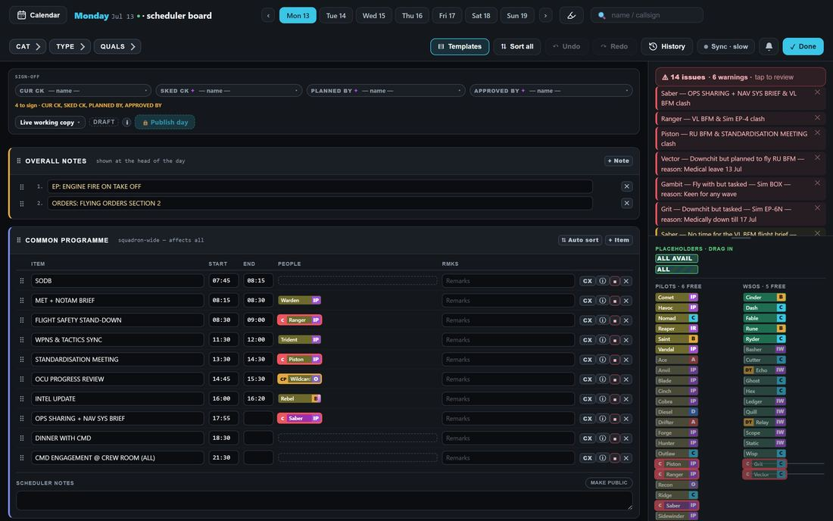
JOURNEY 2 · 1 OF 7
1
click
what you should see
Two ways to edit: the week and the board
Admin only
Where Edit Schedule · the Scheduler Board
Edit Schedule — the week: the big picture, smaller edits
The Scheduler Board — one day, every tool
2
1
1
Tap a day's date to open its board
2
✓ Done goes back to the week
All seven days side by side: drag a puck to another day
Add: + Note, + Item, + Wave, + Line, + Block, + Row, + Inputs
The Amendments panel, the export buttons, the week picker
Per row: CX cancel, flag, info, ✕; Auto sort, Sort all, drag rows
Fill seats, type times, sign and publish — as on the board
Its issue list is always open, beside the crew list
What to test
By hand, in the running app
Automated tests that cover it
The date in a day heading opens the board on that day; ✓ Done returns to the week.
A change on the board shows on the week, and the other way round.
Both have: sign-off and Publish, the plan selector, Templates, drag, tap-to-arm and right-click remove.
board.test.tsx the board's adds, kinds and templates
boardnav.test.tsx the board's day and week stepping
editweek.test.tsx the week's editing, arm and plant
RAPTOR · how the app works · 5 / 42

Slide 6
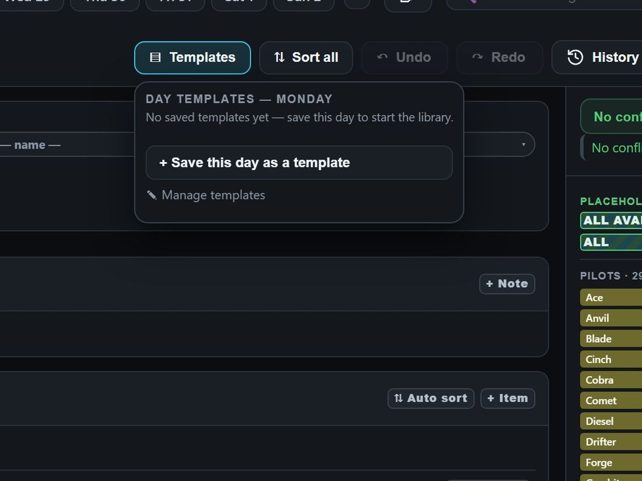
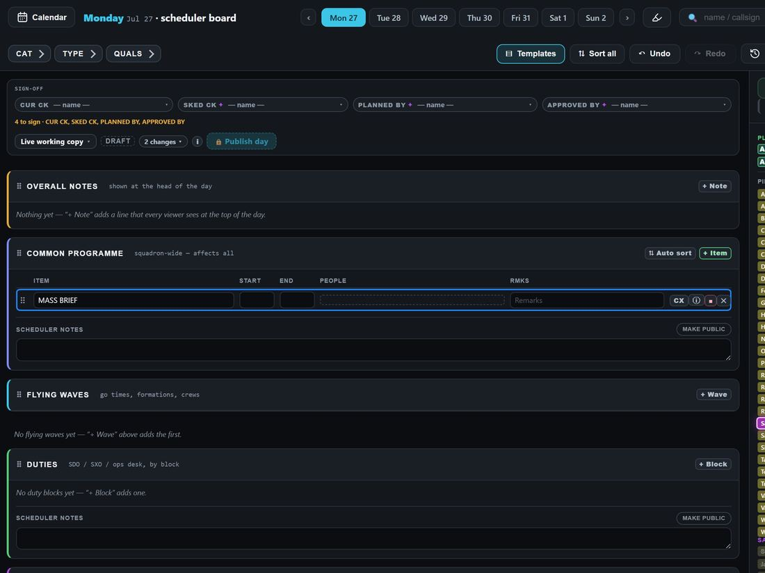
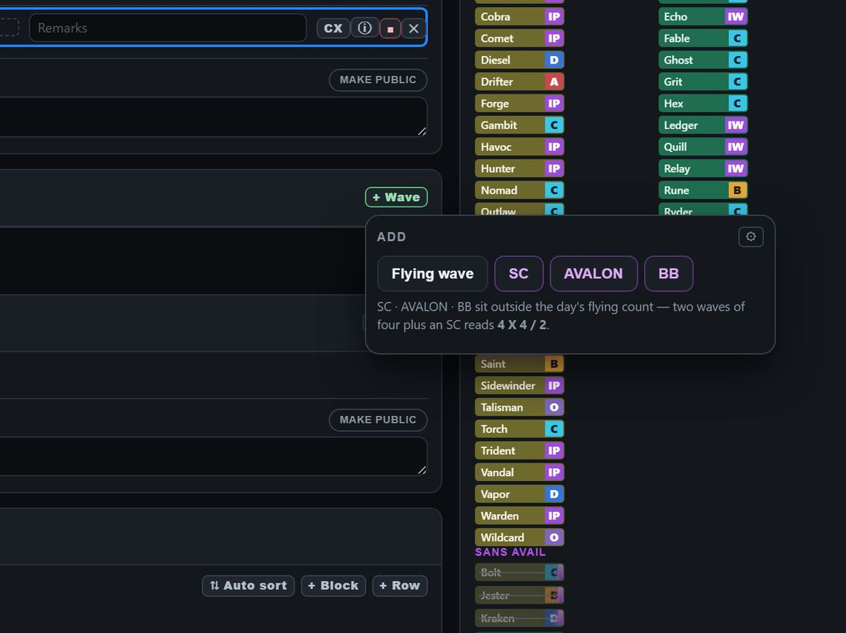
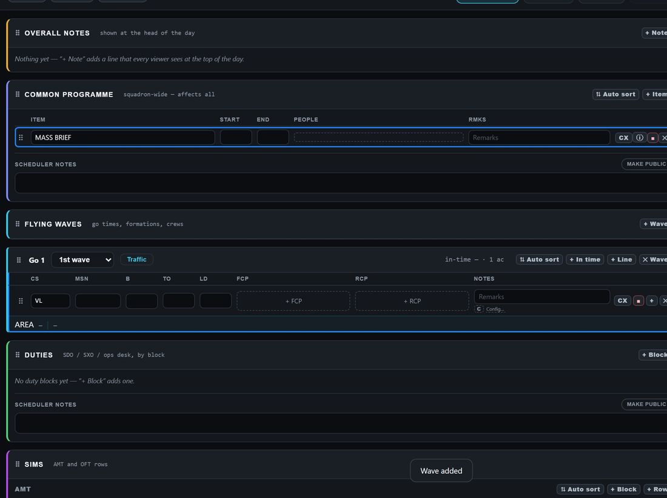
JOURNEY 2 · 2 OF 7
1
click
what you should see
A day from nothing: the first steps
Admin only
Where Edit Schedule · the Scheduler Board
1
4
5
3
2
7
6
1
Templates: apply or save one
2
+ Item on the programme
4
+ Wave
6
+ Line in the wave
Saved day templates listed here
3
Type what it is
5
Flying wave, SC, AVALON or BB
7
Callsign, then seats and times
What to test
By hand, in the running app
Automated tests that cover it
A bare day (week of 27 Jul) says "No flying waves yet — + Wave above adds the first."
A saved day template fills a draft day in one tap; a published day refuses it.
+ Wave offers Flying wave / SC / AVALON / BB and a ⚙ to manage wave templates.
+ Line adds a blank line at the bottom of the wave ("Line added").
daytplui.test.tsx save / apply a day template; published refuses
board.test.tsx + Line, + Wave kinds, ✕ Wave
wavepicker.test.tsx the wave kinds and saved templates
wavedefault-add.test.tsx a new wave lands in the set order
RAPTOR · how the app works · 6 / 42

Slide 7
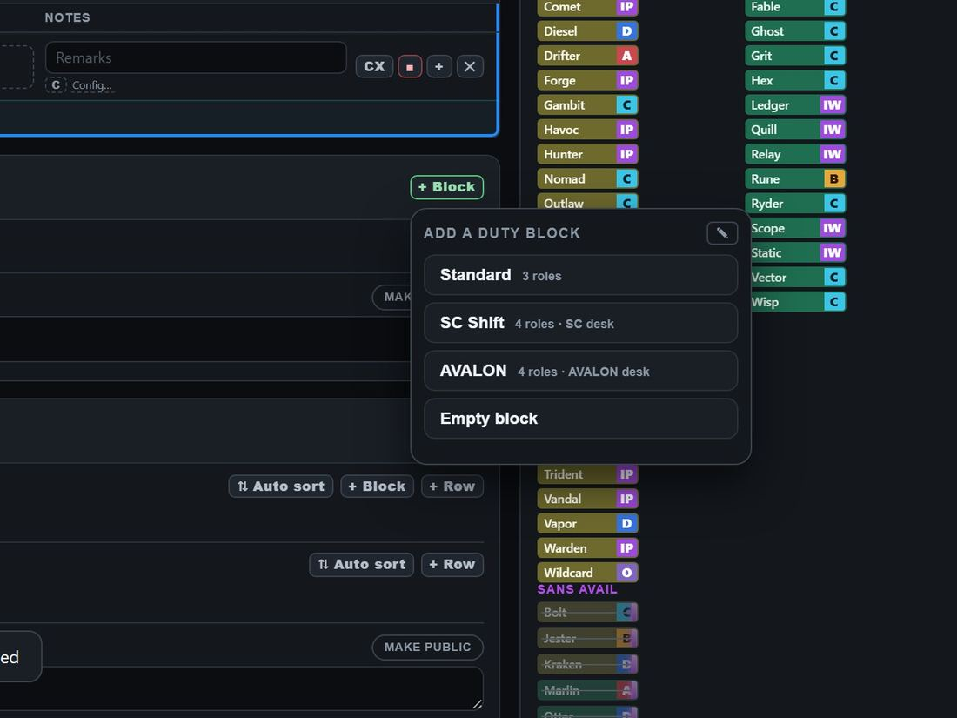
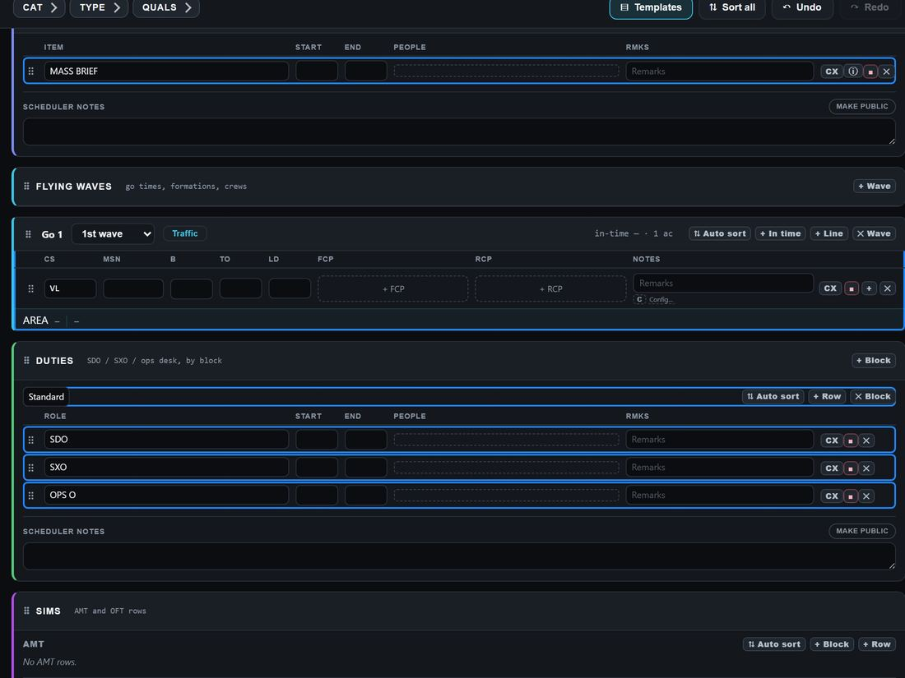
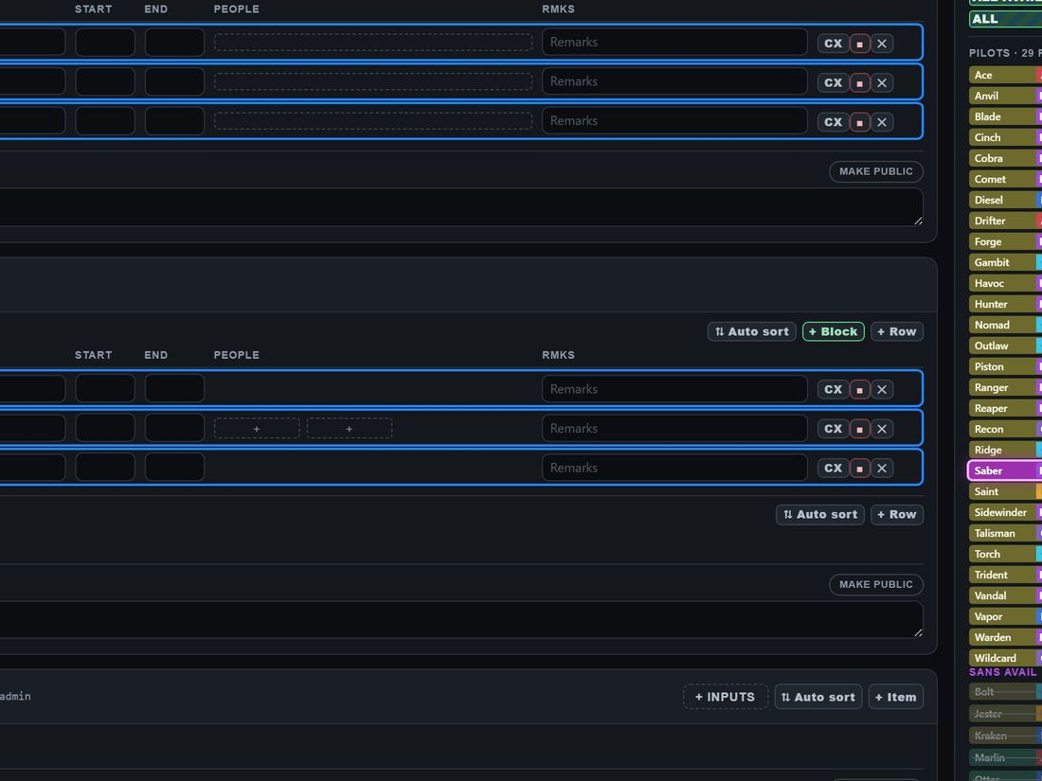
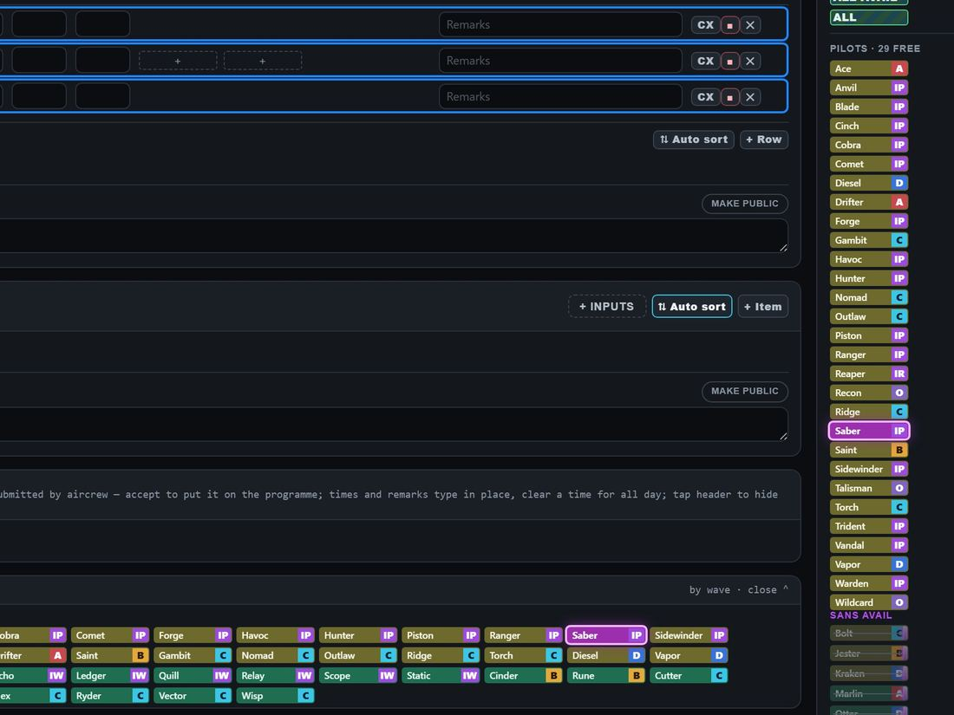
JOURNEY 2 · 3 OF 7
1
click
what you should see
Duties, sims and the ground programme
Admin only
Where Edit Schedule · the Scheduler Board
1
2
4
6
5
3
1
+ Block under Duties
3
+ Row for one more desk
4
Sims: + Block (brief, box, debrief)
5
Ground: + Item
2
A duty template: Standard…
The template's roles land
6
+ Inputs: file for a person
What to test
By hand, in the running app
Automated tests that cover it
Standard gives SDO / SXO / OPS O rows; the pencil in the menu edits the templates.
A sims + Block adds BRIEF, BOX and DEBRIEF rows together.
+ Inputs on the Ground Programme files an input for a person and lands his row ("Input added to the Ground Programme").
SANS and Unavailable have their own + Add for leave, medical and SANS.
board.test.tsx + Block offers the duty templates
DutyTplModal.test.tsx a duty template: rows, new, delete
boardaddinput.test.tsx adding an input through the board
dutytpl.test.ts a template copies onto the day
RAPTOR · how the app works · 7 / 42

Slide 8
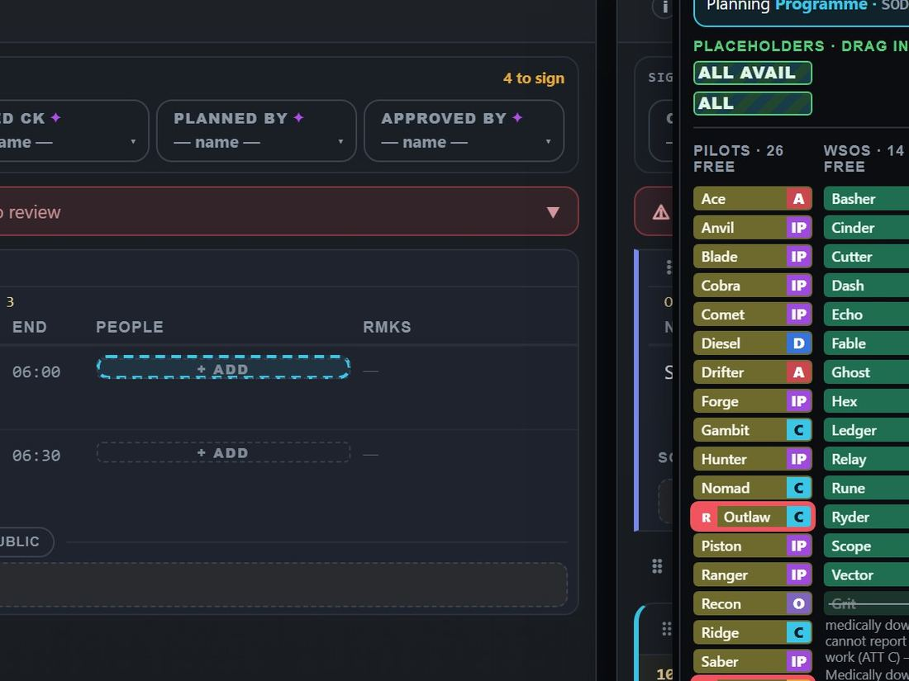
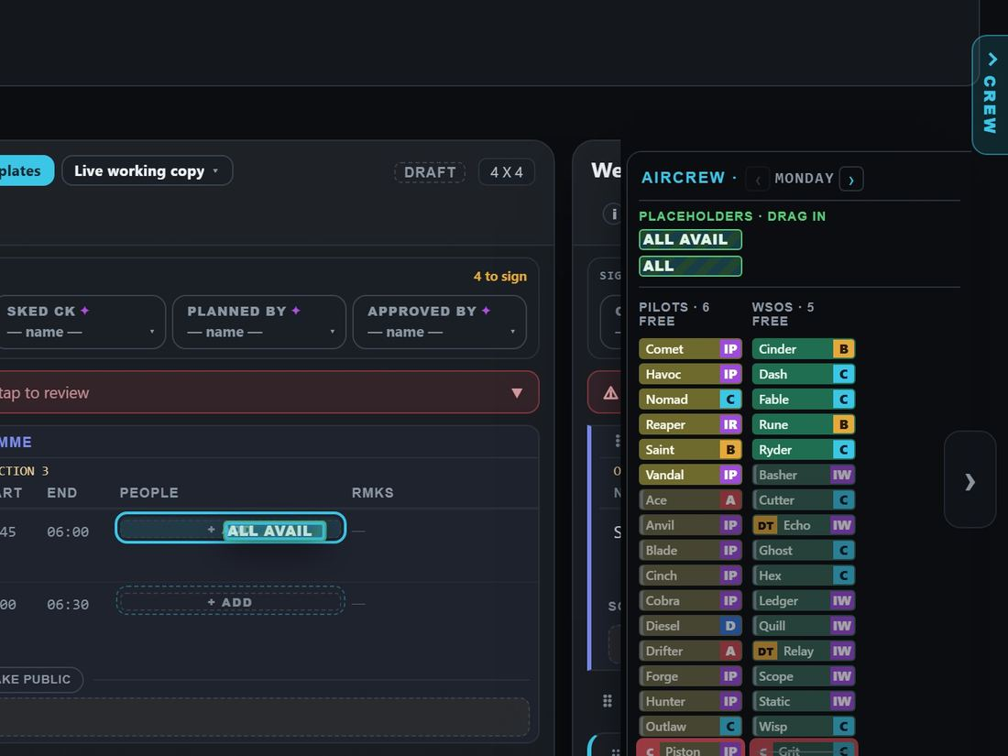
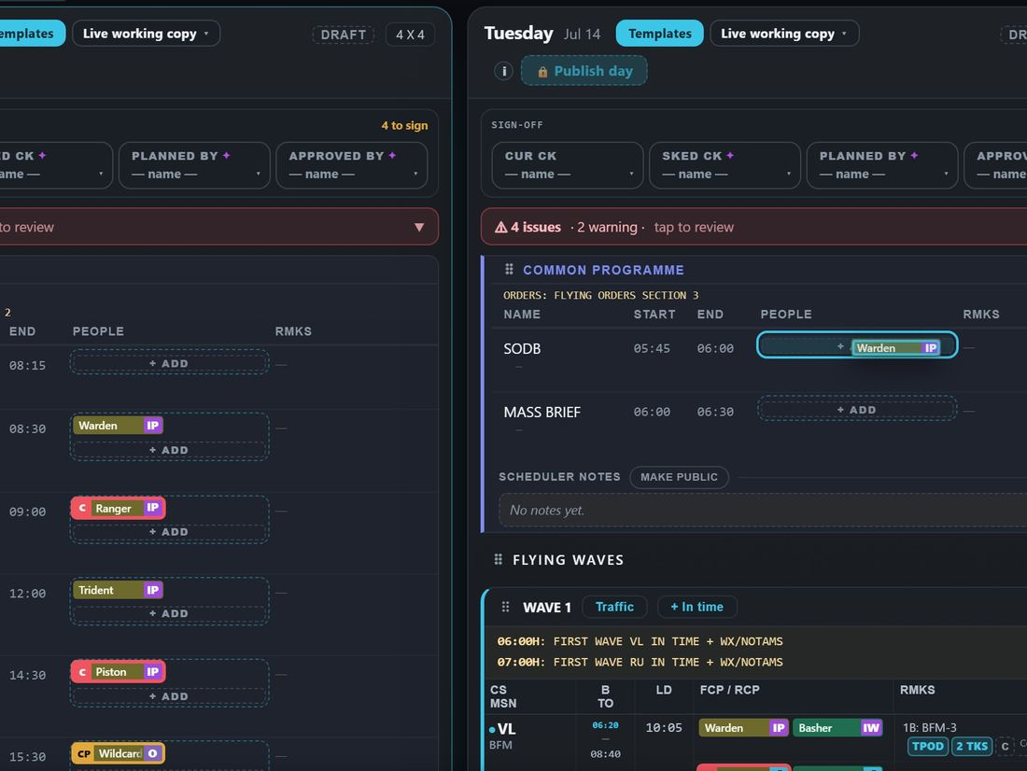
JOURNEY 2 · 4 OF 7
1
click
what you should see
Every way to put a person on a seat (1 of 2)
Admin only
Where Edit Schedule · the Scheduler Board
All of these work on the week and on the board, unless it says.
WAY A Drag from the crew list
WAY B Tap the seat, then a name
WAY C ALL AVAIL or ALL
WAY D Seat to seat, or day to day
1
1
2
2
1
1
2
2
1
Pick up a name
1
The seat arms, list narrows
1
A placeholder, dragged in
1
Drag a puck already on
2
Drop on + ADD or a seat
2
Tap a free name
2
Any seat but a jet's
2
Onto an empty seat: he moves
What to test
By hand, in the running app
Automated tests that cover it
A dropped name leaves the FREE count (it drops by one) and Undo lights up.
Tapping an empty seat rings it and strikes the names who are not free, with their reason.
ALL on a jet seat is refused: "ALL — cannot crew a jet…".
Dragging a puck to another day moves him (week only); onto another puck swaps the two.
e2e/geometry.spec.ts a real mouse drag lands on the pointer machine
drag.test.tsx roster to seat, swaps, drag-off removes
editweek.test.tsx arm a seat, then plant a name
palette.test.ts the crew list carries ALL AVAIL and ALL
RAPTOR · how the app works · 8 / 42

Slide 9
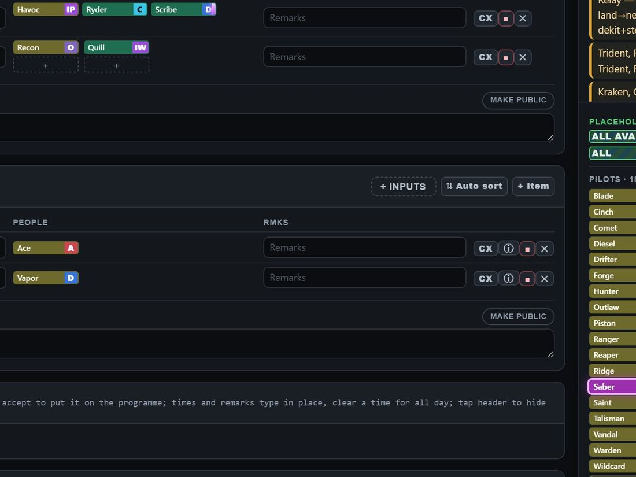
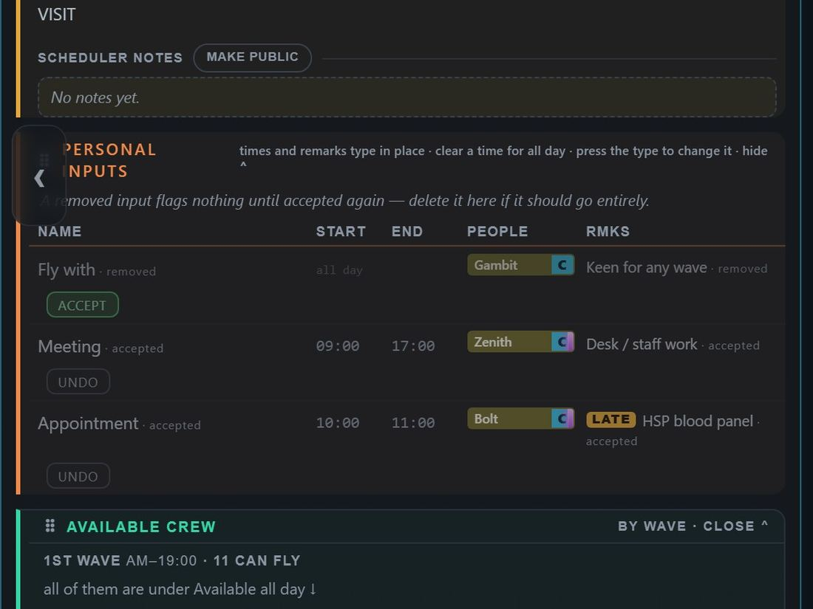
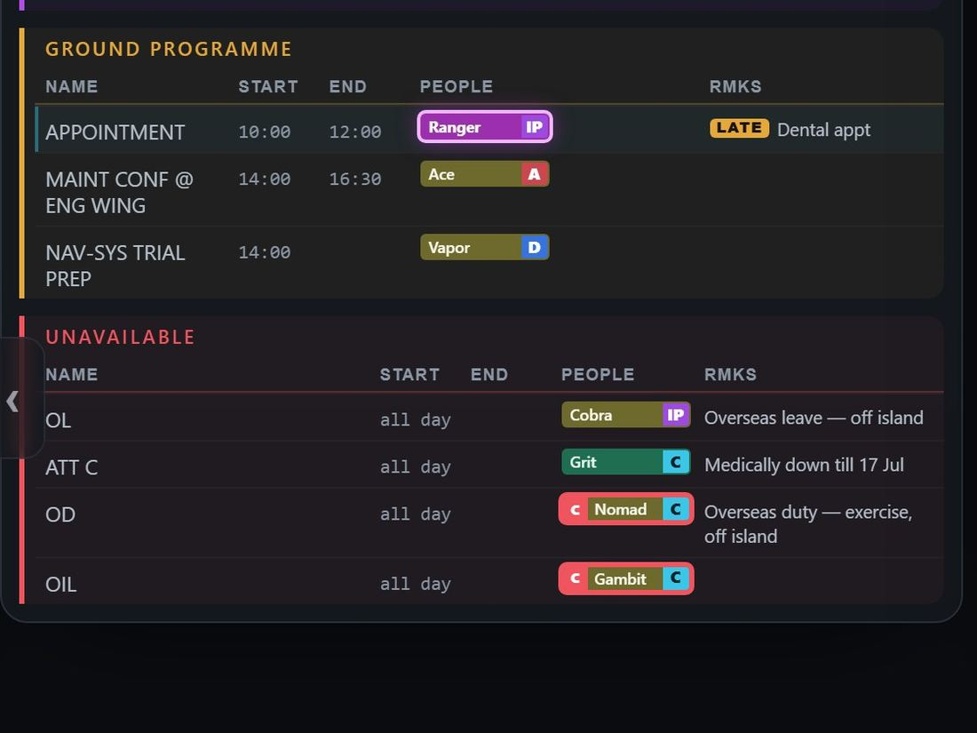
JOURNEY 2 · 5 OF 7
1
click
what you should see
Every way to put a person on a seat (2 of 2)
Admin only
Where Edit Schedule · the Scheduler Board
A tap on a name first does not place him — it lights every copy of him. The search box only highlights.
WAY A + Inputs on the board
WAY B Accept a personal input
WAY C A member files an activity
1
1
1
Person, type, times, Add
1
ACCEPT puts him on the day
It lands on the day by itself
What to test
By hand, in the running app
Automated tests that cover it
An activity input (a meeting, an appointment) lands on its day by itself; UNDO takes it off, ACCEPT puts it back.
On a published day a landed input reads as a pending change instead.
Loading a template, switching plans and Undo also put pucks back — whole-day copies.
boardaddinput.test.tsx adding through the board
accept.test.ts accept and unaccept an input
inputground.test.ts an activity lands on its day by itself
RAPTOR · how the app works · 9 / 42

Slide 10
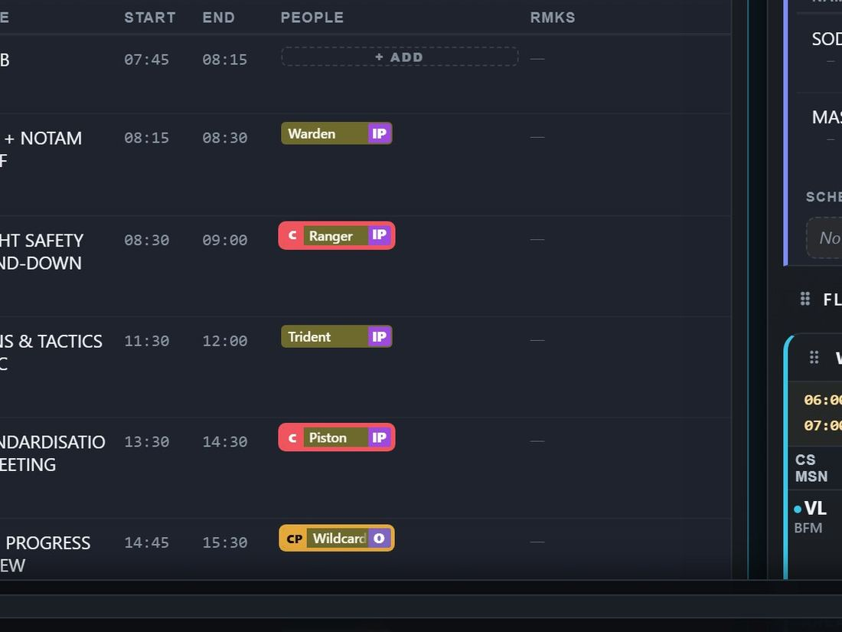
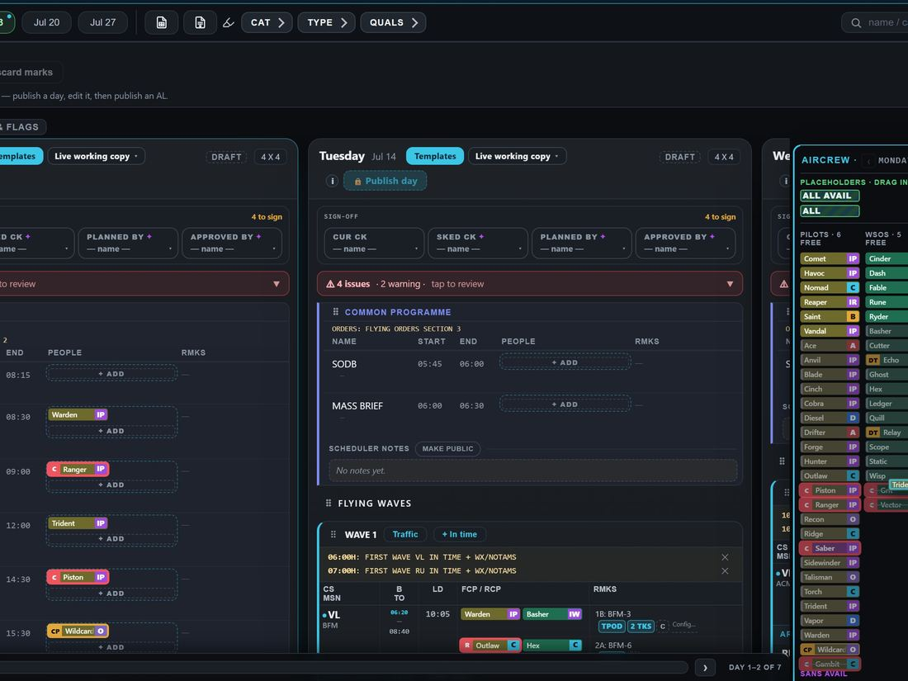
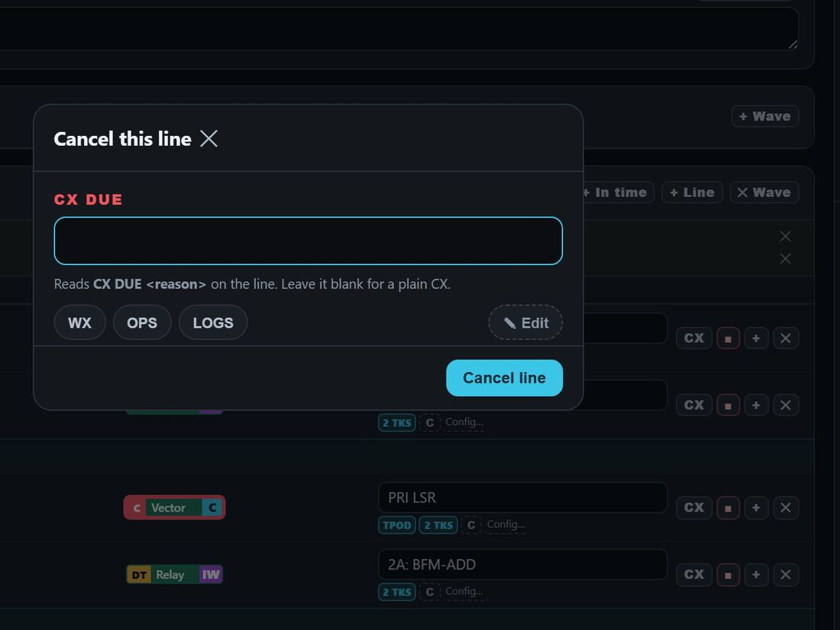
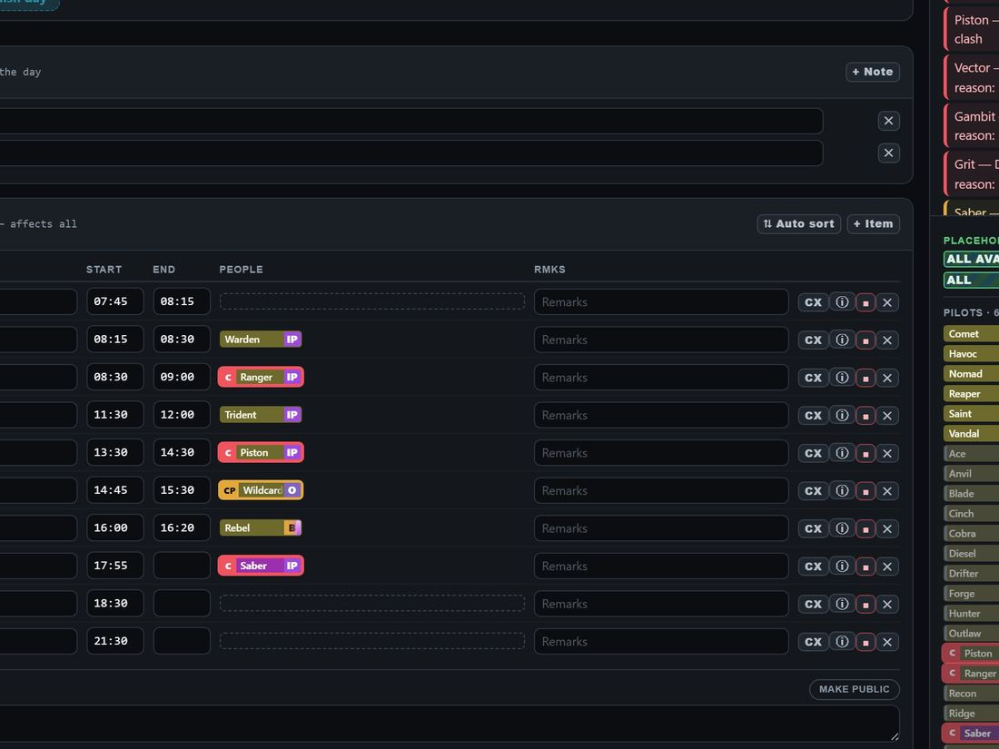
JOURNEY 2 · 6 OF 7
1
click
what you should see
Take off, cancel, put in order
Admin only
Where Edit Schedule · the Scheduler Board
WAY A Right-click to remove
WAY B Drag it off
WAY C Cancel, not delete (board)
WAY D Put rows in order (board)
1
1
1
2
1
1
Right-click the puck
1
Onto the crew list
1
A reason: WX, OPS, LOGS
1
Auto sort by start time
Back in the free list
2
Cancel line
What to test
By hand, in the running app
Automated tests that cover it
Right-click removes with a toast ("Trident removed"); Undo brings him back.
CX keeps the line and prints "CX DUE WX"; Un-cancel restores it.
Auto sort puts one section in time order; Sort all asks first, then sorts the day in one undo.
A row's grip drags it up or down; a section's ⠿ grip moves the whole section (display only).
drag.test.tsx drag-off removes
sort.test.ts Auto sort and Sort all
rowdrag.test.tsx dragging rows, waves and sections
audit-d-sortall-undo.test.tsx Sort all is one undo
RAPTOR · how the app works · 10 / 42

Slide 11
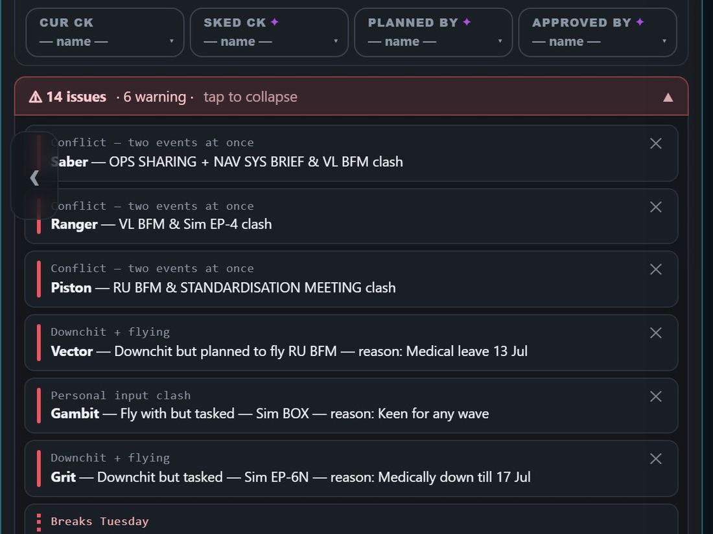
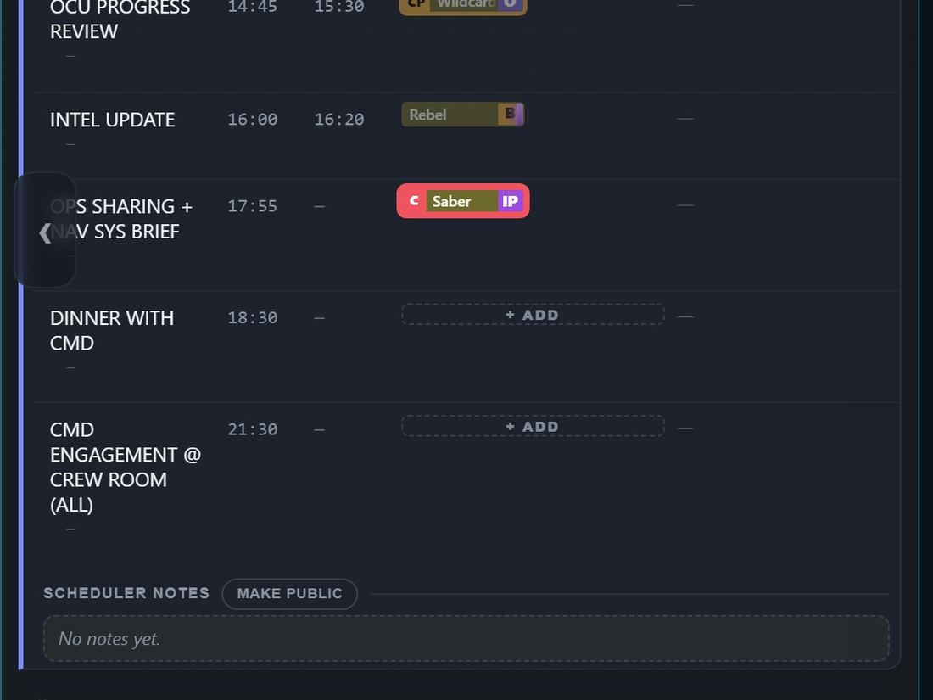
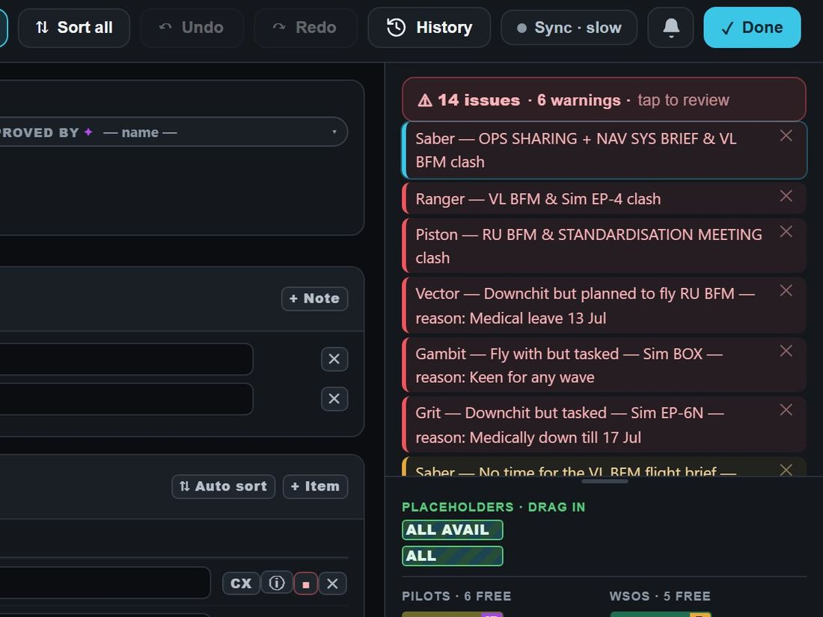
JOURNEY 2 · 7 OF 7
1
click
what you should see
Check the day: the issues
Admin only
Where Edit Schedule · the Scheduler Board
1
1
Tap "N issues · tap to review"
Tap an issue: the week jumps
On the board the list
One line per issue
to the puck and lights it
is always open
What to test
By hand, in the running app
Automated tests that cover it
The bar opens the day's list; tap it again to fold it.
Tapping an issue scrolls to the puck and lights its crew in the warning colours.
An ✕ on an issue hides it on both the week and the board; Undo shows it again.
warnjump.test.tsx an issue click scrolls to the puck
interact.test.tsx the issues bar opens and folds
warnmute-week.test.ts one hide, both surfaces
RAPTOR · how the app works · 11 / 42

Slide 12
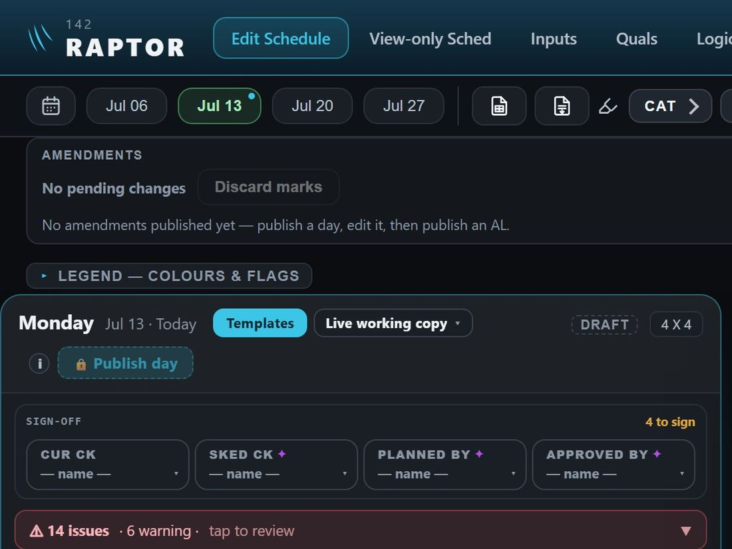
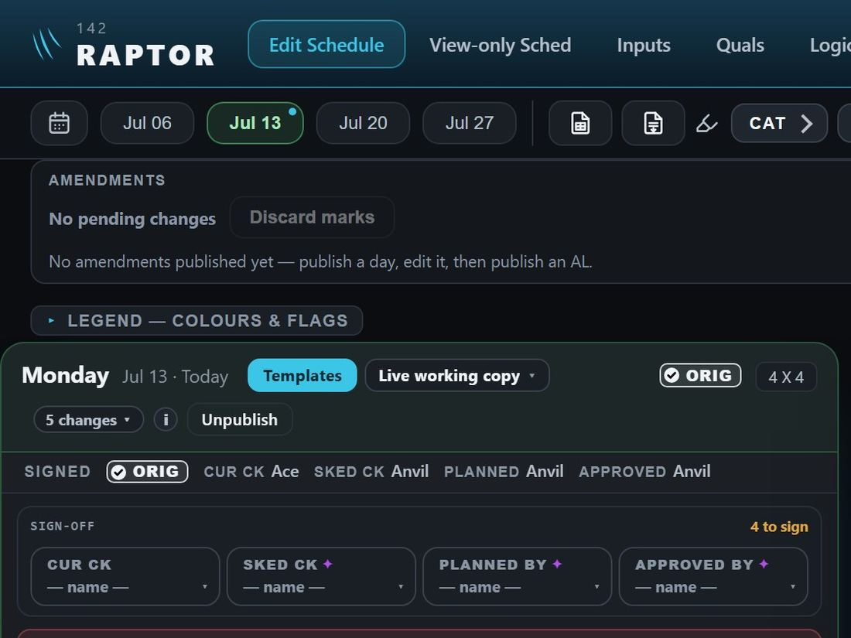
JOURNEY 3
1
click
what you should see
Publish a day
Admin only
Where Edit Schedule
1
4
3
2
1
Open Edit Schedule
3
Pick the four sign-off names
The day wears ORIG
View-only Sched shows ORIG
2
Pick the week
4
Press Publish day
Unpublish appears
"Original — as issued"
What to test
By hand, in the running app
Automated tests that cover it
Publish day stays locked until all four names are picked; its hover hint names who is missing.
After publishing: the ORIG tag, the signed line, and "Monday published — APPROVED".
A member (us / us) sees the issued day on View-only Sched and has no Edit Schedule.
Reload the page: the day is still published.
Change anything after signing: the names clear and Publish locks again.
pubsweep.test.tsx sign, publish, ORIG, what viewers see
publish.test.ts the four sign-off roles; three of four stays locked
signbind.test.ts an edit after signing clears the names
unpublish-button.test.tsx Unpublish shows only where it should
am-01-basics.mjs walk script: the same, in a real browser
RAPTOR · how the app works · 12 / 42

Slide 13



JOURNEY 4
1
click
what you should see
Amend a published day
Admin only
Where Edit Schedule (or the board)
3
4
1
2
Published: ORIG
1
Change something
2
Sign the four again
The day wears AL1
Sign-offs empty again
"1 pending", "Not yet signed"
3
Publish AL1
4
Unpublish takes it back
What to test
By hand, in the running app
Automated tests that cover it
Any change on a published day shows "1 pending" and "Not yet signed"; Publish AL1 stays locked until all four sign.
The changed detail carries a pending mark; after publishing it wears a solid AL1 tag.
A second change after signing drops all four names again.
Unpublish: "AL1 withdrawn — its changes are back on the working copy as pending".
Members keep seeing the issued version until AL1 goes out.
editweek.test.tsx an edit grows the AL button, gated on signing
amendretest.test.tsx Not yet signed / Not yet published
publish-commit.test.ts the Original, then each AL recorded
unpublish-commit.test.ts Unpublish re-opens only what differs
e2e/amendbatch.spec.ts a changed puck wears its ALn tag
RAPTOR · how the app works · 13 / 42

Slide 14



JOURNEY 5
1
click
what you should see
Alternate plans
Admin only
Where Edit Schedule — the plan selector
1
3
4
5
2
1
Open the plan selector
3
Tap a plan to make it live
The day now shows Plan A
4
Back to live copy
2
+ Alt Plan
The live plan is marked ●
Differences mark as the next AL
5
Load onto working copy
Issued versions: look only
What to test
By hand, in the running app
Automated tests that cover it
+ Alt Plan renames the current day to Plan A and makes Plan B the live day.
Switching is plain editing: on a published day the differences show as pending marks, no review screen.
The toast says how the plan compares with what was issued ("matches Original — nothing pending").
Issued rows only look; Load onto working copy asks first if edits are pending.
✎ Manage plans renames or deletes a plan.
planselector.test.tsx the label states, switch, preview
draftsui.test.tsx the menu, + Alt Plan, a published switch
editweek.test.tsx preview a version, load onto working copy
drafts.test.ts plans kept per day
RAPTOR · how the app works · 14 / 42

Slide 15




JOURNEY 6 · 1 OF 2
1
click
what you should see
Read the schedule
Everyone
Where View-only Sched
1
2
5
4
3
1
Jump to a date
3
Tap any day to go to it
4
A published day: its versions
5
Tap the issues bar
2
Or tap a week
The working draft, stamped
What the checks found
What to test
By hand, in the running app
Automated tests that cover it
A member's top bar has no Edit Schedule and no Admin.
A published day opens on "Original — as issued"; "Working draft — not issued" shows the live copy under a stamp.
An unpublished day shows DRAFT and no version picker.
The issues bar opens and folds the list.
draftsui.test.tsx issued by default; working copy under a banner
interact.test.tsx the issues bar opens and folds
weeknav.test.ts the week picker and its window
odds.test.tsx the phone menu's calendar and Today
RAPTOR · how the app works · 15 / 42

Slide 16




JOURNEY 6 · 2 OF 2
1
click
what you should see
Other ways to move about
Everyone
Where View-only Sched
WAY A Day arrows (desktop)
WAY B Next-week preview
WAY C Phone: swipe
WAY D Phone: the menu
1
1
1
2
1
One press, one day
1
Tap a greyed day to load it
One day fills the screen
1
Menu
"Day 2–4 of 7"
Swipe to the next day
2
Pick a date…
What to test
By hand, in the running app
Automated tests that cover it
At the week's end the › arrow crosses into the next week.
Clicking a next-week day loads that week and lands on it.
On a phone a swipe off Sunday or Monday changes week.
pan.test.tsx arrows move whole days; the edge crosses weeks
peek.test.tsx a peek day lands and loads
swipeweeks.test.tsx a swipe off the end changes week
RAPTOR · how the app works · 16 / 42

Slide 17

JOURNEY 7 · 1 OF 2
1
click
what you should see
File an input or a medical
Everyone
Where Inputs
3
1
2
4
5
1
Pick the day(s)
It is on the list
And on that day's schedule
A medical, with its document:
2
The type
the Medical view shows him
3
Times, if not all day
4
Remarks
5
Add input
What to test
By hand, in the running app
Automated tests that cover it
A member files for himself only (the person is fixed); an admin picks anyone.
An input filed less than two weeks ahead wears LATE; a downchit never does.
A medical type asks for its document; adding without one asks first.
The Medical button counts "down now" (red) and "owing an upchit" (amber).
inputs.test.tsx a member files for himself; add and delete
docconfirm.test.tsx a medical without a document asks
medicalview.test.tsx the three sections; a card opens its document
e2e/medical.spec.ts the Medical view fits desktop and phone
lateinput.test.ts the LATE mark; downchits never
RAPTOR · how the app works · 17 / 42

Slide 18

JOURNEY 7 · 2 OF 2
1
click
what you should see
Other ways to file an input
Everyone
Where Inputs
WAY A The Calendar view
WAY B + Inputs on the board (admin)
WAY C Leave through the Leave War
1
2
1
5
6
A day → + Input
1
For any person, that day
An approved bid becomes
1
Type, times, remarks
his leave input (journey 10)
2
Add
What to test
By hand, in the running app
Automated tests that cover it
The Calendar view opens on the real month; ‹ steps back to the demo July.
An input added on the board shows on the Inputs page at once.
An approved Leave War bid appears on the Inputs page at Approve.
inputscal.test.tsx the day popover; hold to add
boardaddinput.test.tsx adding through the board
sync.test.ts approving turns bids into one input
RAPTOR · how the app works · 18 / 42

Slide 19




JOURNEY 8
1
click
what you should see
Update quals
Everyone
Where Quals
5
1
4
6
3
2
1
Enable editing
2
Tick your own box
Another's row refuses
4
Admin: Edit quals
Pilots, WSOs, Personnel, All
3
Your CAT
5
A new qualification
6
Add a column
What to test
By hand, in the running app
Automated tests that cover it
A tick takes effect at once; "Save changes" only leaves edit mode.
A member edits only his own row: "You can only edit your own row".
An admin edits any row, renames callsigns and adds or removes columns.
A change in Quals re-checks the week (a lapsed qual warns at once).
quals-write.test.ts own row only; admin any row
quals.test.tsx a member ticks but cannot reshape
quals.test.tsx a tick or CAT change re-checks the week
qualcols.test.ts a new column, kept after reload
RAPTOR · how the app works · 19 / 42

Slide 20



JOURNEY 9 · 1 OF 2
1
click
what you should see
Bid for leave
Everyone
Where Leave War — your own row
1
2
4
5
3
6
1
Leave War
4
Tap a day on your row
5
Whole day, AM or PM
The bid, plain until answered
2
Fold the Manning away
6
The leave
Your balance moves
3
And the figures
Below zero: tap again
The stage: open for bidding
What to test
By hand, in the running app
Automated tests that cover it
A tap on someone else's row opens nothing; a member bids only on his own.
A bid lands plain; an admin's answer colours it (green approved, purple Ack, red refused).
Going below zero asks once ("Tap the same leave again"), then writes.
Bids only inside the "Bidding on" dates; once Bidding closed, a member's tap opens nothing.
e2e/leavewar.spec.ts a bid lands plain; own row only
bidding.test.tsx placing a bid; below zero asks once
window.test.tsx the bidding window on screen
e2e/leavewar.spec.ts closing the war locks members out
RAPTOR · how the app works · 20 / 42

Slide 21


JOURNEY 9 · 2 OF 2
1
click
what you should see
Other ways to bid, and after publishing
Everyone
Where Leave War — your own row
WAY A Drag across days
WAY B Pick a range in the sheet
WAY C Published: your remarks
1
1
2
1
2
2
3
3
3
1
Press the first day
1
Pick a range
1
Your approved day
2
Release on the last
2
The last day
2
Remarks
3
The leave
3
The leave
3
Save
What to test
By hand, in the running app
Automated tests that cover it
A drag fills the whole span in one go; today it can go below zero without asking (a fix is filed, D418).
Pick a range opens a calendar on the tapped day.
After publishing, a member opens only his own approved leave, for its remarks.
e2e/leavewar.spec.ts drag-selecting fills the whole span
bidding.test.tsx bidding over a range
remarks.test.tsx remarks on an approved leave
RAPTOR · how the app works · 21 / 42

Slide 22


JOURNEY 10 · 1 OF 3
1
click
what you should see
Run the Leave War
Admin only
Where Leave War
1
3
4
5
2
1
→ Bidding closed
2
Tap a bid
5
Tap the new day
Published
The stage now; + New
3
Approve (or Ack, Refuse)
Cancel stops the move
← Bidding closed undoes it
4
⇄ Move
What to test
By hand, in the running app
Automated tests that cover it
Stages: Draft → Open for bidding → Bidding closed → Published; no confirm; the top bar's Undo takes a stage back.
The admin decides in every stage but Draft (D418).
An approved leave reaches Inputs and the schedule at Approve, not at Publish (D418).
A bid moved after bidding closed wears a dotted edge and "moved from".
Published: members are locked out; an approved leave offers only its remarks (D418).
deciding.test.tsx approve, ack, refuse
chrome.test.tsx the stage strip
stage-undo.test.ts Undo takes back a stage move
sync.test.ts approving turns bids into one input
moveone.test.tsx moving one bid
RAPTOR · how the app works · 22 / 42

Slide 23

JOURNEY 10 · 2 OF 3
1
click
what you should see
More ways: many at once, and a new period
Admin only
Where Leave War
WAY A Decide many at once
WAY B A new period
WAY C It starts in Draft
1
2
3
1
4
3
1
2
1
Drag across
1
Its name
1
→ Open for bidding
2
the bids
2
First day
3
Approve all
3
Last day
4
Create
What to test
By hand, in the running app
Automated tests that cover it
A drag-selection offers Ack / Approve / Refuse, Move and Delete for every bid in it.
A day with two entries shows "+1"; its list decides each one.
A new war opens on the admin's screen in Draft; members pick it in Period.
A new war's "Bidding on" reads "THE WHOLE YEAR" until its dates are set.
selectsheet.test.tsx decide many; batch approve
e2e/step4-leavewar.spec.ts the day's list, each undoable
wars.test.tsx creating a leave war
RAPTOR · how the app works · 23 / 42

Slide 24




JOURNEY 10 · 3 OF 3
1
click
what you should see
The Manning — set it up your way
Admin only
Where Leave War
7
1
2
11
8
9
3
4
6
10
12
5
1
Tap a row's name
3
Amber below
7
A new counter
11
⇅ Rearrange
2
⚙ Settings
4
Red below
8
Who: CAT
12
The eye hides a row
Days under-manned
5
Save
9
Holding a qual
The new row
6
Edit counter…
10
Add counter
What to test
By hand, in the running app
Automated tests that cover it
Everyone can open a row's explainer; only an admin changes anything (a member has no ⚙ or Rearrange).
New amber / red lines colour the day's counts at once and change "Under-manned".
A new counter shows a preview count before it is added, then a row at the foot.
A hidden row folds under "Archive" and comes back from there; ↺ Reset counters asks first.
manningsheet.test.tsx the explainer; an admin edits the lines
counterform.test.tsx build, edit, delete; members cannot
counts.test.tsx amber and red; reorder, hide, archive
undermanned.test.tsx the days breaking a manning rule
settingssheet.test.tsx ⚙ is admin only
RAPTOR · how the app works · 24 / 42

Slide 25




JOURNEY 11 · 1 OF 8
1
click
what you should see
Find your way
Everyone
Where Tracker — the same for everyone
4
1
2
3
5
1
Crew: whose marks
Students, and their progress
4
Show All: filter the events
5
Find event
2
Course
Done or not, per event
The matches, ringed
3
Syllabus: which chart
A ring slice per student
What to test
By hand, in the running app
Automated tests that cover it
A member sees exactly the same bar and menus as an admin.
Changing Crew moves the highlighted slice on every ball and the Overall card.
Find event rings the ball in turquoise and scrolls to it; Enter steps to the next match.
smoke.mjs the board draws; the bar reads in order
smoke.mjs typing a code snaps to that ball
smoke.mjs Show All groups by code; says done
tracker.test.tsx a member has every control
RAPTOR · how the app works · 25 / 42

Slide 26




JOURNEY 11 · 2 OF 8
1
click
what you should see
Make a flow chart: the tools
Everyone
Where Tracker — the same for everyone
3
2
5
6
4
9
1
7
8
1
Syllabus ✎
4
+ Acad, + Flight, + Sim…
7
✎ Text: the poke-ball
9
✓ Save changes
2
+ Add syllabus
5
✋ Move: drag it
8
Save
The event, renamed
3
Edit chart layout
6
→ Connect two events
Its prerequisite links
What to test
By hand, in the running app
Automated tests that cover it
Tools: Move, Select, Connect (prerequisite, then the event), Delete (asks), + events, Text, Line, Edit lines, Arrow, Merge, Fit, Reset layout, Edit events.
The first structure change lights "✓ Save changes ●"; saving clears it and the undo history.
A moved ball saves itself; Delete asks, and says marks go at Save.
smoke.mjs a ball drags in edit mode
smoke.mjs a new event shows Save changes
smoke.mjs the poke-ball editor stays open on Delete?
retest.test.tsx a detail typed on one chart stays there
RAPTOR · how the app works · 26 / 42

Slide 27


JOURNEY 11 · 3 OF 8
1
click
what you should see
Edit an event's details — three doors
Everyone
Where Tracker — the same for everyone
WAY A Its pop-up: ✎ Edit details
WAY B Show All: its Edit
WAY C In the chart editor
1
1
7
2
2
8
1
Hours, name, type, crew
1
Filter to it
✎ Text: label, colour,
2
Save
2
Save
badge, crew, links
What to test
By hand, in the running app
Automated tests that cover it
A change of hours shows at once in the event's pop-up.
Reset to doc refills the boxes but saves nothing until Save.
Hours change only in the details window or Show All — not in the poke-ball editor.
smoke.mjs the inline editor has all five fields
smoke.mjs Reset to doc fills the boxes
retest.test.tsx details belong to one chart
RAPTOR · how the app works · 27 / 42

Slide 28



JOURNEY 11 · 4 OF 8
1
click
what you should see
Mark progress
Everyone
Where Tracker — the same for everyone
2
3
1
1
Tap the event
His slice turns black
3
Fails +
2
DCO, DPCO, Marginal, N.A.
Progress moves on
Each failure, dated
Done on: today
What to test
By hand, in the running app
Automated tests that cover it
DCO dates the event today and moves the yellow "available" ring on.
Each Fails + is one failure, drawn as a red tick on the ball and a chip in the Failures card.
Changing Done on after a grade re-dates the mark.
smoke.mjs a ball opens the grading pop-up
smoke.mjs DCO dates the day it was pressed
smoke.mjs every failure is its own chip
tracker.test.tsx a grade is one undo step
RAPTOR · how the app works · 28 / 42

Slide 29



JOURNEY 11 · 5 OF 8
1
click
what you should see
Other ways to update
Everyone
Where Tracker — the same for everyone
WAY A Another student's slice
WAY B The Failures list
WAY C Undo in the top bar
2
1
1
1
1
Tap his slice: he is picked
1
Failures
1
↶ one step at a time
Crew switches to him
2
Change a failure's day
↷ puts it back
What to test
By hand, in the running app
Automated tests that cover it
Tapping another student's slice picks him and opens nothing; tapping again opens his pop-up.
The side panel's dates (last flown, down days, pace, end dates) save on leaving the box.
Undo covers marks, failures, dates, pace and chart edits; there is no bulk marking.
smoke.mjs another crew member's wedge picks them
smoke.mjs changing a day in the list re-dates it
leftovers.test.tsx Undo takes back pace, end date, lull
RAPTOR · how the app works · 29 / 42

Slide 30



JOURNEY 11 · 6 OF 8
1
click
what you should see
What it refuses
Everyone
Where Tracker — the same for everyone
WAY A An N.A. cannot have fails
WAY B A day not yet come
WAY C A loop in the chart
1
1
1
1
Fails + on an N.A.
1
A future Done on
"That link would create a loop"
Refused, with the reason
"pick today or earlier"
1
OK
What to test
By hand, in the running app
Automated tests that cover it
Also refused: the same link twice, a link to itself, a name already used, a colon in a course name, deleting the last course (no automated test yet — filed).
A future day is refused in Done on, Failed on and both Last Flown boxes.
Switching chart, exporting or signing out with unsaved chart edits asks first.
smoke.mjs an N.A. event cannot be failed
leftovers.test.tsx a day after today is refused
smoke.mjs switching with unsaved edits asks first
RAPTOR · how the app works · 30 / 42

Slide 31




JOURNEY 11 · 7 OF 8
1
click
what you should see
Students and courses
Everyone
Where Tracker — the same for everyone
7
2
1
5
6
3
4
8
9
1
+ Add
He joins, linked
6
Course ✎
8
↺ Restore a deleted course
2
Search the roster
4
✎ rename
7
+ Add course
9
Save order
3
Pick him
5
× remove
Delete course
What to test
By hand, in the running app
Automated tests that cover it
A pick from the roster adds him in capitals with a linked dot; a typed new callsign adds a new crew member.
Rename keeps his marks; × removes him and his marks on that chart.
A new course goes to the top and opens empty; a deleted one comes back with ↺ Restore.
There is no "move to another course": remove and add again (starts clean).
smoke.mjs + Add lists the roster; the pick is added
smoke.mjs rename keeps the id; remove takes the work
smoke.mjs a new course at the top; reorder re-slices
retest.test.tsx a deleted course comes back
RAPTOR · how the app works · 31 / 42

Slide 32




JOURNEY 11 · 8 OF 8
1
click
what you should see
Export and import
Everyone
Where Tracker — the same for everyone
2
1
3
4
6
5
1
⇪ File
3
Students & courses too?
What the file holds
Import: replace or add?
2
Export…
4
All charts
6
Replace it
Import…
5
Export
What to test
By hand, in the running app
Automated tests that cover it
Export opens with students unticked every time; ticking them shows the ⚠ warning.
A charts-only file imports without asking about people and changes no marks.
A chart already here asks Skip / Add as new / Replace; a file with people asks once.
A damaged file is refused with a message saying what is wrong.
smoke.mjs Export starts with students unticked
smoke.mjs charts-only import asks nothing, writes no mark
smoke.mjs damaged files refused, with a reason
fileFormat.test.ts the file's shape
RAPTOR · how the app works · 32 / 42

Slide 33




JOURNEY 12
1
click
what you should see
Let people in, add a person
Admin only
Where Admin → Users
1
2
5
3
6
7
4
1
Callsign and initials
On the list, both dots green
5
Tap a man with no sign-in
His sign-in dot turns green
2
Pilot, WSO or personnel
6
Type his defence mail
3
His sign-in, if he uses the app
7
Give sign-in
4
Add person and sign-in
What to test
By hand, in the running app
Automated tests that cover it
Sign-in left blank: the button reads "Add person", no Role box; typing one changes both.
After Add the form clears; he is on People A to Z and has a Quals row.
A row with no sign-in offers Give sign-in · Archive · Delete · Cancel.
The new sign-in works at once; the top right reads "Nova · Member".
Your own row is greyed and cannot be opened. A member has no Admin tab.
accounts-newperson.test.tsx add roster-only; Quals "+ Add person" opens it
accounts-ui.test.tsx gives a man on the roster his sign-in
onedoor-users.test.tsx one row per person, two dots; Post in
roster-add.test.ts callsign, initials, seat and CAT checks
od-walk.mjs walk: the list, the dots, Give sign-in
RAPTOR · how the app works · 33 / 42

Slide 34




JOURNEY 13
1
click
what you should see
Post out, archive, delete
Admin only
Where Leave War (post out) · Admin → Users
4
1
5
8
2
6
3
7
1
His day → PO: PO from
4
Admin → Users: tap his row
6
Restore: his Post in date
8
Delete asks twice
2
Where he goes
5
Archive
7
Restore
It says what goes
3
Post out
What to test
By hand, in the running app
Automated tests that cover it
Post out: the sheet opens on the tapped day, Overseas Sqn chosen; nothing happens until the PO date.
Archive is one tap: he moves to "Archived", both dots red, his sign-in says access suspended.
Restore asks the Post in date; his next sign-in shows "Welcome back — check your quals and CAT".
Delete needs two taps and names what goes before the second.
You cannot archive yourself, or the last admin who can sign in.
e2e/onedoor.spec.ts archive → away on the war → restore → welcome back
onedoor-users.test.tsx archive one tap; restore asks Post in; delete twice
po.test.tsx post out from the grid; members see no PO
person-delete.test.ts delete keeps flown days, clears days to come
accounts-ui.test.tsx suspend / enable; delete says what goes
RAPTOR · how the app works · 34 / 42

Slide 35




JOURNEY 14 · 1 OF 2
1
click
what you should see
Squadron settings and rules
Admin only
Where Admin → Squadron config · Logic
4
1
2
5
3
6
1
Squadron config
A template editor
4
Logic: find a rule
"Rules modified" on the schedule
2
Move a section (Sims up)
5
Edit rules (then Done)
3
Duty templates…
6
Change a setting
What changed
What to test
By hand, in the running app
Automated tests that cover it
A member has no Admin tab; Logic is read-only for him, with no Edit rules.
A section nudge renumbers the list; "Reset to standard order" puts it back.
A setting outside its limits is refused and put back, with the limits named.
After a change every week shows "Rules modified" until "Reset to standard".
admin.test.tsx template openers; a nudge re-orders
logic.test.tsx Edit rules changes the engine; limits refused
DutyTplModal.test.tsx a new template, rows, delete
WaveTplModal.test.tsx the wave editor; members never see it
RAPTOR · how the app works · 35 / 42

Slide 36



JOURNEY 14 · 2 OF 2
1
click
what you should see
Other doors to the same editors
Admin only
Where Admin → Squadron config · Logic
WAY A A day's Templates
WAY B The board's + Block
WAY C The board's + Wave
1
1
1
2
2
2
1
Templates
1
+ Block
1
+ Wave
2
✎ Manage templates
2
The pencil
2
The ⚙
What to test
By hand, in the running app
Automated tests that cover it
Each door opens the same editor as Admin → Squadron config.
A template saved from one door shows at every other.
daytplui.test.tsx both entry points open one picker
board.test.tsx + Block offers the duty templates
wavepicker.test.tsx the pencil opens the editor
RAPTOR · how the app works · 36 / 42

Slide 37




JOURNEY 15
1
click
what you should see
Print, export and data
Admin only
Where Edit Schedule · Inputs · Admin → Data
1
2
4
3
1
Export to Excel
The printable report
3
Inputs: Export to Excel
4
Admin → Data
2
Export as PDF
Clear old data (asks twice)
What to test
By hand, in the running app
Automated tests that cover it
The schedule's CSV is 142-schedule.csv; a published day exports its issued version.
The PDF report is one block per day, marked RESTRICTED, each day stamped signed or working.
A member has no schedule export, but has Export to Excel on Inputs and Quals.
Admin → Data's Clear buttons stay grey until a date is picked; the first tap only counts.
export.test.ts CSV encoding; both span ends
export-published.test.ts a published day exports as issued
printpdf.test.ts the report stands alone, by day
wipe.test.tsx clearing takes clutter only; undoable
RAPTOR · how the app works · 37 / 42

Slide 38



JOURNEY 16
1
click
what you should see
Undo, redo and the change history
Everyone
Where The top bar, every page
1
4
2
3
6
5
1
Undo
3
The clock: the change history
6
Tap a change: go to it
2
Redo
4
All changes
The window stays open
The change, taken back or put back
5
Group by Who
What to test
By hand, in the running app
Automated tests that cover it
Undo is grey until there is something to undo; it takes back only your own changes.
The history window is movable; gold dots mark every detail with a history.
"New to you" holds others' changes until "Mark all as seen"; your own are never new.
The undo list empties at sign-in and sign-out.
e2e/changeswin.spec.ts the window, gold dots, Group by Item
histlist.test.tsx the ways in; a click jumps
undo-wire.test.ts undo and redo are wired
session-undo.test.ts undo is per sign-in
topbar-pair.test.tsx where the pair shows
RAPTOR · how the app works · 38 / 42

Slide 39






JOURNEY 17 · 1 OF 4
1
click
what you should see
One leave filed — where it shows
Everyone
Where Everywhere — nobody touches it
SHOWS UP BY ITSELF IN
ONE ACTION
1
2
3
Schedule the day's Unavailable block
Issues "On leave + flying" for each seat he held
Leave War LL, approved, with the blue "from Inputs" edge
1
A member picks the day
2
LL
Crew list struck through, the reason on hover
Admin "1 new" on the day; the clock counts it
A published day "1 pending", the sign-offs fall
3
Add input
What to test
By hand, in the running app
Automated tests that cover it
Nothing needs a refresh: the schedule, Inputs calendar and Leave War show it at once.
The Leave War's manning counts for that day drop by one.
On a published day members still see the issued version until the next AL.
The bell does not light for inputs; the day's chip and the clock are the notice.
sync.test.ts Inputs-filed LL shows on the war
avail.test.ts leave and downchit close the day
latepub.test.tsx filed after publishing: 1 pending
changes.test.ts someone else's change is new to you
RAPTOR · how the app works · 39 / 42

Slide 40



JOURNEY 17 · 2 OF 4
1
click
what you should see
An activity, and a downchit
Everyone
Where Everywhere — nobody touches it
SHOWS UP BY ITSELF IN
ONE ACTION
Schedule a Meeting lands on the Ground Programme
Medical the downchit leads the tracker
A Meeting with times, or a
Leave War the downchit shows on his day
medical (ATT C), on Inputs
What to test
By hand, in the running app
Automated tests that cover it
An activity with times lands as a Ground Programme row on the week, the board and View-only.
An activity never reaches the Leave War; a downchit does.
A downchit never wears LATE; each seat he holds raises "Downchit + flying".
A weekend Duty asks the OIL question before it is saved.
inputground.test.ts an activity lands on its day
medicalview.test.tsx the Medical count is live
sync.test.ts a spanned ATT C shows on the war
lateinput.test.ts downchits are never LATE
RAPTOR · how the app works · 40 / 42

Slide 41


JOURNEY 17 · 3 OF 4
1
click
what you should see
The Leave War and Inputs, both ways
Everyone
Where Everywhere — nobody touches it
SHOWS UP BY ITSELF IN
ONE ACTION
Leave War the bid turns green
Inputs his leave input appears at once
3
4
2
The other way a leave filed on Inputs shows on the war
3
The admin approves a bid
What to test
By hand, in the running app
Automated tests that cover it
A bid alone never reaches Inputs; Approve does, before the war is published (D418).
Publishing the war changes no input.
A weekend Duty credited FO reaches the war only when that day is published.
sync.test.ts a 3-day LL run becomes one input
sync.test.ts refusing a mid-span day splits it
oilsync.test.ts publishing the Saturday lands FO
RAPTOR · how the app works · 41 / 42

Slide 42



JOURNEY 17 · 4 OF 4
1
click
what you should see
A name changed on Quals
Everyone
Where Everywhere — nobody touches it
SHOWS UP BY ITSELF IN
ONE ACTION
1
Schedule every puck of his, renamed
Leave War his row's name
An admin renames a callsign
Admin → Users his row, same person
on Quals (Enable editing)
What to test
By hand, in the running app
Automated tests that cover it
The stored person never changes — only his label — so nothing is lost or duplicated.
A lapsed qualification ticked off on Quals warns on the week at once, with a Q mark.
Archiving a man posts him out of the war from that day and keeps his flown pucks.
personid.test.ts a rename moves nothing
latepub.test.tsx a lapsed AAR warns at once
onedoor.test.ts archiving keeps every puck
RAPTOR · how the app works · 42 / 42

