Slide 1

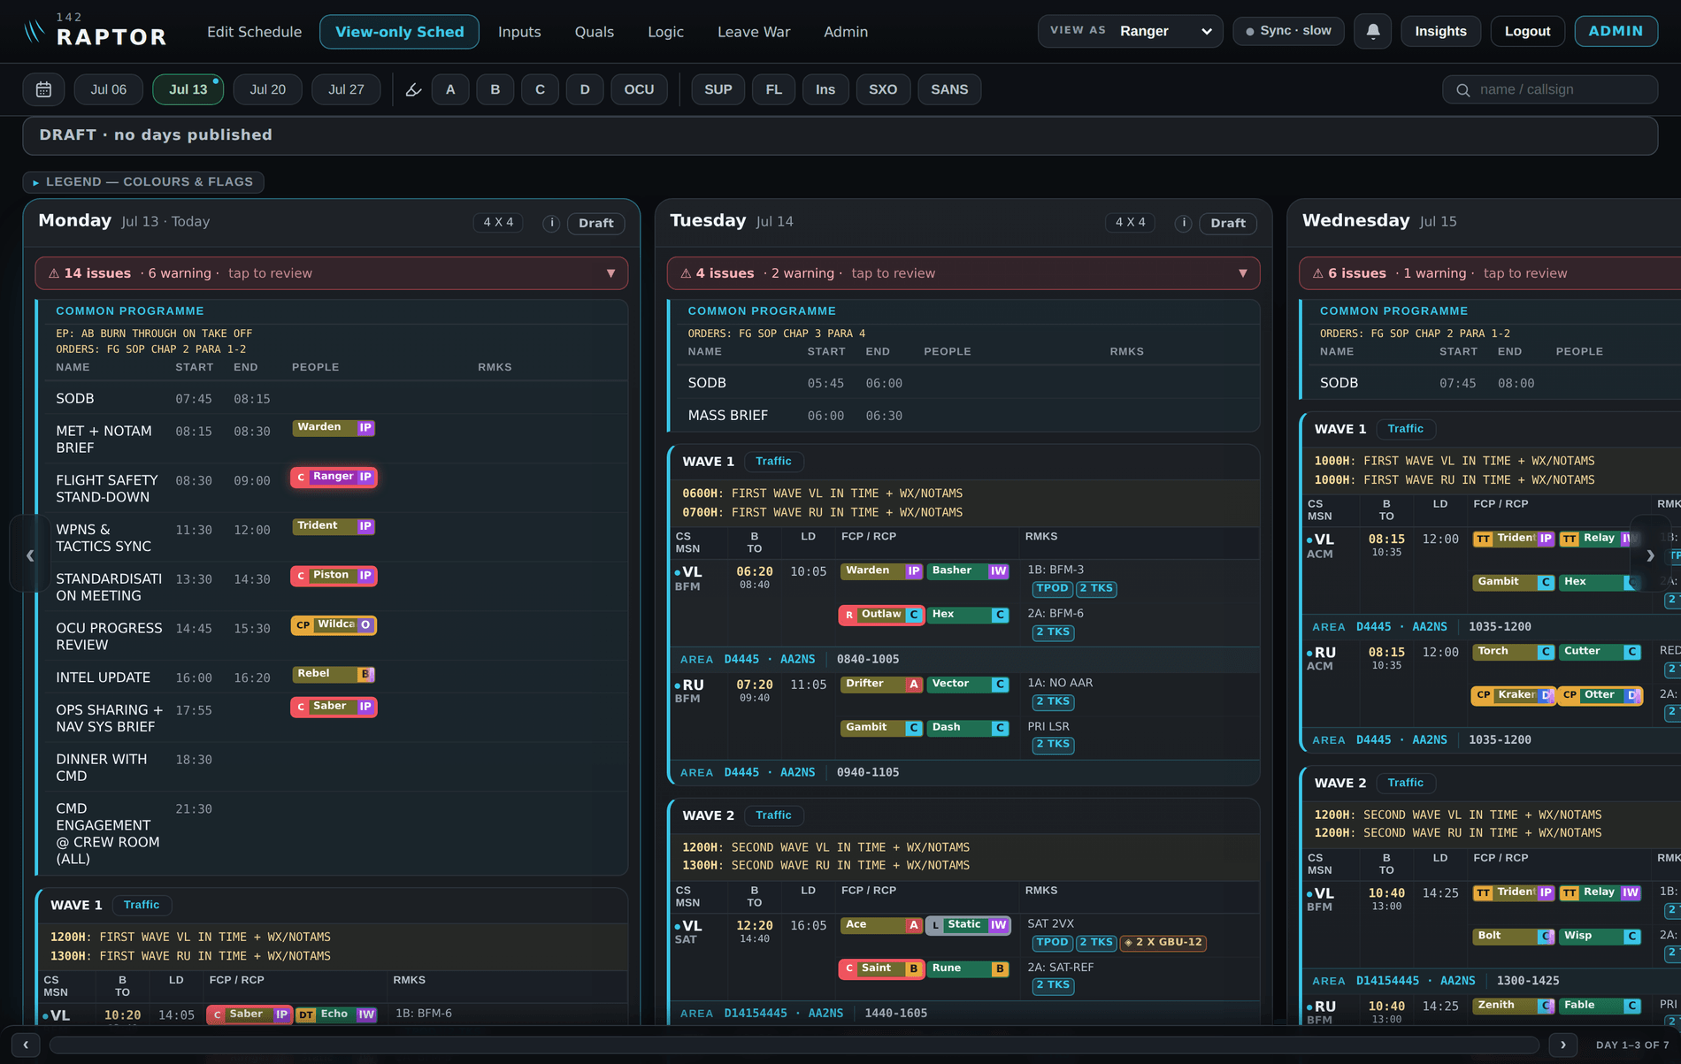
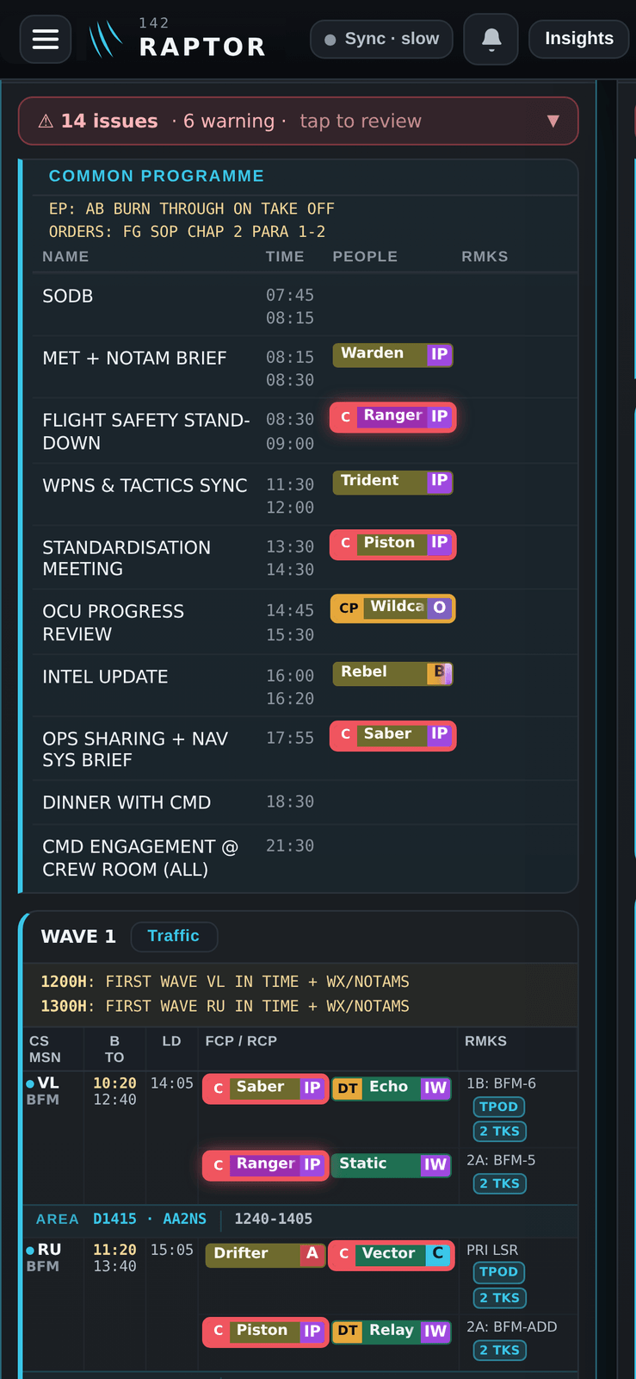
142 · RSAF
RAPTOR
READINESS AVAILABILITY PLANNING
TRACKING & OPS REPORTING
Your wingman in the planning room. One application for the flying programme, the crew, the rules and the manpower.
The live flying programme — a full week at a glance
Application in progress
Commander brief · Aug 2026
Roll-out: 142 SQN → 149 SQN → FG
Notes:
RAPTOR — Readiness, Availability, Planning, Tracking and Ops Reporting — is 142 Squadron's operations planner. The idea in one line: it's the wingman in the planning room. It holds the flying programme, the crew, the rules and the manpower picture in one place, and it backs the planner up the moment something doesn't add up. It works on a desktop and on a phone, and it's live today.

Slide 2
THE PROBLEM WE SET OUT TO SOLVE
Today the picture is scattered across too many places
The flying programme, leave, medical status, up-chits, qualifications, duties and student progress each live in a different spreadsheet, chat or form — and the same facts get re-typed into every one.
Flying programme
spreadsheet
Leave applications
chat + forms
Medical certs
email / paper
Up-chits
paper / memory
RAPTOR
Qualifications
One application · one source of truth
spreadsheet
Duties & manning
whiteboard
Enter a fact once. Everyone sees the same picture — and nothing has to be re-keyed.
Student syllabus
separate tracker
RAPTOR
02
Notes:
This is the real problem. Everything a squadron plans against sits in a different place — the programme in one spreadsheet, leave over chat, medical certs in email, up-chits on paper, quals in another sheet, student progress in yet another tool. The same fact gets entered again and again, and mistakes slip through because nothing is joined up. RAPTOR pulls all of it into one application — enter a fact once, and everyone sees the same picture.

Slide 3
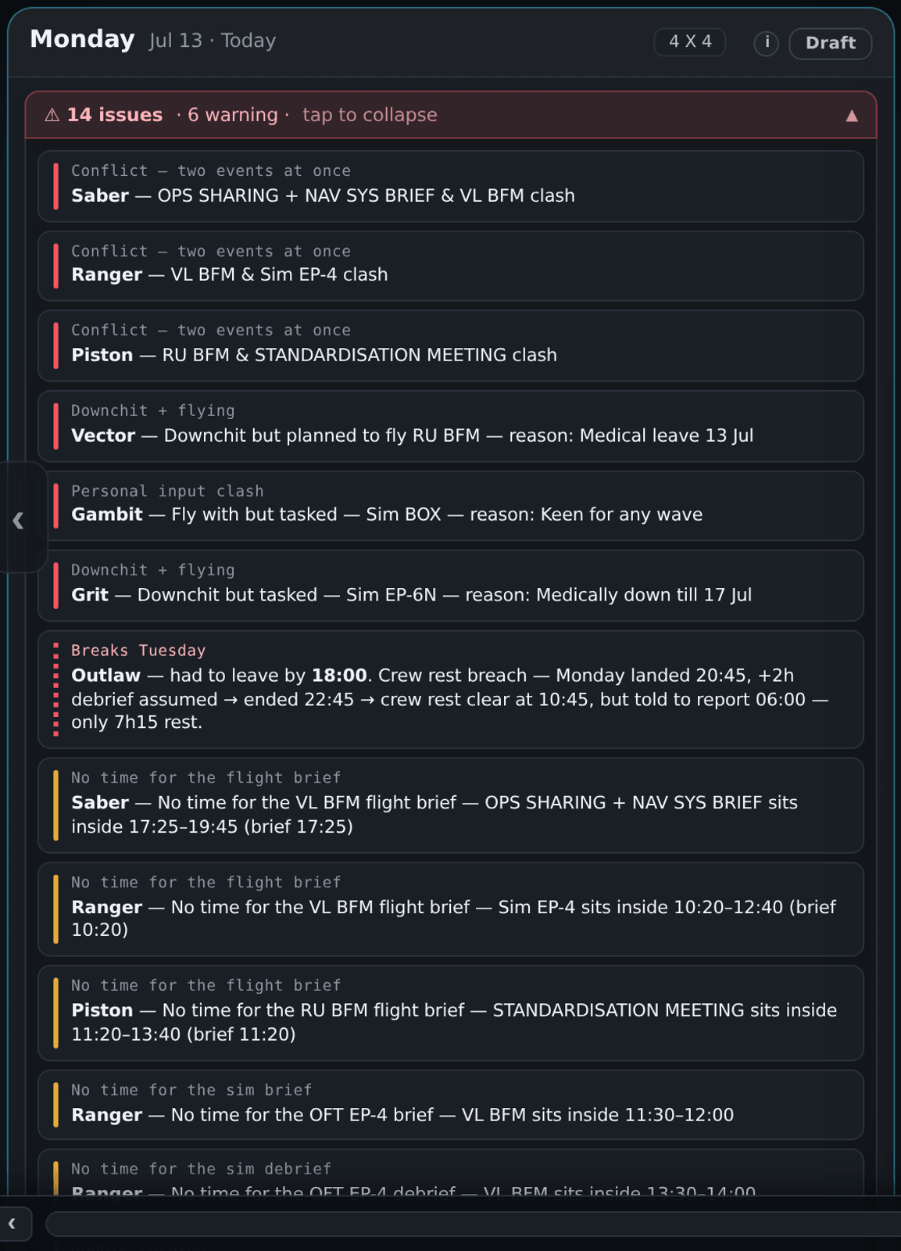
YOUR WINGMAN · 1
It backs you up when a plan doesn't add up
Every line is re-checked the instant it changes — RAPTOR flags what breaks the rules, clearly and on the spot, so a mistake is caught before it flies.
Crew-rest breach
Late land last night vs. an early report — RAPTOR does the maths and names who's short.
Double-booking / clash
One person, two places at once — across sorties, sims, duties and meetings.
Downchit but tasked
Someone medically down still on a flying line — flagged with the reason and dates.
No time for the brief
A meeting or sim sits inside the flight's brief window — the brief can't happen.
Illegal crew combination
“OCU pilot with CAT C WSO — not an authorised combination” — quals checked on every pairing.
RAPTOR
03
A soft bar: it warns clearly and grades severity, but the planner stays in command.
Notes:
The wingman half of RAPTOR. The moment a line changes, the engine re-checks the whole day and flags what breaks the rules — every example here is real, from the app: a crew-rest breach with the maths done for you; double-bookings across sorties, sims, duties and meetings; someone medically down still on a flying line; a flight whose brief window is eaten by a meeting; and an illegal crew combination — an OCU student paired without the authorised crew. Red for a hard breach, amber for a tight advisory — but the planner stays in command; nothing is silently blocked.

Slide 4
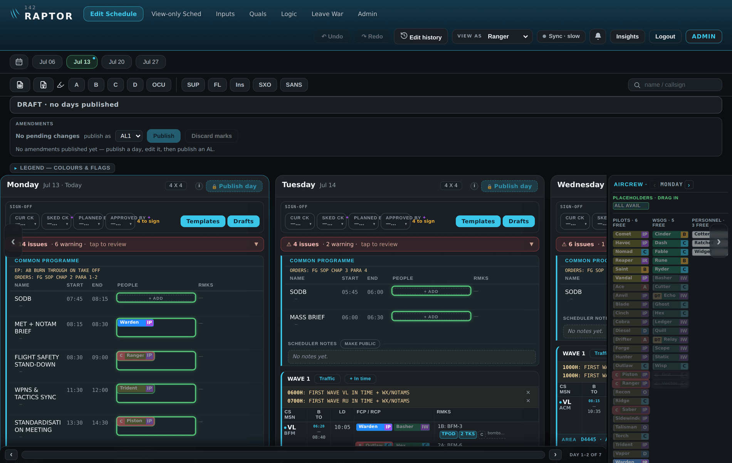
YOUR WINGMAN · 2
It shows you exactly who can fly the line
Reach for a crew and RAPTOR has already done the thinking — who's qualified, who's rested, who's free.
Available-crew placeholders The palette lists who is free right now — pilots, WSOs and personnel — and strikes out anyone already committed.
Click a crew → green shows where Select someone and every slot they can legally fill lights up green. No guesswork.
Read them across the whole week Tap a puck and that person is highlighted on every day — trace where they are all week at a glance.
Qualified · rested · conflict-free. If a placement still breaks a rule, it's flagged right on the puck.
RAPTOR
04
Notes:
Placing crew is where the rules engine meets the roster. The available-crew placeholders on the right of the schedule show exactly who is free, striking out anyone already flying, on duty or on leave. Click a crew member and every slot they could legally fill lights up green. Select a puck and that person is highlighted across the whole week — easy to read where they are, day by day. And if you override and place someone anyway, the breach is flagged right on the puck.

Slide 5
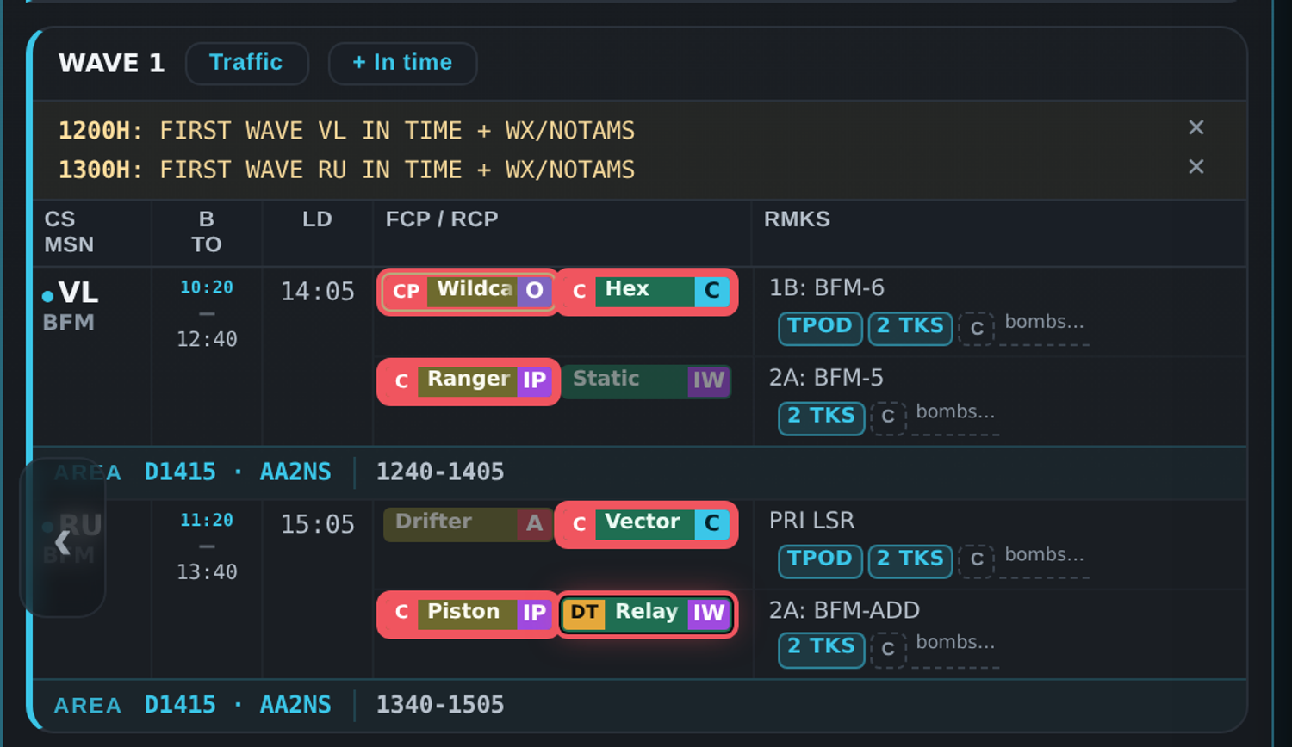
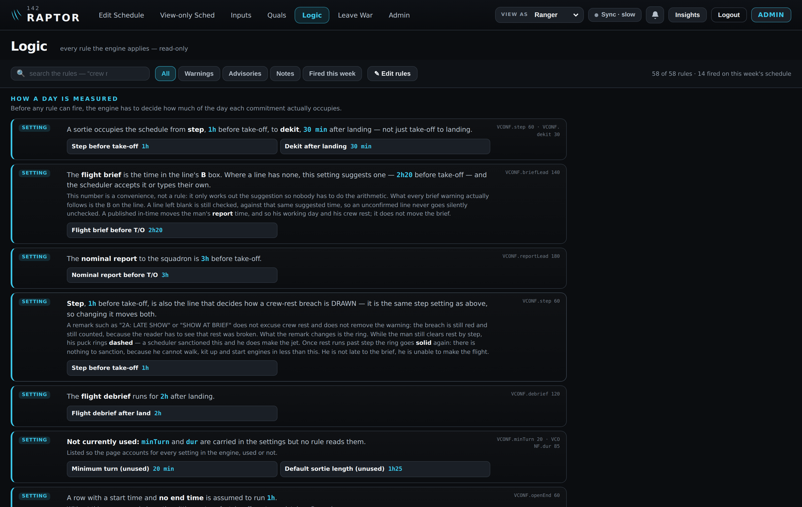
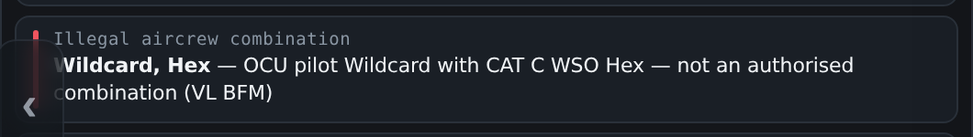
YOUR WINGMAN · 3
Flagged on the crew — and every rule is yours to tune
An OCU student crewed without authorisation — red rings on the pair, and the reason in plain English:
58 rules, in plain English The Logic tab spells out every rule the engine applies — and shows which fired on this week's schedule.
Squadron-editable numbers Crew-rest hours, brief lead, report time, debrief — management tunes the thresholds on the page, no coding.
RAPTOR
05
Notes:
Two things commanders usually ask next. First — the flag lands where the decision is: here an OCU student has been crewed without the authorised pairing, and both pucks ring red on the board itself, with the reason written in plain English underneath. Second — the rules aren't a black box. The Logic tab lists all 58 rules the engine applies, in plain English, shows which ones fired this week, and the numbers — crew-rest hours, brief lead, report time — are squadron-editable right on the page. Policy changes don't need a programmer.

Slide 6
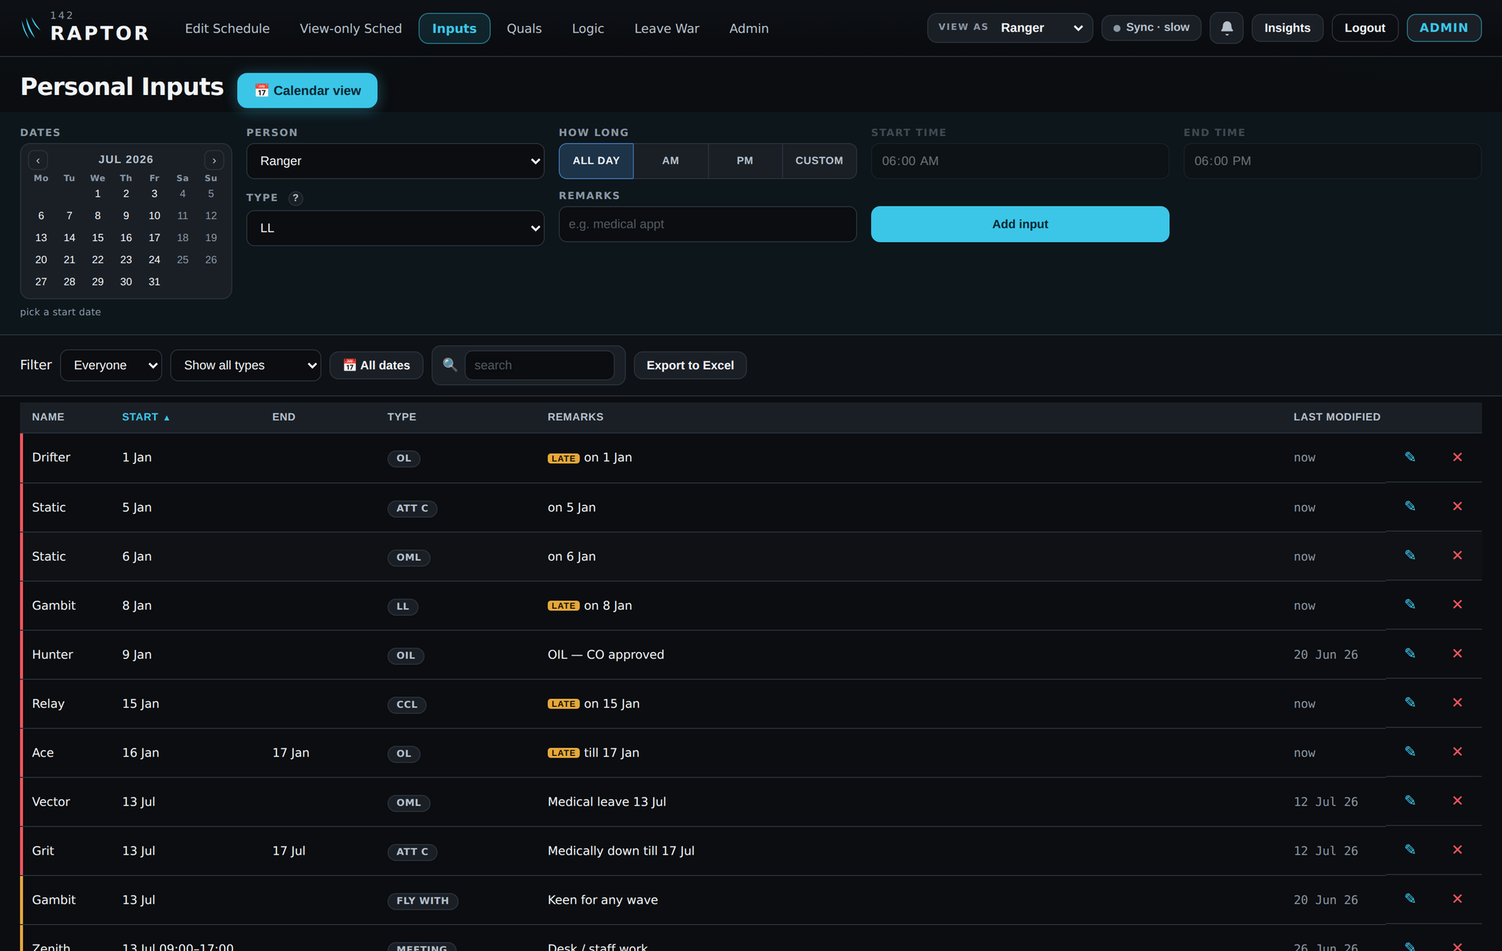
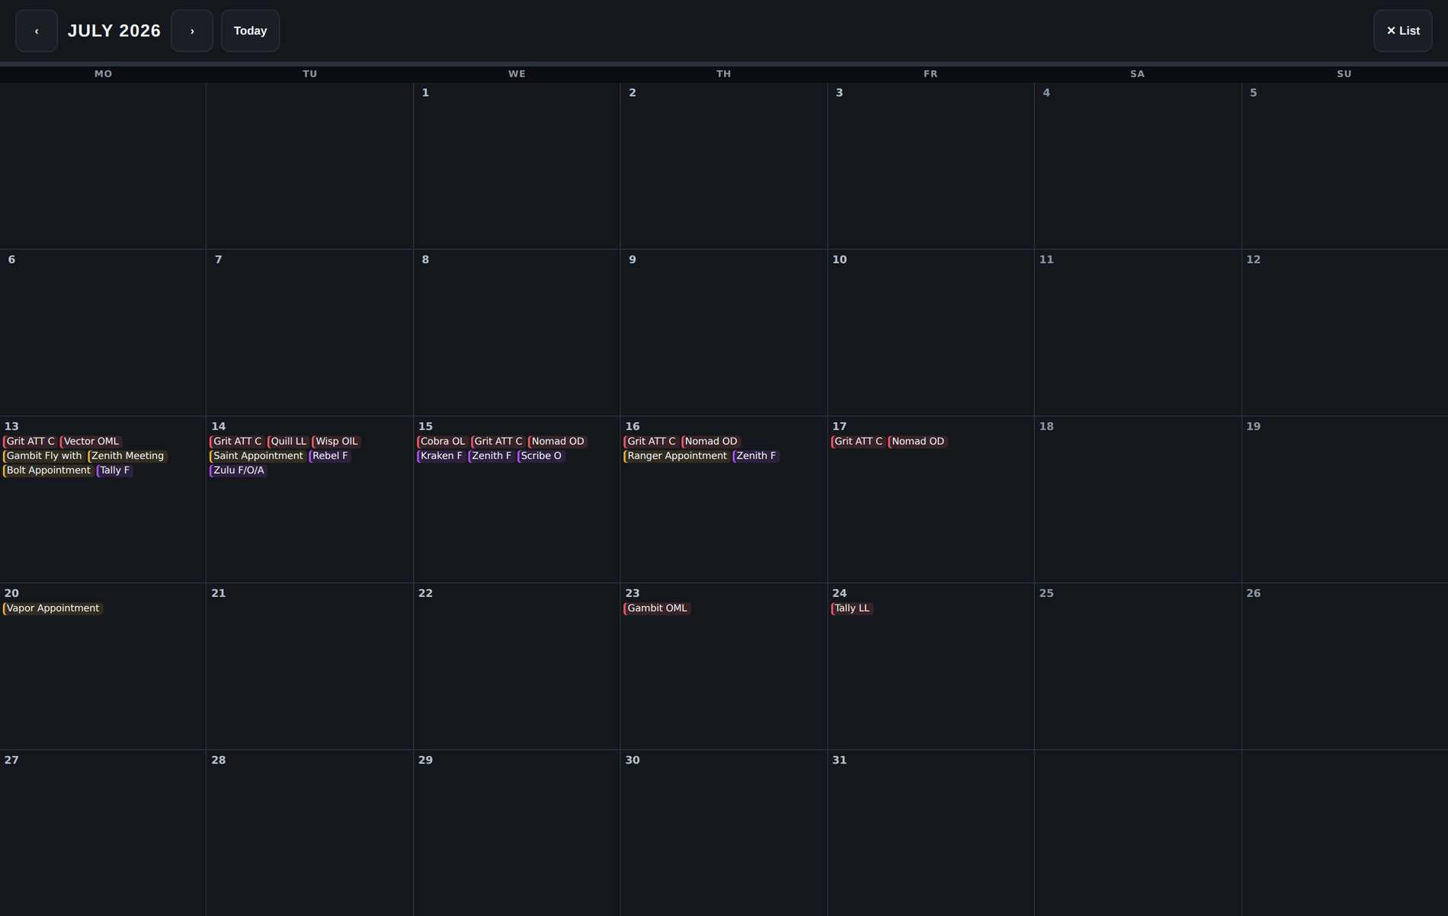
ONE PLACE TO FILE EVERYTHING
Leave, medical & up-chits — filed once on the Inputs page
…and the month calendar shows every input at a glance.
Snap, upload, done Screenshot your approved leave application or medical cert and upload it here — no forms re-filled.
Up-chit reminders Due to be up-chitted and haven't been? RAPTOR reminds you — nothing lives on a personal note.
Synced everywhere Filed once, it flows to the schedule, the crew palette, the warnings and Leave War.
RAPTOR
06
Notes:
Everything personal is filed in one place — the Inputs page. Leave types, medical statuses like ATT C and OML, off-days, appointments, even 'fly with' requests — each with its dates and remarks, and late filings visibly marked. People can screenshot their approved leave application or their medical cert and upload it right here, instead of re-filling forms. The app reminds anyone due an up-chit who hasn't got one. And the month calendar view lays every input out at a glance. Filed once, it syncs to the schedule, the availability palette, the warnings and Leave War.

Slide 7
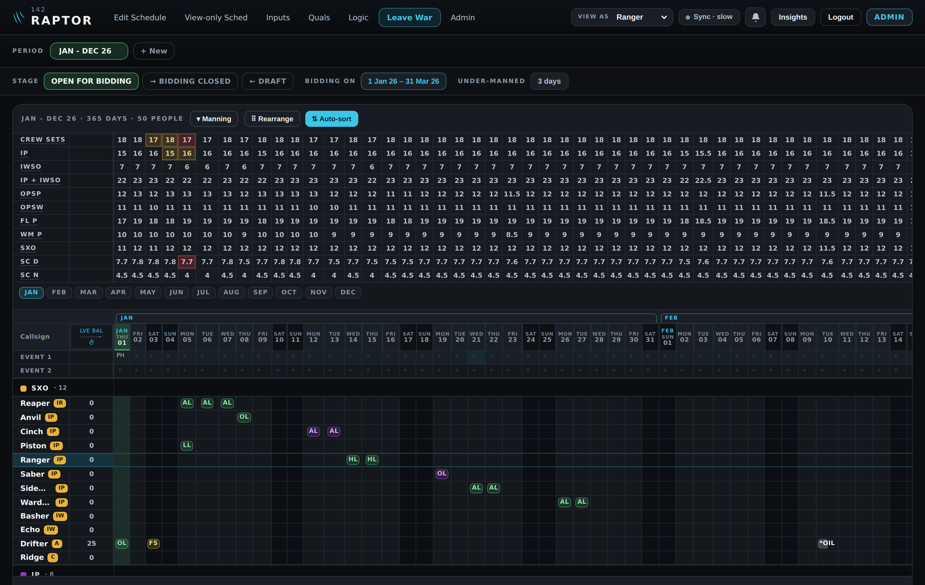
THE MANPOWER RED LINE
A year of leave and manning — with the red line built in
Approved vs pending Green chips are approved leave, purple still pending — AL, OL, LL, HL, medical — every type, all year.
Amber, then red Management sets the daily manning floor per category; the counts turn amber, then red, the moment a day drops below it.
Under-manned days, counted The header keeps score — the days below the red line are impossible to miss.
Synced both ways. Approve a bid and it lands on the programme; leave filed on the Inputs page draws the balances down here.
RAPTOR
07
Notes:
Leave War is the manpower half. A whole year, all fifty people, every leave type — green chips approved, purple pending. Above it, the manning counts: management sets the day-to-day floor for each category, and the numbers turn amber, then red, the instant a day drops below the line — with the under-manned days counted in the header. And it's synced both ways with the schedule: approve a bid and it lands on the programme; leave filed on the Inputs page draws the balances down here. Note: some cells on this screenshot carry illustrative demo data.

Slide 8
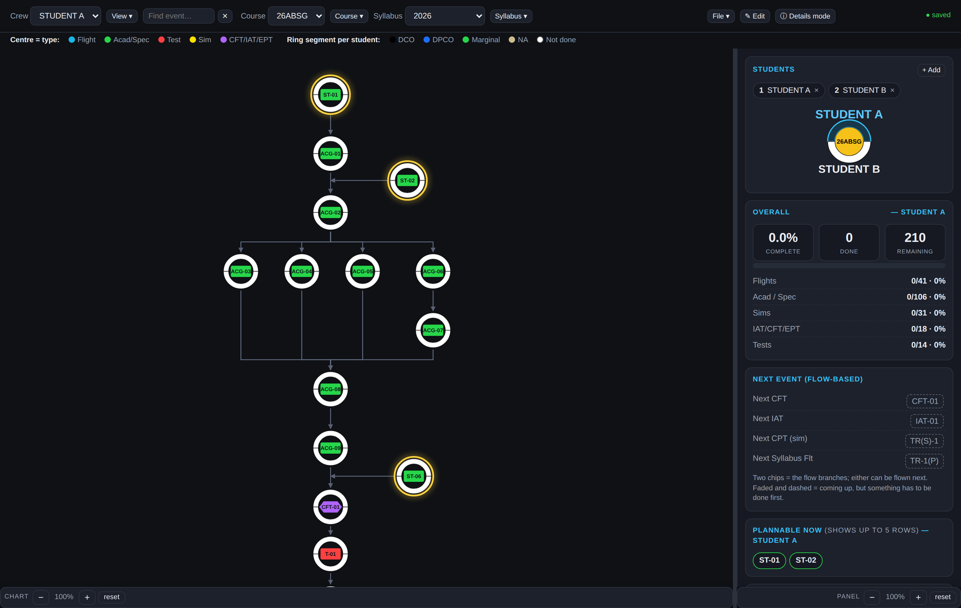
COMING INTO RAPTOR — THE UPGRADE TRACKER
Every OCU student's syllabus, one click deep
The whole syllabus, mapped Every event as an interactive flow chart — flights, academics, sims, tests — graded per student.
One click, all the stats Progress by type, currency & flex, what's plannable now, and a forecast of when they should finish.
Crew pairing from the syllabus It knows when a student needs an IP and when a pairing is allowed — the same rules the schedule flags.
Then just plan them “Plannable now” says exactly which events are next — the scheduler plans straight off it.
The last time the flow chart lives on paper. Folded into RAPTOR: one stop shop.
RAPTOR
08
Notes:
The OCU upgrade tracker — already built, and folding into RAPTOR. Today, planning a student means squinting at a paper flow chart, then the syllabus details, then crew pairing rules, then working out the statistics by hand. Here it's one click: the whole syllabus as an interactive flow chart graded per student, with the stats beside it — progress by type, currency and flex, which events are plannable right now, and a forecast of when they should finish. It knows when a student needs an IP and which pairings the syllabus allows — the same rules the schedule flags. The scheduler looks at one screen and plans the student. Once it's inside RAPTOR, that's the one stop shop complete.

Slide 9
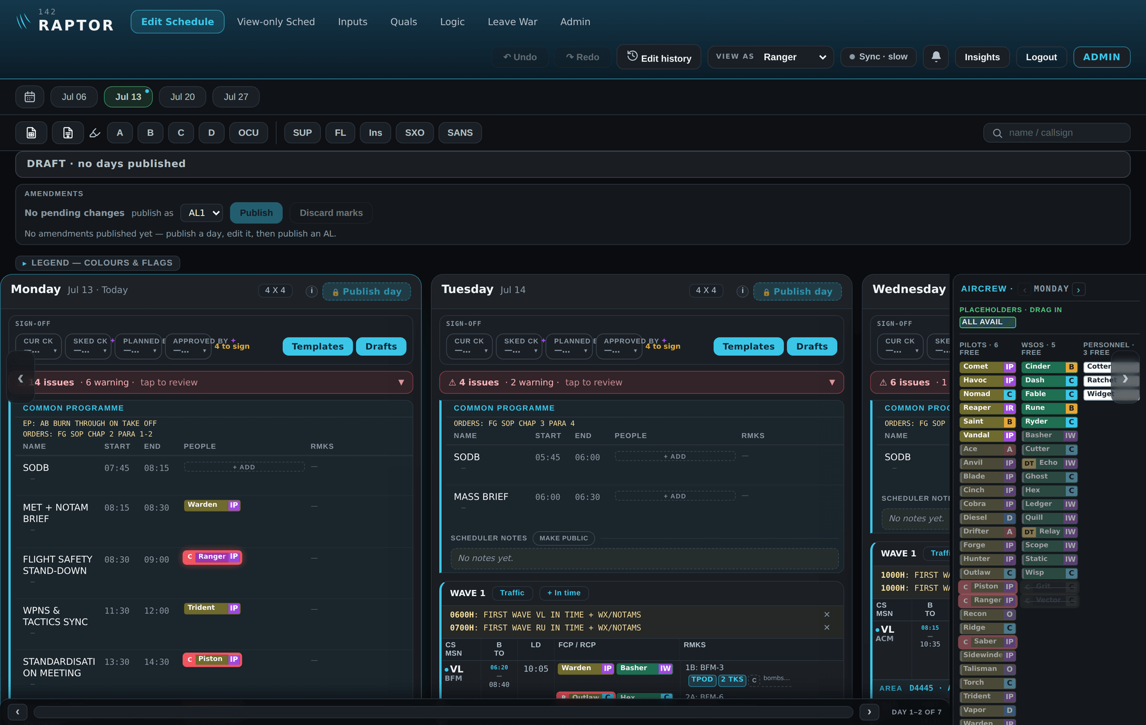
BUILT FOR THE WAY THE SQUADRON WORKS
Full-power at the desk, thumb-friendly on a phone
The same tool, designed for both screens — spacious and readable on a phone, and using the whole width on a desktop.
RAPTOR
DESKTOP
PHONE
09
Notes:
The interface was a first-class concern, because a tool only helps if people use it. On a phone it reads top to bottom, stays spacious, and every control is reachable with a thumb. On a desktop it uses the full width — days side by side, the crew palette docked on the right, drag-to-place. Same data, same rules, shaped for whichever screen is in front of the planner.

Slide 10
WHERE IT'S GOING
From prototype to the squadron's live system
1
2
3
Microsoft 365 · Power Apps on Teams
Robust & operational
OCU tracker folds in
From the demo to Power Apps inside Teams, on a live shared database — multi-user, real-time, inside tools the squadron already runs.
Extensive testing with the RAID office to prove it stands up to daily use — the priority for the next three months.
The upgrade tracker joins RAPTOR, putting student progress beside the programme — the one stop shop complete.
142 SQN
→
149 SQN
→
FG
now → 3 months, with RAID office
once proven
potential wider roll-out
One squadron. One source of truth. Built with AI over 500+ rounds of testing, behind six automated quality gates.
RAPTOR
10
Notes:
The path from here. One: off the demo and onto the squadron's own Microsoft platform — Power Apps inside Teams on a live shared database, genuinely multi-user. Two: robustness — extensive testing with the RAID office over the next three months. Three: the OCU tracker folds in, completing the one stop shop. Then the roll-out: 142 Squadron first, 149 once proven, potentially FG-wide. One squadron, one source of truth — built with AI over more than five hundred rounds of testing, behind six automated quality gates.

