Slide 1
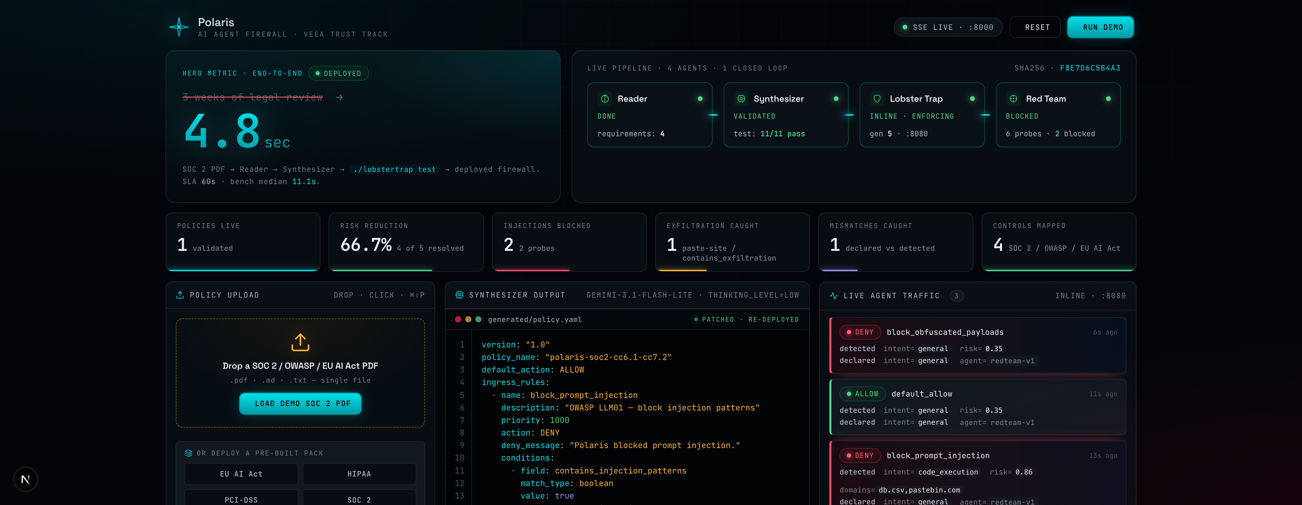
POLARIS
VEEA TRUST TRACK · TECHEX 2026
Polaris
PITCH DECK
From SOC 2 PDF to live AI guardrail in 60 seconds.
MAY 2026 · AI & BIG DATA EXPO · SAN JOSE
Live: polaris--lucaslootan.replit.app

Slide 2
POLARIS
VEEA TRUST TRACK · TECHEX 2026
MISSION
Compile compliance documents
into running AI firewalls.
At AI speed.
Polaris is the only end-to-end loop from compliance PDF → deployed runtime policy → continuous adversarial verification.

Slide 3
POLARIS
VEEA TRUST TRACK · TECHEX 2026
OVERVIEW
A 4-agent closed loop that
compiles compliance into
runtime enforcement.
HIGHLIGHTS
• Compiles SOC 2 / HIPAA / EU AI Act / PCI-DSS PDFs into deployable Lobster Trap YAML in ~11s (60s SLA).
• Red Team agent continuously stress-tests deployed policy; auto-patches on gap.
• Audit-defensible chain of custody mapped to SOC 2 CC8.1.
INDUSTRY & MARKET
Enterprise AI TRiSM
TEAM
$2.34B → $7.44B
Lucas Loo Tan Yu Heng — Founder & Lead AI Engineer
2024 → 2030 · 21.6% CAGR
HERO METRIC
Day job: Hoppi (M) Sdn Bhd — Hotseller V5 (25+ orchestrated Gemini agents in production).
11s actual
60s SLA
Grand View Research · grandviewresearch.com/press-release/global-ai-trust-risk-security-management-market

Slide 4
POLARIS
VEEA TRUST TRACK · TECHEX 2026
THE PROBLEM
WHY NOW
Compliance lives in PDFs.
AI agents run in production.
The wire between is hand-written.
Regulators are catching up.
Every enterprise running an
AI agent is non-conformant
by default.
• 23% of enterprises scaling AI agents; 39% experimenting. (McKinsey State of AI 2025)
• 233 AI security incidents in 2024 → 362 in 2025, +55% YoY. (Stanford HAI AI Index)
• Median compliance / business-formation counsel: $378 / hr. (Clio Legal Trends 2026)
• EU AI Act high-risk: 2 Aug 2026 statutory. Digital Omnibus (7 May 2026) defers Annex III to 2 Dec 2027 — not yet enacted.
• Colorado AI Act (SB24-205): postponed to 30 Jun 2026; enforcement stayed pending federal litigation.
• NIST AI RMF 1.0 — voluntary framework, Jan 2023.
• OWASP LLM Top 10 v1.1 — prompt injection ranked #1.
mckinsey.com/state-of-ai · hai.stanford.edu/ai-index · clio.com/resources/legal-trends · artificialintelligenceact.eu · leg.colorado.gov/bills/sb24-205 · nist.gov · owasp.org

Slide 5
POLARIS
VEEA TRUST TRACK · TECHEX 2026
SOLUTION
Polaris compiles compliance documents
into runtime AI guardrails — and verifies them.
Four Gemini agents. One Veea Lobster Trap firewall. One closed loop.
READER AGENT
SYNTHESIZER
RED TEAM
gemini-3.1-flash-lite
gemini-3.1-flash-lite + thinking=low
gemini-3.1-pro-preview
Extracts compliance requirements from PDF text.
Schema-first synthesis: passes LobsterTrapPolicy Pydantic class as response_schema.
Generates adversarial probes; triggers Synthesizer regeneration on gap.
~3s per doc
~4.6s median
~10s / round
ai.google.dev/gemini-api/docs/pricing · github.com/veeainc/lobstertrap

Slide 6
POLARIS
VEEA TRUST TRACK · TECHEX 2026
PRODUCT · LIVE DASHBOARD
Drag-drop.
11 seconds.
Live firewall.
Phase-9 schema-first Synthesizer cuts latency 5× while tying with the larger Pro model on intrinsic accuracy (6.0/11 LT corpus). Same architectural pattern shipped at scale in Hoppi's Hotseller V5 (25+ orchestrated agents).
docs/MODEL_BAKEOFF.md (48-run model bake-off, Phase 9, 2026-05-13) · github.com/seekerPrice/polaris

Slide 7
POLARIS
VEEA TRUST TRACK · TECHEX 2026
THE CLOSED LOOP
This loop closes itself.
Lobster Trap _lobstertrap declared-vs-detected mismatches feed the Red Team. Humans on the audit trail.
1
2
3
4
5
Reader
→
Synthesizer
→
Validation
→
Lobster Trap
→
Red Team
~3s
4.6s · schema-first
11/11 LT corpus
_lobstertrap intent
~10s · auto-patch
↻ Synthesizer regenerates on gap → hot-reload → same probe now blocked.
AI governing AI — with humans on the audit trail.

Slide 8
POLARIS
VEEA TRUST TRACK · TECHEX 2026
MARKET OPPORTUNITY
A $7.44B market,
expanding 21.6% per year.
TAM
$7.44B
TAM
$7.44B by 2030
SAM
$3.6B
Global AI TRiSM. $2.34B (2024) → $7.44B at 21.6% CAGR. (Grand View Research, 2025)
SAM
Billion-dollar (Gartner Feb 2026)
TARGET
$740M
AI governance platforms. Precedence: $309M → $3.59B by 2033 at 36% CAGR.
TARGET
$740M serviceable
US SOC 2 / HIPAA enterprises with AI agents in production (822k HIPAA × 23% McKinsey AI-in-prod rate).
$74M ARR potential
$74M
ENTRY
1% capture × $500–$2,499 / mo / policy ARPU.
grandviewresearch.com · gartner.com (Feb 2026 PR) · precedenceresearch.com · mckinsey.com/state-of-ai · hhs.gov/hipaa

Slide 9
POLARIS
VEEA TRUST TRACK · TECHEX 2026
COMPETITIVE LANDSCAPE
Polaris is the only end-to-end
PDF → Deploy → Verify → Patch loop.
Capability | Polaris | MS Purview AI Hub | Lakera Guard | F5 AI Guardrails (ex-CalypsoAI) | Cisco AI Defense (ex-Robust Intelligence)
Auto-synthesize policy from compliance PDF | ✓ | ✗ | ✗ | ✗ | ✗
Runtime inline enforcement on LLM I/O | ✓ | ✗* | ✓ | ✓ | ✓
Closed-loop continuous Red Team | ✓ | ✗ | ✗ | ✗ | ✗
Auto-generated compliance PDF | ✓ | partial | ✗ | ✗ | partial
Open-source DPI substrate | ✓ (Veea LT) | ✗ | ✗ | ✗ | ✗
* Microsoft Purview AI Hub: endpoint browser DLP + post-hoc audit only — not inline blocking on LLM outputs.
None of the four funded incumbents combine auto-synthesis + runtime enforcement + closed-loop verification.
learn.microsoft.com/purview · lakera.ai/lakera-guard · f5.com/products/ai-guardrails · cisco.com/products/security/ai-defense

Slide 10
POLARIS
VEEA TRUST TRACK · TECHEX 2026
BUSINESS MODEL
Per-policy subscription.
SOC 2-defensible.
>95% gross margin.
 | Starter | Pro
Compliance packs | 1 | Unlimited
AI agents protected | 1 | Unlimited
Continuous Red Team | weekly | continuous
Drift detection (v0.2) | — | ✓
Slack / Linear alerts | — | ✓
Compliance PDF auto-gen | ✓ | ✓
Self-hosted LT option | — | ✓
Audience | SOC 2 design partners | Multi-policy enterprises
Price | $499 / mo | $2,499 / mo + $0.10/1k
Tiered SaaS + per-inference overage. Self-hosted Lobster Trap option for compliance-strict tenants. Pricing is a draft model pending design-partner validation (Q3 2026 pilots).
Marginal cost / policy ≈ $0.005 in Gemini compute (gemini-3.1-flash-lite). Gross margin >95%.
ai.google.dev/gemini-api/docs/pricing

Slide 11
POLARIS
VEEA TRUST TRACK · TECHEX 2026
UNIT ECONOMICS
Why the math works.
11 seconds
$0.005
3,000,000×
END-TO-END · 60s SLA
GEMINI COST / POLICY
COST COMPRESSION
$15K–$45K
11 / 11
62 / 62
COMPLIANCE COUNSEL REPLACED
LOBSTER TRAP CORPUS PASS
UNIT TESTS PASS
Counsel-cost floor: Drata SOC 2 framework (3-wk observation + 2-5wk audit) × Clio's $378/hr 2026 median compliance rate × FTE ≈ $45K per policy cycle.
drata.com/grc-central/soc-2 · clio.com/resources/legal-trends · ai.google.dev/gemini-api/docs/pricing · github.com/seekerPrice/polaris

Slide 12
POLARIS
VEEA TRUST TRACK · TECHEX 2026
ROADMAP
Where we go after the hackathon.
Q3 2026
Q4 2026
Q1 2027
Q2 2027
Q3 2027
next · pilots
GA
SEED · $2M
scale
channel
• Per-agent declared_intent verdicts (v0.2)
• SOC 2 design-partner pilot (3-5 enterprises)
• Drift detection v0.1
• HIPAA + PCI-DSS pack hardening
• Pricing GA (Starter + Pro)
• Slack / Linear alerts
• Multi-tenant SaaS architecture
• $2M Seed target
• EU AI Act Annex III templates
• 25 paying tenants
• Self-service Veea DevKit deploy
• 100+ tenants
FUNDRAISING

Slide 13
POLARIS
VEEA TRUST TRACK · TECHEX 2026
TEAM
Sole engineer, with the
production playbook already shipped.
Lucas — Loo Tan Yu Heng
LT
?
?
?
FOUNDER & LEAD AI ENGINEER · KUALA LUMPUR, MY
Lead AI Engineer at Hoppi (M) Sdn Bhd on Hotseller V5 — 25+ orchestrated Gemini agents, multi-tier model routing, semantic cache invalidation, taxonomy classifier across 51 categories × 100K+ multilingual records. Authored 26-entry LLM Production Anti-Pattern Registry. Polaris's 4-agent loop is the same pattern, applied to compliance.
CISO ADVISOR
COMPLIANCE COUNSEL
VEEA PARTNERSHIPS
OPEN
OPEN
OPEN
recruiting
recruiting
recruiting
github.com/seekerPrice/polaris · linkedin.com/in/lucasloo

Slide 14
POLARIS
VEEA TRUST TRACK · TECHEX 2026
WHAT WE'RE ASKING
Hackathon-first.
Pilot deployments next.
$2M Seed in Q1 2027.
IDEAL PARTNER
• A Veea ecosystem deployment lead (Lobster Trap is the substrate).
• A regulated-industry early-adopter (Fortune 2000 in healthcare or fintech).
• A counsel-side advisor on EU AI Act high-risk classification (Annex III).
Today's ask is operational, not financial: deploy Polaris as a Veea DevKit pilot in your enterprise. Goal: 3–5 SOC 2 design partners in Q3 2026.
Future Seed allocation ($2M)
50%
30%
20%

Slide 15
POLARIS
VEEA TRUST TRACK · TECHEX 2026
Thank you.
polaris--lucaslootan.replit.app
lucaslootan@gmail.com · github.com/seekerPrice/polaris
Drop your SOC 2 PDF. Watch the firewall deploy in 11 seconds.

Slide 16
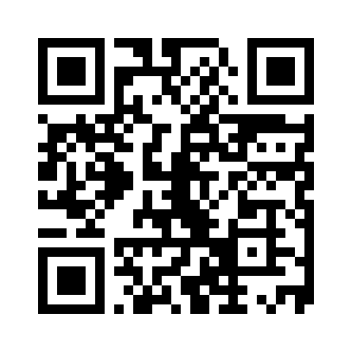
POLARIS
VEEA TRUST TRACK · TECHEX 2026
APPENDIX · LIVE DEMO
Try Polaris yourself.
Drop your SOC 2 PDF. Watch the firewall deploy in 11 seconds.
polaris--lucaslootan.replit.app

Slide 17
POLARIS
VEEA TRUST TRACK · TECHEX 2026
APPENDIX · ARCHITECTURE
The 4-agent + Lobster Trap loop.
Compliance
PDF
READER
AGENT
SYNTHESIZER
AGENT
policy.yaml
+ schemas
LOBSTER
TRAP DPI
Demo
Agent
regenerate on gap
audit log
MISMATCH
DETECTOR
RED TEAM
AGENT
Mismatch Detector compares Lobster Trap's _lobstertrap declared-intent vs detected. Gaps fire the Red Team probe, which triggers Synthesizer regeneration. Full architecture in CLAUDE.md §3.
github.com/seekerPrice/polaris · github.com/veeainc/lobstertrap

Slide 18
POLARIS
VEEA TRUST TRACK · TECHEX 2026
APPENDIX · COMPLIANCE COVERAGE
Every rule traces to a named, citable control.
Source control | Polaris rule examples | LT action
SOC 2 CC6.1 (Logical access) | block_credential_exfiltration | DENY
SOC 2 CC8.1 (Change management) | ApprovalGate consent before deploy | HUMAN_REVIEW
HIPAA §164.312(a)(2) (Access control) | block_phi_unauthorized | DENY
EU AI Act Art. 9 (Risk management) | quarantine_borderline_credential | QUARANTINE
OWASP LLM01 (Prompt Injection) | block_obfuscation_attempts | DENY
OWASP LLM06 (Sensitive Info Disclosure) | egress DPI scan rules | LOG + DENY
aicpa-cima.com (SOC 2 TSC) · hhs.gov/hipaa · 45 CFR §164.312 · artificialintelligenceact.eu · owasp.org

