Slide 1

Telco Churn Prediction
& Customer Clustering
SC1015:Introduction to Data Science and Artificial Intelligence
Mini Project
Lab Group : SC13
Team Number: 6
Presented by:
Tan Jue Lin (U2111250D)
Sanskkriti Jain (U2123542L)
Soh Zu Wei (U2111130L)
Notes:
Hi, my name is … and I have with me here my teammates, … and … We are from the lab group SC13 and today we are going to be presenting our SC1015 Mini Project.
This is just a guideline -- feel free to choose your own style, depending on your own data-story.
First 2 minutes (approx.) of your presentation -- Your Motivation
You MUST mention which dataset(s) you used, and what EXACTLY is your problem definition.
This is your chance to explain your MOTIVATION. Don't get carried away; be precise and clear.
Dataset used:
Problem Definiton:
Motivation:
Explain setup (model etc)
Data Preparation
Exploratory Data Analysis + Initial Analysis
Further Data Analysis
Classification Model + Analysis Clustering Model + Analysis
Outcome? (did it solve the problem? Anything interesting?)
Data-driven insights and recommendations (towards the target problem)
Distribution of Work
Next 3 minutes (approx.) of your presentation -- Set The Stage
Present your Exploratory Data Analysis and some initial data-driven Insights from the dataset.
You MAY also mention how you are planning to set up the Analysis / ML problem for this case.
You MUST mention how you collected / curated / cleaned / prepared the data for this problem.
Did you only use tools and techniques learned in this course? What ELSE did you learn / try?
Next 3 minutes (approx.) of your presentation -- Core Analysis
If you used ML (regression, classification, or something else); mention mainly WHICH one(s).
You may now briefly CLARIFY why and how the ML problem(s) aim(s) to solve your objective.
How did you apply ML technique(s) to SOLVE your problem? Which model(s), how and why?
Did you only use tools and techniques learned in this course? What ELSE did you learn / try?
Last 2 minutes (approx.) of your presentation -- Finish Strong
What is the OUTCOME of your project? Did it solve your original problem? Anything interesting?
What are your data-driven INSIGHTS and recommendations / views towards the target problem?
Problem:
Are there any relationships between customer attributes and churn?
Can we create a model that will help us predict whether customer will churn?
Can we cluster the telco customers into different segments to help the telco understand their customer segments?

Slide 2
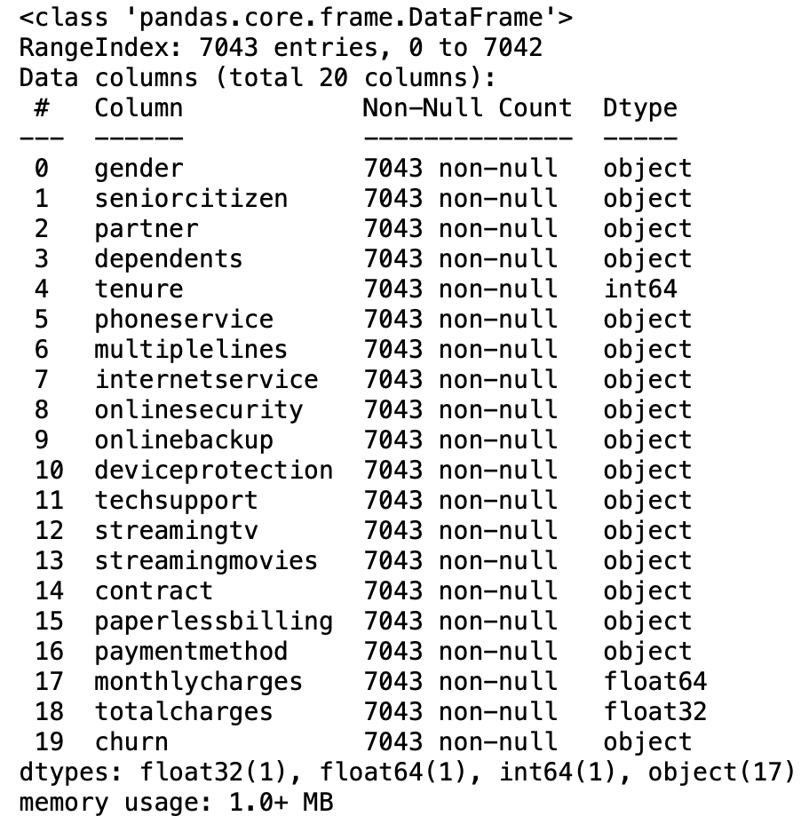
IBM Telco Churn Dataset
The dataset we have chosen is the IBM telecom churn dataset available from Kaggle.
The data set contains 7043 observations and 21 columns with 20 variables.
Notes:
The dataset we have chosen is the IBM telecom churn dataset available from kaggle. The data set contains 7043 observations and 21 columns with 20 variables

Slide 3

Problem Motivation
The telco sector is one of the most competitive industry, and in order to survive, telco companies have to maximise revenue (highest ROI to increase customer retention)
Customer churn is a major problem and one of the most important concerns for large companies and is the main reason why understanding customers is important.
Notes:
The telecom industry is a fast-paced industry with ever growing competition and customer churn is a major point of concern for these companies. Churn is a measure of the loss of a customer when they stop using the product/service a company provides. And our analysis has shown that IBM has a churn of 26.5% on average.

Slide 4
Problem Definition
Can we predict whether customers will churn?
Can telco customers be clustered into different segments to help the telco understand their customer segments and create targeted strategies?
Notes:
Through our presentation we will be exploring Our problem definition which is :
Can we predict whether customers will churn?
Can telco customers be clustered into segments to help the telco understand their customers segments and create targeted strategies?

Slide 5
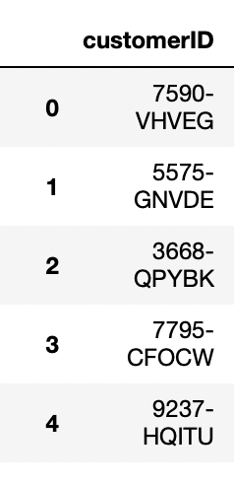
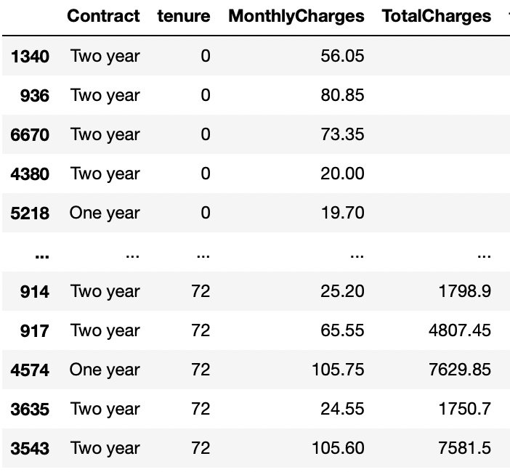
Data Cleaning
TotalCharges
The Null Values were filled in using the formula
monthlycharges*tenure = totalcharges
CustomerID
Variable that was dropped from the dataset
Notes:
For our data cleaning, first we looked at the column TotalCharges was wrongly detected as an object and should be a numeric variable instead. The null values in this column were then filled in using this formula. In order to clean the data further, the variable CustomerID was dropped as it was redundant for our project.

Slide 6
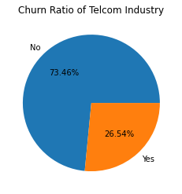
Churn Ratio of the Telco
26.54% of the customers have stopped using the service in a span of 3 years or less
Based on this variable we aim to create and get telcos to adopt better marketing strategies for the customers.
32%
1
20%
2
Notes:
The first point to look at it is the the churn ratio, it is observed that 26.54% of the customers registered in the telco company churn in a span of 3 years or less. Based on this variable we aim to create and get telcos to adopt strategies which help retain/retract customers in the company.

Slide 7
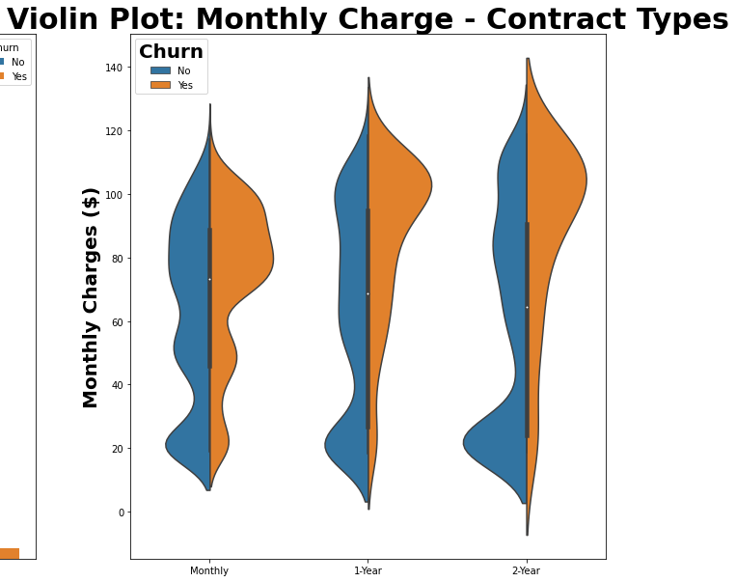
Exploratory Data Analysis
Contract Types: Monthly, One-Year, Two-Year
More customers churn when on monthly contracts with average costs of more than $60/month as we can see on the violin plot
As contract durations increase, churn decrease showing telcos should market for longer tenures
Monthly Charges: Indicates the customer’s current total monthly charge for all their services from the company.
Tenure in Months: Indicates the total amount of months that the customer has been with the company by the end of the quarter specified above.
Notes:
Next I am going to be talk about Exploratory Data Analysis. The variables we use here are Monthly Charges which Indicates the customer’s current total monthly charge for all their services from the company and Tenure in Months which Indicates the total amount of months that the customer has been with the company by the end of the quarter specified above. The contract can be a monthly, one year or two year contract. It is observed that significantly more customers churn when they are on monthly contracts. As we can see on the violin plot, in the monthly charges plot, those who churn are the widest and the interquartile range shows that the majority spend over $60 when on monthly contracts. And as the contract lengths increase, the churn decreases showing that telcos should aim to get longer contracts.

Slide 8
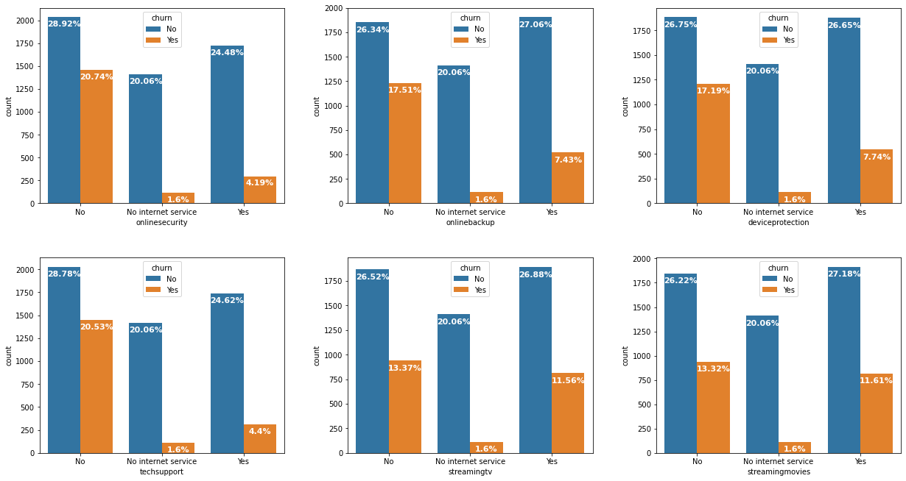
Add - on Services
Customers with online security and/or tech support churn the least and are ready to pay for the extra service available
Customers with streaming services (TV/Movies) churn the most
Notes:
Secondly, the add-on services customers get impacts their churn to a great extent, Customers with online security and/or tech support churn the least meaning these services are worth paying the extra money for whereas Customers with streaming services (TV/Movies) churn the most.

Slide 9
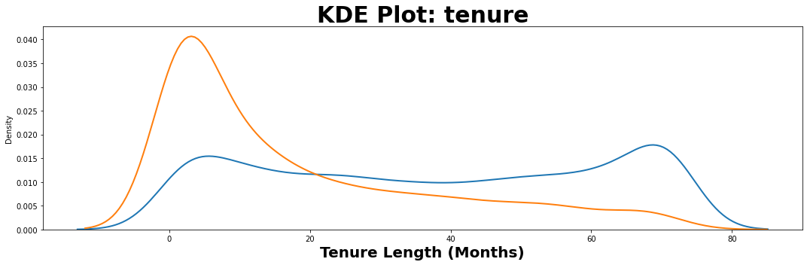

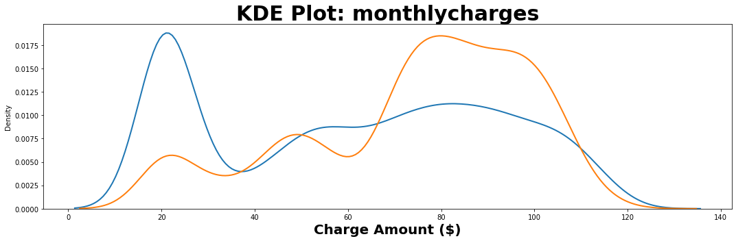
Customer Tenure and Monthly Charges
Customers are more likely to churn within the first year of tenure
As the tenure increases, the probability of churn decreases
As monthly charges increase, the probability of customer churn increases
Customers who churn most likely have bills exceeding $60
Notes:
Apart from the Violin Plot, we also use the KDE plot to show the relation between churn and the tenure. It is clearly seen through these plots that customers are more likely to churn within the first year of tenure where the line graph is seen to be at its peak. As the tenure increases, the churn decreases as we see a falling gradient which is why telcos should market for longer tenures. For monthly charges, as gradient increases which means the monthly charges increase, the churn also increases.

Slide 10
02
Churn Prediction
Notes:
If you used ML (regression, classification, or something else); mention mainly WHICH one(s).
You may now briefly CLARIFY why and how the ML problem(s) aim(s) to solve your objective.
How did you apply ML technique(s) to SOLVE your problem? Which model(s), how and why?
Did you only use tools and techniques learned in this course? What ELSE did you learn / try?

Slide 11
Problem 1: Can we predict whether if a
customer will churn?
Classification Problem
Classification Models
Since churn is a yes/no variable and not numerical, this is a classification problem.
For classification problems, we will need to train classification models to predict whether a customer will churn.
Notes:
Now after EDA and some basic analysis, the first question we’re trying to tackle here is whether if we can predict if a customer will churn or not.
We know that the column for Churn consist of only Yes/No values, which is a classic classification problem of predicting categorical values and requires classification models.

Slide 12
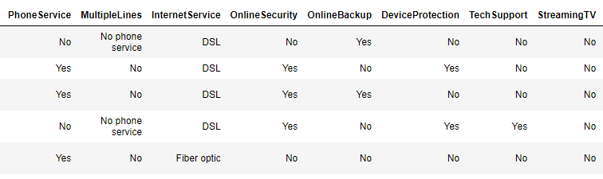
Additional Data Preparation Steps
In the dataset, we have many categorical values that are Yes/No and they’re not suitable for training classification models.
However, just changing Yes/No into 1 or 0 is not good enough as the machine may assume higher numbers are more important. Hence, OneHotEncoding is used.
OneHotEncoding
Notes:
Additional data preparation steps were taken to convert the categorical variables to as just changing yes/no to 1 or 0 is not good enough since the model may assume higher numbers are more important. Hence, One Hot Encoding is used.

Slide 13
Attempt #1
01
02
03
04
Decision Tree
Standard Train/Test Split
For this attempt, we will be using train_test_split of 30% data reserved for testing.
Logistic Regression
Parameters Untuned
Random Forest
Parameters are not tuned
Support Vector Classifier
Notes:
For the first attempt of training, we will use the standard train/test split function with 30% for test data.
The parameters for this attempt are also not tuned.
We will be training 4 different models.
Decision Tree, Logistic Regression, Random Forest and Support Vector Classifier.
I will not go into every model for the presentation. I’ll be focusing on decision tree and SVC. More details on analysis and implementation can be found in github code.

Slide 14
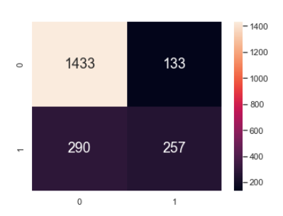
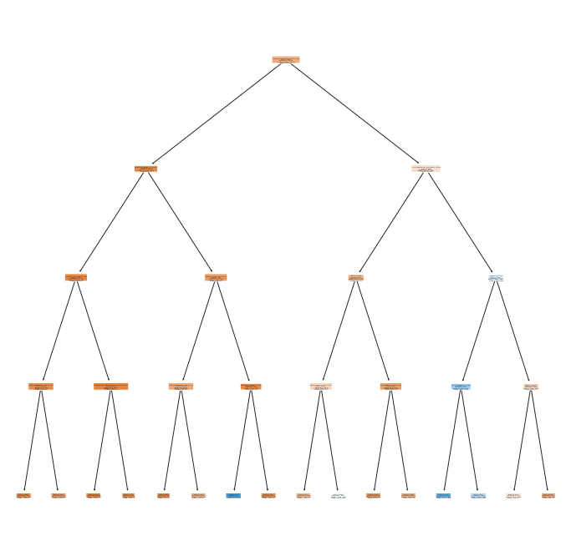
01
Decision Tree
Accuracy measures and rates (Test Data)
Classification Accuracy : 0.7998106956933271
TPR Test : 0.46983546617915906
TNR Test : 0.9150702426564495
FPR Test : 0.08492975734355045
FNR Test : 0.5301645338208409
Notes:
For the first model, we ran decision tree with a depth of 4. The decision tree builds classification model in the form of a tree structure by breaking down the data into smaller subsets through decision making.
And we were able to achieve a classification accuracy of 79.9% and True Positive Rate of 47% with a true negative rate of 91%. This shows that this decision tree model is actually quite accurate in predicting churn, but however it does leave more to be desired since we’ve yet to tuned any parameters such as the depth of the tree.

Slide 15
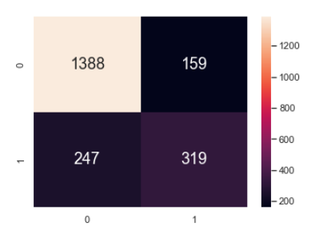
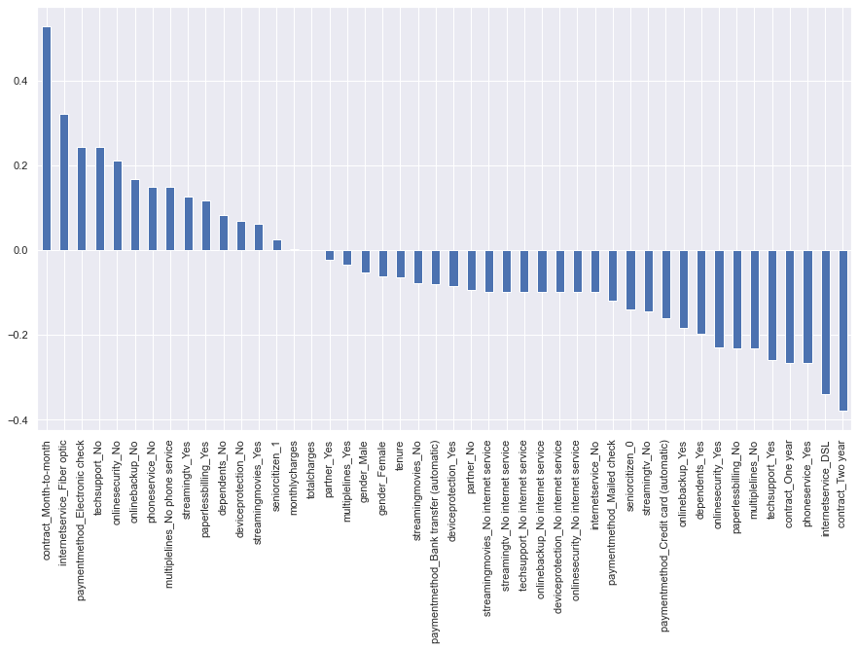
02
Logistic Regression
Accuracy measures and rates (Test Data)
Classification Accuracy : 0.8078561287269286
TPR Test : 0.5636042402826855
TNR Test : 0.8972204266321914
FPR Test : 0.10277957336780866
FNR Test : 0.4363957597173145
After training: weights of variables for the model
Notes:
(HIDDEN DURING PRESENTATION)
Implementation code can be found in our github code! (not enough time to present all the models)
Logistic Regression is another model that is used for our classification. It models the probabilities for classification problems with two possible outcomes.
Classification Accuracy is 80.7%, TPR is 56% and TNR is 89.7%.
Another plus side of using logistic regression is that we are able to train the model and then afterwards plot out a bar chart to show the weights of different variables in predicting churn for this model.
For example, we can see that the fiber optic and month-to-month contract variable are strong variables in predicting churn for the logistic regression model.

Slide 16
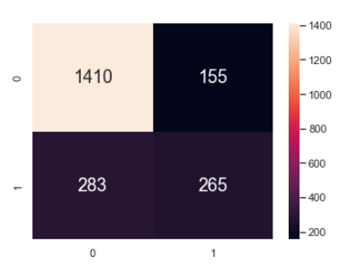
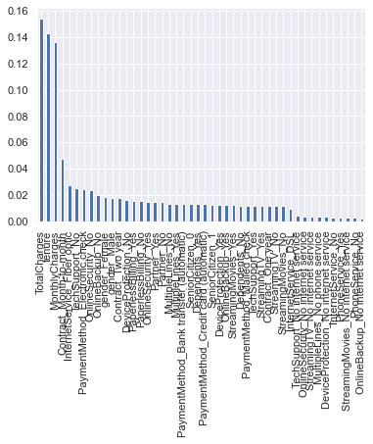
03
Random Forest
Accuracy measures and rates (Test Data)
Classification Accuracy : 0.7927117841930904
TPR Test : 0.4835766423357664
TNR Test : 0.9009584664536742
FPR Test : 0.09904153354632587
FNR Test : 0.5164233576642335
After training: weights of variables for the model
Notes:
(HIDDEN DURING PRESENTATION)
Implementation code can be found in our github code! (not enough time to present all the models)
Another model that is used is Random Forest builds decision trees based on different samples and take majority vote for classification.
We were able to achieve an accuracy score of 79%, TPR of 48% and TNR of 90%.
Random Forest Model also shows the weight of different variables, for example in this case, we can see that totalcharges is the most impactful in determining churn for the random forest model.

Slide 17
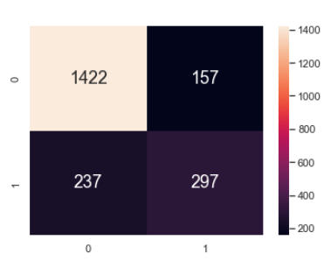
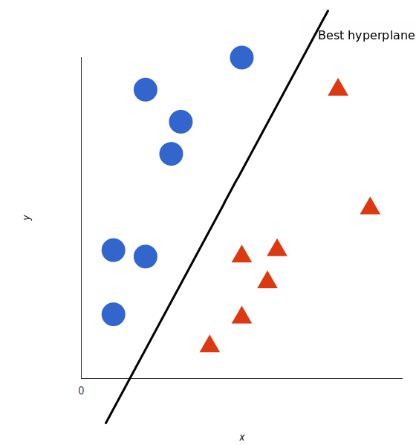
04
Support Vector Classifier
How support vector classifier works:
Accuracy measures and rates (Test Data)
Classification Accuracy : 0.8135352579271179
TPR Test : 0.5561797752808989
TNR Test : 0.9005699810006333
FPR Test : 0.09943001899936668
FNR Test : 0.4438202247191011
Notes:
Another model that we use is the Support Vector Classifier. It works by mapping data to a higher dimensional feature space using a hyper plane to distinctly classify points.
We were able to achieve a classification accuracy score of 81% and true positive rate of 55% and true negative rate of 90% on the test data. This shows that the SVC model is highly accurate and is another excellent model in churn prediction.

Slide 18
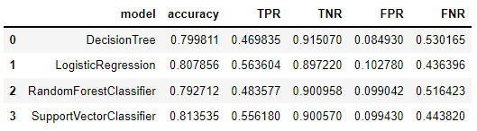
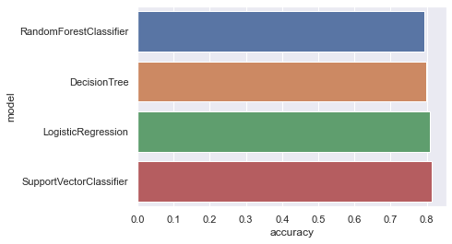
Comparing Models
High accuracy scores across the board.
(shows that the variables in dataset are quite helpful in training the models to predict churn)
However, difficult to pick the best models as different runs results in different best models.
Need more training to get more consistent data (attempt #2)
Notes:
In this slide, we can see an overview of the model scores for the 4 models, it seems that all the models in general have relatively similar accuracy.
Since accuracy are similar, another area we can look at is to try to pick the best true positive and true negative rate while reducing false positive and false negative rate.
The high accuracy score across the board shows that the variables and data in the dataset are quite helpful for training the models to predict churn.
However, we are not able to pick the best model as different runs results in different best accuracy scores.

Slide 19
Attempt #1
Attempt #2
Parameters Untuned
GridSearchCV
Parameters are not tuned
For this attempt, we will find use GridSearchCV to find the best hyperparameters for each model.
Standard Train/Test Split
K-Folds Testing
For this attempt, we will be using train_test_split of 30% data reserved for testing.
Using the most optimised parameter, we will run a k-fold of 10 to compare the models.
Much more accurate & consistent than train_test_split.
Notes:
So for our second attempt:
Instead of just trying random parameters to find out what works best and instead of the standard train test split, we can use gridsearchcv and k-folds cross validation to improve our results.
—
We incorporated GridSearchCV to tune the parameters of the models, for example such as the depth of the decision tree, what is the best depth to achieve the highest accuracy score, or for random forest, what is the best n-estimator parameter to use.
Also, this time round, instead of just train test split, we made use of k fold cross validation of 10 to achieve more accurate and consistent results.
The details for GridSearchCV and cross-validation implementation can be found in the github. After running GridSearchCV and kfold cross validation, on the right you can see a boxplot of the 4 different models, each value in the boxplot consist of the accuracy score for each run of the k-fold model. Since different runs achieve different accuracy, we can run multiple times to achieve a range of accuracy for each model.
In this comparison, we can clearly see that despite how the models are quite close in accuracy, we can still pick up two of the models that are consistently more accurate and also has slightly less variation in accuracy. The two models are Logistic Regression and Support Vector Classifier.
With more data from the telco, these models will be even more accurate. Telco can make use of the two selected classification model to predict with a good amount of certainty and accuracy whether a customer will churn or not based on the customer variables given. If a customer is predicted to churn, they can then thereby try to spot these customers and then try to retain them before they churn.

Slide 20
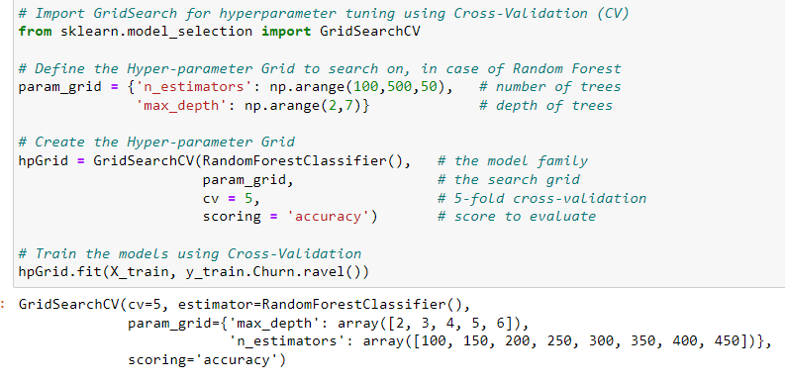
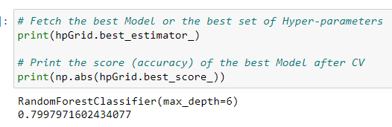
Attempt 2:Tuning Models (GridSearchCV)
GridsearchCV will test different depths of the trees to find the best depth with the highest accuracy.
The best depth returned by model is a max-depth of 6 for random forest.
Notes:
Using GridSearchCV, we were able to test different parameters, such as the best depth of a tree to achieve the highest accuracy score. After finding out the best parameters like the best depth for random forest is 6, we used it for our tuning our final models.

Slide 21
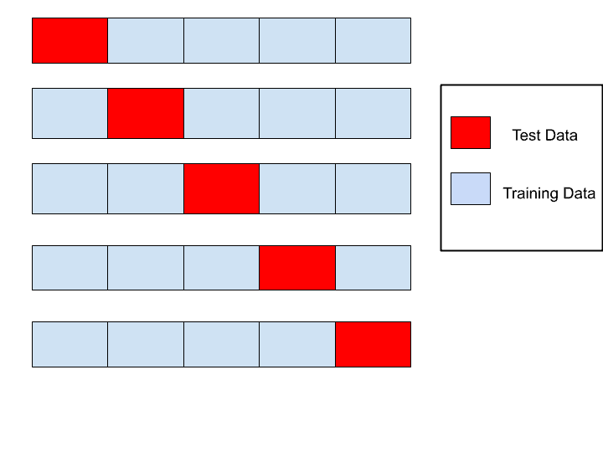
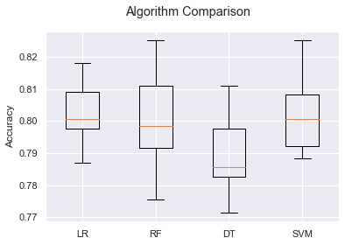
K-Folds Cross Validation
Attempt 2:
Instead of using train test split this time round, a k-fold cross validation split of 10 is ran for each model.
Boxplot shows the 10 different runs of accuracy score for each model (range of accuracy)
LR - Logistic Regression, RF - Random Forest, DT - Decision Tree, SVM - Support Vector Model/Classifier
Notes:
After running GridSearchCV, we also performed k-folds cross validation with a split of 10, to achieve more accurate and consistent results.
On the right you can see a boxplot of the 4 different models, each value in the boxplot consist of the accuracy score for each run of the k-fold model. Since different runs achieve different accuracy, the accuracy score obtained from multiple runs help us plot a range of accuracy for each model.

Slide 22
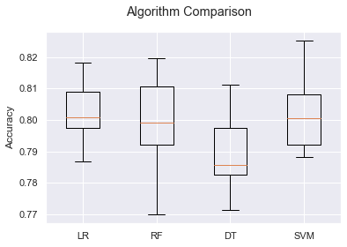
Attempt #2 Results
GridSearchCV + Cross Validation Results
1
Models are still quite close in accuracy, but we can now see which are more consistent with less variation. The two best models are Logistic Regression and Support Vector Classifier(highest median of accuracy and least variation)
Predict with Accuracy
(SVC)
2
Telco can predict future customer data with about ~80% accuracy. If a customer is predicted to churn, they can try to retain them in advance before they churn. (retention > acquisition)
LR - Logistic Regression, RF - Random Forest,
DT - Decision Tree, SVM - Support Vector Model/Classifier
Notes:
For the results of our attempt #2, we can see that despite the fact that the models are still very close in terms of accuracy scores, we were able to pick up the two best models based on the boxplot. The two best models are Logistic Regression and Support Vector Classifier. These two models have higher median accuracy and less variance in accuracy based on multiple runs.,
With the models, the telco can use it to predict any future customer data to determine whether if a customer will churn or not with good accuracy. If a customer is predicted to churn, they can then try to retain them in advance before they churn. (once again, I would like to reiterate that retention is always better than acquisition for the telco business)

Slide 23
03
02
Customer Segmentation
Notes:
If you used ML (regression, classification, or something else); mention mainly WHICH one(s).
You may now briefly CLARIFY why and how the ML problem(s) aim(s) to solve your objective.
How did you apply ML technique(s) to SOLVE your problem? Which model(s), how and why?
Did you only use tools and techniques learned in this course? What ELSE did you learn / try?

Slide 24

Additional Data Preparation Steps
Numerical Data
Churn variable
1
2
Numerical variables are put on the same scale (sklearn standard scaler) as they have measurements of different units.
This ensures all features are equally considered for the final clustering
(i.e. distance measured between points of each feature are roughly the same).
c
Dropped from the dataset
to keep the dataset as unlabelled for clustering
(unsupervised learning)
Notes:
Under Data preparation, We put all numerical variables on the same scale to ensure all features are equally considered for the final clustering.
Secondly, Variable 'Churn' is dropped from the dataset to keep the dataset as unlabelled for clustering unsupervised learning.
https://towardsai.net/p/data-science/how-when-and-why-should-you-normalize-standardize-rescale-your-data-3f083def38ff
https://python.plainenglish.io/data-science-project-clustering-mixed-data-7d5fd6e7f047

Slide 25
Problem 2: Can we segment Telco company’s customers into clusters in order to achieve more effective customer marketing?
Our dataset and model used
K-Prototype Clustering Method
Numerical Data
1
Categorical Data
2
Notes:
Now onto the 2nd problem, the question is can we segment customers into clusters in order to achieve more effective customer marketing?
With both numerical and categorical data, we use KPrototype clustering algorithm to work with both data easily.

Slide 26
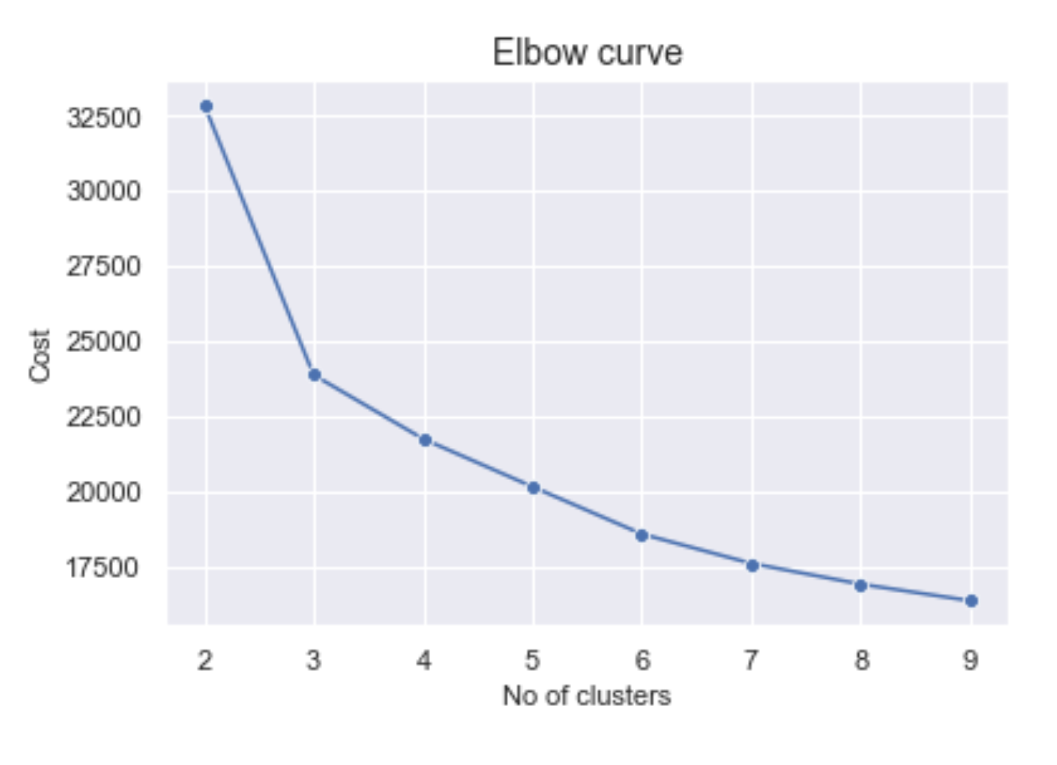
Finding Optimal Number of Clusters
1
Elbow Method
Elbow point is the cluster number where the value of the cost is not rapidly changing anymore.
Elbow Method → 5 clusters
Notes:
Before clustering, we’ll first need to identify the optimal number of clusters. To do so, we first tried the Elbow method. In this method, we want to find the elbow point which is the point on the graph where the value of the cost is not rapidly changing anymore. This point gives the optimal number of clusters.
Here, The elbow method tell us that 5 is the optimal number of clusters.

Slide 27
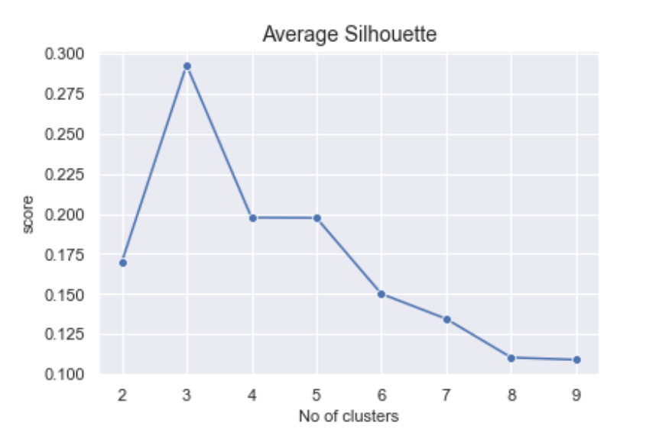
Finding Optimal Number of Clusters
2
Average Silhouette method
A silhouette value close to 1 indicates the data point is well clustered. (i.e. far away from other clustered points).
Average Silhouette method → 3 clusters
Elbow Method → 5 clusters
∴ We choose 4 clusters as the
optimal number of clusters
Notes:
Next, we use a different method, the Average Silhouette Method,. Silhouette value tells us how well the points are clustered within the range of 2 to 9 clusters. When the value is close to 1, it indicates the data point is well clustered.
As seen on the graph, average silhouette score is highest When number of cluster are 3.
Now from both cluster evaluation methods, we choose 4, which is the middle of 3 and 5, as the optimal clusters.

Slide 28
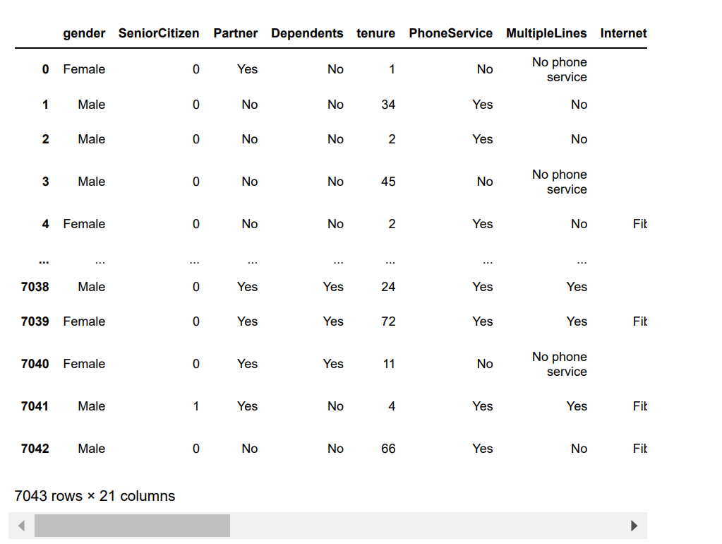
K-Prototype Clustering Method
Our results
Notes:
Now, we can use the Kprototype to group our data into 4 clusters
After clustering, Here are our cluster results. As you can see it is very difficult to identify and profile our clusters when there are so many features and rows. Hence, we need a way to pick out just a few important variables.

Slide 29
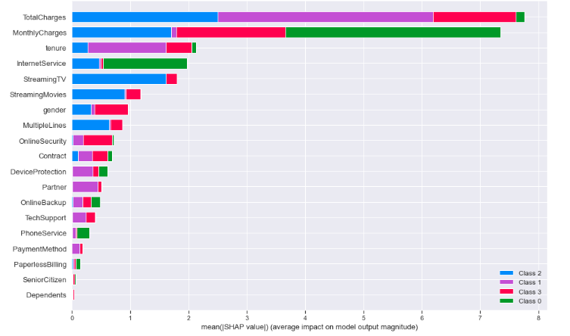
Machine Learning: Shapley
The Shapley plot ranks the variables in order of importance and it helps us figure out the top 5 features in forming the various clusters.
Top 5 variables for clustering:
TotalCharges, MonthlyCharges, Tenure, InternetService, StreamingTV
Notes:
In order to identify important variables for clustering, we have used the Shapley plot. This method ranks the variables in order of importance in forming the various clusters.
We can now profile the clusters using the top 5 variables.

Slide 30
Cluster Interpretation for Data Driven Insights
Cluster 1
Cluster 2
Cluster 3
Cluster 4
Lowest total charges
Lowest monthly charges
Did not subscribe to internet service
Cluster 1 - Lowest Spenders, Only Subscribe to Phone Services
Highest total charges
Highest monthly charges
Subscribe to Internet service & StreamingTV
Largest cluster
Lowest tenure
Did not subscribe to any add on services
High total charges
High monthly charges
Low tenure
Subscribe to Internet service & StreamingTV
Lowest Spenders,
Only Subscribe to Phone Services
High Spenders, Subscribes to Most Services (High Average Tenure)
Average Spenders, Subscribes to Main Services (internet & phone only)
High Spenders, Subscribes to Most Services (Low Average Tenure)
Notes:
Here is our new cluster results. It now has 4 rows, with each row representing one cluster. To interpret the cluster, for the numerical variables, it will be using the average value while the categorical variable using the mode. (CLICK)
For cluster 1, it has the lowest total charges and monthly charges. As these group of customers generally did not subscribe to the company's internet services, it means that they are only with the company due to their Phone services contract. This might explain why their total spendings is the lowest among the 4 clusters. Thus, We can say this cluster consists of low spender customers. (CLICK)
For cluster 2, it has the highest total charges and monthly charges. These group of customers generally subscribe only to the internet and Streaming TV service. With the longest tenure and highest spendings, we can say that they are the loyal and high spenders of the company. (CLICK)
As for cluster 3, its the largest cluster. Its impt to note that it has the lowest tenure. Upon a closer look at the main summary table, we see that this cluster subscribes to both internet and phone services. However, they generally do not subscribe to any of the add on services. Thus, we think that this cluster consist of the average spenders customers. (CLICK)
For last cluster 4, the spendings of this cluster is similar to cluster 2, but the difference between cluster 2 and 3 is that this group generally has the lower tenure even though their total charges are higher. We believe that this might be attributed to their subscription of Internet Services and streaming TV. Thus, We have named this cluster as high but volatile customers. (CLICK)

Slide 31
Recommendations
Cluster 1 - Lowest Spenders, Only Subscribe to Phone Services
Cluster 2 - High Spenders, Subscribes to Most Services (High Average Tenure)
Promote internet services to them or offer bundles consisting of both internet and phone services bundles to these customers
Offer special services and discounts to these customers to show appreciation for their loyalty.
Cluster 3 - Average Spenders, Subscribes to Main Services (internet & phone only)
Cluster 4 - High Spenders, Subscribes to Most Services (Low Average Tenure)
Telco can offer more promotions on their add on services to these customers.
Introduce Loyalty Programs to ensure customers come back and renew their contracts.
Notes:
With all the data driven insights, we came up with strategies for all clusters.
For cluster 1, lowest spenders who only subscribe to phone services, the company can promote their internet and phone services using bundles to attract this group to subscribe to the internet.
For cluster 2, the high spenders who subscribes to most services, we feel that it would not be so much of increasing their spendings, but more of deepening the relationship with these customers. Hence, the company can offer special services and discounts to these customers to show appreciation for their loyalty over the years.
For cluster 3, the average spenders who only subscribes to main services only, Telco can offer more promotions to ensure their loyalty.
For Cluster 4, the high spenders with lower tenure, Telco company can come up with customer loyalty programs to ensure these customers will renew their contract with the company in the future.

Slide 32
Project Outcome (Summary)
Churn Prediction
Customer Segments
Relationship between variables
Given the customer variables, telco can use our classification model (SVC and Logistic Regression) to predict whether a customer will churn or not with ~80% accuracy.
Telco can use the unsupervised clustering model we provide to better understand their customer segments and execute targeted strategies and recommendations.
The variables: churn, monthly charges, contract type and certain add ons services has a direct impact on whether a customer will churn or not.
Notes:
To summarise our project outcome. In EDA, we analysed relationship between variables and their impact on churn variable. In problem 1, we recommended telco to use SVC and Logistic Regression model to predict if a customer will churn or not with ~80% accuracy. Lastly, Telco can use unsupervised clustering to better understand their customer segments and execute targeted strategies and recommendations.

Slide 33
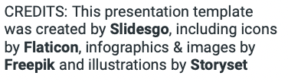
THANK YOU!
Team Members and Contributions
Soh Zu Wei - Classification Models (with gridsearchcv, kfold & one-hot-encoding, github, edit video)
Sanskkriti - Problem Motivation, Data Preparation, Cleaning and Exploratory Data Analysis
Jue Lin - Clustering Models (Kprototypes, elbow method, silhouette, clustering strategies)

Slide 34
References
https://www.zendesk.com/sg/blog/customer-churn-rate/#:~:text=Why%20is%20customer%20churn%20rate,impact%20on%20its%20bottom%20line
https://www.heavy.ai/use-case/customer-churn-analysis
https://www.kaggle.com/datasets/blastchar/telco-customer-churn
https://www.analyticsvidhya.com/blog/2022/01/churn-analysis-of-a-telecom-company/
https://towardsdatascience.com/end-to-end-machine-learning-project-telco-customer-churn-90744a8df97d
https://python.plainenglish.io/data-science-project-clustering-mixed-data-7d5fd6e7f047
https://github.com/zachzazueta/telecom_churn_project/blob/master/Notebook%202%20-%20Cleaning%20and%20KPrototypes2.ipynb
https://towardsdatascience.com/the-k-prototype-as-clustering-algorithm-for-mixed-data-type-categorical-and-numerical
https://www.kaggle.com/code/bandiatindra/telecom-churn-prediction
https://scikit-learn.org/stable/modules/generated/sklearn.model_selection.GridSearchCV.html

