Slide 1
Crispr/Cas9 LockOn
A project by Meryl Stav and Mike Tung

Slide 2
Table of Contents
Introduction
Background
Our Research
Future Plans
Conclusions

Slide 3
Table of Contents
Introduction
Mike Tung, CEO
Meryl Stav, COO,
Abstract on LockOn
Background
Our Research
Future Plans
Conclusions

Slide 4
Introduction: Mike Tung, CEO
Bachelor of Arts in Biology Specializing in Cell Biology, Molecular Biology & Genetics
Wyss Institute for Biologically Inspired Engineering Post Graduate Research Fellow

Slide 5
Introduction: Meryl Stav, COO
Bachelor’s of Science in Mathematics and Computer Science from Northeastern University
Assistant Staff in Open and Embedded Systems Group of ISR and Tactical Systems Division of MIT Lincoln Laboratory

Slide 6
Introduction: LockOn
LockOn is

Slide 7
Table of Contents
Introduction
Background
What is CRISPR/Cas9?
How will LockOn help you?
Our Research
Future Plans
Conclusions

Slide 8
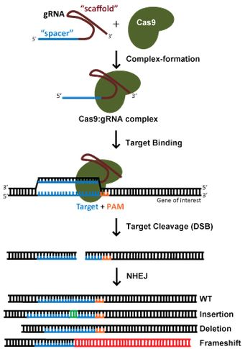
What is CRISPR/Cas9?
CRISPR/Cas9 Endonuclease System. Cas9 and a synthetic gRNA with the spacer sequence is coupled to form a Cas9-gRNA complex
The Cas9-gRNA complex binds to the gene of interest (blue) that is immediately followed by a PAM (orange)
If there is sufficient homology between the target site and the gRNA and there exists a PAM, Cas9 cuts the DNA and exits, leaving the damaged DNA to repair itself either by Non-Homologous-End-Joining or Homology-Directed-Repair (Not Shown) to introduce mutations that will disrupt and silence the targeted gene

Slide 9
How will LockOn help you?

Slide 10
Table of Contents
Introduction
Background
Our Research
Demo
Benchmarks
Future Plans
Conclusions

Slide 11
Demo
Insert qtime video

Slide 12
Benchmarks
What we’ve tested so far and the timing

Slide 13
Table of Contents
Introduction
Background
Our Research
Future Plans
Future Tests and Projected Benchmarks
Company Expansion
Conclusions

Slide 14
Future Tests and Projected Benchmarks

Slide 15
Company Expansion

Slide 16
Table of Contents
Introduction
Background
Our Research
Future Plans
Conclusions
Final Thoughts
Acknowledgements
Extra Slides

Slide 17
Final Thoughts

Slide 18
Acknowledgements

Slide 19
Extra Slides (if necessary)

