Slide 1
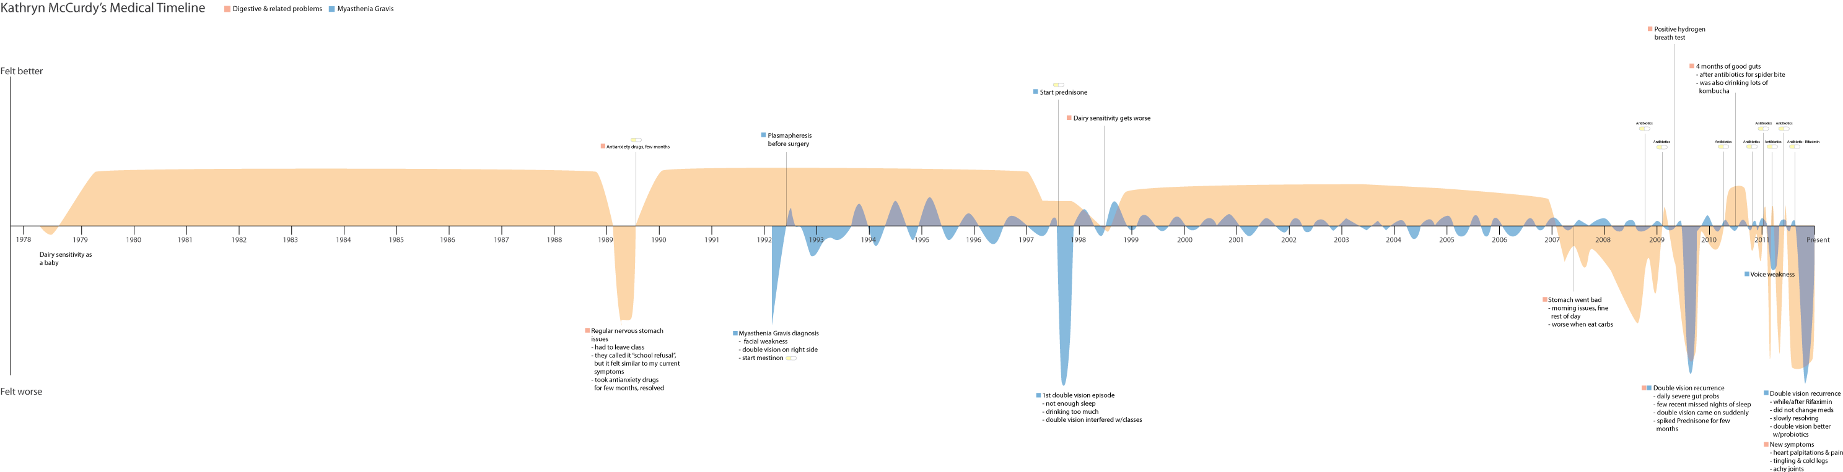
TimeMiner
Mohammad Ahmadzadeh
Alok Hota

Slide 2
What is TimeMiner?
Find world events by analyzing clusters of Wikipedia articles
Create visualizations depicting occurrence and mutation of events

Slide 3
Clustering
Static strength
Relatively stable
Link backs
Common editors
Common references
Syntactic correlation

Slide 4
Clustering
Static strength
Relatively stable
Link backs
Common editors
Common references
Syntactic correlation
Dynamic strength
Can change rapidly
Number of edits
Number of views
Based on temporal similarity

Slide 5
Purpose of strengths
Static strength
Connection weight
Dynamic strength
Occurrence and importance

Slide 6
Visualizations
Time-line of historically notable world events
Graph cluster showing connections between articles over time

Slide 7
Any questions?

