Slide 1

Java LDAP Persistence with DataNucleus
Stefan Seelmann
seelmann@apache.org

Slide 2
Stefan Seelmann
Freelancer
  Software Development with Java
  LDAP, Identity- and Access-Management
Open Source Developer
  Apache Directory Project
  DataNucleus LDAP Store

Slide 3
Agenda
Motivation
Java Persistence, JDO and DataNucleus
Basic Demo
DataNucleus LDAP Store
Advanced Demo
Status and Conclusion

Slide 4
Java LDAP Development
Java APIs for LDAP
  Mature: Netscape LDAP SDK, JLDAP (Novell/OL)
  Modern: Unbound ID, Apache Directory, OpenDS
    Hopefully a common Java LDAP API soon?
  JNDI, Spring-LDAP
Drawback:
  Developer has to deal with LDAP
    DN, RDN, filters, modification items, error codes
  Boiler-Plate code, exception handling

Slide 5
Java Persistence
Standards
  JPA (Java Persistence API): JSR 220, RDBMS only
  SDO (Service Data Objects): JSR 235
  JDO: (Java Data Object): JSR-12 and JSR-243
Products
  O/R Mapper: Hibernate, TopLink/EclipseLink, ...
  Apache iBATIS, Cayenne, OpenJPA, Tuscany, ...
  DataNucleus
  ...

Slide 6
JDO
Java-centric API to access persistent data
Datastore independent
Started by Sun, now driven by Apache JDO
Versions 1.0, 2.0, 2.1, 2.2, 2.3 in progress
Three main parts
  Persistence definition (metadata)
  Persistence API
  Query language/API

Slide 7
DataNucleus
Reference implementation of JDO
Apache licence
Designed to be extensible
Data stores:
  LDAP, RDBMS, db4o, NeoDatis, Excel, ODF, XML, HBase, BigTable
APIs:
  JDO, JPA, REST
Query languages
  JDOQL, JPQL, native

Slide 8
Persistence Definition
What data to persist, Java centric
Annotation, XML metadata, API
public class User
{
String uid;
Group group;
}
@PersistenceCapable
public class User
{
@Persistent
String uid;
@Persistent
Group group;
}
<class name=“User“>
<field name=“uid“/>
<field name=“group“
persistence-modifier="persistent/>
</class>

Slide 9
Persistence API
Used to persist and retrieve objects
PersistenceManagerFactory pmf =
JDOHelper.getPersistenceManagerFactory(...);
PersistenceManager pm =
pmf.getPersistenceManager();
...
pm.makePersistent(someObject);
pm.getObjectById(id);
pm.deletePersistent(someObject)

Slide 10
Query Language and API
Used to retrieve objects on criteria
  API or SQL-like string
  Elements: filter, ordering, aggregation
  DataNucleus has in-memory evaluation
Fetch groups
  Which fields to fetch
Query q = pm.newQuery(User.class);
q.setFilter(“accountId=bbunny“);
Collection result = q.execute();

Slide 11
Basic Demo
Class User
  Single-valued fields (String, long, Calendar)
  Multi-valued fields
Annotations
Persist, Query, Delete
Interjection: Reusal of ORM metadata!

Slide 12
LDAP Store Objective
Use standard API to access LDAP data
Easier LDAP usage
  No need to learn (too much) LDAP
  Work with Java objects instead of LDAP
  Declarative persistence
Need full control how data is persisted
Support existing LDAP data
  DIT Structure
  Schema
Leverage LDAP best practices and patterns

Slide 13
Basic Mapping
Java Object ↔ LDAP Entry
  @PersistentCapable
  Object classes defined in „schema“
    Automatically added to entry
    Base filter for retrieval
    Rule: one object class per object
Java Fields ↔ LDAP Attribute
  @Persistent
  String, Primitives, Number, Calendar → SV attribute
  Collection, Set, List of above → MV attribute
  byte[] → binary attribute

Slide 14
Object Identity
Application identity and single-field identity
  One field marked as „primary key“ → RDN
    Must be unique per object type!
  String, Primitives, Number, UUID
  Only single-valued RDN supported
Parent of Entry determined by „table“
  Distinguished Name
  LDAP URL
    Discriminator for inherited classes
  Reference to parent field

Slide 15
Relationships
Relationship Strategies
  By DN (default)
  By attribute
  Hierarchical
  Embedded
Dangerous without transactions!

Slide 16
Relationship by DN
Typical usage: groupOfNames
@PersistenceCapable(table="ou=Groups,...", schema="top,groupOfNames")
public class Group
{
@Persistent(column="member")
@Extension(vendorName="datanucleus", key="empty-value", value="...")
Set<User> members = new HashSet<User>();
...
}
@PersistenceCapable(table="ou=Users,...",
schema="top,person,organizationalPerson,inetOrgPerson")
public class User
{
@Persistent(mappedBy="members")
Set<Group> memberOf = new HashSet<Group>();
...
}

Slide 17
Relationship by Attribute
Typical usage: posixAccount, posixGroup
@PersistenceCapable(table="ou=Groups,...", schema="top,posixGroup")
public class Group
{
@Persistent(column="memberUid")
@Join(column="uid")
private Set<Account> members = new HashSet<Account>();
...
}
@PersistenceCapable(table="ou=Accounts,...", schema="top,posixAccount")
public class Account
{
@Persistent(mappedBy="members")
Set<Group> secondaryGroups = new HashSet<Group>();
...
}

Slide 18
Hierarchical Relationship
Typical usage: Organizational structure
@PersistenceCapable(table="dc=example,dc=com",
schema="top,organizationalUnit")
public class Department
{
...
}
@PersistenceCapable(table="{department}",
schema="top,person,organizationalPerson,inetOrgPerson")
public class User
{
...
@Persistent(defaultFetchGroup = "true")
private Department department;
...
}

Slide 19
Embedded Objects
Containment relationship
Embedded objects don't have their own identity
  Loaded together with the owner object
Two variants:
  As child
  Into owner entry

Slide 20
Queries
Only a subset of JDQL filter is translated to LDAP
  Logical: & |
  Operators: ==, !=, <, <=, >=, >
  Methods: startsWith() and endsWith()
Not schema aware!
Advanced filters, aggregation, ordering is evaluated in-memory!

Slide 21
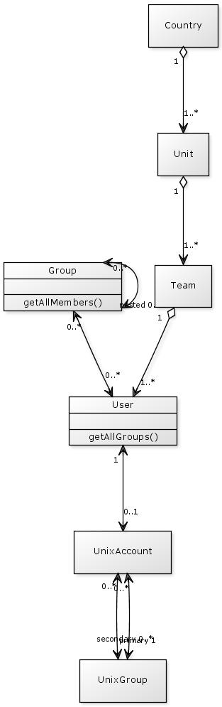
Advanced Demo
Organization hierarchy
  country, organization, organizationalUnit
Users
  inetOrgPerson
Nested groups
  groupOfNames
Unix accounts and groups
  posixAccount, posixGroup
Wicket web application

Slide 22
Status
Prototype implementation
Basic mapping works well
Relationships by DN and attribute works well
Hierarchical relationship sucks
Performance is partially poor
  Collections
  Hierarchical relationships
Transactions are missing!

Slide 23
Future Steps
Connection handling (encryption, authn)
Hierarchical relationships
  compound identity
Large data
  lazy loading, paged search, VLV
Query
Schema awareness
java.util.Map
Auto-creation of schema and DIT
Tooling to create beans and metadata from LDAP

Slide 24
Conclusion
Pros:
  Standardized API for different datastores
  When using LDAP as datastore
Cons:
  Setup (dependencies, enhancer)
  Learning curve (lifecycle, metadata, configuration)

Slide 25
Resources
DataNucleus
  http://www.datanucleus.com
DataNucleus LDAP store documentation
  http://www.datanucleus.org/products/
  accessplatform_2_0/ldap/support.html
JDO specification
  http://db.apache.org/jdo/specifications.html
Paper, slides, examples
  http://github.com/seelmann/ldapcon2009-datanucleus

