Slide 1
The problem: how many rides, where, and when?
Forecast hourly trips in 12 Addis Ababa zones for 1–14 November 2025 (4,032 zone-hours)
• Why it matters: drivers in the right zone at the right hour mean shorter waits and more completed trips
• Trips (85k rows, Jan–Oct): hourly requests per zone, plus fares, wait times and active drivers
  – messy: 3 date formats, 55 spellings of 12 zones, −1 codes, duplicates, an outage, a zone launched in March
• Weather (hourly, observed + November forecast): temperature, rain, humidity, wind
  – trap: recorded on UTC, not local time; −9999 rain codes; a July block in °F
• Events (165): football, concerts, conferences, road closures, holidays
  – messy: multi-zone and city-wide entries, missing or reversed end times, free-text crowd sizes, cancellations
• Our goal: one clean zone × hour table that joins all three, then a model that uses only what is known 14 days ahead
Addis Ride Demand Forecasting · TEAM ALPHA | 1/5

Slide 2
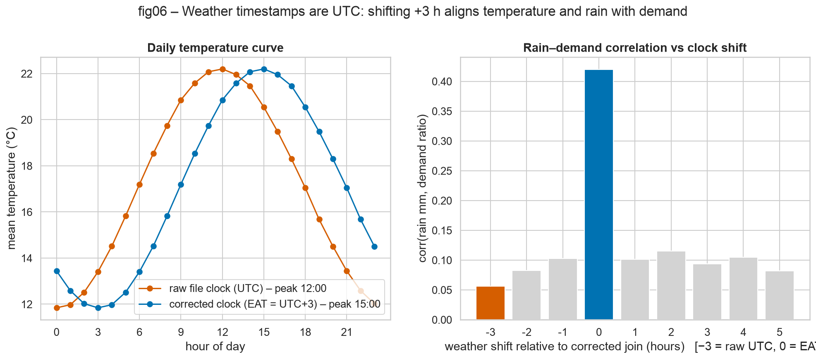
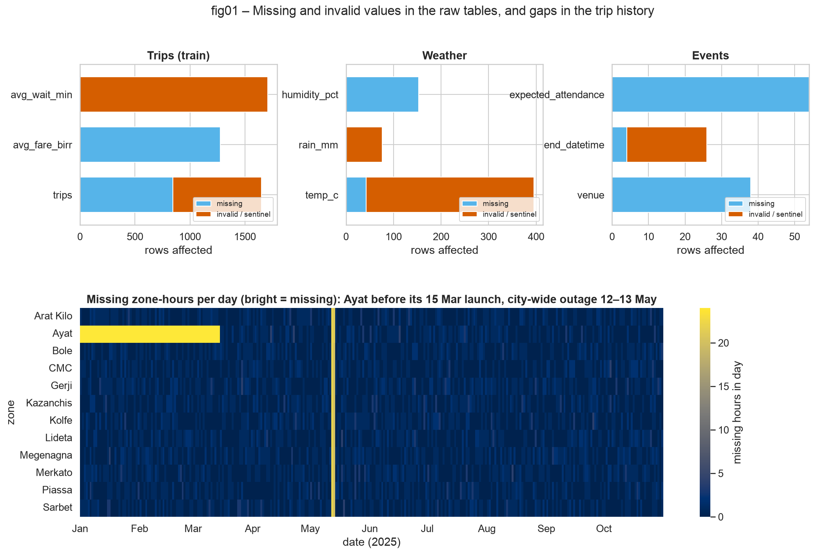
Cleaning & integration: one clock, one zone key, one row per zone-hour
• The clock problem: the weather file is on UTC. Raw temperature peaks at 12:00; after +3 h it peaks at 15:00 EAT, and rain–demand correlation jumps from 0.06 to 0.42
• Join map: zone-hour grid ← weather (many-to-one on the hour) ← events (interval join from 2 h before start to 2 h after end, per affected zone)
• Key numbers (A4):
  – 38,574 timestamps parsed explicitly (no day/month swaps)
  – 32,391 zone labels → 12 canonical zones
  – 846 duplicates, 675 −1 codes, 123 impossible spikes removed
  – 353 °F readings converted, 76 −9999 rain codes, 192 missing weather hours filled
  – 42-hour city-wide outage and Ayat before launch excluded, not zero-filled
  – Weather match 100%; joins never change row counts; 13/13 integrity checks pass
• Result: master_train has 82,979 zone-hours, master_test has 4,032
Addis Ride Demand Forecasting · TEAM ALPHA | 2/5

Slide 3
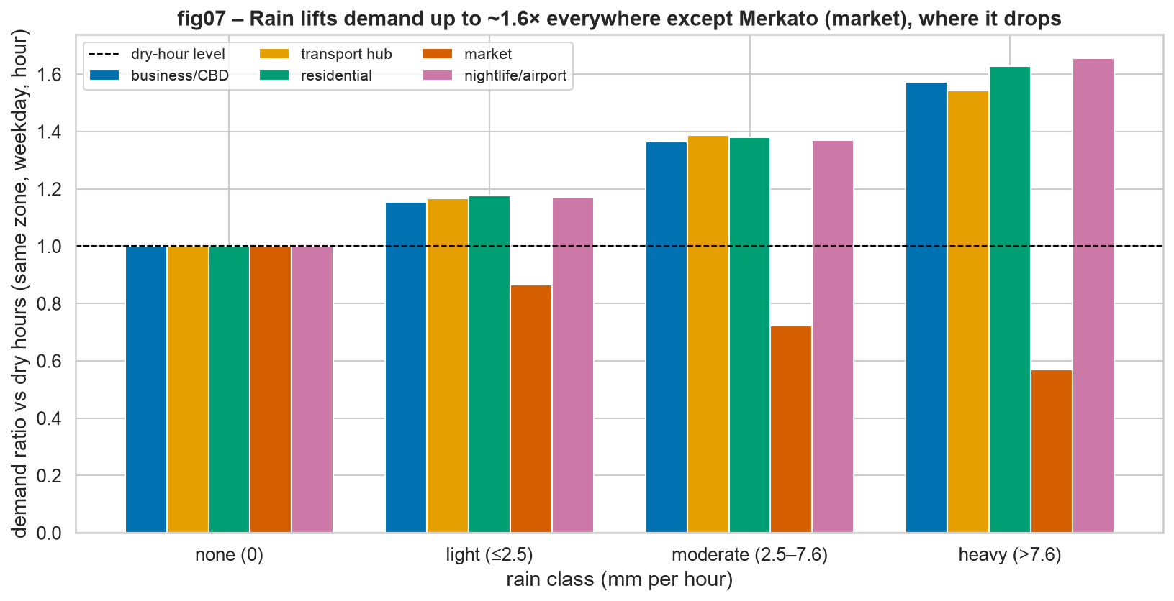
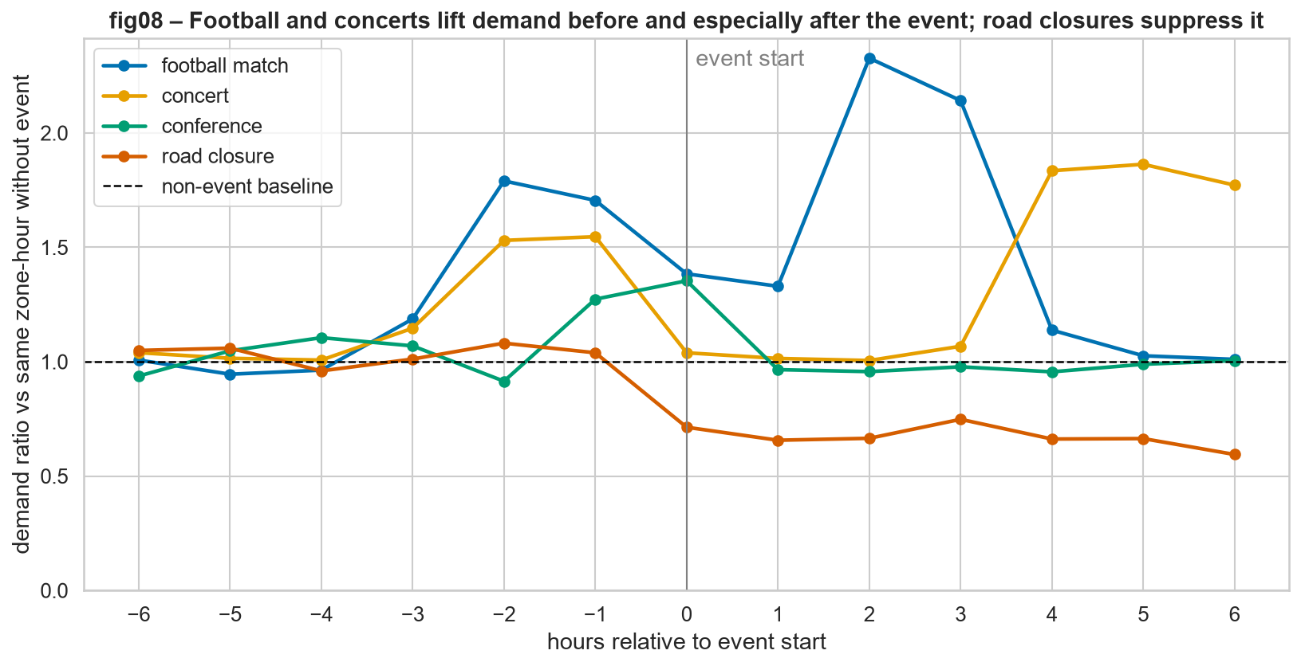
What the data says: rain and events move demand — but not everywhere
• Rain: +13% in light rain, +30% moderate, +46% heavy — sub-linear. But **Merkato falls ~21%**: an open-air market loses shoppers when it rains
• Events: football lifts demand +75%, with the biggest surge in the **2 hours after the final whistle (+124%)**. Concerts +31%; road closures −24%. So event windows must extend past the end time
Addis Ride Demand Forecasting · TEAM ALPHA | 3/5

Slide 4
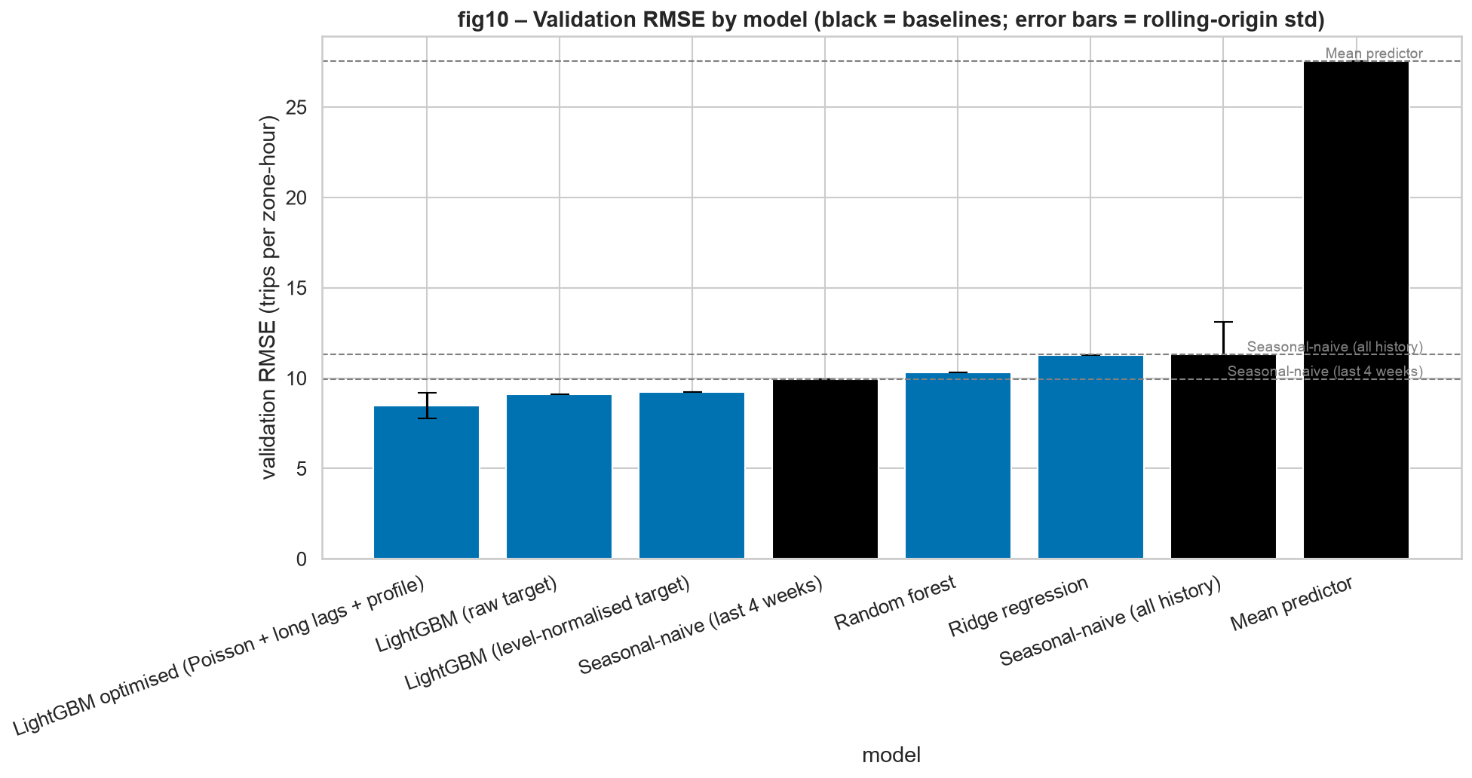
Modelling & evaluation: beat the baseline, honestly
Chronological validation: train before 18 Oct, test on 18–31 Oct, plus 4 rolling 14-day folds
Model | RMSE | MAE
Mean predictor | 27.54 | 20.69
Seasonal-naive (zone×weekday×hour) | 11.30 | 7.36
Ridge / random forest | 11.29 / 10.31 | 7.55 / 6.76
LightGBM, tuned | 9.03 | 6.06
LightGBM optimised (final) | 8.47 | 5.85
• Ablation: calendar + lags 9.74 → + weather 9.21 → + events 9.64 → both **9.06**: both joins help
• Rolling origin: 9.21 ± 0.71 vs 12.32 ± 1.83 for seasonal-naive, better in every fold
• Leakage check: adding active_drivers fakes an RMSE of 4.25, so it is excluded; only lags of 14 days or more are used
• Optimisation: Poisson loss, 2–5-week lags and an 8-week zone×weekday×hour profile take RMSE from 9.03 to 8.47
Addis Ride Demand Forecasting · TEAM ALPHA | 4/5

Slide 5
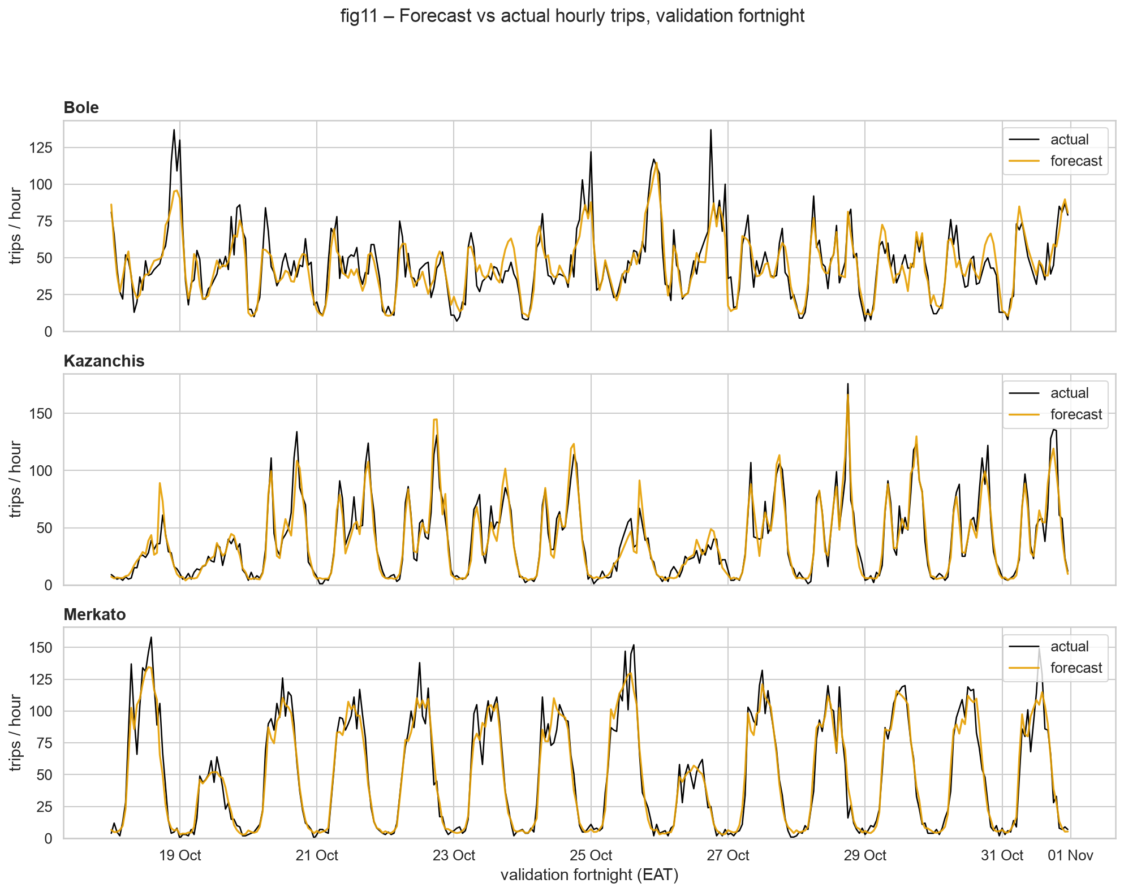
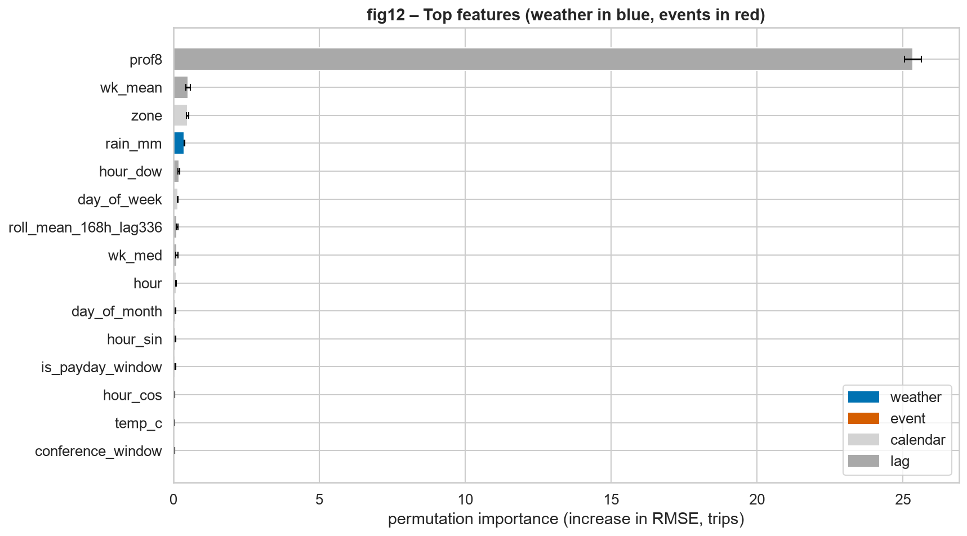
Error analysis, final score 8.47 RMSE, demo and next steps
• Final score: RMSE 8.47, MAE 5.85 trips per zone-hour (≈17.5% of demand). That is 25% better than seasonal-naive and ≈ 4–5 drivers per zone-hour
• Where it misses: busy zones in absolute terms (Bole 11.0, Megenagna 10.9, Merkato 10.5 vs Ayat 5.9) but relative error is flat (17–20%); rush hours; the tallest post-event surges; one-off holidays (Meskel)
• Demo: pick a zone and a date → 24-h forecast, peak hour, drivers needed, expected fares, and the weather/events looked up
  – run locally: streamlit run app/app.py (live demo on our laptop)
• Next: holiday- and event-specific multipliers, quantile forecasts for staffing, training with noisy weather forecasts, weekly retraining and hosting
Addis Ride Demand Forecasting · TEAM ALPHA | 5/5

