Slide 1
HR ATTRITION ANALYTICS
Diagnosing Why Employees Leave
An end-to-end analytics project built on Microsoft Fabric and Power BI
from business problem to a governed, interactive dashboard.
Seema Kumari | Data Analyst, Business Intelligence & Microsoft Fabric

Slide 2
The Business Problem
Why this project exists, and how it was approached
Problem
Approach
HR Leadership had no centralized way to see why employees were leaving. Attrition analysis was manual, slow, and inconsistent between reporting cycles.
Overall attrition sat at 16.1% above the 10–15% industry benchmark with no visibility into which segments were driving it.
Unplanned attrition carries real cost: recruiting spend, onboarding time, and lost institutional knowledge.
1
Ingest
Dataflow Gen2 pulled the raw HR CSV (1,470 employees) via the Web/CSV connector.
2
Clean & Enrich
Engineered Salary Band and Age Group columns to simplify grouped analysis.
3
Store
Key Questions Answered
Loaded into a Fabric Lakehouse as a flat table — right-sized for a sub-2,000-row dataset.
What is the overall attrition rate?
Which departments and roles are losing the most people?
How do pay, age, and tenure relate to attrition?
Which behaviors (overtime, travel, marital status) predict risk?
4
Model
Built a Power BI semantic model with 5 core DAX measures for auditable KPI logic.
5
Secure & Publish
Applied Column-Level Security on MonthlyIncome, then published a 2-page interactive dashboard.
HR Attrition Analytics • Business Problem & Approach
2

Slide 3
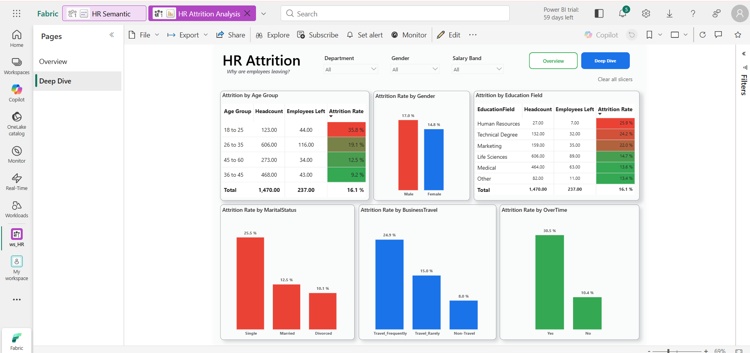
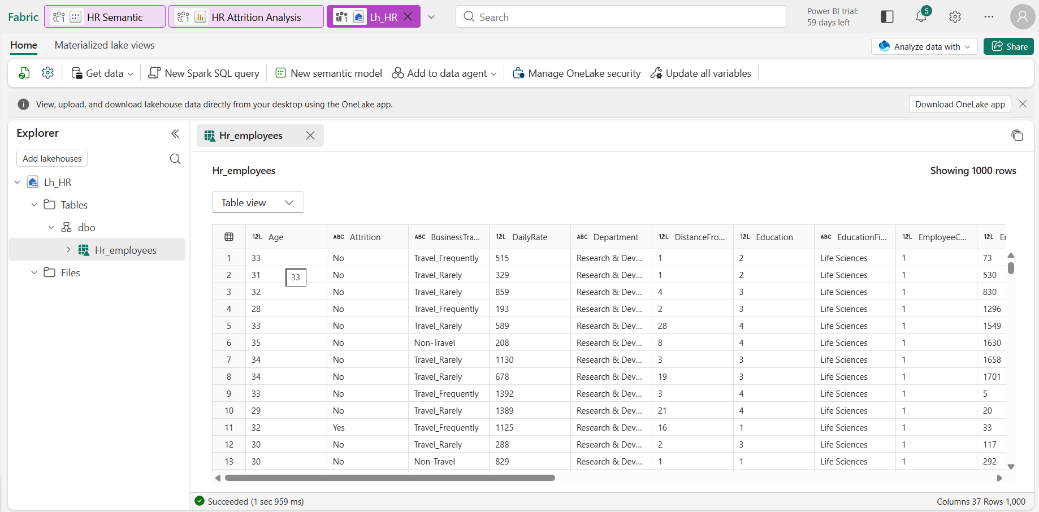
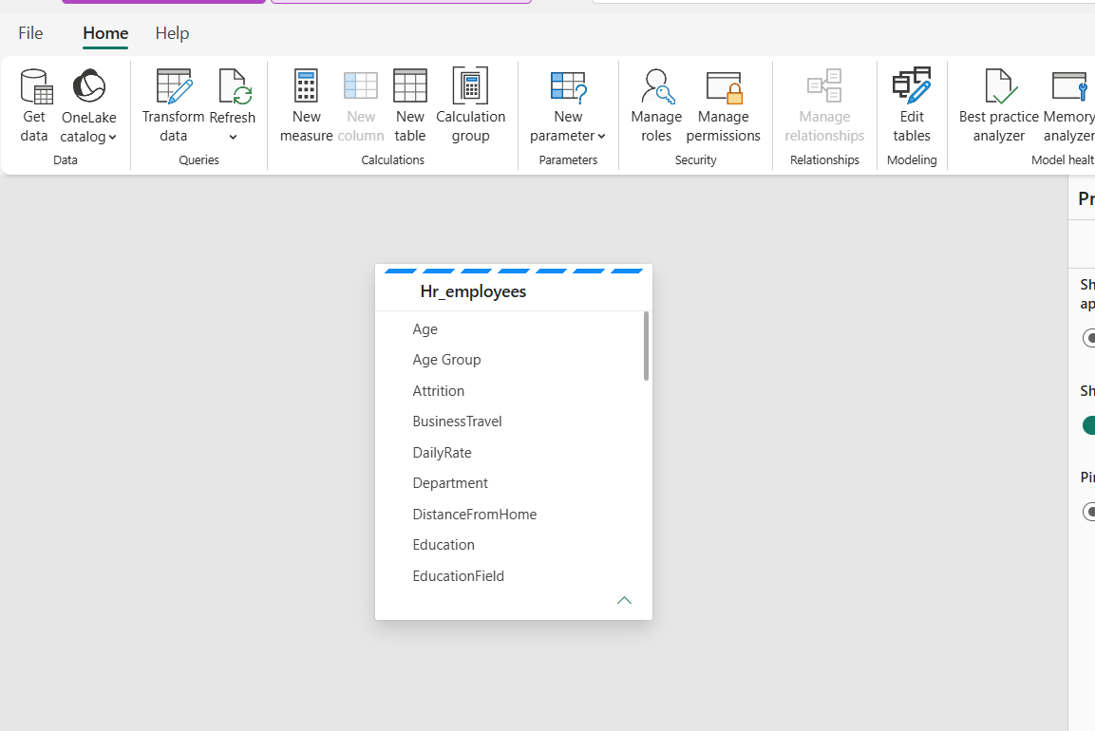
Built on Microsoft Fabric
Ingestion, storage, and modeling — end to end on one governed platform
Fabric Workspace
Lakehouse Table
Semantic Model
HR Semantic model + Attrition Analysis report, organized in a dedicated ws_HR workspace.
1,000+ row Hr_employees table landed in the Lakehouse, ready for modeling.
Engineered fields (Age Group, etc.) alongside source columns for clean, ready-to-chart data.
Governance: Column-Level Security
MonthlyIncome is restricted at the default reader role via Fabric's OneLake Security. General viewers explore attrition freely; only authorized roles see individual salary values.
HR Attrition Analytics • Platform & Data Model
3

Slide 4
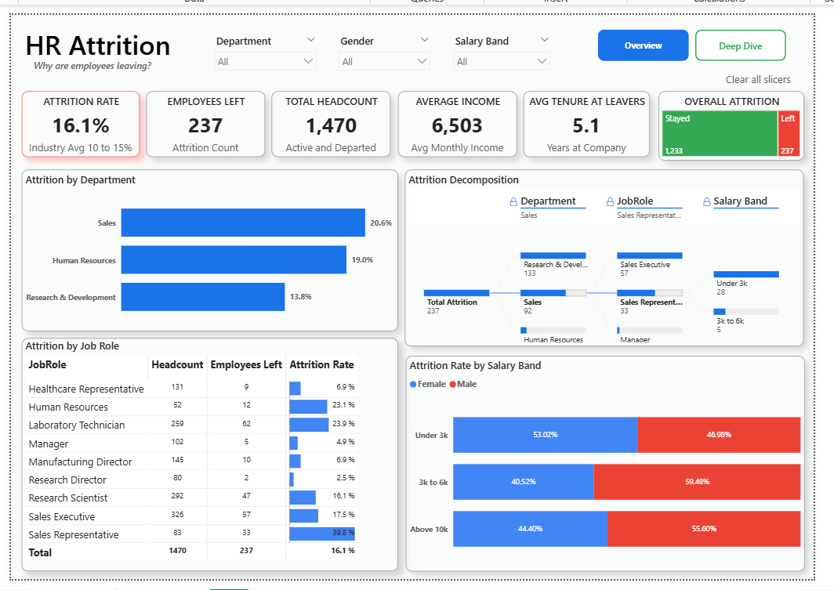
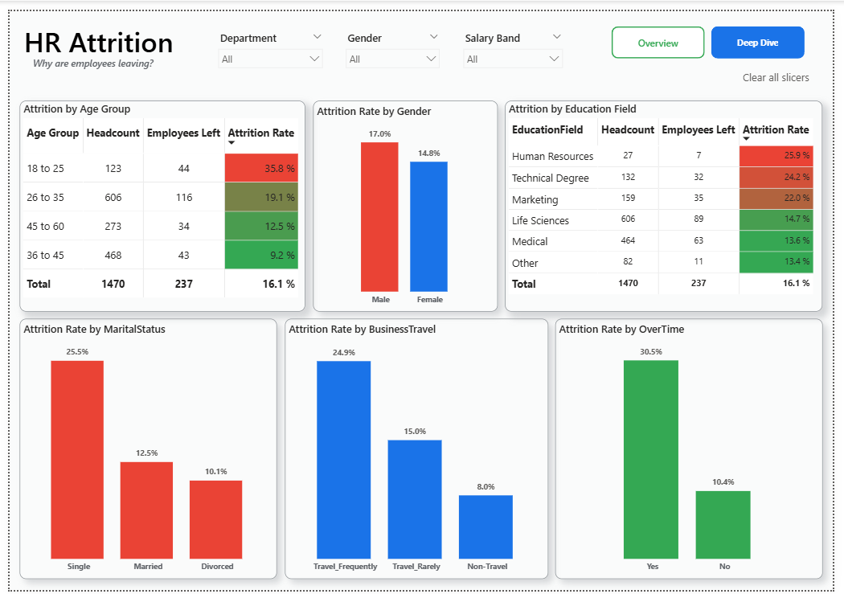
The Dashboard
Two-page, cross-filterable Power BI report : Overview and Deep Dive
Overview — KPIs, department attrition, decomposition tree
Deep Dive — Age, gender, travel, overtime, marital status
16.1%
39.8%
35.8%
30.5%
Overall Attrition
Sales Reps — Highest Risk Role
Age 18–25 Attrition
Overtime Workers Who Left
HR Attrition Analytics • The Dashboard
4

Slide 5
Key Insights & Recommendations
What the data shows and where retention effort should go next
Findings
Recommendations
Sales leads departmental attrition (20.6%), ahead of HR (19.0%) and R&D (13.8%).
Lower salary bands correlate strongly with attrition — "Under 3K" skews heavily toward departures.
Frequent travelers leave at ~3x the rate of non-travelers (24.9% vs. 8.0%).
Single employees leave more than 2x as often as married employees (25.5% vs. 12.5%).
Gender split reverses by department: men leave more company-wide, but women leave more within HR specifically.
Prioritize retention budget on Sales / Sales Reps and the Under-3K salary band.
Review overtime policy and workload distribution.
Introduce hybrid travel policies for frequent travelers to curb burnout risk.
Build targeted onboarding for employees under 25.
Future Work
ML-based attrition risk scoring for active employees.
Fabric Data Activator alerts on threshold breaches.
Exit-date field for true time-series trend analysis.
HR Attrition Analytics • Insights & Recommendations
5

