Slide 1
🍔MEALDASH
Delivery Operations Analytics
Diagnosing why delivery times vary across 45,000+ quick-commerce orders
and turning it into three specific, actionable recommendations.
Excel (Power Query)
SQL
Microsoft Fabric
Power BI
Prepared for: Analytics Leadership Review

Slide 2
THE BUSINESS PROBLEM
Nobody knew why delivery times varied or how to find out fast
MealDash's delivery times swing widely: some orders arrive in 10 minutes, others take almost an hour. Diagnosing a single slow week meant a data analyst manually digging through raw records for a day or two, with no standing answer to the question ops kept asking:
10 – 54 min
Delivery time range observed
“Why was it slow and what can we actually do about it?”
1–2 Days
To manually diagnose a slow week — before this project
This project answers 10 specific business questions — moving from the overall scale of the problem, to the levers ops can control (traffic, distance, staffing, bundling) versus the ones they can't (weather), and finally to whether performance is trending better or worse over time.
Minutes
To answer the same question — after this project
Business Problem
MealDash — Delivery Operations Analytics

Slide 3
DATASET & SCOPE
A real, messy, 45,000-order dataset nothing synthetic
What's in the data
✔ In Scope
✘ Out of Scope
Delivery timestamps & GPS coordinates
Weather conditions & road traffic density
Delivery agent ratings & vehicle type
Festival-day flags
≈45,000 real orders — Zomato Delivery
Operations dataset (Kaggle)
Traffic
Weather
Distance
Vehicle type
Agent performance
Order bundling
Festival effects
Pricing
Restaurant menu data
Customer app experience
Left out on purpose — pulling them in would dilute a focused delivery-time analysis.
Note: no “promised delivery time” field exists, so SLA breach rate is benchmarked against segment averages instead of a formal target.
Dataset & Scope
MealDash — Delivery Operations Analytics

Slide 4
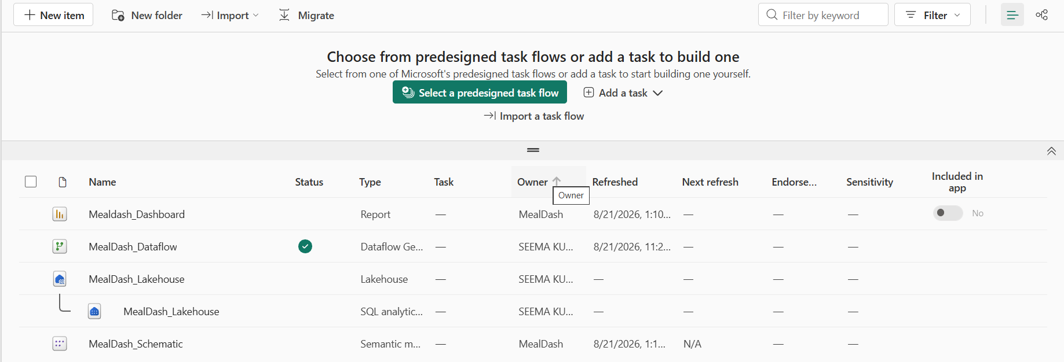
APPROACH
A governed, repeatable pipeline not a one-off manual pull
1
→
2
→
3
→
4
→
5
Clean in Excel
Version on GitHub
Load to Fabric
Query in SQL
Visualize in Power BI
Power Query: nulls, formats, categories + Haversine Distance_km column
Cleaned data pushed to a refreshable source, not a static upload
Dataflow Gen2 pulls data into a governed Lakehouse
10 business questions answered via the SQL Analytics Endpoint
3-page live dashboard on the same semantic model
Fabric workspace: Lakehouse, Dataflow Gen2 & SQL Analytics Endpoint under one governed roof
Approach
MealDash — Delivery Operations Analytics

Slide 5
TOOLS & TECHNOLOGIES
Each tool earns its place in the pipeline
1
Excel · Power Query
2
SQL · Fabric Analytics Endpoint
First cleaning pass: nulls, formats, categorical standardization, and a Haversine-based Distance_km column.
Answered all 10 business questions using CTEs, CASE-based bucketing, and window functions (PERCENTILE_CONT, rolling averages).
3
Microsoft Fabric · Lakehouse + Dataflow Gen2
4
Power BI
A repeatable, governed pipeline pulling cleaned data from GitHub into a Lakehouse instead of a one-off manual upload.
A 3-page live, interactive dashboard with DAX measures, built on the same governed semantic model as the SQL layer.
Tools & Technologies
MealDash — Delivery Operations Analytics

Slide 6
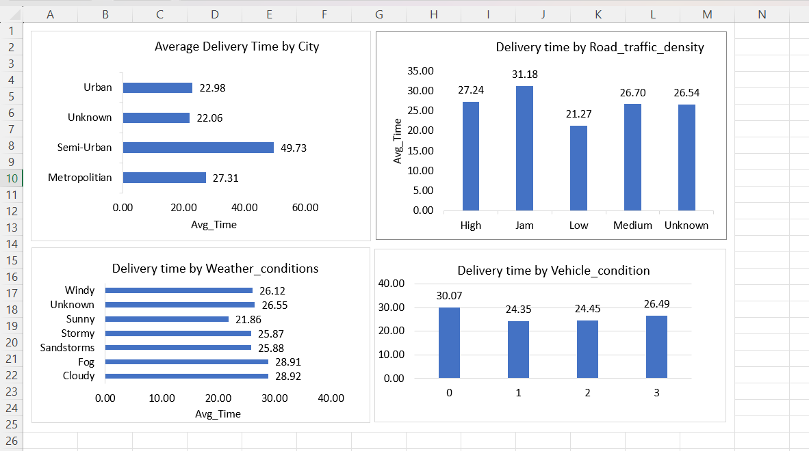
KEY INSIGHTS · 1 OF 3
Baseline, city, traffic & weather
26 min
27 min
+10 min
28 min
Overall avg (10–54 min range)
Metropolitan — slowest by volume
(34,000+ orders)
Jam traffic vs. Low traffic
Fog & Cloudy — slowest weather
(not storms)
Key Insights
MealDash — Delivery Operations Analytics

Slide 7
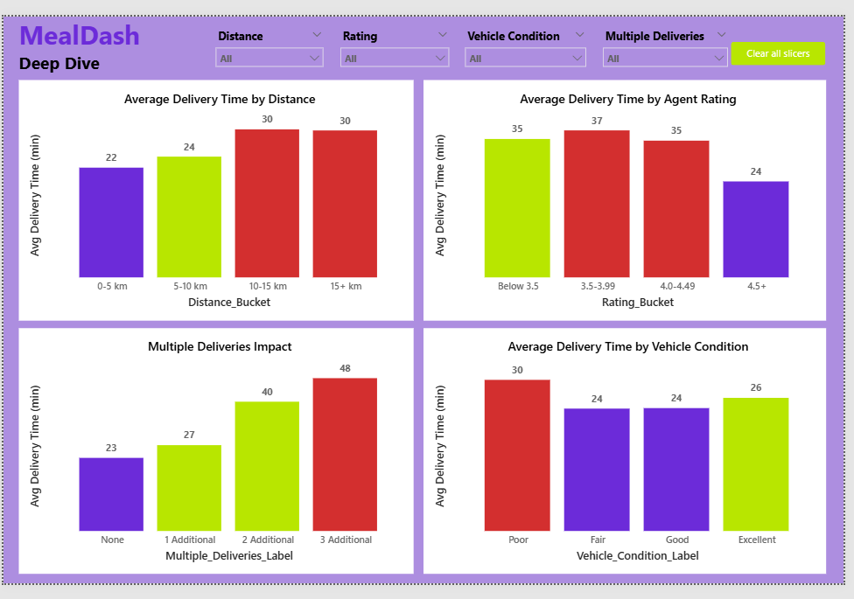
KEY INSIGHTS · 2 OF 3
Distance, vehicle, agent rating & bundling
Distance
Crossing the 5 km mark is the real cost — time plateaus after that, it isn't proportional to distance.
Vehicle type
Minor effect (~3 min) between fastest and slowest vehicle.
Agent rating
4.5+ rated agents deliver 10–13 min faster than every lower bucket — the clearest pattern in the dataset.
Bundled orders
2–3 bundled orders more than doubles delivery time (22 → 47 min), and the cost accelerates with each extra stop.
Key Insights
MealDash — Delivery Operations Analytics

Slide 8
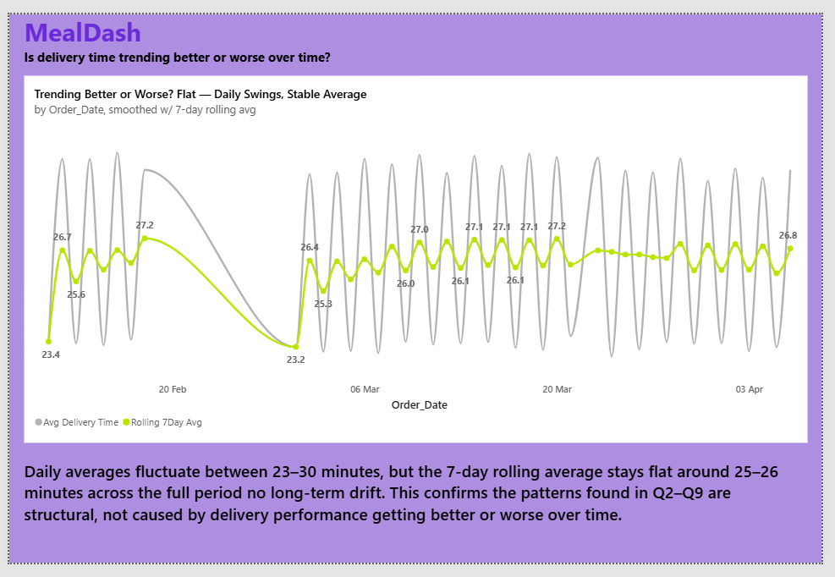
KEY INSIGHTS · 3 OF 3
Festival impact & the trend over time
75–80%
Festival days are slower than
normal days — the largest single
effect found across all 10 questions
Flat
7-day rolling average holds steady
around 25–26 min — no long-term
drift; patterns are structural
Key Insights
MealDash — Delivery Operations Analytics

Slide 9
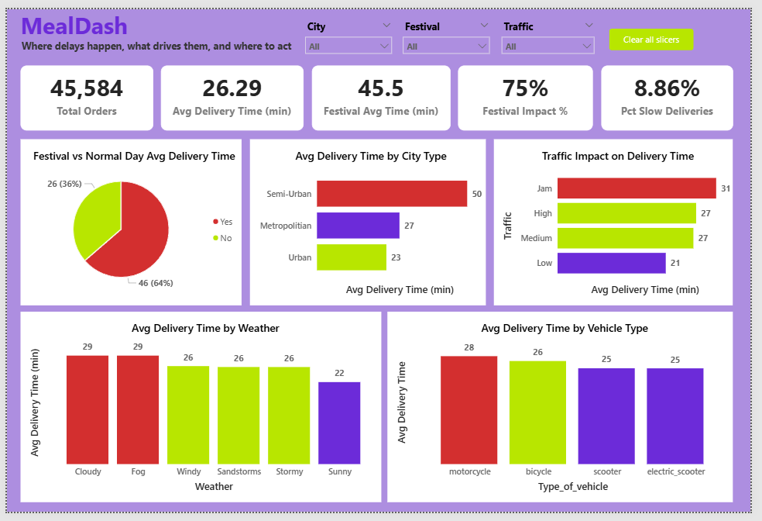
LIVE DASHBOARD
A 3-page Power BI dashboard, built for self-serve exploration
Page 1 — Executive Overview
Total orders, avg delivery time, festival impact %, and slow-delivery rate at a glance.
Page 2 — Delivery Drivers Deep Dive
Distance, rating, vehicle condition and bundling, all slicer-driven.
Page 3 — Trend Over Time
Daily averages smoothed with a 7-day rolling average to separate noise from signal.
🔗 Open the Live Interactive Dashboard
Live Dashboard
MealDash — Delivery Operations Analytics

Slide 10
RECOMMENDATIONS
Three findings ops can act on this week
🎯
📦
⭐
Pre-plan festival-day staffing
Cap bundled deliveries at 1 extra order
Use agent ratings for order routing
Festival deliveries take 75–80% longer — the single largest effect found. Low volume (896 orders) but high impact makes this a high-ROI, low-effort fix: targeted staffing on known festival dates, not a company-wide change.
2–3 bundled orders more than doubles delivery time (22 → 47 min), and the cost accelerates non-linearly. Capping at 1 extra order for time-sensitive deliveries captures most of the efficiency without the steep penalty.
4.5+ rated agents deliver in 24 min vs. 34–37 min for every lower bucket — a 10+ minute gap. A strong, easy-to-access signal for prioritizing time-sensitive orders, even though causal direction isn't fully resolved.
Traffic and weather matter too — but they're conditions ops can't directly control. These three are things ops can act on now.
Recommendations
MealDash — Delivery Operations Analytics

Slide 11
WHAT'S NEXT
Future Work
1
Validate the festival-day effect against a full year of festival dates
2
Replace straight-line (Haversine) distance with actual road-route distance
3
Investigate the direction of causation between agent rating and delivery speed
4
Add a live data connection to support ongoing monitoring, not one-time diagnosis
Thank you
Open to opportunities, collaborations, and conversations around data analytics.
github.com/seema-kri/MealDash

