Slide 1

VANTARA
SMART SUPPLY CHAIN INTELLIGENCE PLATFORM
Supply Chain Performance Analytics
Revenue, Delivery & Customer Insights — 2015 to 2017
Prepared by Seema Kumari | Business Analyst
End-to-End Project — SQL · Excel · Power BI · Documentation

Slide 2
What This Presentation Covers
A walk-through of the problem, the work, what I found, and what I'm recommending.
01
02
03
The Business Problem
Data & Approach
Challenges I Faced
Why this analysis was needed
Source data, tools, and pipeline
Real issues hit during the build, and how I fixed them
04
05
06
Key Findings
Recommendations
Dashboard Preview
Revenue, profitability, delivery, customers
What I'm suggesting leadership do next
The final Power BI deliverable
VANTARA · Smart Supply Chain Intelligence
02

Slide 3
01 — THE PROBLEM
Growth Without Clear Profit
Vantara's order volume kept climbing year over year, but leadership couldn't tell whether that growth was actually translating into healthier profit, faster deliveries, or more loyal customers. The questions were simple to ask and hard to answer without digging into the data directly.
THE PROJECT, IN NUMBERS
180,519
order-line records analyzed
Was rising order volume actually increasing profit, or just masking thinner margins?
5
relational tables (1 fact, 4 dimension)
How reliable were deliveries — and which shipping mode was really the problem?
3 yrs
of order history modeled (2015–2017)
How many orders were sitting in limbo (pending, on hold, fraud review) instead of confirmed revenue?
Were customers actually loyal, or was the business relying on one-time buyers?
3
dashboard pages built in Power BI
VANTARA · Smart Supply Chain Intelligence
03

Slide 4
02 — DATA & APPROACH
From Raw CSV to Decision-Ready Model
I started with a single flat file of 180,519 order-line records (DataCo Smart Supply Chain dataset, Kaggle) and rebuilt it into a proper analytical pipeline — end to end, the same way I would on the job.
1
2
3
4
5
Clean
Model
Store
Analyze
Report
Python / Pandas
Star Schema
PostgreSQL
SQL
Excel + Power BI
Fixed types, removed sensitive fields, standardized text, handled bad records
→
Split into fact_orders + 4 dimension tables, linked by keys
→
Relational database with referential integrity
→
Revenue, profit, delivery, and customer queries
→
Pivot model, scenario planning, 3-page dashboard
VANTARA · Smart Supply Chain Intelligence
04

Slide 5
03 — REAL PROBLEMS, REAL FIXES
Challenges I Ran Into Along the Way
This project didn't go smoothly the first time — and that's the point. Here's what actually went wrong and how I worked through it.
Date/time mismatch broke joins
A needed column was dropped too early
order_date carried a timestamp, so it silently failed to match the date dimension — revenue showed up as one giant “blank” bucket in Excel.
payment_type wasn't in my original column list, so the Delivery page couldn't be built.
FIX: Stripped time with INT(), converted to true Date, rebuilt the relationship.
FIX: Patched the Python script to bring “Type” back in as payment_type, reloaded the table.
Source data had corrupted values
A reference KPI turned out to be wrong
A handful of Customer State values were zip-code-like numbers, not real state codes.
I started with a placeholder Repeat Customer Rate of 76% from a different dataset.
FIX: Relabeled them “Unknown” in SQL rather than deleting the rows, to protect order/revenue totals.
FIX: Recalculated independently in SQL, DAX, and Excel — all three agreed on the real number: 63.51%.
VANTARA · Smart Supply Chain Intelligence
05

Slide 6
04 — KEY FINDING 1
Revenue Was Stable — Until It Wasn't
WHAT HAPPENED
Revenue held a steady $900K–$1M/month rhythm through September 2017, peaking at $1.03M. Then it broke:
$452.7K in December — a 56% drop from the September peak, while order volume stayed steady.
Orders went UP in this window, not down — this points to a pricing or data-recording issue, not falling demand. Flagged as the single biggest red flag in the dataset.
VANTARA · Smart Supply Chain Intelligence
06

Slide 7
04 — KEY FINDING 2
A Few Categories Carry the Business
WHAT THE DATA SHOWS
Fishing and Cleats alone account for nearly 32% of total profit. Vantara is, in practice, an outdoor and sporting-goods business — the catalogue should reflect that.
Meanwhile, categories like Strength Training, Video Games, and Men's Clothing contribute almost nothing to profit — worth a hard look on whether they're earning their shelf space.
VANTARA · Smart Supply Chain Intelligence
07

Slide 8
04 — KEY FINDING 3
Late Deliveries Are the Real Operational Risk
THE COUNTERINTUITIVE PART
First Class — the option customers pay more for — has the worst late-delivery rate at 95%, far above Standard Class at 38%. Across all modes combined, the overall late rate sits at 55%.
This is not a single-mode problem — it points to a broader fulfilment capacity or carrier reliability issue that affects customers regardless of which (and how much) shipping they pay for.
VANTARA · Smart Supply Chain Intelligence
08

Slide 9
04 — KEY FINDING 4
Loyal Customers, Even Spend
20,652
63.51%
51.9%
~$1.6K
Total Customers
Repeat Customer Rate
of Orders from Consumer Segment
Lifetime Value — nearly equal across all segments
THE INSIGHT
Consumer's revenue lead comes from volume, not from spending more per customer — lifetime value is nearly identical (~$1.6K) across Consumer, Corporate, and Home Office. 63.51% of customers return for repeat orders, a genuinely strong loyalty signal. Puerto Rico and California are the top contributing states by customer revenue.
VANTARA · Smart Supply Chain Intelligence
09

Slide 10
05 — WHAT I'M RECOMMENDING
Five Actions Worth Taking Next
1
Investigate the Oct–Dec 2017 revenue drop
Orders rose while revenue collapsed — get Finance and Sales to confirm if this is a pricing change or a data issue before planning next year.
2
Tighten the order pipeline
Over half of all orders sit in pending, on-hold, or fraud-review states. Set clear SLAs to move orders out of limbo and track this as its own KPI.
3
Double down on proven categories
Fishing, Cleats, Camping & Hiking, and Cardio Equipment drive disproportionate profit — prioritize inventory and marketing spend there.
4
Fix fulfilment reliability broadly
A 55%+ late rate spans every shipping mode, including the premium option — this is a capacity issue, not a single-carrier problem.
5
Keep using discounts as a lever
Profit ratio stays flat (~12%) regardless of discount level — discounting isn't the margin problem, so don't cut it to chase margin.
VANTARA · Smart Supply Chain Intelligence
010

Slide 11
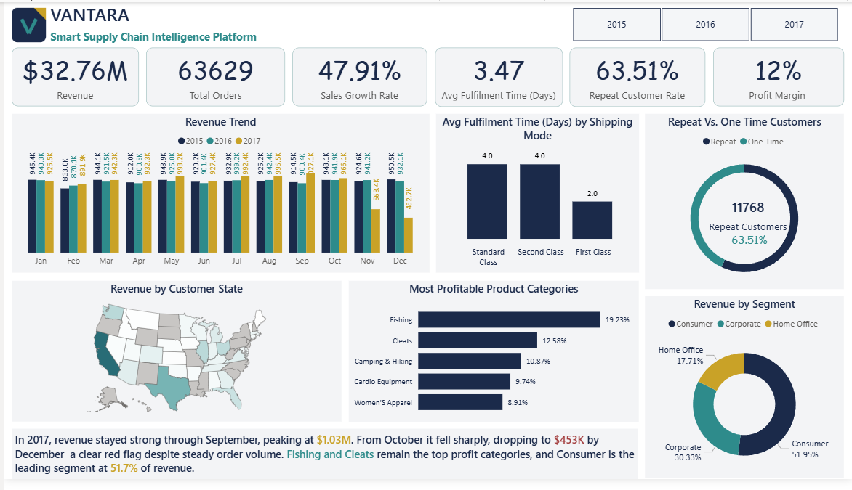
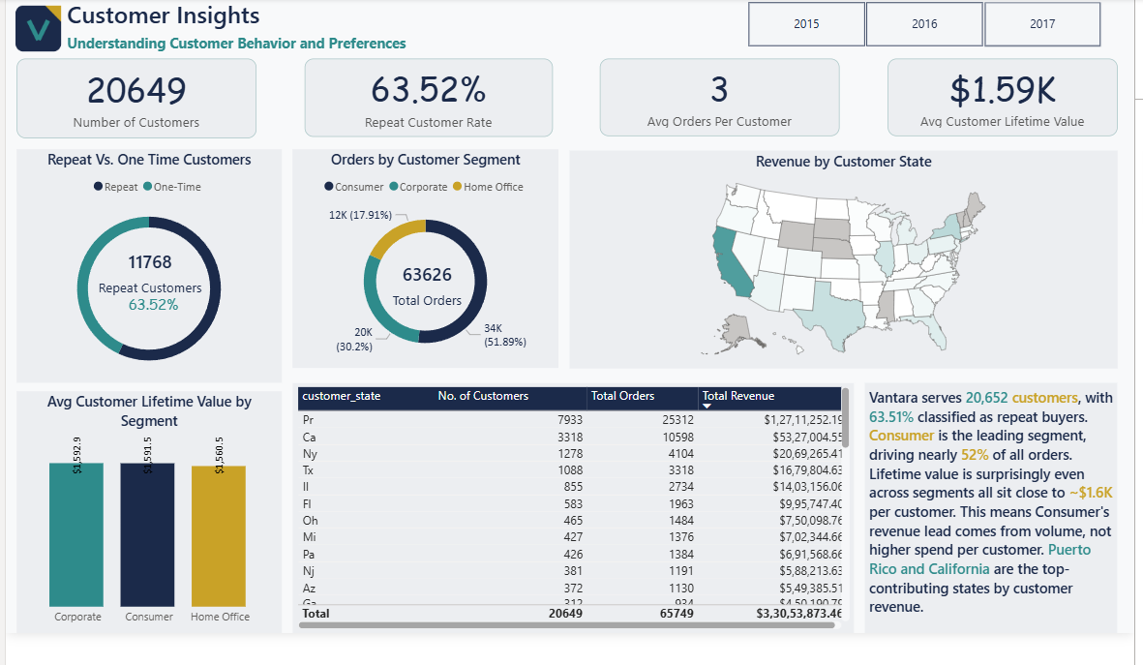
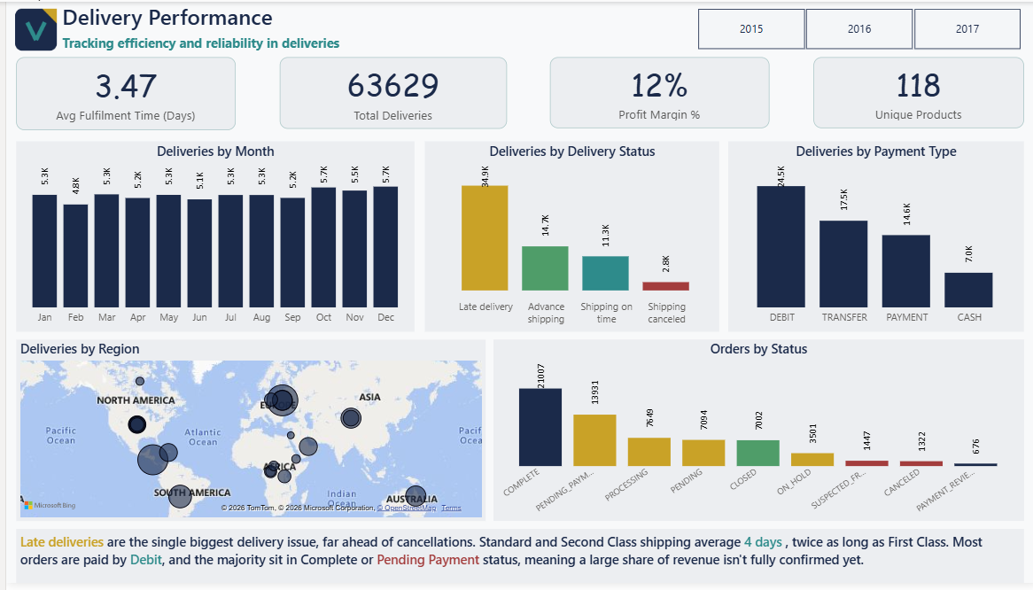
06 — THE DELIVERABLE
Three-Page Power BI Dashboard
Page Preview
Page Preview
Page Preview
Page 1
Page 2
Page 3
Overview
Delivery Performance
Customer Insights
Revenue trend, profit by category, customer loyalty, and regional performance — at a glance.
Fulfilment time, delivery status, payment type, and order status breakdowns.
Customer count, repeat rate, lifetime value by segment, and state-level revenue.
VANTARA · Smart Supply Chain Intelligence
011

Slide 12
VANTARA
Thank You
Full project — SQL queries, Excel model, Power BI dashboard, and documentation — available in the GitHub portfolio repository.
Seema Kumari | Business Analyst
· linkedin
·Github

