Slide 1
DOMAIN : SOCIAL NETWORK
PROJECT : FACEBOOK DATA
DONE BY : SEEMA S B

Slide 2
INTRODUCTION
Now a days people are into many social medias like facebook, twitter, instagram so on. People use it to connect with their family and friends and also to share their views.
The project Facebook Data is collective information considering different parameters.
It gives the idea about what kind of users are on Facebook and also how long they have been using Facebook.

Slide 3
DATASET DESCRIPTION
The dataset has description about information related to the users.
The dataset has 14 numeric data columns and 1 categorical data column .
Every user is differentiated based on the unique value in column userid.
The columns mobile_likes_received and www_likes_received are highly correlated with column likes_received.

Slide 4
COLUMN NAME | DESCRIPTION
Userid | ID of user
Age | User’s age(years)
dob_day | Day of date of birth(1-31)
dob_year | Year of date of birth
dob_month | Month of date of birth
gender | Male / Female
tenure | How long have users been on site (assumed to be days)
friend_count | Total number of friends
friendships_initiated | Friend requests sent
likes | Total number of likes by user
likes_received | Total number of likes received by user
mobile_likes | Number of likes by user(through mobile)
mobile_likes_received | Number of likes received (through mobile)
www_likes | Number of likes (through desktop website)
www_likes_received | Number of likes received (through desktop)

Slide 5
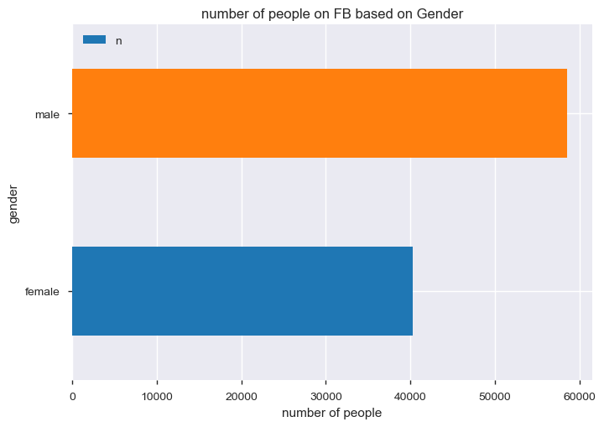
BUSINESS QUESTIONS IDENTIFIED
Question 1: On basis of gender, which gender is more on facebook.
Approach: Grouping data on basis of gender and performing count() on it.
Findings & Visualizations: From the data, it can be found that Male users are more in number.

Slide 6
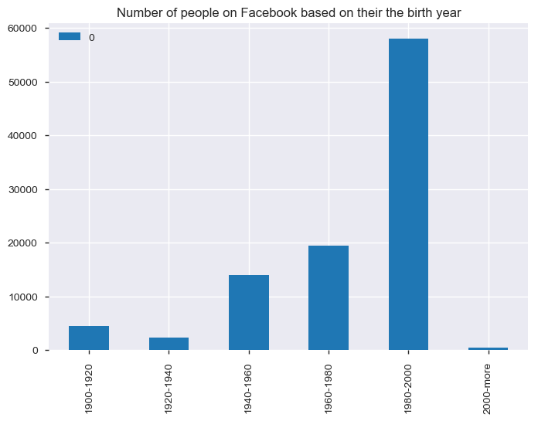
Question 2: Trying to find which age group users are more on facebook.
Approach: Creating a separate Dataframe with class interval of 20 with count of users in that particular age group.
Findings & Visualizations: From the data, it can be found that users in age group 1980-2000 are more on facebook.

Slide 7
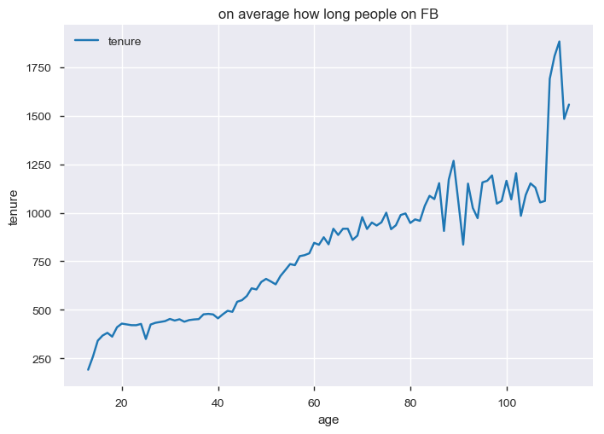
Question 3: On an average, how long users are on facebook based on age.
Approach: Grouping data on basis of age and performing mean() on it. Then plotting a graph of age vs tenure.
Findings & Visualizations: From the data, it can be found that users in age around 110 are more on facebook.

Slide 8
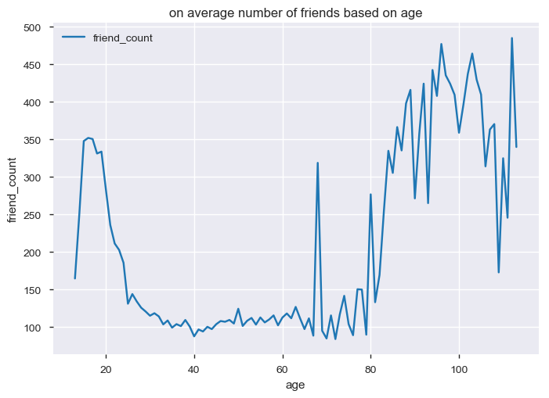
Question 4: On an average, how many friends do users have on facebook based on age.
Approach: Grouping data on basis of age and performing mean() on it. Then plotting graph of age vs friend_count.
Findings & Visualizations: From the data, it can be found that users in age around 110 are have more friends on facebook.

Slide 9
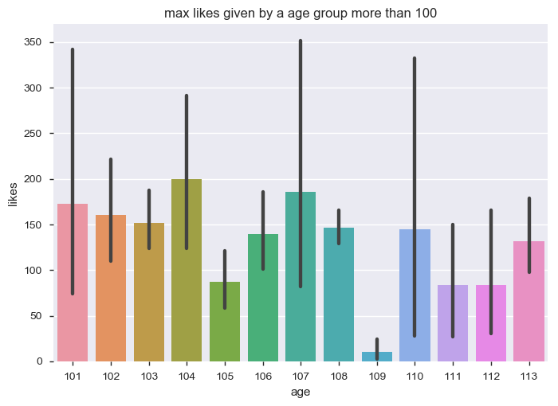
Question 5: In the age group 100 and above, which age has given more likes on facebook.
Approach: Creating a dataframe which has data of only age group 100 and above. Then plotting the graph age vs likes.
Findings & Visualizations: Users in age 104 have given more likes.

Slide 10
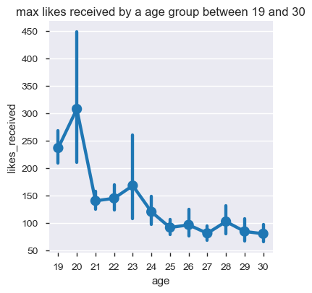
Question 6: In the age group 19 to 30, which age has got more likes on facebook.
Approach: Creating a dataframe which has data of only age group 19 to 30. Then plotting the graph age vs likes_received.
Findings & Visualizations: Users in age 20 have got more likes.

Slide 11
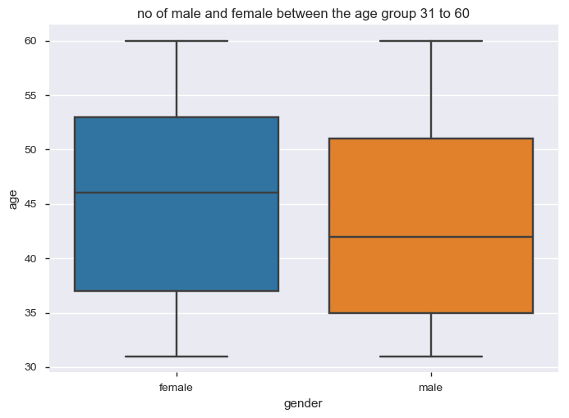
Question 7: In the age group 31 to 60, which gender users are more on facebook.
Approach: Creating a dataframe which has data of only age group 31 to 60. Then plotting the graph gender vs age.
Findings & Visualizations: Female users are more in age group 31 to 60.

Slide 12
Question 8: Trying to find out relation between the variables likes, likes_received, mobile_likes, mobile_likes_received, www_likes, www_likes_received based on gender.
Approach: Plotted pairplot for columns likes, likes_received, mobile_likes, mobile_likes_received, www_likes, www_likes_received using gender.
Findings & Visualizations: From the graph we can see that likes_received, mobile_likes_received, www_likes_received are highly correlated to each other.
Please refer next slide for graph.

Slide 13
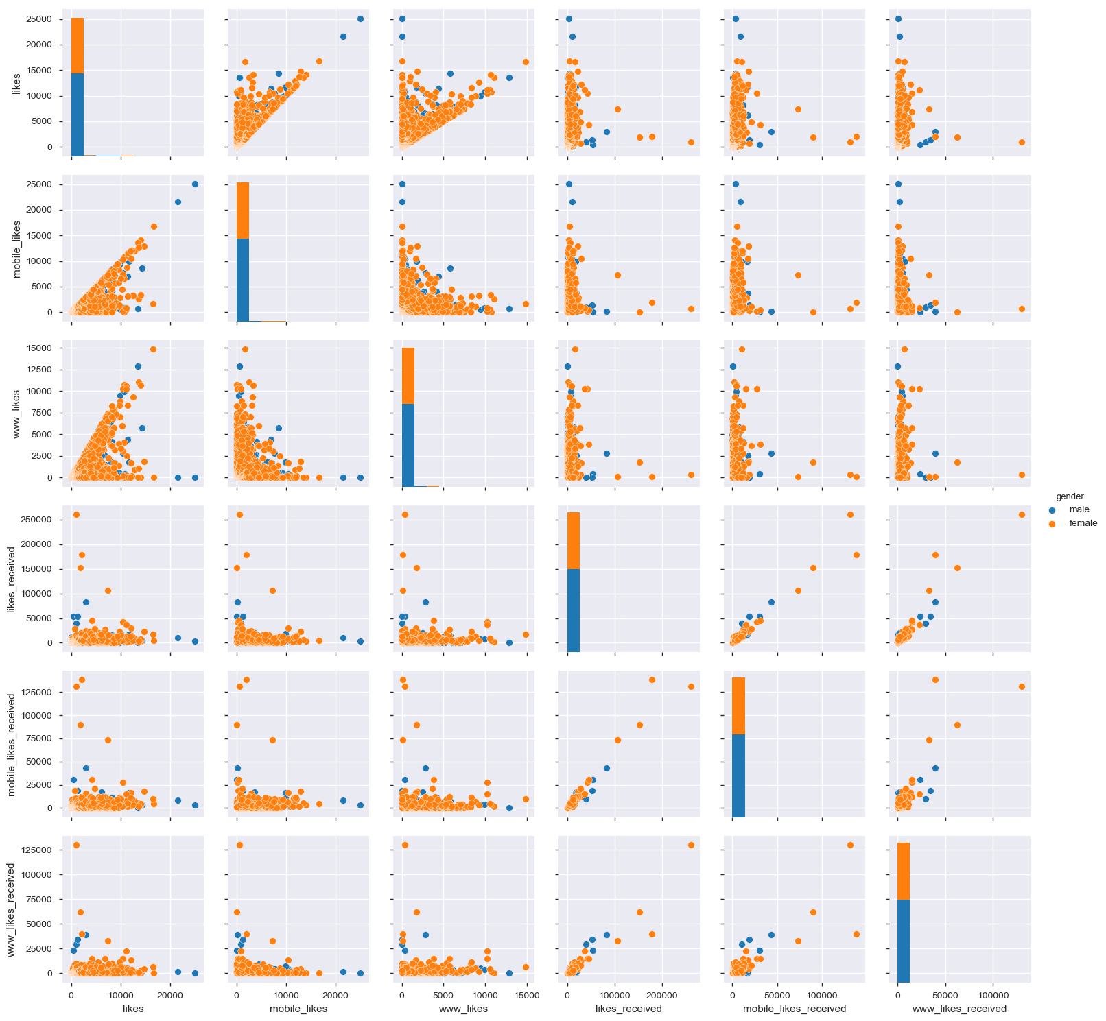

Slide 14
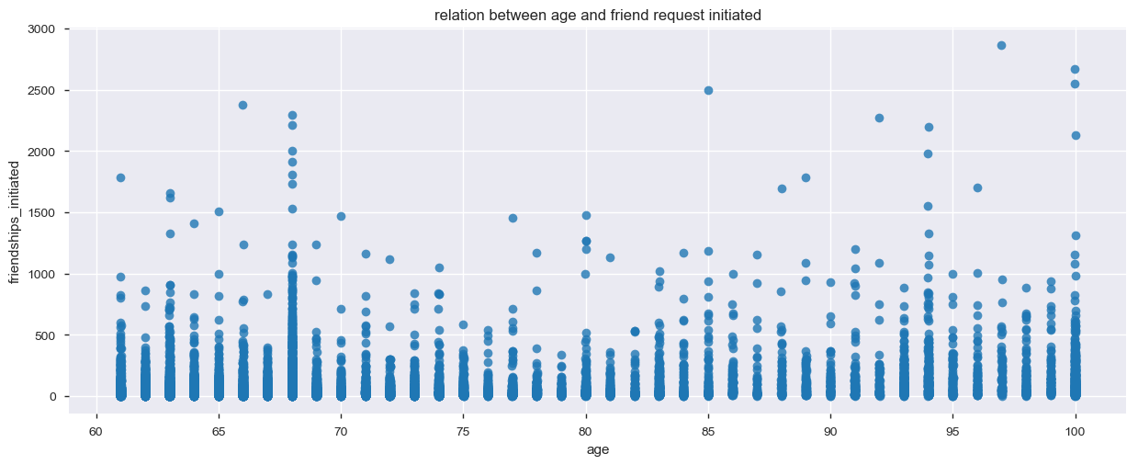
Question 9: In the age group 61 to 100, which age has sent more friend requests on facebook.
Approach: Creating a dataframe which has data of only age group 61 to 100. Then plotting the graph age vs friendships_initiated.
Findings & Visualizations: Users with age 68 has sent more friend request.

Slide 15
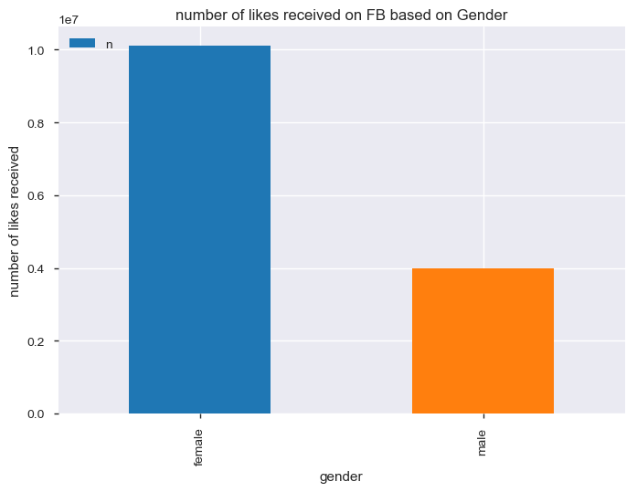
Question 10: Based on gender, which gender has got maximum likes on facebook.
Approach: Creating a dataframe by grouping data based on gender and performing sum() on it.
Findings & Visualizations: Female users have got maximum likes on facebook.

