Slide 1
RAG-POWERED HEALTH INSURANCE ASSISTANT
PolicyGenie
Your AI Copilot for Policy Answers & Claims Pre-Checks
Retrieval-Augmented Generation
ChromaDB
Groq · Llama 3.3 70B
By Seema KsheerSagar
Policy & Claims Copilot Initiative
Notes:
• Introduce PolicyGenie — an AI copilot for policy Q&A + claim pre-checks • Built on a lightweight RAG stack: PDF → ChromaDB → Groq Llama 3.3 70B • Roadmap for today: the problem, how it works, a live demo, then impact

Slide 2






WHY POLICYGENIE
From slow & inconsistent to instant & grounded
TODAY
WITH POLICYGENIE
Long call-center waits for simple questions
Answers grounded only in the policy text
Every claim cited — section + page
Inconsistent answers across agents
Claims pre-checked before submission
Claim errors & delays from missing documents
Free-tier stack — fast & cheap to iterate
PolicyGenie — Policy & Claims Copilot
2
Notes:
• Set up the pain: agents and customers both wait on repetitive coverage questions • Different agents give different answers — no single source of truth • Goal: ground every answer in the actual policy, cite it, and catch claim mistakes early • Keep it on free/cheap tiers so the team can iterate quickly

Slide 3





DEVELOPER STACK
A lean, mostly-free RAG stack
pypdf
nltk
ChromaDB
HF / OpenAI
Groq
Parse the PDF
Sentence chunking
Vector store (cosine)
Embeddings
Llama 3.3 70B inference
PolicyGenie — Policy & Claims Copilot
3
Notes:
• Every stage is a small, swappable, mostly-free library • pypdf for parsing, NLTK for chunking, HF or OpenAI for embeddings • ChromaDB for local vector storage, Groq for fast free-tier inference • Each piece can be swapped later (e.g. Chroma → a managed vector DB) without a rewrite

Slide 4



SYSTEM ARCHITECTURE
How a PDF becomes a cited answer
User Query
Delivered
Policy PDF
Chunk + Embed
ChromaDB
Retrieve Top-K
Groq LLM
Cited Answer
Source document
NLTK + embeddings
Vector store
Cosine similarity
Llama 3.3 70B
Section + page
OFFLINE · INDEX ONCE
ONLINE · EVERY QUESTION
PolicyGenie — Policy & Claims Copilot
4
Notes:
• Two phases: index the policy once (offline), then answer every question (online) • PDF is chunked, embedded, and stored in ChromaDB • Each user question is embedded the same way and matched by cosine similarity • Groq LLM answers strictly from the retrieved chunks and cites section + page

Slide 5

STEP 1 · INGEST & CHUNK
Turning a PDF into clean, tagged chunks
Extract page-by-page
pypdf keeps the page number as metadata
S1
S2
S3
S4
S5
S6
Chunk 1
Detect headings heuristically
Short ALL-CAPS / Title-Case lines → section name
Chunk 2 · overlaps S3, S4
~500 chars / chunk · 2-sentence overlap · page + section kept on every chunk
Chunk with overlap
NLTK groups sentences to ~500 chars, 2-sentence overlap
PolicyGenie — Policy & Claims Copilot
5
Notes:
• pypdf reads the PDF page by page, keeping page numbers as metadata • A simple heuristic (ALL CAPS / Title Case, short line) tags each line with its section — no ML needed • NLTK splits into sentences, groups them to ~500 characters per chunk • 2-sentence overlap between chunks so an idea isn't cut in half at a boundary

Slide 6
STEP 2 · EMBED & STORE
Turning text into searchable vectors
Pick an embedding provider
Store in ChromaDB
Hugging Face (free)
ids
one id per chunk
sentence-transformers/all-MiniLM-L6-v2
embeddings
the numeric vector
OpenAI (paid, cheap)
documents
the original chunk text
text-embedding-3-small — higher quality
metadatas
{ page, section } for citation
One config switch — flip providers without touching the rest of the pipeline.
hnsw:space = “cosine” — similarity search matches meaning, not exact words.
PolicyGenie — Policy & Claims Copilot
6
Notes:
• Embedding provider is swappable: HF MiniLM (free) or OpenAI (paid, better quality) • ChromaDB stores ids, vectors, original text, and { page, section } metadata • It's a persistent local store — no need to re-embed unless the policy changes • Cosine similarity is what powers the retrieval step next

Slide 7

STEP 3 · RETRIEVE & GENERATE
Grounded generation with Groq · Llama 3.3 70B
Retrieve top-K
The prompt contract
Question embedded, matched by cosine similarity — closest chunks return with section + page.
Answer ONLY using the provided context
Assemble context
If it's not in the context, say so — never guess
Each chunk is labeled “[Section, Page]” before being handed to the model.
Cite section + page for every claim
Generate with Groq
Llama 3.3 70B (free tier) answers only from that context, citing every claim.
e.g. (Source: Waiting Periods, p.12)
This contract is what keeps PolicyGenie from hallucinating coverage details.
PolicyGenie — Policy & Claims Copilot
7
Notes:
• User question is embedded with the same model used for the documents • Top-K chunks retrieved by similarity, each tagged with section + page • Groq LLM is instructed to answer only from context and cite sources, or say it doesn't know • This prompt contract is the key guardrail against hallucinated coverage answers

Slide 8
DEVELOPER STACK
Simple RAG App — Health Insurance Policy Assistant
A friendly Retrieval-Augmented Generation (RAG) pipeline.
Pipeline:
Read a PDF (pypdf)
Semantic-ish chunking using nltk (group sentences into chunks)
Create embeddings — choose either the free Hugging Face Inference API (sentence-transformers/all-MiniLM-L6-v2) or OpenAI (text-embedding-3-small, paid)
Store chunks + embeddings + metadata in ChromaDB (local, persistent)
Retrieve Top-K similar chunks using cosine similarity
Generate an answer using Groq — Llama 3.3 70B Versatile (free tier)
Note: Groq does not provide embedding models — it's an LLM inference API only. So embeddings come from Hugging Face (free) or OpenAI (paid, your choice — see Step 1), and Groq is used purely for the final answer generation.
PolicyGenie — Policy & Claims Copilot
Notes:
• Every stage is a small, swappable, mostly-free library • pypdf for parsing, NLTK for chunking, HF or OpenAI for embeddings • ChromaDB for local vector storage, Groq for fast free-tier inference • Each piece can be swapped later (e.g. Chroma → a managed vector DB) without a rewrite

Slide 9
DEVELOPER STACK
Environment Setup
Step 1 - Install Packages
!pip -q install chromadb groq pypdf nltk requests
nltk.download("punkt", quiet=True)
nltk.download("punkt_tab", quiet=True)
Step 2 - Imports and Configuration
import os
import re
import requests
import nltk
import chromadb
from pypdf import PdfReader
from groq import Groq
nltk.download("punkt")
nltk.download("punkt_tab")
# ---- PASTE KEYS HERE (or set as environment variables) ----
from google.colab import userdata
os.environ["HF_TOKEN"] = userdata.get('HF_TOKEN')
os.environ["GROQ_API_KEY"] = userdata.get('GROQ_API_KEY')
os.environ["OPENAI_API_KEY"] = userdata.get('OPENAI_API_KEY') # only needed if EMBEDDING_PROVIDER = "openai"
HF_TOKEN = os.environ["HF_TOKEN"]
GROQ_API_KEY = os.environ["GROQ_API_KEY"]
OPENAI_API_KEY = os.environ["OPENAI_API_KEY"]
PolicyGenie — Policy & Claims Copilot
3
Notes:
• Every stage is a small, swappable, mostly-free library • pypdf for parsing, NLTK for chunking, HF or OpenAI for embeddings • ChromaDB for local vector storage, Groq for fast free-tier inference • Each piece can be swapped later (e.g. Chroma → a managed vector DB) without a rewrite

Slide 10
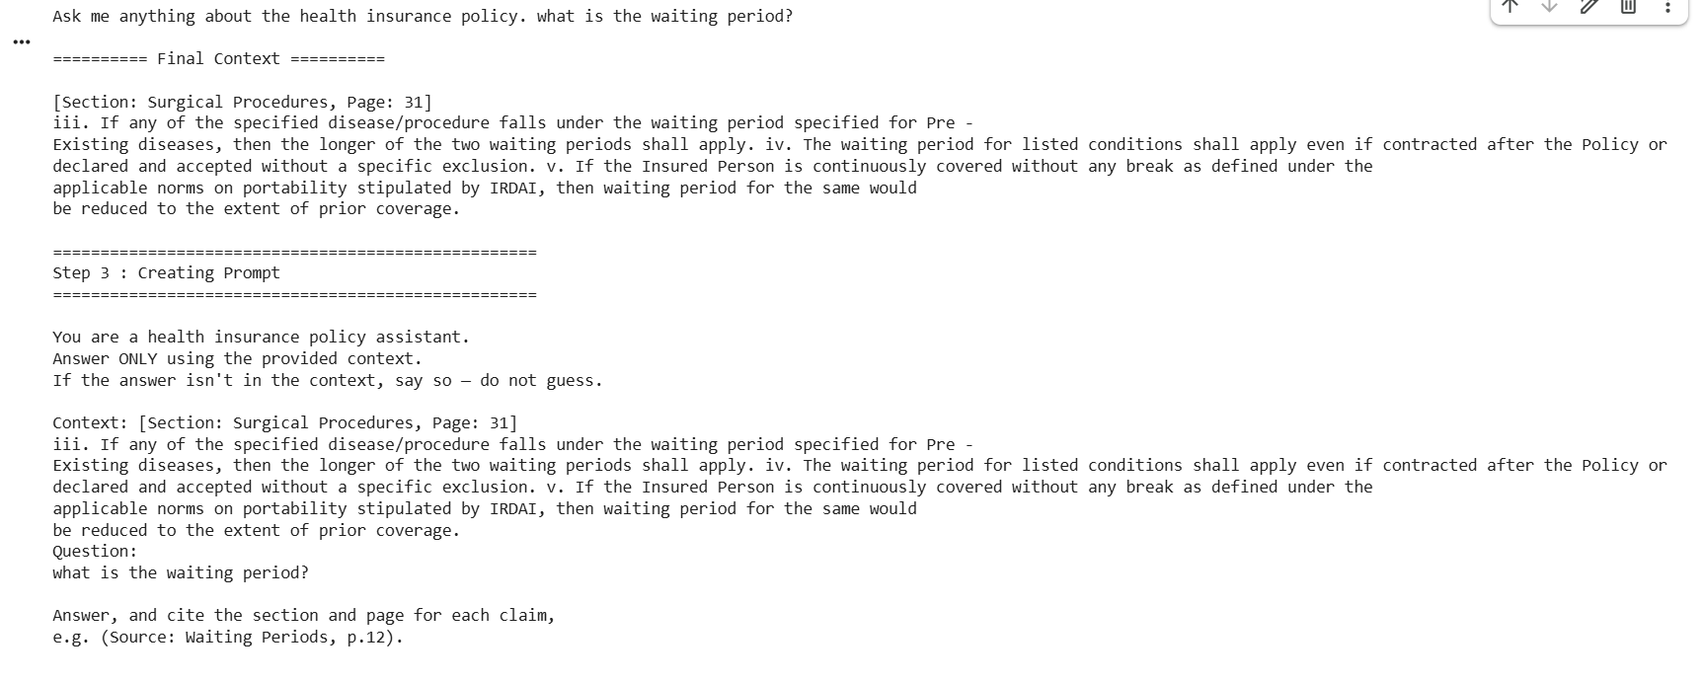
LIVE DEMO
Ask a question, get a cited answer
What is the waiting period for pre-existing diseases?
PolicyGenie — Policy & Claims Copilot
8
Notes:
• Walk through this live example (or run a real query if time allows) • Point out the answer is structured, numbered, and easy to act on • Highlight the citation — traces directly back to the ingested PDF, not memorized

Slide 11
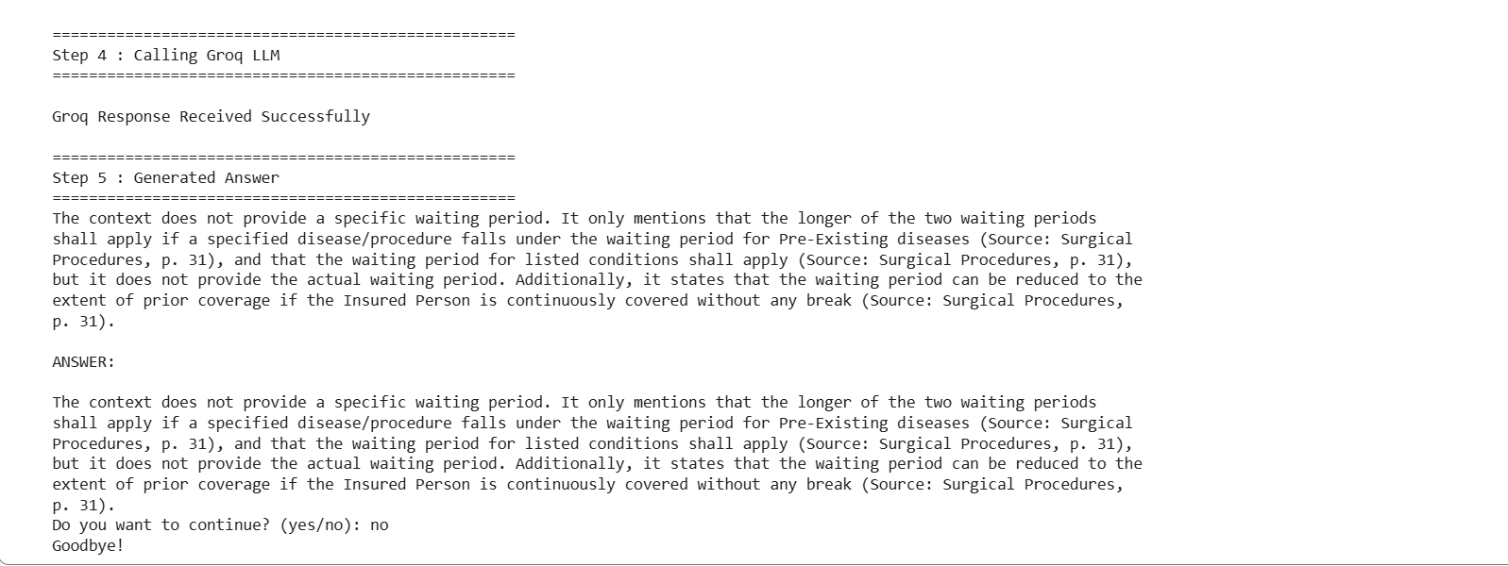
LIVE DEMO
PolicyGenie — Policy & Claims Copilot
8
Notes:
• Walk through this live example (or run a real query if time allows) • Point out the answer is structured, numbered, and easy to act on • Highlight the citation — traces directly back to the ingested PDF, not memorized

Slide 12
IMPACT
What PolicyGenie delivers
Instant, grounded answers
Lighter call-center load
First-time-right claims
Cheap & fast to iterate
Thank You
Questions & Discussion
Notes:
• Faster answers, lighter call-center load, first-time-right claims • Every answer is traceable to a section + page — builds trust • Cheap to run and fast to iterate — a solid foundation for future features • Open the floor for questions

