Slide 1



Agri-Tech
Farm Water Management
IITM & GL – ACSE Oct’21
Final Capstone Demo and Presentation - Oct 2022
By Sundar Rajan Ganesan & Seema Nair (IoT-Group2)

Slide 2
Agenda
Architecture
Components used in this Project
Data Model
Edge Computing
Solution Files
Project Structure
Thresholds
Business Logic
Graphical Dashboard
Questions?

Slide 3


















Architecture
Update sensor group config with initial setting (one-time).
Read sensor config.
Send sensor Latitude & Longitude and get Air Temperature, Air Humidity & Rain data from Open Weather API.
Send this raw data Soil Temperature, Soil Moisture, Air Temperature, Air Humidity and Rain data to Topic iot/agritech.
Push Raw Data to RawDataTable.
Push Raw Data to Kinesis Data Stream.
Get Raw Data and execute Lambda function.
Log Anomaly State, Actuator State and Rain forecast for sensor group (each of four sensors) in Anomaly Table.
Once all four sensors for an actuator have logged anomalies , determine if sprinkler has to be turned on(1) or off(0), send payload to iot/actuatorstat topic for actuator simulator to receive command to turn sprinkler on or off.
Store data from step 9 in SprinklerDataTable.
Update sensor config with new setting.
Send Raw Data for analytics and for Graphical Representation of Sensor Data to Node-Red
Send Place, Severity Levels and Actuator State for display on Dashboard (UI)
Data
Analysis Layer
13
END to END FLOW
Node Red UI
12
Data Processing Layer
AWS Cloud
7
6
10
5
Data
Storage Layer
8
SprinklerDataTable
AnomalyTable
RawDataTable
9
Data Ingestion Layer
AWS IoT Core
IoT policy
IoT certificates
IoT rules
iot/actuatorstat
iot/agritech
4
Topics
Device
Layer
11
Sensor config.
2
3
Sprinklers
(Actuators)
Sensors
Python Actuator Simulators
Python Sensor Simulators
External Integration
1

Slide 4


Components Used in this Project
 | AWS IAM | To Create AgriTechRole and LambdaRole. AgriTechRole is used for S3 and IoT. LambdaRole is used for Lambda Function execution.
 | Amazon S3 | S3 bucket sniotg2 for auto-provisioning of devices on the cloud. Provisioning template is used and bulk registration done.
 | AWS IoT Core | During bulk-registration, IoT things, groups, thing types (Actuator, Sensor) are created. Certificates & Policies are attached. Simulator code for sensor publishes to MQTT topic iot/agritech & Lambda function publishes to MQTT topic iot/actuatorstat. Rules are also configured for lambda functions execution.
 | Kinesis Data Stream | AgriTechDataStream Streams Raw Data to AnomalyFunction. Sensor data is a large stream of real time data which needs to tracked and processed for detecting anomalies near real time
 | AWS Lambda Functions | Two Lambda functions are used, one to store raw data to RawDataTable and other to process sensor group anomalies and publish actuator command to MQTT topic iot/actuatorstat.
 | Dynamo DB Tables | Three tables used. Data Model on next slide.
 | Node-Red | Node-Red UI is used for Graphical representation of Sensor Status, Senor Group Anomaly State and Sprinkler Status on the UI.
 | SQLite DB | SQLite DB is used to store Sensor Group Config data. SQLite is a lightweight disk-based database that doesn’t require a separate server process and allows accessing the database using a nonstandard variant of the SQL query language

Slide 5
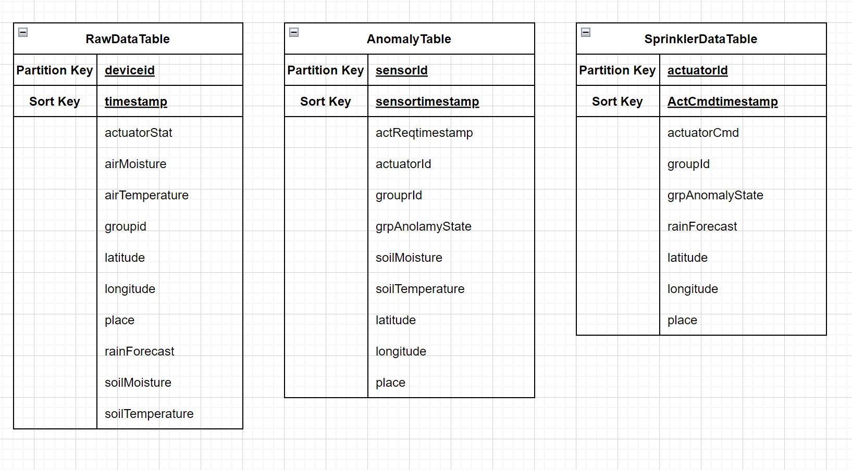
Data Model

Slide 6
Edge Computing
Components and External Integrations
 | Sensor Group Configuration Database | Column | Description
 | Sensor Group Configuration Database | DEVICE ID | Id of the Sensor device
 |  | GROUP ID | Sensor Group Id
 |  | LAT | Latitude value for sensor group
 |  | LONG | Longitude value for sensor group
 |  | LOCATION | Place value for sensor group
 |  | CONTROL ID | Group Anomaly State (Severity level)
 |  | ACTUATOR STATUS | Actuator Status ON (1) or OFF (0)
 | Open Weather Map API Integration | Returns the Weather data for given sensor group latitude and longitude values.
sensor_group_config

Slide 7
Solution Files
Code File | Notes
bulkregistration.py config.py main.py general-policy.json provisioning-data.json provisioning-template.json | Device onboarding (bulk registration process)
senor_grp_config.py | Generates the initial SQLite config database
soil_sensor_grp_publish.py | Sensor Simulator. (Publisher) Also fetches Air Temperature, Air Moisture and Rain forecast from Open Weather Map.
actuator_stat_subscribe_grp.py | Sprinkler Simulator. (Subscriber) Subscribes to the topic iot/actuatorstat and updates the sensor group config (SQLite db).
AnomalyFunction.py | Lambda Function - code to be added to code section after creating AWS Lambda function.
RawDataStorageFunction.py | Lambda Function - code to be added to code section after creating AWS Lambda function.
node_red_dashboard_ui.json | JSON file that can be imported into a Node-Red UI
AgriTech_Windows_CopyFileProgram.py AgriTech_Windows_StartSimulation.py | Utility Files for Windows OS to make copying of certificates and running of simulators faster.
README.md | Readme file with step by step explanation of the project setup and execution.

Slide 8
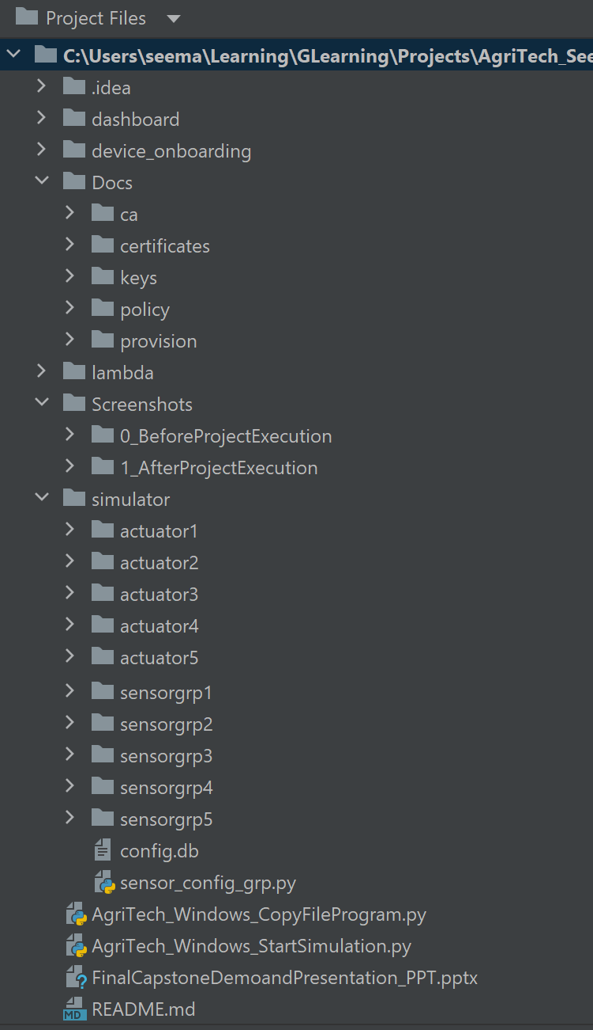
Project Structure

Slide 9







Thresholds
 | Soil Temperature | Soil Moisture | Weather Forecast | Severity Level | Sprinkler Command
 | < 20 | 86-100 |  | 0-Normal | OFF
 | < 20 | 86-100 | No Rain | 0-Normal | OFF
 | 20-25 | 75-86 |  | 4-Low | OFF
 | 20-25 | 75-86 | No Rain | 4-Low | ON
 | 25-30 | 60-74 |  | 3-Medium | OFF
 | 25-30 | 60-74 | No Rain | 3-Medium | ON
 | 30-35 | 45-49 |  | 2-High | OFF
 | 30-35 | 45-49 | No Rain | 2-High | ON
 | >=35 | 30-44 |  | 1-Critical | OFF
 | >=35 | 30-44 | No Rain | 1-Critical | ON

Slide 10
Business Logic
Incoming Sensor ‘n’ reading along with weather forecast
Get Actuator Status for all four sensors in the group for voting
Does weather forecast Rain?
Yes
No
Has sensor group voted to turn sprinkler off
(Vote<1)
?
Has sensor group voted to turn sprinkler on
(Vote>=3)
?
Yes
No
Yes
No
Command to Turn OFF the Sprinkler
Store Actuator Status and Max-Severity in sensor group config
Command to Turn On the Sprinkler

Slide 11
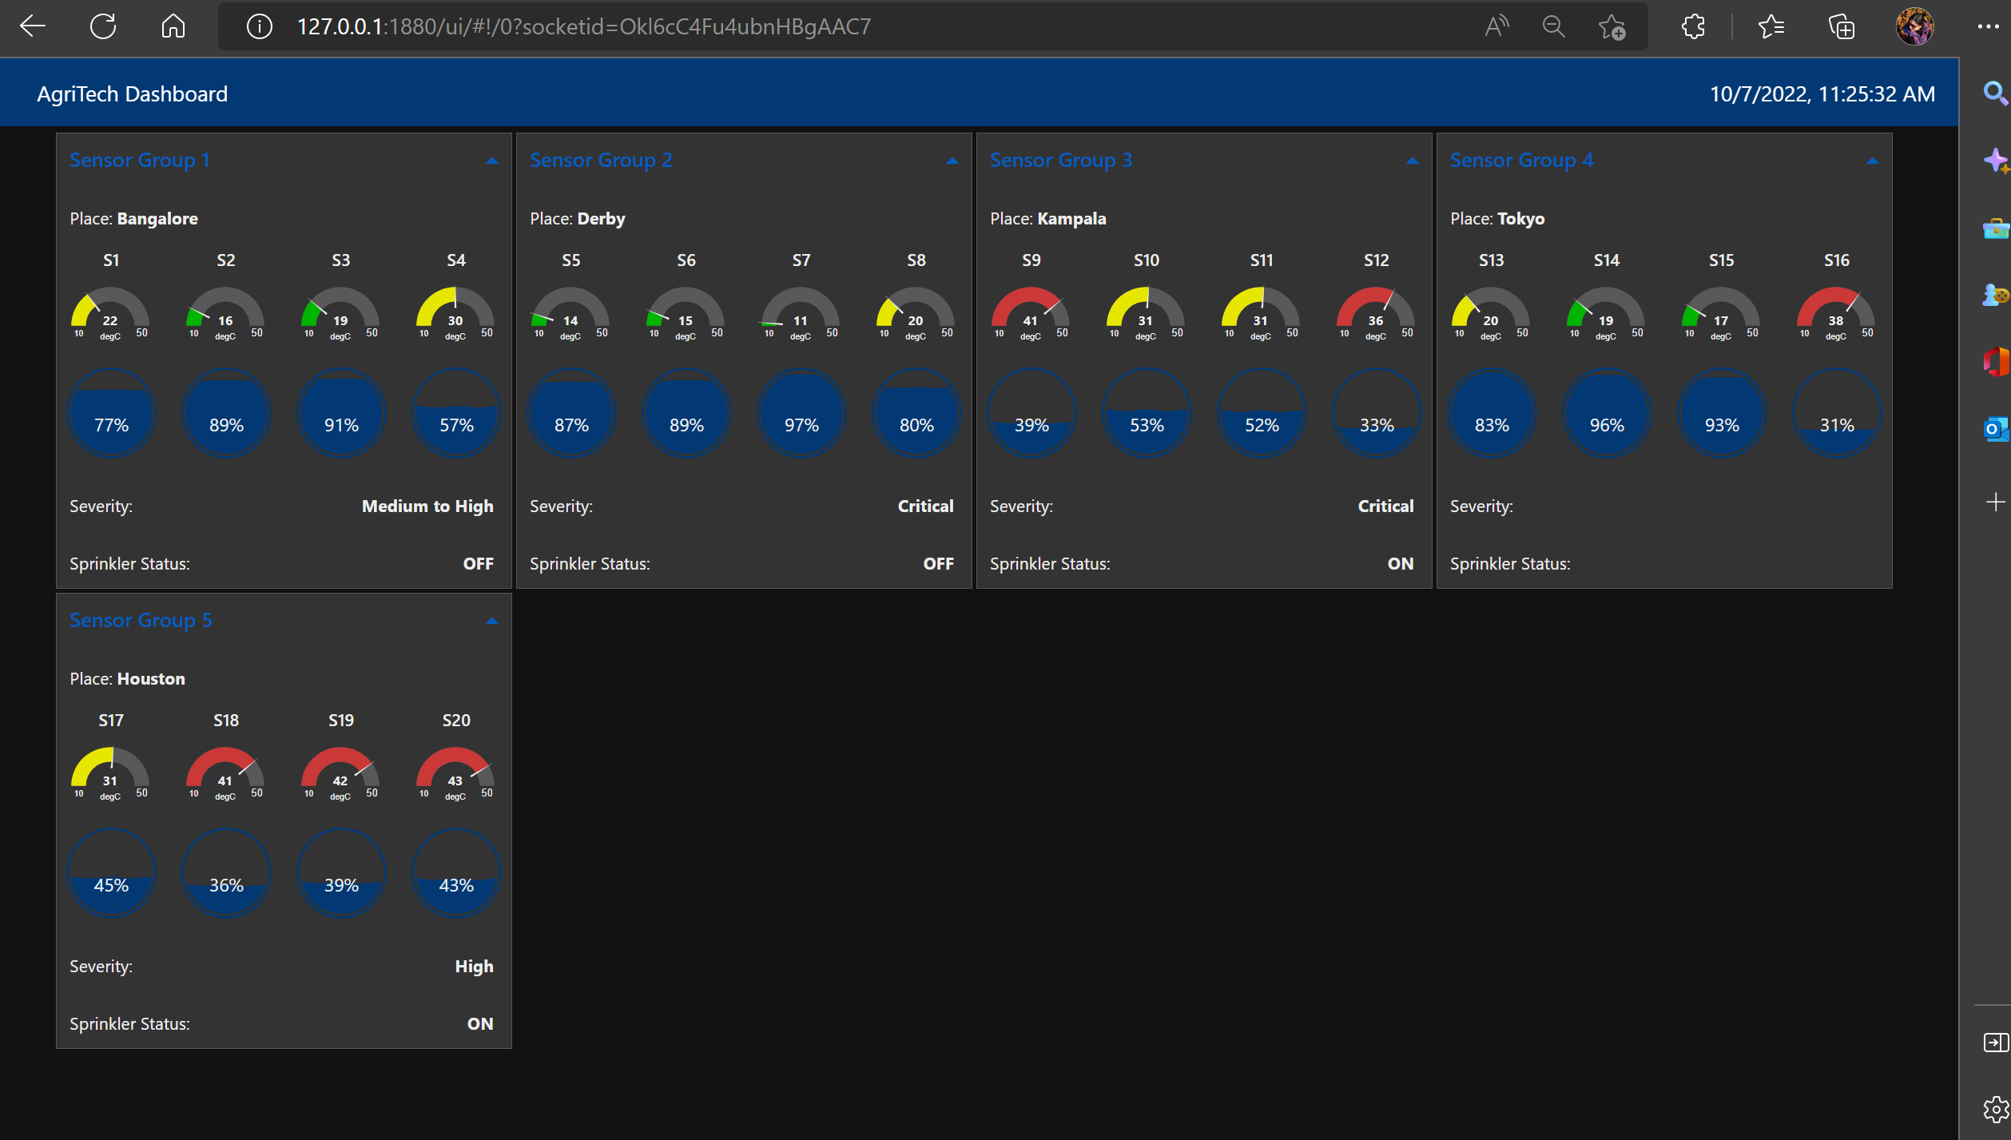
Graphical Dashboard (Node-Red UI)

Slide 12
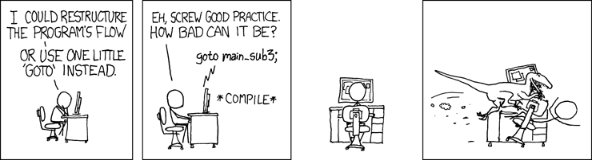
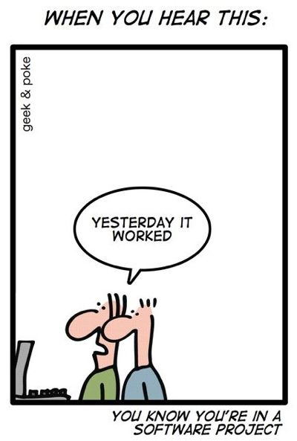

Questions?
Image src
Image src
This Photo by Unknown Author is licensed under CC BY-NC

Slide 13
Thank You.

