Slide 1
Thorpe
Status - ARCore 90-Degree Image Rotation Bug
MEMBER
James/Nick/Billy
DATE
Nov / 18, 2025

Slide 2
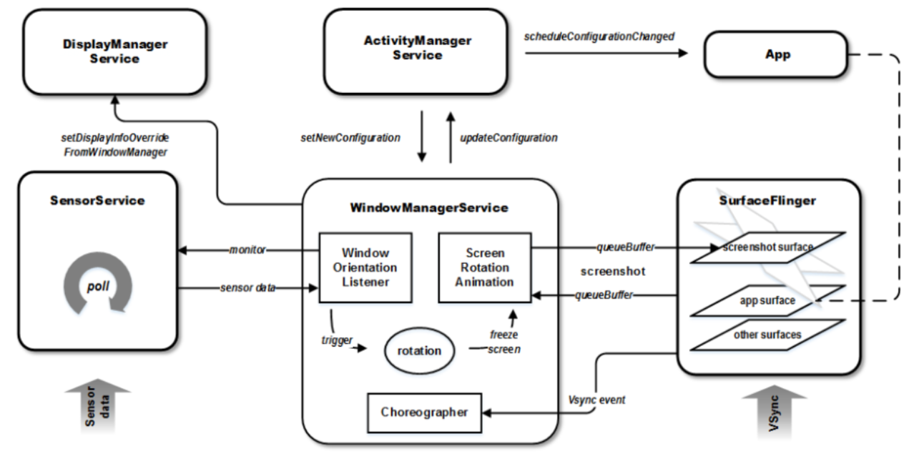
Background
 |  |  |  |  | Android Launcher | Sanpdragon Camera |  |  | ARCore CamCal
Case | android.lens.poseRotation (x,y,x,w) | device tree camera sensor yaw/picth/roll (android.sensor.orientation) | DisplayRotation.java | ro.surface_flinger.primary_display_orientation | UI | UI | Stream | Still Image | UI | Stream
1 | [0,0,0,1] |  | ROTATION_0 | ORIENTATION_0 (IDP) | Portrait | Portrait | Portrait | Landscape | Landscape | Landscape
2 | [0,0,0,1] | roll= 0, pitch=0, yaw=180 | ROTATION_0 | ORIENTATION_90(Thorpe) | Landscape | Landscape | Landscape | Landscape | Landscape | Portrait
3 | [0,0,0,1] | roll= 0, pitch=0, yaw=180 | ROTATION_0 | ORIENTATION_90 | Landscape | Landscape | Landscape | Landscape | Landscape | Portrait
4 | [0,0,0,1] | roll= 90, pitch=0, yaw=180 | ROTATION_0 | ORIENTATION_90 | Landscape | Landscape | Portrait | Portrait | Landscape | Portrait
5 | [0,0,0,1] | roll= 0, pitch=90, yaw=180 | ROTATION_0 | ORIENTATION_90 | Landscape | Landscape | Landscape | Landscape | Landscape | APP fail
6 | [0,0,0,1] | roll= 0, pitch=0, yaw=270 | ROTATION_0 | ORIENTATION_90 | Landscape | Landscape | Landscape | Landscape | Landscape | APP fail
7 | [0,0,0,1] | roll= 0, pitch=90, yaw=270 | ROTATION_0 | ORIENTATION_90 | Landscape | Landscape | Landscape | Landscape | Landscape | APP fail
8 | [0,0,0,1] | roll= 0, pitch=0, yaw=180 | ROTATION_0 | ORIENTATION_0 | Landscape | Landscape | Portrait | Landscape | Landscape | Landscape
9 | [0,0,0.707,0.707] | roll= 0, pitch=0, yaw=180 | ROTATION_0 | ORIENTATION_90 | Landscape | Landscape | Landscape | Landscape | Landscape | Portrait
10 | [0,0,0,1] | roll= 90, pitch=0, yaw=180 | ROTATION_90 | ORIENTATION_0 | Landscape | Portrait | Landscape | Landscape | Landscape | Landscape
New solution
Mainline

Slide 3
Mainline: Original Baseline
ro.surface_flinger.primary_display_orientation=ORIENTATION_90
  The SurfaceFlinger defined the internal display’s natural orientation as 90°
AR core camera calibration fail (90 degree)

Slide 4
Status | Description
Mainline | Original setup using system property ro.surface_flinger.primary_display_orientation=ORIENTATION_90
Solution | Set ro.surface_flinger.primary_display_orientation=ORIENTATION_0 adjust sensor, touch, and camera XY orientation to align with portrait as the natural orientation Add +90° offset on top of Phase 2 with animation and framework-level configuration 3.1 Change window Manager Service Change wm/DisplayRotation.java code Set NATURAL_ROTATION (default coordinate system) as Surface.ROTATION_90 Set "def_user_rotation" as 1 3.2 Change setup wizard direction 3.3 Change launcher direction 3.4 Change Boot Animation

Slide 5
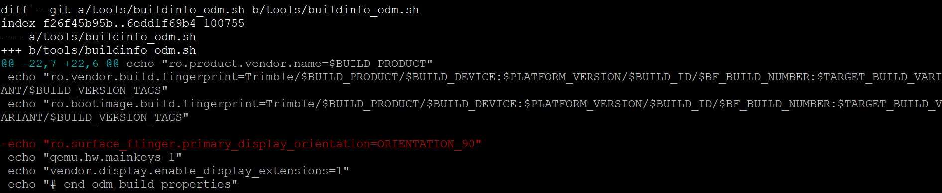
#1 Set ro.surface_flinger.primary_display_orientation=ORIENTATION_0
Reverted system property:
  ro.surface_flinger.primary_display_orientation (removed)

Slide 6
#2 adjust sensor, touch, and camera XY orientation to align with portrait as the natural orientation
Purpose:
  Sensor HAL: Swap X/Y axes to treat portrait as the natural reference
  Touch Input: Coordinate remap (X↔Y)
  Camera HAL: Ensure sensorOrientation and displayRotation match the logical portrait mode
Result:
  System and hardware behave consistently as if portrait = ROTATION_0
Path: /LINUX/android/build/make

Slide 7
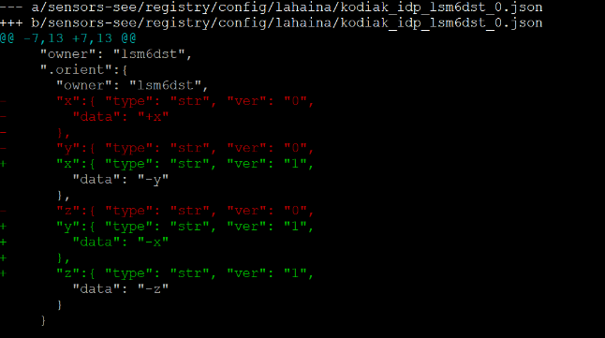
#2 adjust sensor, touch, and camera XY orientation to align with portrait as the natural orientation
(2-1) Adjusted the following:
  Sensor HAL: Swap X/Y axes to treat portrait as the natural reference

Slide 8
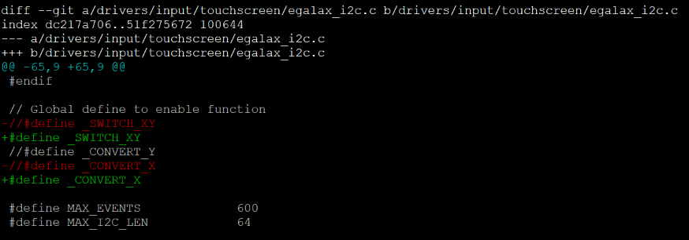
#2 adjust sensor, touch, and camera XY orientation to align with portrait as the natural orientation
(2-2) Adjusted the following:
  Touch Input: Coordinate remap (X↔Y)

Slide 9
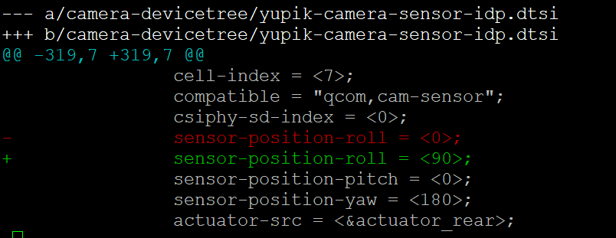
#2 adjust sensor, touch, and camera XY orientation to align with portrait as the natural orientation
(2-3) Adjusted the following:
  Camera HAL

Slide 10
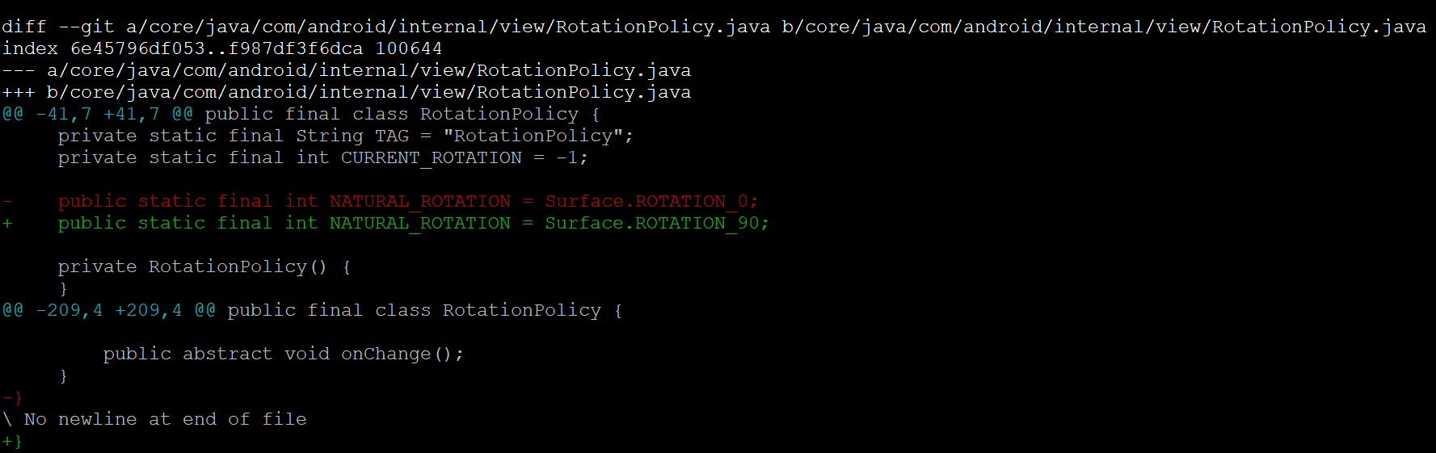
#3 Add +90° offset
3.1 Change window Manager Service
  A. RotationPolicy.java

Slide 11
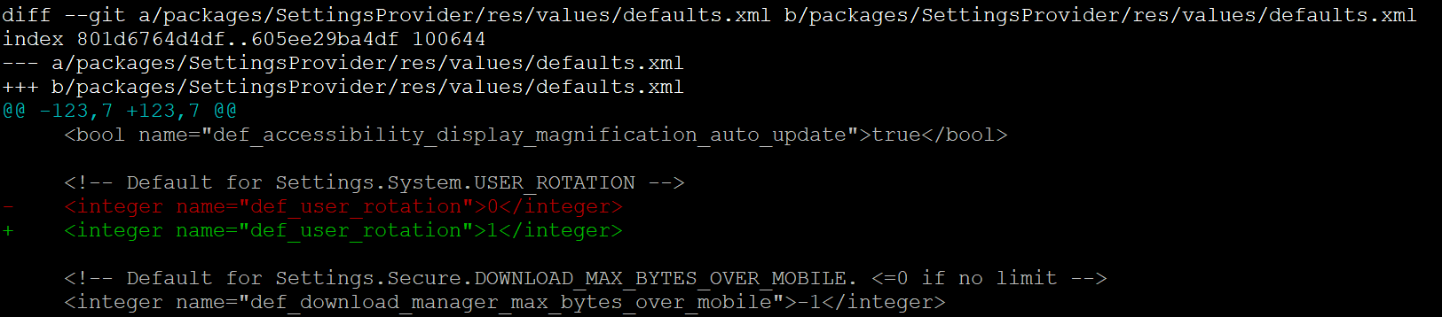
3. Add +90° offset
3.1 Change window Manager Service
  B. SettingsProvider defaults.xml
Path: /QCM6490_apps_qssi15/LINUX/android/frameworks/base
Result:

Slide 12
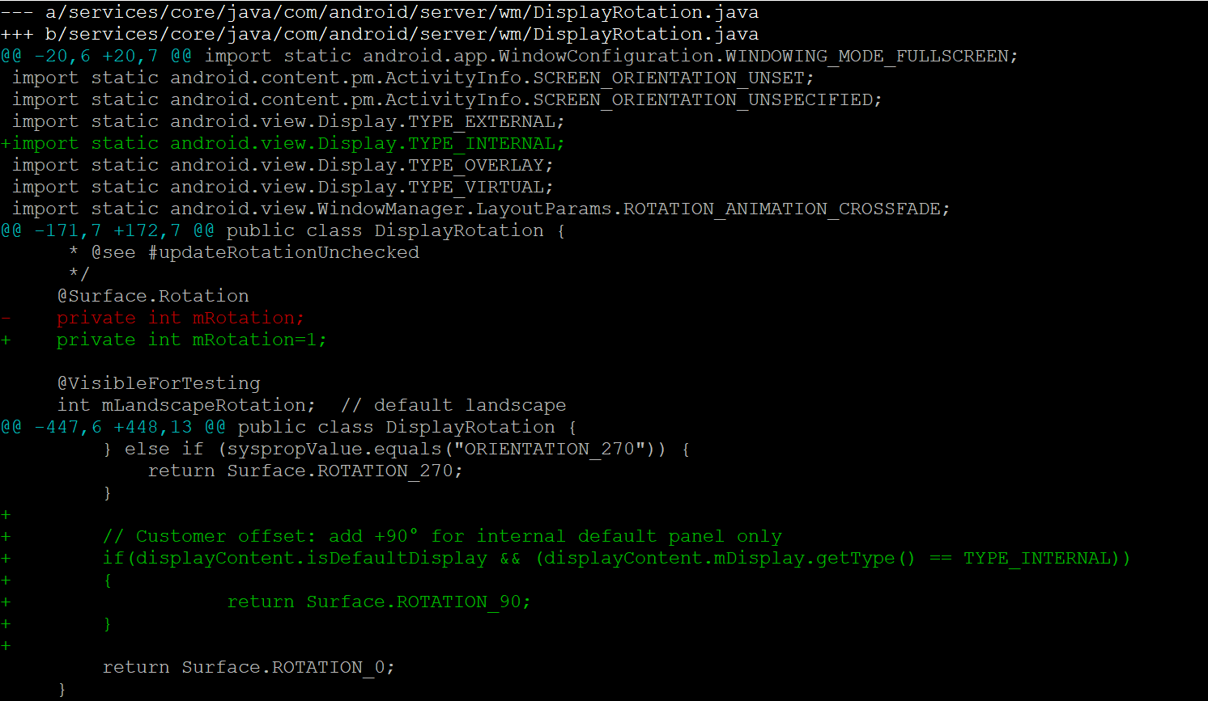
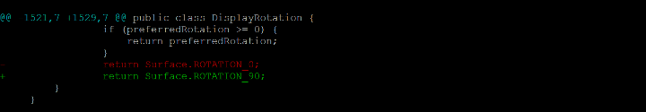
3. Add +90° offset
3.1 Change window Manager Service
  C. DisplayRotation.java

Slide 13
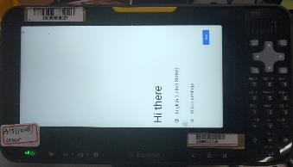
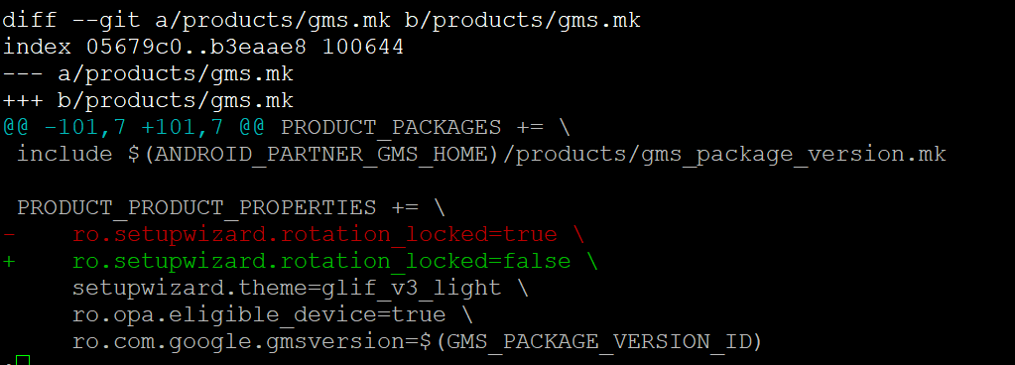
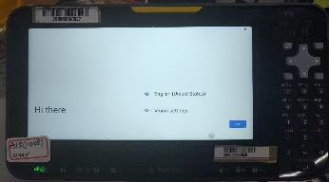
3. Add +90° offset
3.2 Change setup wizard direction
  Default launcher orientation: Landscape
ro.setupwizard.rotation_locked=true
Path: /QCM6490_apps_qssi15/LINUX/android/vendor/partner_gms
ro.setupwizard.rotation_locked=false

Slide 14
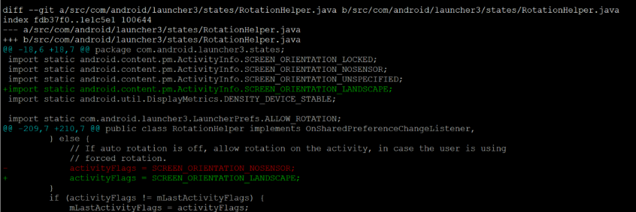
3. Add +90° offset
3.3 Change launcher direction
  Default launcher orientation: Landscape
  Behavior:
    Home rotation OFF: Always landscape
    Home rotation ON: Follows sensor

Slide 15
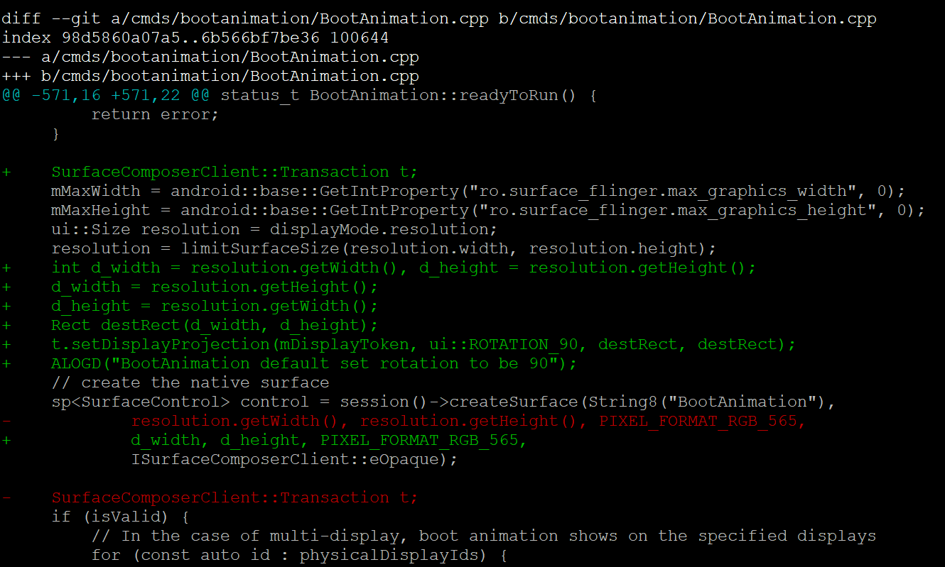
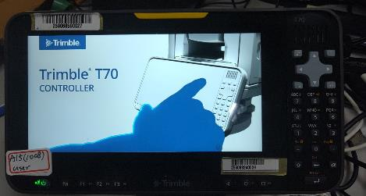
3. Add +90° offset
3.4 Change Boot Animation
  Ensures smooth user experience on screen rotation events

Slide 16
#3 Validation Checklist – (v20251107)
Category | Validation Step | Expected Result
Boot | Power on SetupWizard | Default 90° offset portrait behavior shown | PASS
Home Screen | Auto Rotation OFF | Fixed landscape | PASS
 | Auto Rotation ON | Follows sensor | PASS
Touch Input | function test | Matches point | PASS
Camera | Auto Rotation OFF | UI | PASS
 |  | Streaming | PASS
 |  | Still Image | PASS
 | Auto Rotation ON | UI | FAIL
 |  | Streaming | FAIL
 |  | Still Image | FAIL
External Display | HDMI/Virtual Display | Show original view | PASS
Boot Animation | App rotation | Default 90° offset portrait behavior shown | PASS

Slide 17
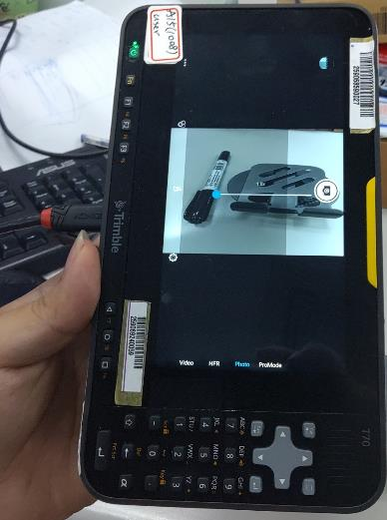
#3 Validation Checklist – (v20251107)
Camera UI, Streaming and Still image abnormal when Auto Rotation is ON

Slide 18
#3 Validation Checklist – (v20251112)
 |  | 202511120447_thorpe_dev_arcore
Test Case | Description | Result | Comment
Boot Animation |  | Pass
Setup Wizard orientation | Power on SetupWizard | Pass
Home Screen | Auto Rotation OFF | Pass
Home Screen | Auto Rotation ON | Pass
Touch Input | function test | Pass
Display autorotation |  | Pass
ARCORE app |  | Pass
Snapdragon camera app stream | Auto Rotation OFF | Pass
Snapdragon camera app still image | Auto Rotation OFF | Pass
Snapdragon camera app UI | Auto Rotation OFF | Pass
Snapdragon camera app video | Auto Rotation OFF | Pass
Snapdragon camera app video mode UI | Auto Rotation OFF | Pass
Snapdragon camera app stream | Auto Rotation ON | Pass | Fixed it in Landscape UI
Snapdragon camera app still image | Auto Rotation ON | Pass | Rotatable
Snapdragon camera app UI | Auto Rotation ON | Pass | Fixed it in Landscape UI
Snapdragon camera app video | Auto Rotation ON | Pass | Fixed it in Landscape UI
Snapdragon camera app video mode UI | Auto Rotation ON | Pass | Fixed it in Landscape UI
third-party camera app stream | Auto Rotation OFF | Pass
third-party camera app still image | Auto Rotation OFF | Pass
third-party camera app UI | Auto Rotation OFF | Pass
third-party camera app video | Auto Rotation OFF | Pass
third-party camera app video mode UI | Auto Rotation OFF | Pass
third-party camera app stream | Auto Rotation ON | Pass
third-party camera app still image | Auto Rotation ON | Pass
third-party camera app UI | Auto Rotation ON | Pass
third-party camera app video | Auto Rotation ON | Pass
third-party camera app video mode UI | Auto Rotation ON | Pass
Display Port |  | Pass
Youtube player |  | Pass
External Display(Vysor) | Virtual Display | Pass
Screenshot Orientation (Recent button) |  | Fail
THRPI-203 : Display Will rotate 90 degrees in the photo editing screen |  | Fail | portrait view
THRPI-210: QR Reader App (built-in) is rotated to Portrait |  | Fail | portrait view

Slide 19
#3 Validation Checklist –
(v20251127)
 |  | 202511270355_thorpe_dev_arcore
Test Case | Description | Result | Comment
Boot Animation |  | Pass
Setup Wizard orientation | Power on SetupWizard | Pass
Home Screen | Auto Rotation OFF | Pass
Home Screen | Auto Rotation ON | Pass
Touch Input | function test | Pass
Display autorotation |  | Pass
ARCORE app |  | Pass
Snapdragon camera app stream | Auto Rotation OFF | Pass
Snapdragon camera app still image | Auto Rotation OFF | Pass
Snapdragon camera app UI | Auto Rotation OFF | Pass
Snapdragon camera app video | Auto Rotation OFF | Pass
Snapdragon camera app video mode UI | Auto Rotation OFF | Pass
Snapdragon camera app stream | Auto Rotation ON | Pass | Fixed it in Landscape UI
Snapdragon camera app still image | Auto Rotation ON | Pass | Rotatable
Snapdragon camera app UI | Auto Rotation ON | Pass | Fixed it in Landscape UI
Snapdragon camera app video | Auto Rotation ON | Pass | Fixed it in Landscape UI
Snapdragon camera app video mode UI | Auto Rotation ON | Pass | Fixed it in Landscape UI
third-party camera app stream | Auto Rotation OFF | Pass
third-party camera app still image | Auto Rotation OFF | Pass
third-party camera app UI | Auto Rotation OFF | Pass
third-party camera app video | Auto Rotation OFF | Pass
third-party camera app video mode UI | Auto Rotation OFF | Pass
third-party camera app stream | Auto Rotation ON | Pass
third-party camera app still image | Auto Rotation ON | Pass
third-party camera app UI | Auto Rotation ON | Pass
third-party camera app video | Auto Rotation ON | Pass
third-party camera app video mode UI | Auto Rotation ON | Pass
Display Port |  | Pass
Youtube player |  | Pass
External Display(Vysor) | Virtual Display | Pass
Screenshot Orientation (Recent button) |  | Pass
THRPI-203 : Display Will rotate 90 degrees in the photo editing screen |  | Pass | portrait view
THRPI-210: QR Reader App (built-in) is rotated to Portrait |  | Pass | portrait view

Slide 20
Next Step
Solve Camera bug – Closed
Solve Recent snapshot bug - Closed

