Slide 1

GMS-helper
AI-Powered Precision Certification

Slide 2
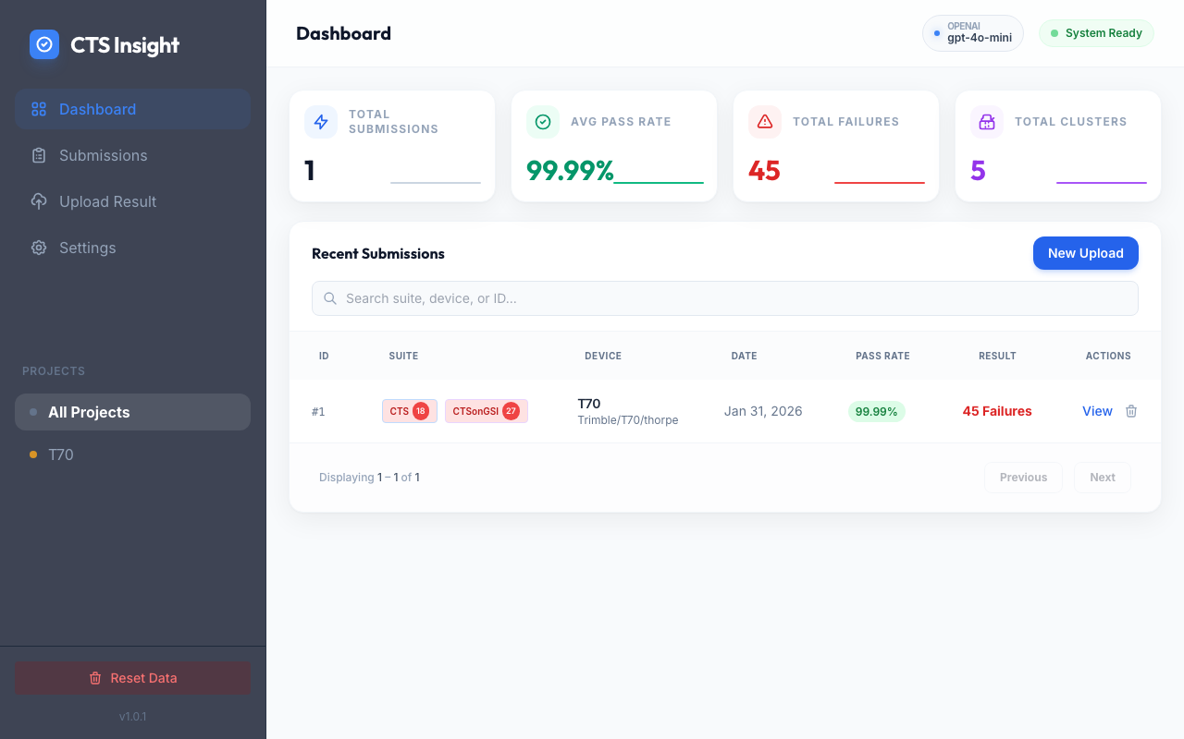
Zero-Wait Ingestion
Immediate feedback for T70 project
Processed 45 failures across recent runs
Hardware: Trimble T70 (thorpe)
99.99% overall stability reached

Slide 3
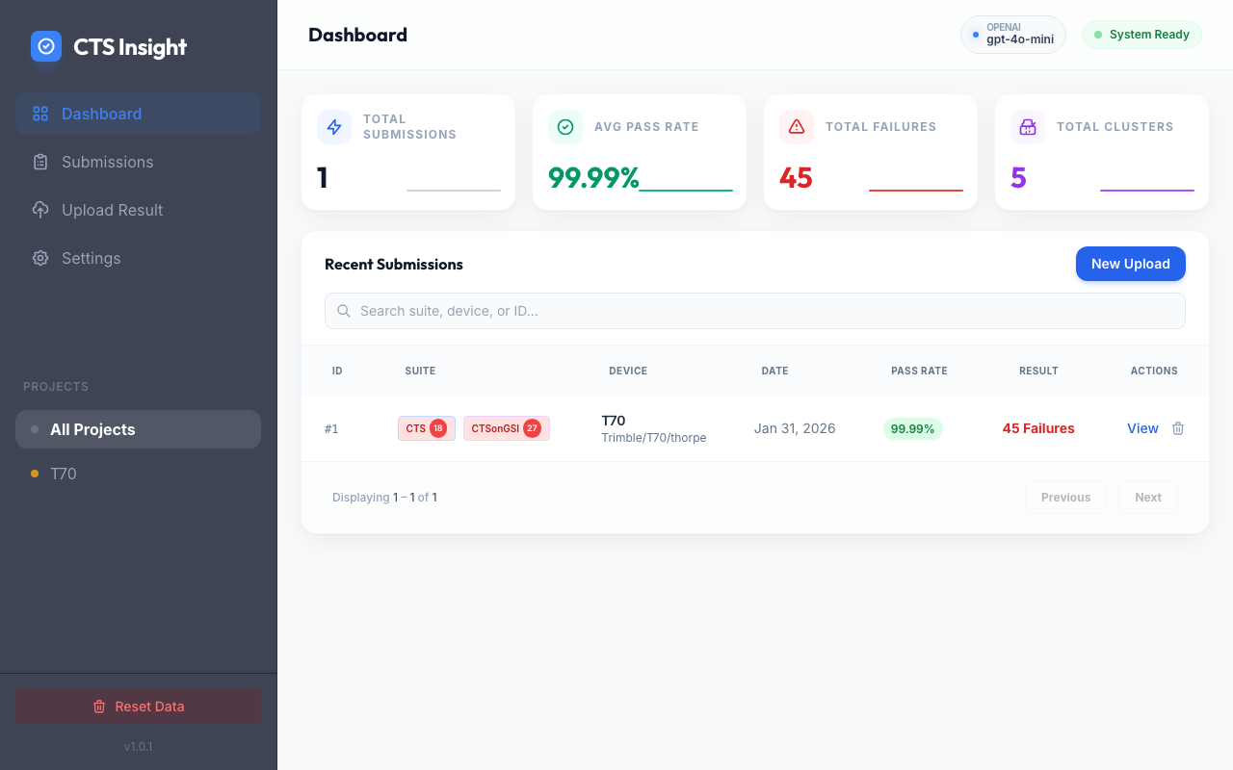
Intelligence Layer
Reduced noise from 45 individual failures
Authored 5 actionable clusters via AI
Automated Root Cause Identification
One-click sync with issue tracking
Risk Mitigation: Predicative certification analysis.

Slide 4
Executive Reporting
Unified View: CTS (18) + GSI (27)
Status: 45 Failures across T70 fleet
Automated Excel/PDF stakeholder reports
Clear Audit Trail for Certification

Slide 5
Accelerate Your Certification Today
GMS-helper: The Intelligence Your Release Needs.

