Slide 1
C Programming Examples
Pointer, Sorting, Structure

Slide 2
Example: Sum_Swap
#include<stdio.h>
int sum(int a, int b);
void swap(int *p, int *q);
int main (void) {
int a, b, total;
printf("Input two integers : ");
scanf("%d%d", &a, &b); // 10 20
printf("a:%d, b:%d \n", a, b);
total = sum(a,b); // function call(call by value)
printf("** sum function call**\n");
printf("a:%d, b:%d, a + b = %d \n", a, b, total);
swap(&a, &b); // call by address
printf("** swap function call**\n");
printf("a:%d, b:%d \n",a, b); // 20 10
return 0; }
int sum(int a, int b)
{
int total;
total = a + b;
return total;
}
void swap(int *p, int *q)
{
int temp;
temp = *p;
*p = *q;
*q = temp;
}
Notes:
3월 첫째주 -<number>

Slide 3
A Sorting Algorithm Example
#include <stdio.h>
void bubble(int a[ ], int n);
void prn_array(char* s, int a[ ], int n);
void swap(int *p, int *q);
int main(void)
{ int a[ ] = {7, 3, 66, 3, -5, 22, -77, 2};
int n;
n = sizeof(a) / sizeof(int);
prn_array("Before", a, n);
bubble(a, n); /* bubble sort */
prn_array(" After", a, n);
putchar('\n');
return 0;
}
void bubble(int a[ ], int n)
/* n is the size of a[ ] */
{
int i, j;
for (i = 0; i < n - 1; ++i)
for (j = n - 1; i < j; --j)
if (a[j-1] > a[j])
swap(&a[j-1], &a[j]);
}
void swap(int *p, int *q)
{
int tmp;
tmp = *p;
*p = *q;
*q = tmp;
}
void prn_array(char* s, int a[ ], int n)
{
int i;
printf("\n%s%s%s", " ", s, " sorting:");
for (i = 0; i < n; ++i)
printf("%5d", a[ i ]);
printf('\n');
}

Slide 4
Example: a playing card (card1.c)
#include <stdio.h>
enum suit {club = 1, diamond, heart, spade};
struct card {
int pips;
enum suit suit_name; };
void print_suit(enum suit suit_name);
int main(void)
{
struct card c1 = {5, spade}, c2;
c2.pips = 12;
c2.suit_name = diamond;
printf("card 1: %d", c1.pips);
print_suit(c1.suit_name);
putchar('\n');
printf("card 2: %d", c2.pips);
print_suit(c2.suit_name);
putchar ('\n');
return 0;
}

Slide 5
Example: a playing card (card1.c)
void print_suit(enum suit suit_name)
{ switch(suit_name)
{
case club:
printf(", club.\n");
break;
case diamond:
printf(", diamond.\n");
break;
case heart:
printf(", heart.\n");
break;
case spade:
printf(", spade.\n");
break;
}
}

Slide 6
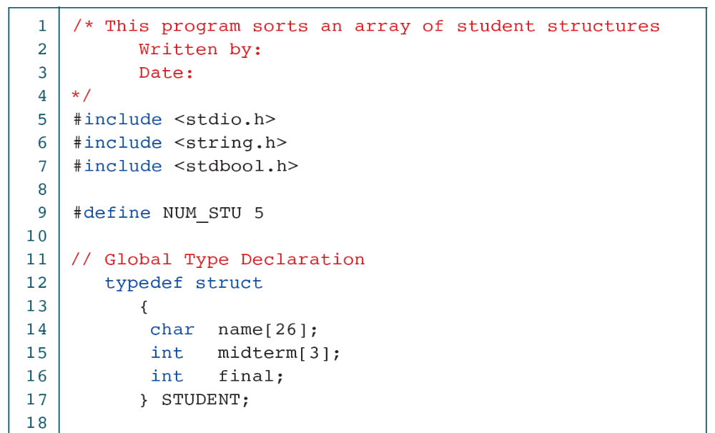
Example : Sort Array of Student Structures(1)

Slide 7
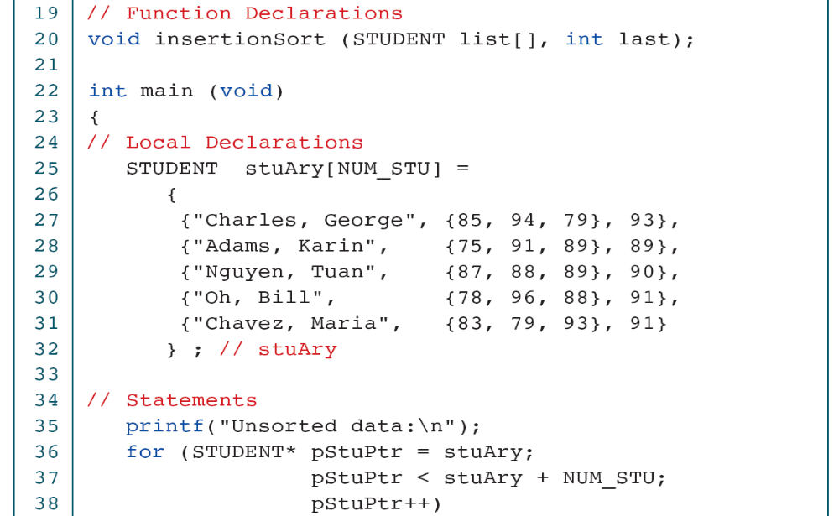
Example : Sort Array of Student Structures(2)

Slide 8
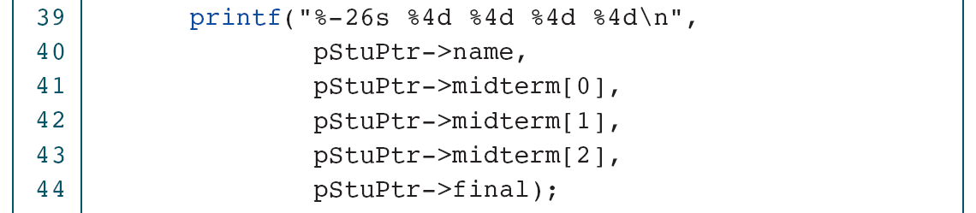
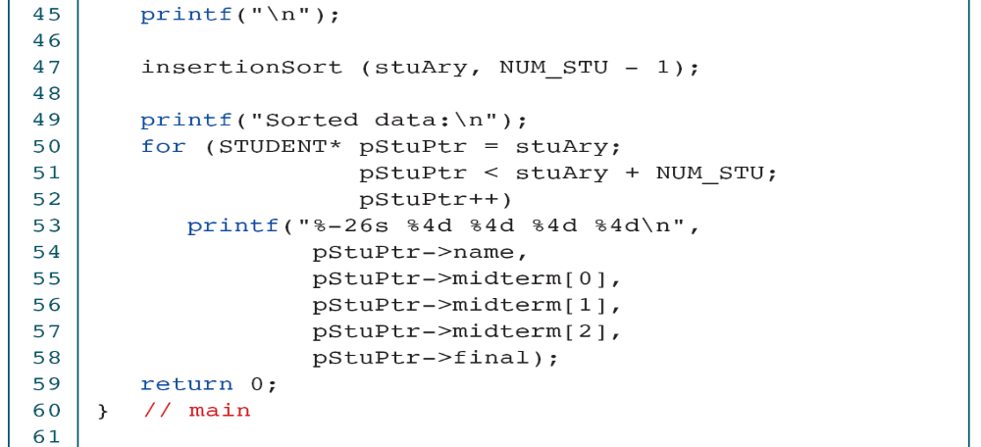
Example : Sort Array of Student Structures(3)

Slide 9
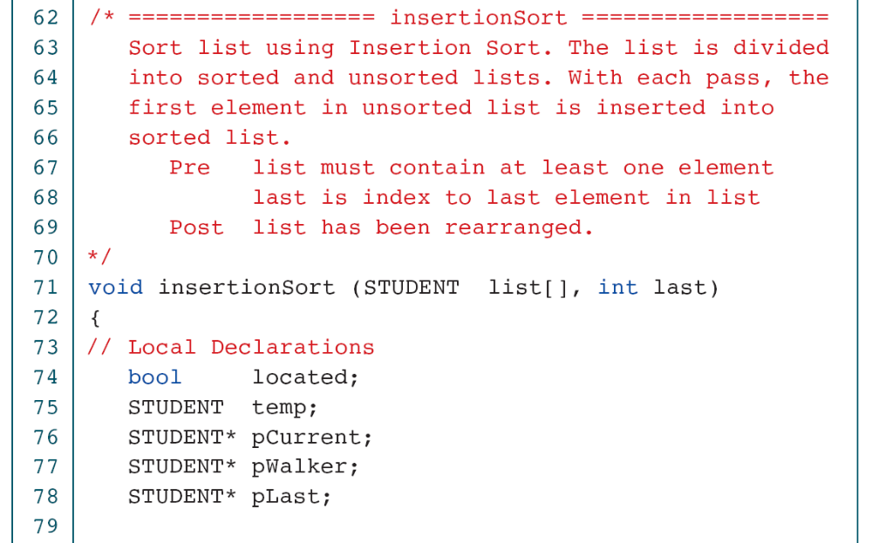
Example : Sort Array of Student Structures(4)

Slide 10
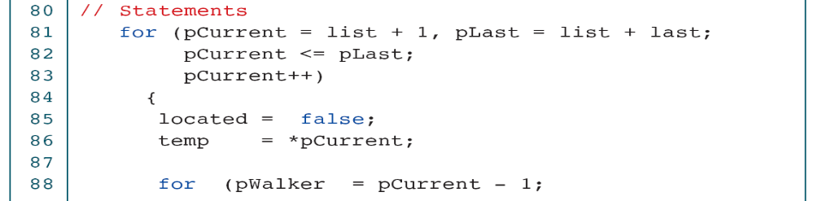
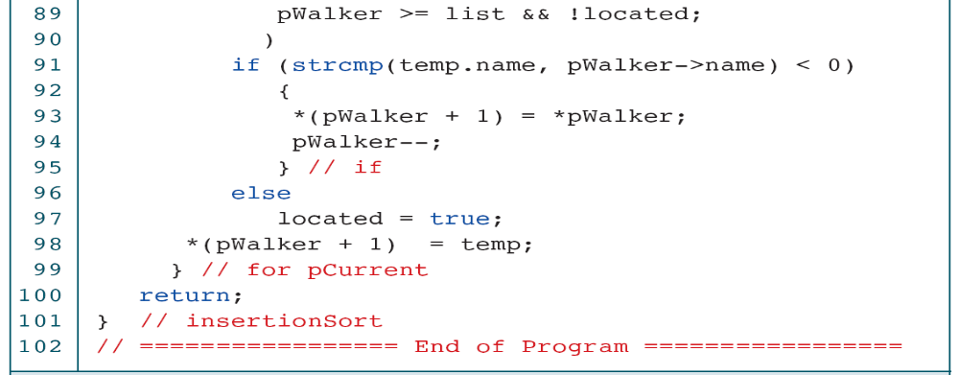
Example : Sort Array of Student Structures(5)

Slide 11
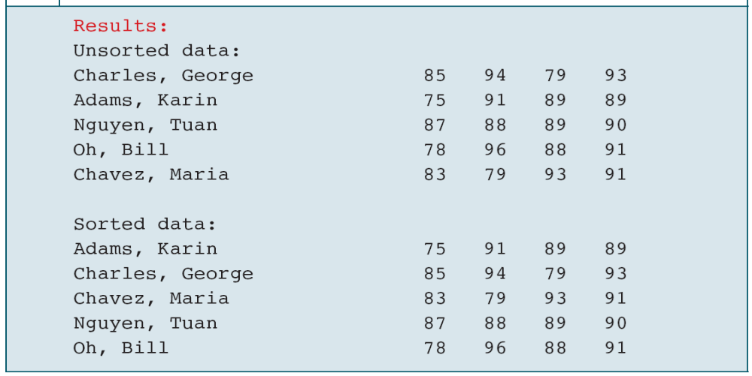
Example : Sort Array of Student Structures(6)

